Slide 2
Welcome! Database Development and Design
Developing and Design of databases using SQL Server

Slide 3

About Me
Education
Bachelor’s degree – FINKI (2013-2019)
Working Experience
Seavus Group (2016 – 2021) – Database developer
IWConnect (2021 - ongoing) – Technical consultant
Contact email: ivanovska_angela@hotmail.com
LinkedIn: https://www.linkedin.com/in/angelaivanovska/

Slide 4
Major course intro
Understanding the Core Database Concepts
Database Server, Database, Data Types, DDL, DML
INSERT, UPDATE, DELETE
Querying data
Select statements, Filtering, Sorting, Unions, Joins
Foreign keys
Advanced querying
Aggregate functions, Grouping data, Views
Database routines
Stored procedures, Functions
Error handling and Basic Administration
Triggers and Constraints, Error handling
Users, Permissions, Roles

Slide 5
Agenda
Session 1
Database concepts and usage
Types of databases
Key terminology (DDL and DML statements)
Demo 1 - DDL and DML
Introduction to SSMS (SQL Server Management Studio)
Data types
Demo 2 – Data types
CRUD Operations (Create, Read, Update, Delete)
Create, Insert, Update, Delete
Client requirement – Orders system
Workshop – Creating tables
Knowledge check (Quiz, Discussion, Homework)
Session 2
Session 3
Session 4
Session 5
Session 6
Session 7

Slide 6
Session 1

Slide 7
Database concepts and usage

Slide 8
Database definitions 1/2
Cambridge dictionary
A large amount of information stored in a computer system in such a way that it can be easily looked at or changed
Wikipedia
Database is an organized collection of data, generally stored and accessed electronically from a computer system. Where databases are more complex they are often developed using formal design and modeling techniques.
Britannica
Database, also called electronic database, any collection of data, or information, that is specially organized for rapid search and retrieval by a computer. Databases are structured to facilitate the storage, retrieval, modification, and deletion of data in conjunction with various data-processing operations.

Slide 9
Database definitions 2/2
Database consists of logically related data stored in a single repository
Provides advantages over file system management approach
Eliminates inconsistency, data anomalies, data dependency, and structural dependency problems
Stores data structures, relationships, and access paths

Slide 10
Example of an old traditional database application
Suppose we are building a system to store the information about:
Customers
Products
Orders

Slide 11
Can we do it without DBMS?
Sure we can! Start by storing the data in files:
Customer.txt Product.txt Order.txt
Now write C or Java programs to implement specific tasks

Slide 12
Doing it without DBMS
Perform an order: “Customer A” orders “Product A”
Write a C program to do the following:
Read ‘Customer.txt’
Read ‘Product.txt’
Write in ‘Orders.txt’ - “Customer A orders Product A”
Write in “Product.txt” - “Product A” has changed available quantity

Slide 13
Problems without DBMS
CRASH !
System crashes:
What is the problem ?
Large data sets (Millions of Customers and Products)
What is the problem ?
Concurrent access by many users
Multiple users want to place an order in a same time. Multiple requests for write to Orders data file
Read ‘Customer.txt’
Read ‘Product.txt’
Write in ‘Orders.txt’ - “Customer A orders Product A”
Write in “Product.txt” - “Product A” has changed available quantity

Slide 14
Database Management System (DBMS)
Makes data management more efficient and effective
Query language allows quick answers to ad hoc queries
Provides better access to more and better-managed data
Promotes integrated view of organization’s operations
Reduces the probability of inconsistent data

Slide 15
Importance of DBMS
Makes data management more efficient and effective
Query language allows quick answers to ad hoc queries
Provides better access to more and better-managed data
Promotes integrated view of organization’s operations
Reduces the probability of inconsistent data

Slide 16
Importance of DBMS 2
Data dictionary management
Data storage management
Data transformation and presentation
Security management
Multi-user access control
Backup and recovery management
Data integrity management
Database access languages and application programming interaces
Transaction management

Slide 17
Types of databases

Slide 18
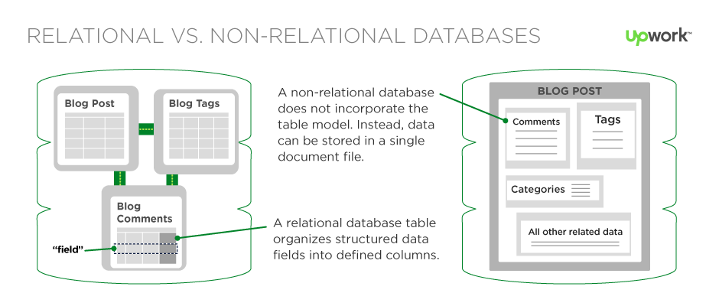
Types of databases 1/3
Relational databases (SQL)
Non-Relational databases (NoSQL)

Slide 19
Types of databases 2/3
SQL | NoSQL
RELATIONAL DATABASE MANAGEMENT SYSTEM (RDBMS) | Non-relational or distributed database system
These databases have fixed or static or predefined schema | They have dynamic schema
These databases are not suited for hierarchical data storage | These databases are best suited for hierarchical data storage.
These databases are best suited for complex queries | These databases are not so good for complex queries
Vertically Scalable | Horizontally scalable

Slide 20
Types of databases 3/3
Relational databases (SQL)
Structured (table based)
Most popular vendors
SQL Server , Oracle, MySQL, PostgreSQL
Non-Relational databases (SQL)
Non structured
Document based
Key-value pairs
Graph databases
Wide column stores
Most Popular vendors
MongoDB, Cassandra, Hbase, CoachDB

Slide 21
Key terminology

Slide 22
Key database terminology 1/2
Data Definition Language (DDL) is a subset of the Transact-SQL language; it deals with creating database objects like databases, schemas, tables, constraints, and stored procedures. The interface used to create these underlying DDL statements is the SSMS user interface.
The five main DDL statements are as follows:
USE: Changes the database context.
CREATE: Creates a SQL Server database object (table, view, or stored procedure).
ALTER: Changes an existing object.
DROP: Removes an object from the database.
TRUNCATE: Removes rows from a table and frees the space used by those rows.

Slide 23
Key database terminology 2/2
Data Manipulation Language (DML) is the language element that allows you to use the core statements INSERT, UPDATE and DELETE to manipulate data in any SQL Server tables. Core DML statements include the following:
SELECT: Retrieves rows from the database and enables the selection of one or many rows or columns from one or many tables in SQL Server.
INSERT: Adds one or more new rows to a table or a view in SQL Server.
UPDATE: Changes existing data in one or more columns in a table or view.
DELETE: Removes rows from a table or view.

Slide 24
A table example terminology
Meta Data
Table Name
Field
Customer
Id | Name | Acct | City | Size | Active
1. | Vero | 12235 | Skopje | 1000 | 1
2. | Tinex | 43253 | Bitola | 2000 | 0
3. | Ramstore | 34534 | Ohrid | 1200 | 1
Record
Data

Slide 25
Important to know
Relational databases are structured in tables
Table names within single database are UNIQUE
One table CANNOT HAVE more than one column with same column name
Names of keys, like primary key, foreign key are unique
There is ONLY ONE primary key in single table, and they define the uniqueness of the records
One table can have more than one foreign keys

Slide 26
Introduction to SSMS

Slide 27
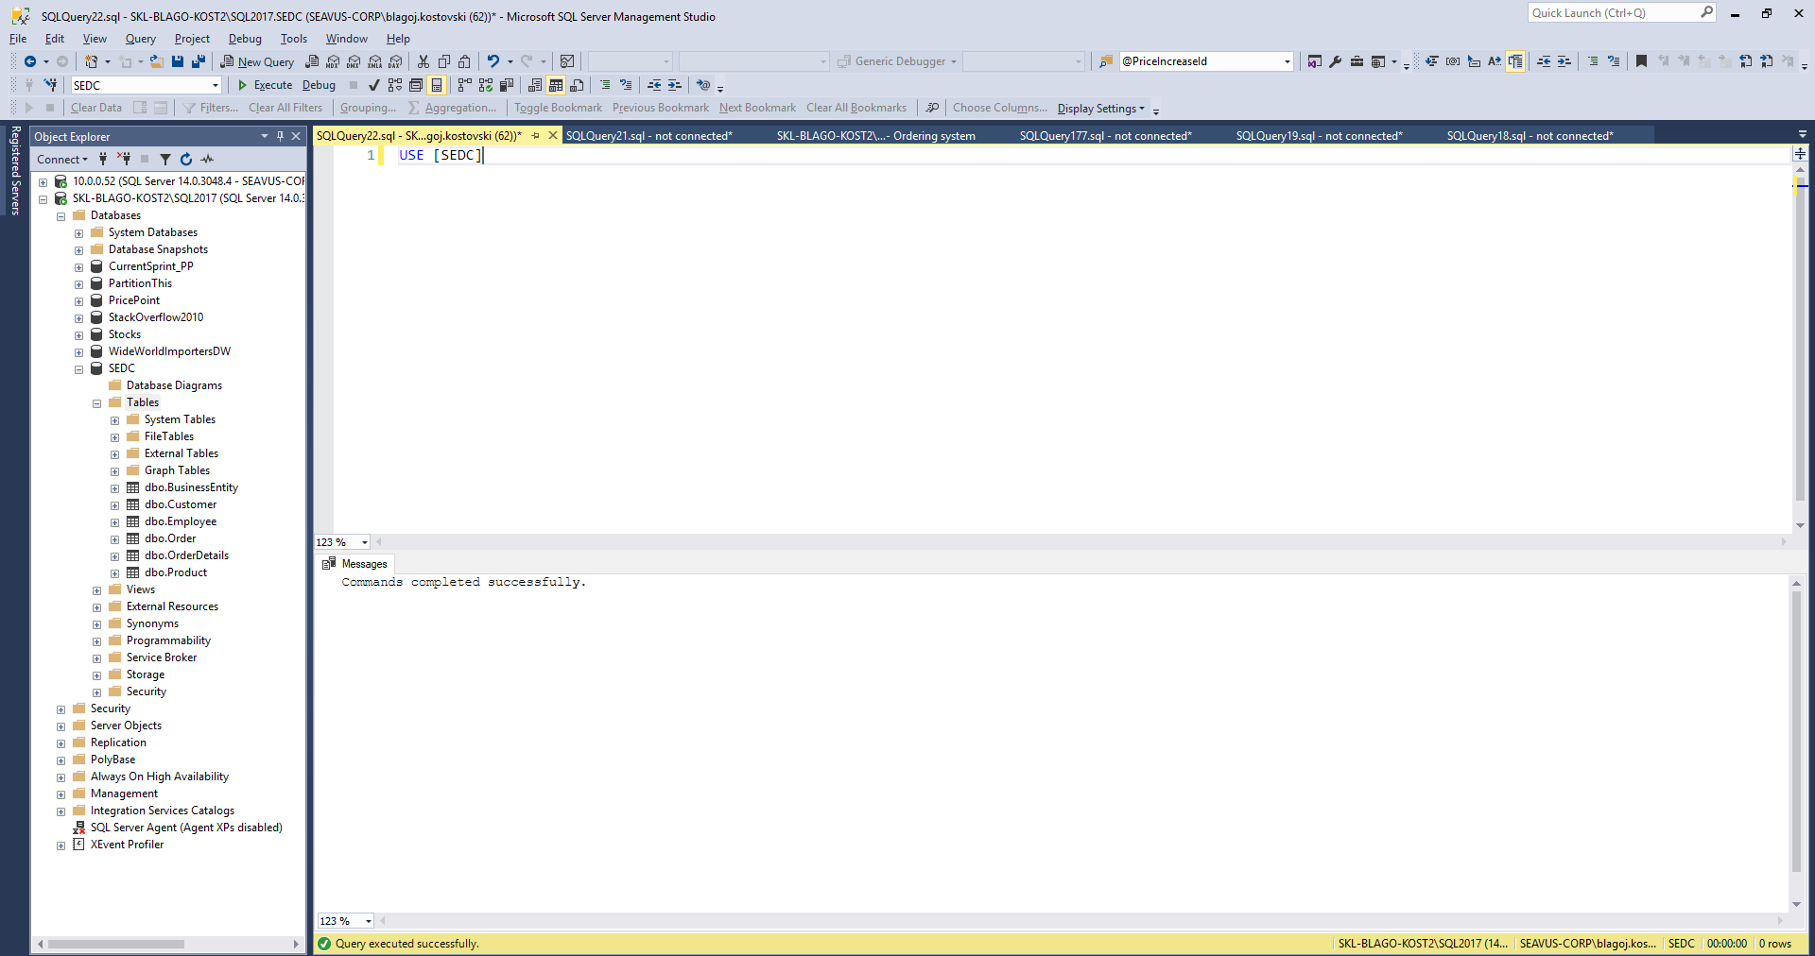

Slide 28
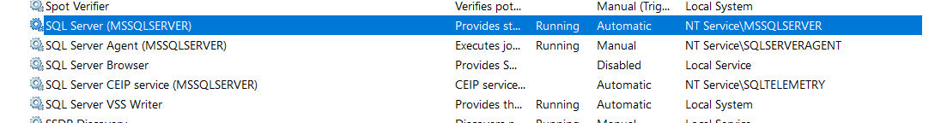
Services
Before running SSMS, please check if the service bellow is Running.

Slide 29
Data types in SQL Server

Slide 30
Data types in SQL Server
Each column in a database table is required to have a name and a data type.
SQL data type is an attribute that specifies type of data of any object. Each column, variable and expression has related data type in SQL.
You would use these data types while creating your tables. You would choose a particular data type for a table column based on your requirement.
SQL developers have to decide what types of data will be stored inside each and every table column when creating a SQL table.
The data type is a label and a guideline for SQL to understand what type of data is expected inside of each column, and it also identifies how SQL will interact with the stored data.

Slide 31
Data types in SQL Server
In SQL Server, each column, local variable, expression, and parameter have a related data type. A data type is an attribute that specifies the type of data that the object can hold: integer data, character data, monetary data, date and time data, binary strings, and so on.
Exact numeric | Unicode character strings
Approximate numeric | Binary strings
Date and time | Other data types
Character strings

Slide 32
Data types in SQL Server
Exact numeric
Data type | Range | Storage
bigint | -2^63 (-9,223,372,036,854,775,808) to 2^63-1 (9,223,372,036,854,775,807) | 8 Bytes
int | -2^31 (-2,147,483,648) to 2^31-1 (2,147,483,647) | 4 Bytes
smallint | -2^15 (-32,768) to 2^15-1 (32,767) | 2 Bytes
tinyint | 0 to 255 | 1 Byte
Data type | Range | Storage
Decimal(p,s) | 10^38 +1 to 10^38 – 1 (p-Precision , S-Scale) Example: Decimal(5,2) – max: 999,99 | Depends on Precision
Data type | Range | Storage
Money | -922,337,203,685,477.5808 to 922,337,203,685,477.5807 (-922,337,203,685,477.58 to 922,337,203,685,477.58 ) | 8 bytes
smallmoney | - 214,748.3648 to 214,748.3647 | 4 bytes

Slide 33
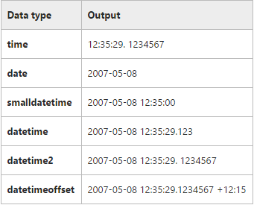
Data types in SQL Server
Approximate Numeric
Date and Time
date
datetimeoffset
datetime2
smalldatetime
datetime
time
n value | Precision | Storage size
1 - 24 | 7 digits | 4 bytes
25-53 | 15 digits | 8 bytes
Data type | Range | Storage
float | - 1.79E+308 to -2.23E-308, 0 and 2.23E-308 to 1.79E+308 | Depends on the value of n
real | - 3.40E + 38 to -1.18E - 38, 0 and 1.18E - 38 to 3.40E + 38 | 4 Bytes

Slide 34
Data types in SQL Server
Character Strings
char
varchar
text
Unicode Character Strings
nchar
nvarchar
Ntext

Slide 35
Data types in SQL Server
Binary Strings
binary
varbinary
image
text
Other Data Types
cursor
timestamp
hierarchyid
uniqueidentifier
sql_variant
xml
table
Spatial Types

Slide 36
Data types - Overview
References:
http://www.w3schools.com/sql/sql_datatypes.asp
https://msdn.microsoft.com/en-us/library/ms187752.aspx
https://docs.oracle.com/cd/B19306_01/server.102/b14200/sql_elements001.htm
http://dev.mysql.com/doc/refman/5.7/en/data-types.html
…
Hint: Always use official documentation when you design tables regarding the data types.

Slide 37
CRUD operations
Create, Read, Update, Delete

Slide 38
CREATE operation 1/2
Create new data structure (Table, View, Function, Procedure, …)
Example:
CREATE TABLE [TableName] (
[Col1] [Data type 1],
[Col2] [Data type 2],
...
[ColN] [Data type N])
CREATE TABLE [Customer](
[Id] [int] NOT NULL,
[Name] [nvarchar](100) NOT NULL,
[City] [nvarchar](100) NULL)

Slide 39
Create operation 2/2
Primary key concept
Short, Not changeable, Incremental, Unique
Identity concept
CREATE TABLE [Customer](
[Id] [int] IDENTITY(1,1) NOT NULL,
[Name] [nvarchar](100) NOT NULL,
[City] [nvarchar](100) NULL,
CONSTRAINT [PK_Customer] PRIMARY KEY CLUSTERED
(
[Id] ASC
))
GO

Slide 40
INSERT operation
Insert new data
Example:
INSERT INTO [TableName] ([Col1],[Col2],...)
VALUES (Value1,Value2,...)
INSERT INTO [Customer] ([Id], [Name], [City])
VALUES (1, 'Vero Skopje', 'Skopje')
INSERT INTO [Customer] ([Id], [Name], [City])
VALUES (2, 'Vero Strumica', 'Strumica')

Slide 41
READ operation
Read all data in the table
Read only specific columns:
Read specific columns and Rows:
SELECT * FROM Customer
SELECT ID, Name, City
FROM Customer
SELECT ID, Name, City
FROM Customer
WHERE City = 'Skopje'

Slide 42
UPDATE operation
Update data
Example:
UPDATE [TableName]
SET Col1 = NewValue, Col2 = NewValue2,...
WHERE ColN = oldValue
UPDATE Customer
SET Name = 'Vero Bitola', City = 'Bitola'
WHERE Name = 'Vero Skopje'

Slide 43
DELETE operation
Delete data
Example:
DELETE
FROM [TableName]
WHERE ColN = oldValue
DELETE
FROM Customer
WHERE Name = 'Vero Skopje'

Slide 44
Demo 1 - DDL and DML
Session 1 – 01 Create table.xlsx
Session 1 – 02 DDL and DML.sql

Slide 45
Demo 2 - Data types
Session 1 – 03 Format table.xlsx
Session 1 – 04 Data types.sql

Slide 46
Client requirement – Orders system

Slide 47
The requirement
Client has 7 Business Entities based in the biggest cities in Macedonia
Client has around 100 Employees
Client has around 100 Customers (Legal Entities) in Macedonia
Client offers around 1000 different products on the market
Client business is based on the B2B (Business to Business) model
Core requirement:
System should be able to manage client orders
Each order should contain following information: Date, Status, Employee performing the order, Customer, Total amount of the order
Additionally for each order system should keep details about products, single product price and quantity per product included in the order
Lets find some company as an example – Vitalia
https://www.vitalia.com.mk/products-filter-page/

Slide 48
B2B model example
Vitalia Skopje
Vitalia Bitola
Vitalia Strumica
Vitalia Kumanovo
Vitalia Tetovo
Vitalia Stip
Vitalia Ohrid
Vitalia
Business Entity
Customers
Stokomak
Kit-Go
Zito market
Tinex

Slide 49
Workshop – Creating tables

Slide 50
Creating tables by using T-SQL
Create new database: SEDC
Create the following tables:
BusinessEntity
Employee
Product
Customer
Order
OrderDetails
Try to insert data in the tables

Slide 51
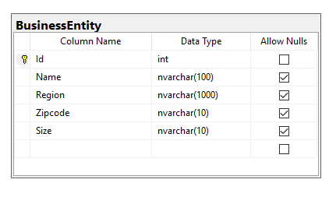
Create table - BusinessEntity
CREATE TABLE [dbo].[BusinessEntity](
[Id] [int] IDENTITY(1,1) NOT NULL,
[Name] [nvarchar](100) NULL,
[Region] [nvarchar](1000) NULL,
[Zipcode] [nvarchar](10) NULL,
[Size] [nvarchar](10) NULL,
CONSTRAINT [PK_BusinessEntity] PRIMARY KEY CLUSTERED
(
[Id] ASC
))

Slide 52
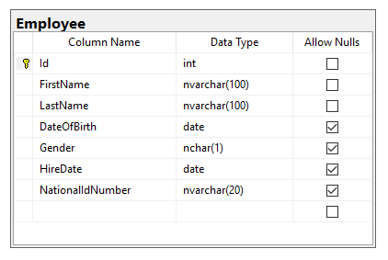
Create table - Employee
CREATE TABLE [dbo].[Employee](
[Id] [int] IDENTITY(1,1) NOT NULL,
[FirstName] [nvarchar](100) NOT NULL,
[LastName] [nvarchar](100) NOT NULL,
[DateOfBirth] [date] NULL,
[Gender] [nchar](1) NULL,
[HireDate] [date] NULL,
[NationalIdNumber] [nvarchar](20) NULL,
CONSTRAINT [PK_Employee] PRIMARY KEY CLUSTERED
(
[Id] ASC
))

Slide 53
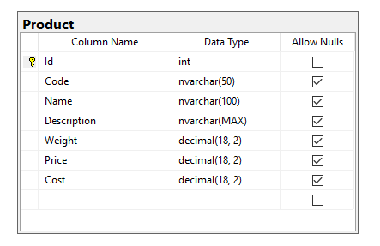
Create table - Product

Slide 54
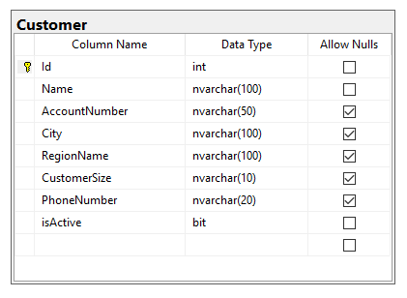
Create table - Customer

Slide 55
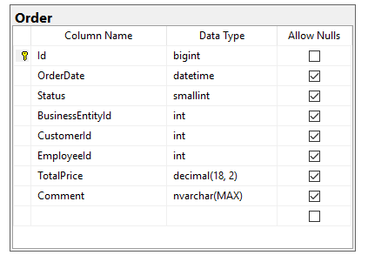
Create table - Order

Slide 56
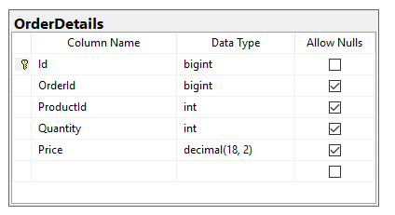
Create table - OrderDetails

Slide 57
Create tables with script
If there are any problems with the table creation provide full script
Session 1 workshop - 01 Create tables.sql

Slide 58
Knowledge check
Quiz, Discussion, Homework

Slide 59
Quiz
Which of the following is not a DDL statement?
a. CREATE
b. INSERT
c. ALTER
d. DROP
Which of the following is not a DML statement?
a. UPDATE
b. INSERT
c. CREATE
d. DELETE

Slide 60
Quiz
Which SQL statement is used to update data in a database?
a. SAVE
b. MODIFY
c. SAVE AS
d. UPDATE
Which of the following is not numeric data type?
a. bigint
b. decimal
c. nvarchar
d. money
Which of the following is not true about the int data type?
a. int is an integer
b. bigint is used when the value will exceed int data type’s range
c. An Integer uses 8 bytes to store data
d. Int can not store textual values

Slide 61
Quiz
What is the purpose of IDENTITY(1,1) statement in the table creation?
What is the purpose of ALLOW NULLS configuration in the table creation?

Slide 62
Homework 1

Slide 63
Homework requirement
Faculty has 88 Teachers
Faculty has hardcopy records for 569 Students (graduated and not graduated)
Faculty has 41 Courses in Curriculum
Faculty has several activities that students should achieve to pass the exam
Faculty has around 20000 records (Grades) for passed exams
Core requirement:
System should be able to manage Exams
Each Grade record should contain following information: Date, Student, Teacher, Course, Grade value
Additionally for each Grade, system should keep details about Achievement type (home work, exam, class activity…), achievement points, achievement maximum points and achievement date
Lets find some faculty as an example – FINKI
https://www.finki.ukim.mk/mk/dodiplomski-studii

Slide 64

SEDCHome – List of tables
Student
- ID
- FirstName
- LastName
- DateOfBirth
- EnrolledDate
- Gender
- NationalIDNumber
- StudentCardNumber
Course
- ID
- Name
- Credit
- AcademicYear
- Semester
Teacher
- ID
- FirstName
- LastName
- DateOfBirth
- AcademicRank
- HireDate
Grade
- ID
- StudentID
- CourseID
- TeacherID
- Grade
- Comment
- CreatedDate
GradeDetails
- ID
- GradeID
- AchievementTypeID
- AchievementPoints
- AchievementMaxPoints
- AchievementDate
AchievementType
- ID
- Name
- Description
- ParticipationRate

Slide 65
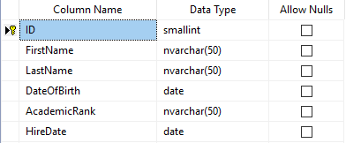
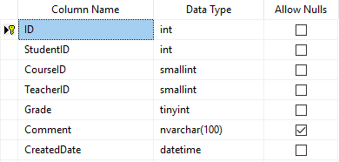
SEDCHome – Table example
Teacher
Grade

Slide 66
