Slide 1
Heritage College Code Testing Platform (HCCTP)
Sponsors: Allan
Team Members: Cameron, David
Francis, Kyle, Santiago, Serge, Shuai

Slide 2
Introduction
Today we will be presenting our elevator pitch, user priorities, our definition of Release 1 (commitment/target), Release 2 estimates and mock-up.

Slide 3
The elevator pitch
•For students and teachers of the Heritage CS program
•who need an application to perform tests on students’ code
•the Heritage College Code Testing Platform
•is a code testing tool
•that allows teachers to create test cases for lab/assignment for a course, and allow students to test their code.
•Unlike teachers having to manually mark a student’s code
•Our project offers the teacher one common place to set up all the testing for labs and assignments and a quick way for students to check that their code works correctly.

Slide 4
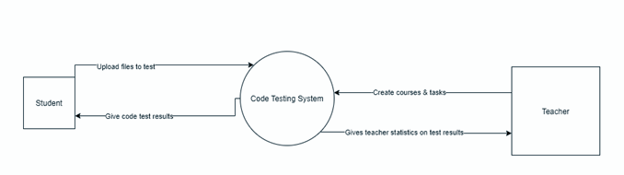
System Context

Slide 5
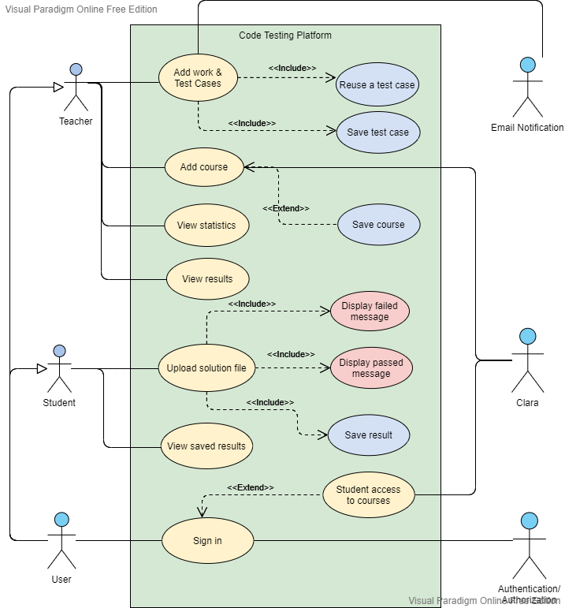
Use Case

Slide 6
Mock-up
https://app.moqups.com/UmItvVIO7w/view/page/ad64222d5

Slide 7
USER PRIORITIES

Slide 8
User Stories
Priority: 1 As a teacher, I want to add courses so that I can assign work to my students in that course. | Priority: 2 As a teacher, I want to add work (labs, assignments, and tests) to my courses so that my students can upload their work. | Priority: 3 As a teacher, I want to add test cases for the work I assign so that my students can test their code without needing my presence.

Slide 9
User Stories
Priority: 4 As a teacher, I would like to be able to set up test case settings such as course, session/instance, description and coding language so that my students know what to do | Priority: 5 As a student, I want to be able to upload my code files for the work my teacher assigned so that I can run them against the test cases my teacher provided. | Priority: 6 As a student, I want to manage a test result report of how my code did against the test cases so that I can see where my code failed and passed.

Slide 10
User Stories
Priority: 6 As a student, I would like to be able to compile my code for test cases in one spot instead of transferring code so that I can see my code results. | Priority: 7 As a student, I want to be able to re-submit my code after a failed result. | Priority: 8 As a teacher, I want to be able to see the sorted statistical test results for my students so that I know which questions the students are having trouble with.

Slide 11
User Stories
Priority: 9 As a student, I want to see how efficient my code is after testing to see how I can improve it. | Priority: 10 As a teacher, I would like students to be able to submit .zip files so that they can run their whole solution against the test cases. | Priority: 11 As a teacher, I would like a catalog of test functions, parameters, and outputs so I can use it for future test cases.

Slide 12



How big is this thing?
Construction
Release 1
Release 2
Deployment & System Testing
~4 months
~ 2 weeks
~3 months
~ 1 week

Slide 13
Release 1 Proposal (End of fall 2021)
Definition
Commitment/target: Target => Java, Database
What the user should expect:
Student should be able to run test cases that teacher makes

Slide 14
Release 2 (End of Winter term)
What is reasonable: testing [python, javascript, php] code, Adding a course, Login, Adding work to course, Student upload file, basic statistics
What is not reasonable: CSS, HTML, efficiency test

Slide 15
The NOT list
In | Out
Upload test file | Efficiency testing
Testing student code
Create course, work and test cases
Statistics on test results
Unresolved

Slide 16
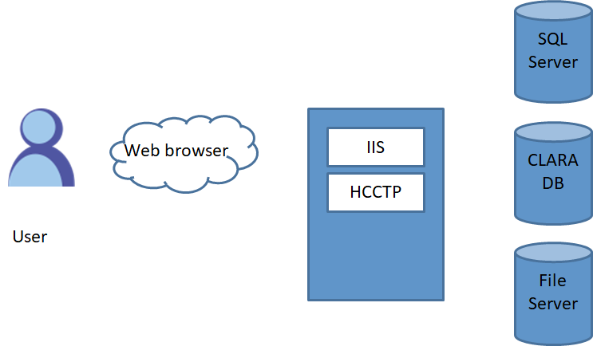
Technical solution
Technologies:
C#, SQL
JQuery, Bootstrap
Visual Studio 2019
Asp.net MVC, EntityFrameworkCore

Slide 17
What keeps us up at night
• dealing with clara
• code efficiency analysis
• compiling code in browser

Slide 18
Trade-off sliders
 | The classic four
 | Feature completeness (scope)
 | Stay within budget (budget)
 | Deliver Project on time (time)
 | High quality, low defects (quality)

Slide 19
Q & A
Teacher:
Automatically validate courses for teacher; only allow courses for current semester?
Do you want categories: labs, assignment and test? (Some categories for teacher only)
Course access once semester is over? Is data deleted or kept
Keep course data (all work, results and statistics) saved on teacher’s profile for future use if teaches course again
Teacher adds test cases by file upload only or can also add in browser?

Slide 20
Q & A
Student:
For file upload, do you want due dates/end dates for student access to lab
End of semester, all student access and saved results deleted or should student have their result saved on a student profile?
Confirm file upload only for students
Should student files be zipped?
General design:
Browser priority (Edge, Chrome, Firefox…)
Mobile option?

Slide 21
Thank you for your time!!!

