Slide 1
Heritage College Code Testing Platform HCCTP
Release 1 - Sprint 1
Sponsors: Allan McDonald
Development Team:
Cameron Radmore, David House, Francis Manning, Kyle Radmore, Santiago Cifuentes, Serge Arseneault, Shuai Yan

Slide 2
Goals of this Meeting
Show the current state of the project
Get confirmation on completed tasks
Discuss next Sprint

Slide 3
Agenda
Sprint 1 Commit
Demo
Sprint 2 Deliverables
Questions

Slide 4
Sprint 1 Commit
Let’s start with the Sprint 1 Commit

Slide 5


Slide 6
Demo

Slide 7
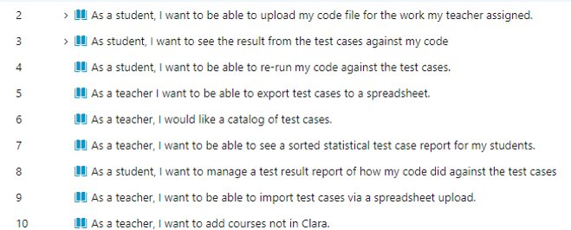
Sprint 2
Deliverables

Slide 8
Questions?

Slide 9
Comparison of programming languages
Language | Data Type | Default Value | Reference Type
C# | ✅ | ✅ | out / ref
Java | ✅ | ❌ | ❌
JavaScript | ❌ | ✅ | ❌
PHP | ✅ | ✅ | &
Python | ✅ | ✅ | ❌

Slide 10
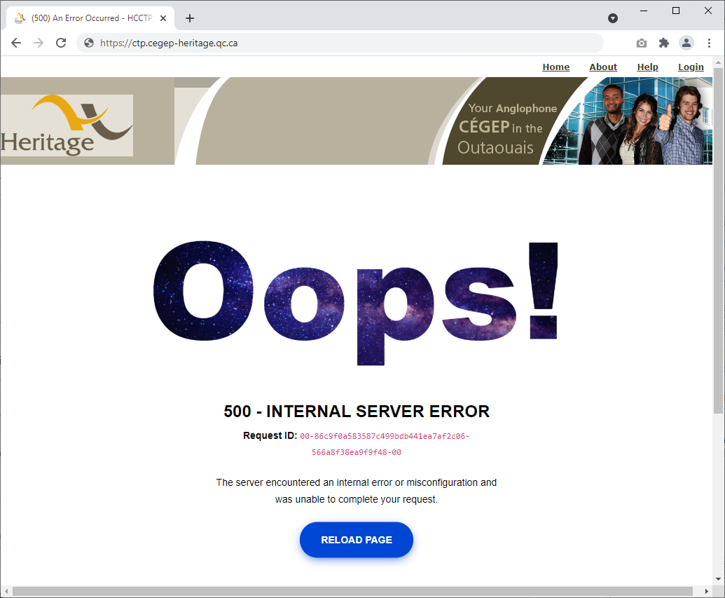
Error
Notes:
Custom Error Page

Slide 11
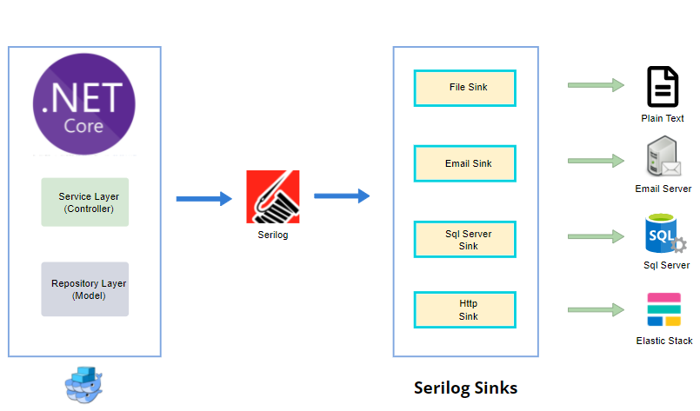

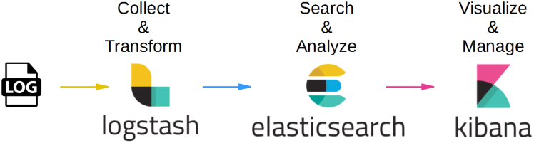
Serilog
app.UseSerilogRequestLogging();
ctp@cegep-heritage.qc.ca
Notes:
https://www.codeproject.com/Tips/1159173/Integrate-Serilog-Logging-Framework-with-ASP-NET-C

Slide 12
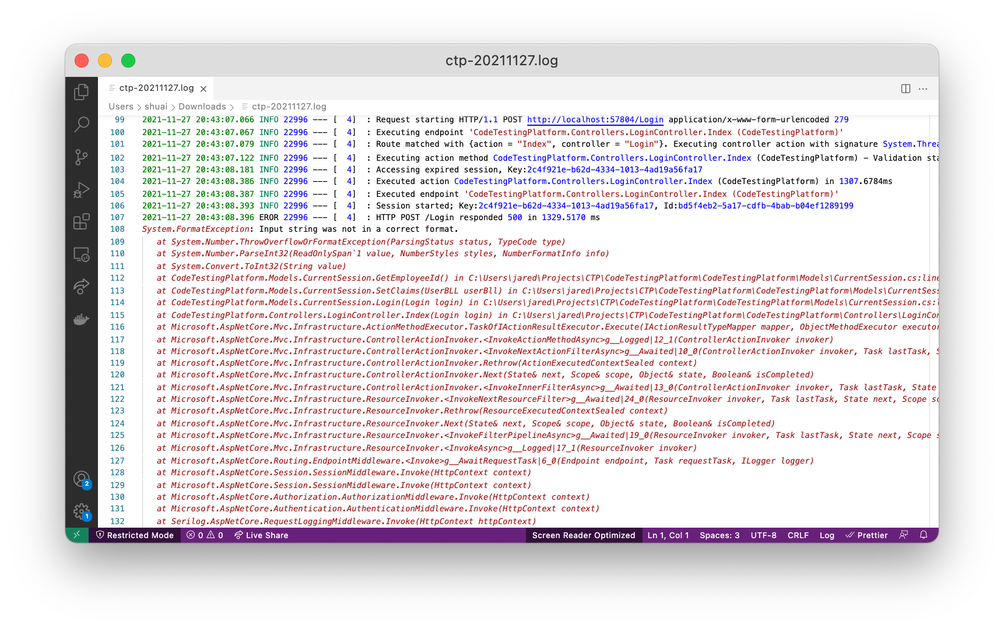
Writes log events to the file (Plain Text)

Slide 13
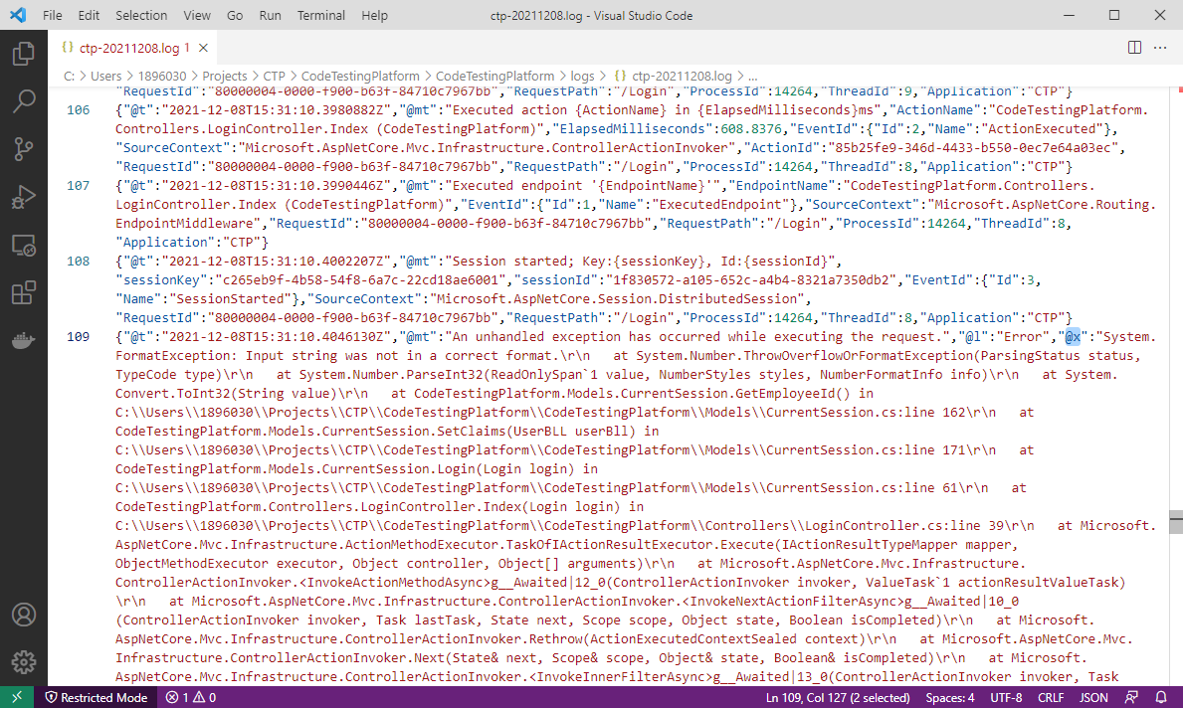
Writes log events to the file (Compact Json)

Slide 14
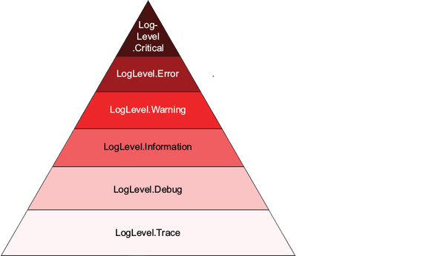
Log Levels
Disastrous errors that may
leave the app unable to function
Unhandled errors and exceptions
that don't affect other requests
Unexpected conditions that you can work
around, such as handled exceptions
For tracking normal application flow
For tracking detailed information,
especially during development
For very detailed, sensitive
information - rarely used
Notes:
ASP.NET Core in Action

Slide 15
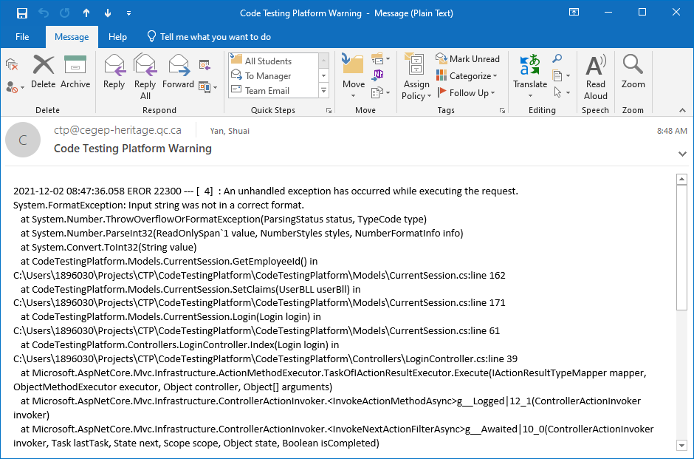
Writes log events to the Email

