Slide 1
Porto Seguro: Final Submission
.287
(AR) Xgb x2 + Kernels xgb, lgb
Weighted Average
?
Submit File
.6
.284
Kernel Xgb
.2
.273
K-Tf (AR)
.2

Slide 2
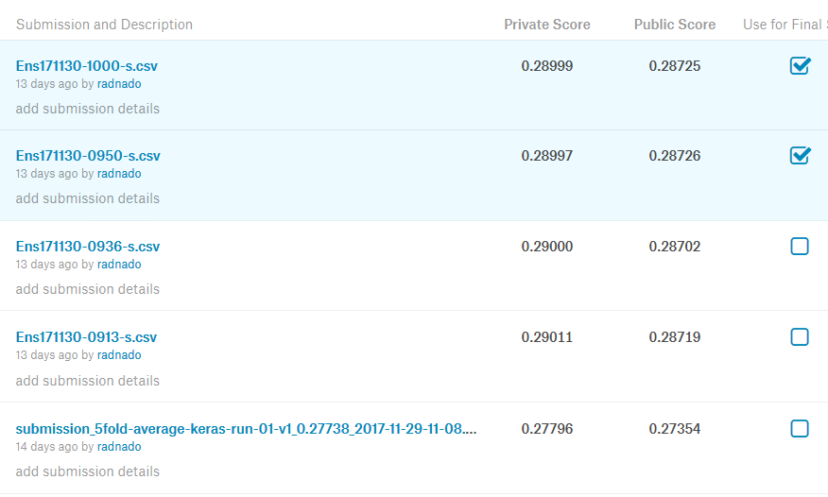
Porto Seguro: Final Score
Achieved 465th (8.9%)
If selected would have been approx. 311th (6.0%)

Slide 3
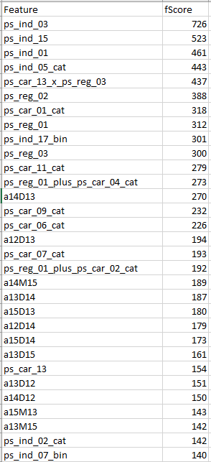
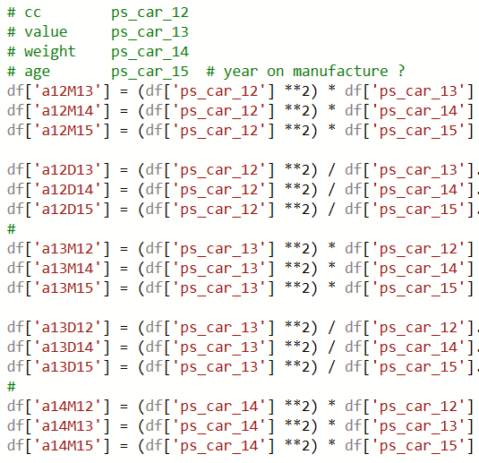
Porto Seguro: Feature Engineering ‘Shotgun’
58 Features
Feature Eng.
190 Features
Boruta (70%)
Xgboost FI
77 Features

Slide 4
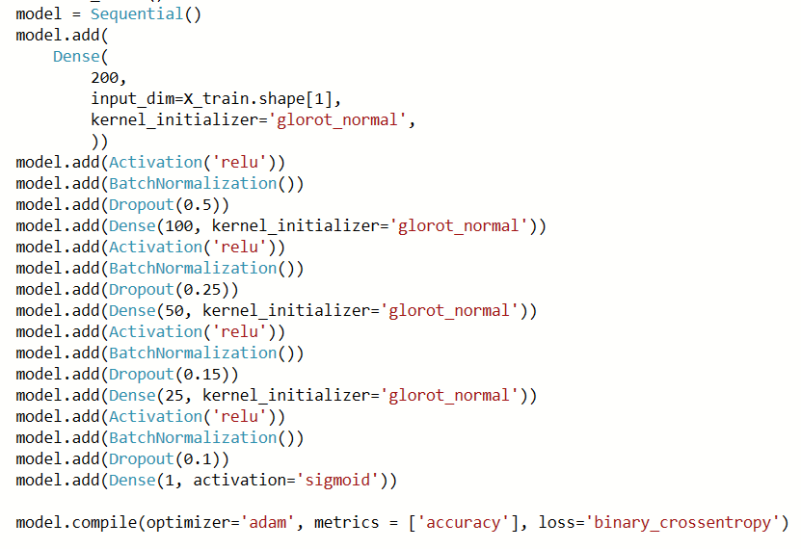
Porto Seguro: Neural Network 0.273

