Slide 1
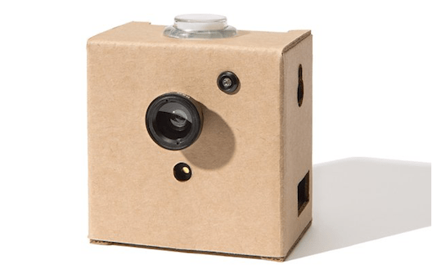
Google AIY Vision Kit – First Impressions
Hardware:
Raspberry Pi Zero
Raspberry Pi Camera V2
Vision Bonnet (VPU for on device neural network acceleration)
Information https://aiyprojects.withgoogle.com/vision/
US$99 from Amazon (Ubuy NZ$186, FishPond NZ$352)

Slide 2
Demonstration models available
Joy / Face Detector
Dog / Cat / Human Detector
Dish Detector - Recognise over 2000 types of food
Image Classifier - Identify 1000 types of objects
Nature Explorer - Recognise 4080 different species

Slide 3
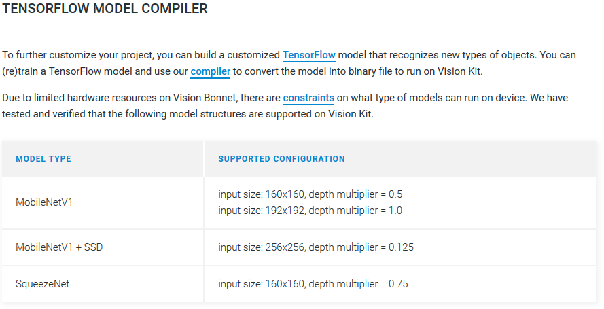
Build and run your own models

Slide 4
AIY – Impressions and Next Steps
Great for:
Building enthusiasm and support for a possible project
Prototyping and ‘Proof of Concept’
Probably not for:
Production use (not robust enough, too expensive)
Next Steps:
A custom project

