Slide 1
USER MANUAL · VERSION 2.3
Amazon orders, ready for Gardners
How to turn Amazon order reports into Gardners i12 .ORD files with the Amazon Orders Converter
Notes:
User manual for the Amazon Orders Converter v2.3, property of NS Nexus Limited.

Slide 2
OVERVIEW
What the converter does
Amazon reports
Order Converter
Gardners .ORD files
Unshipped Orders and All Orders .txt files from Seller Central
Reads the reports, cleans the data and checks every order
One i12 order file per Amazon order, ready to send
✓
One file per order
✓
Customer data stays private
✓
Protected by your PIN
Multi-book orders become one file with a line for each book.
Reports are read in your browser. Only order numbers go to the number service.
Each company logs in with its Gardners Account ID and PIN and has its own numbers.

Slide 3
AT A GLANCE
Six steps from Amazon to Gardners
1
2
3
4
5
6
Log in
Download
Check settings
Upload
Review
Save files
With your Gardners Account ID and PIN
Get the Unshipped Orders and All Orders reports from Seller Central
Check the shared numbers and other settings
Drop both report files onto the converter
Check each order, fix any warnings, confirm prices
Download one .ORD file per order, or all of them as a .zip

Slide 4
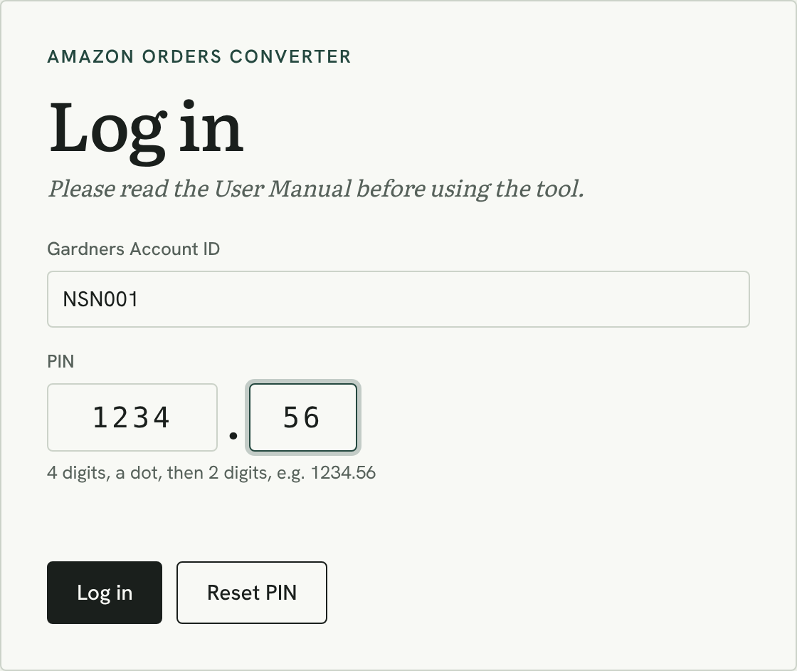
STEP 1
Log in
Gardners Account ID: your account, e.g. NSN001. It is your user name.
PIN: type 4 digits in the first box and 2 digits in the second, e.g. 1234 . 56. The cursor moves to the second box by itself.
Log in. Your account then shows at the top right, with Log out next to it.
Stays logged in for 12 hours in that browser tab. Closing the tab logs you out.
5 wrong PINs in a row lock log-in for that account for 15 minutes.

Slide 5
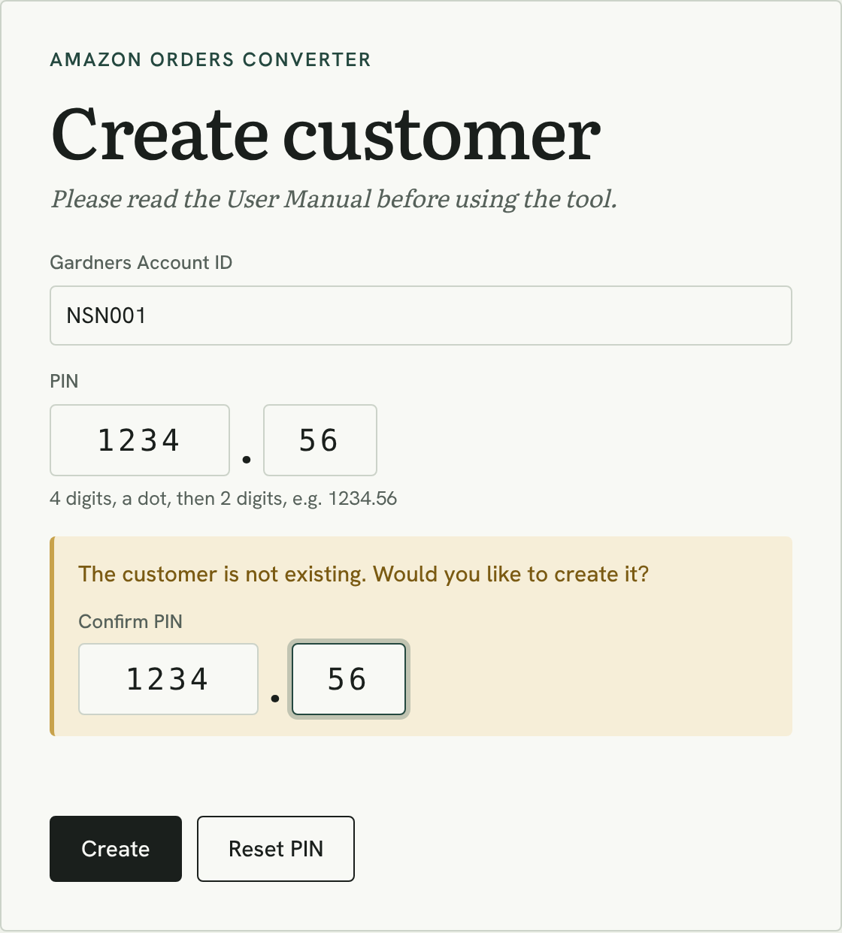
STEP 1
First time: create your customer
Enter your Gardners Account ID and a PIN, then press Log in.
“The customer is not existing. Would you like to create it?” appears when the account is new.
Type the PIN again in Confirm PIN and press Create. You are logged in straight away.
Choose a PIN you can remember. It is never stored as you type it, so nobody can look it up for you.
Then set your starting numbers in Settings → Shared numbers (Step 3).

Slide 6
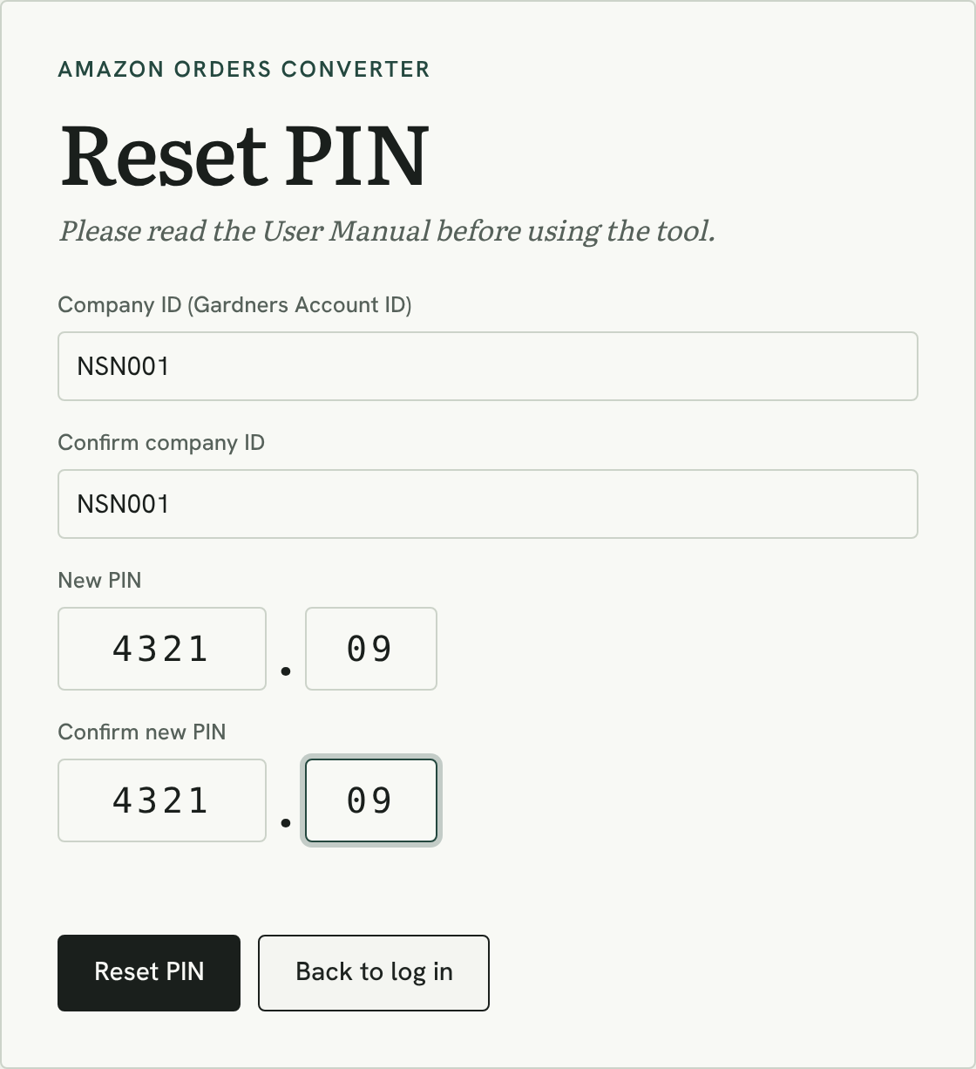
STEP 1
Forgotten PIN: Reset PIN
Press Reset PIN on the log-in screen.
Enter the company ID twice (your Gardners Account ID).
Enter the new PIN twice, 4 digits . 2 digits, then press Reset PIN.
You are logged in with the new PIN. Every other computer using the account is logged out.
Check “PIN last changed” in Settings after you log in. If you didn’t change it, reset it straight away.
Limit: 3 resets per account in 24 hours.

Slide 7
STEP 2
Download the reports from Seller Central
REQUIRED
OPTIONAL
Unshipped Orders report
All Orders report
Gives the customer name, delivery address, ISBN and quantity. Orders are built from this report.
Adds the price the customer paid for each book. Without it you can type prices in by hand.
1
Orders → Order Reports
1
Reports → Fulfillment → All Orders
2
Open the Unshipped Orders tab
2
Set the date to Exact date and pick the day
3
Click Request Download, then Download when ready
3
Click Request .txt Download
Tip: upload the .txt files exactly as downloaded. Opening and re-saving them in Excel can damage order numbers.

Slide 8
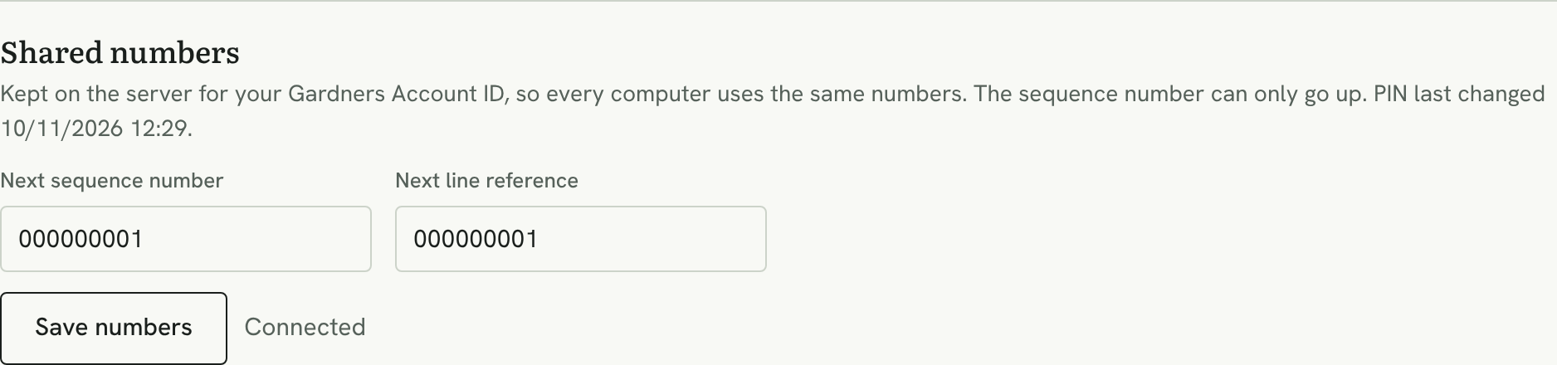
STEP 3
Check your settings
Your account comes from the log-in. It goes in every file header and file name.
Shared numbers. The sequence number can only go up, never down, so a number is never reused.
Test order: Y = test only, nothing shipped; N = live. A TEST or LIVE banner above the orders shows which is on.
Made a mistake? Press Reset to defaults to go back to the original values.
Settings → Shared numbers
The next sequence number and line reference are kept on the server for your account, so every computer uses the same numbers. Set the starting numbers once; after that they count up by themselves. It also shows when your PIN was last changed.

Slide 9
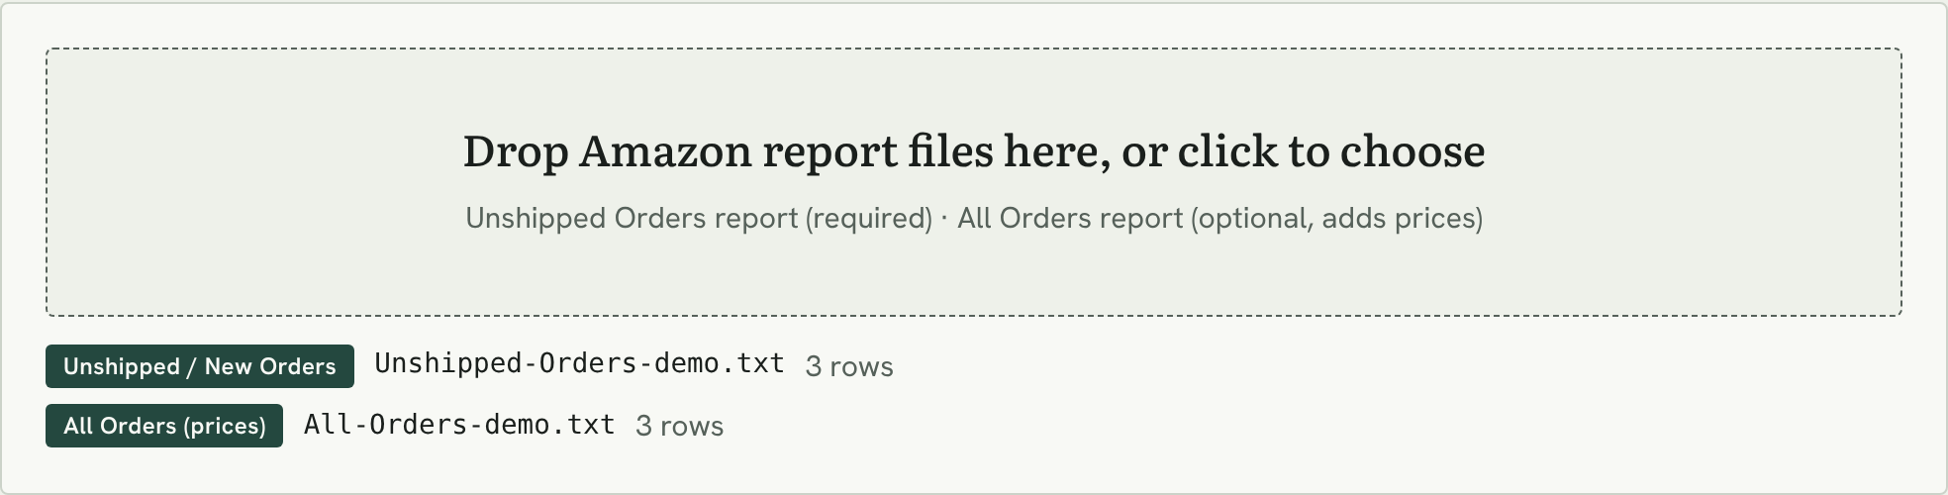
STEP 4
Upload the report files
Drop or click
Check the labels
Add more any time
Drag both .txt files onto the box together, or click it and pick them. The order of files doesn’t matter.
Each file gets a label: “Unshipped / New Orders” or “All Orders (prices)”. A red label means the file wasn’t recognised.
Files added later are merged in. Press Clear before starting a new day’s batch.

Slide 10
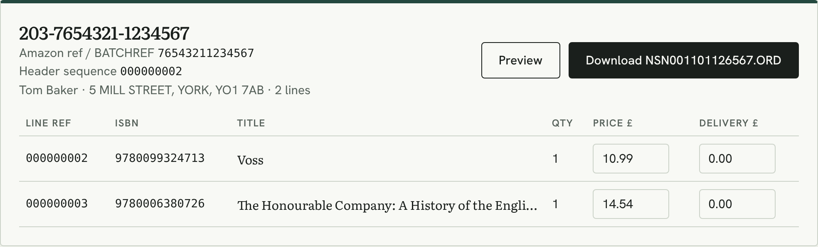
STEP 5
Review each order
Header sequence under the order number: unique for every order, given when you download.
Line ref for each book: its own unique reference.
Customer and address as they will appear on the delivery.
Price and Delivery can be edited. What you type goes into the file.
Preview shows the exact .ORD content before you download it.

Slide 11
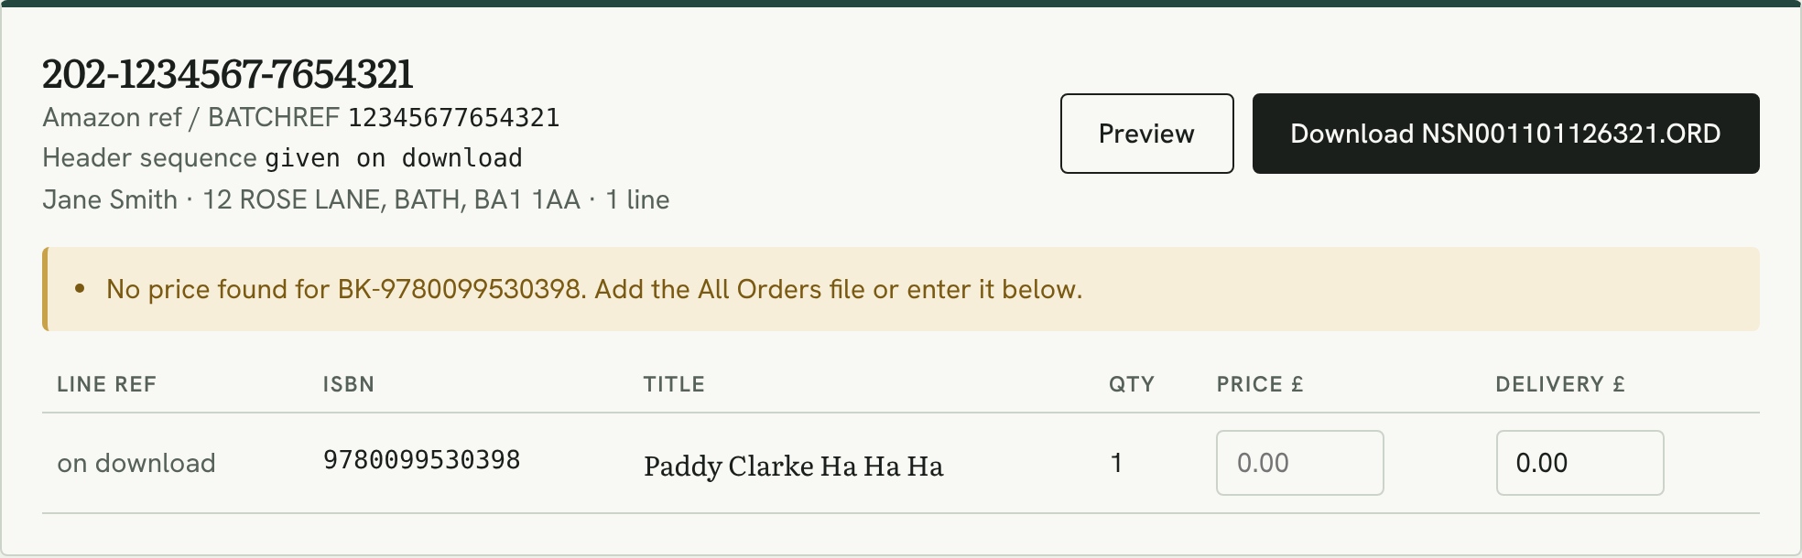
STEP 5
Fix anything flagged in yellow
Warning | What to do
No price found | Add the All Orders file, or type the price
SKU doesn’t give a valid ISBN | Check the SKU in Amazon; non-book items can’t go to Gardners
Postcode / address line 1 is empty | Check the order in Seller Central
Unknown country code | Confirm the destination with Gardners
Same file name as another order | Download those two orders one at a time
Nothing left to ship | Already shipped. No file is needed
Orders can still be downloaded with a warning, so always check before sending to Gardners.

Slide 12
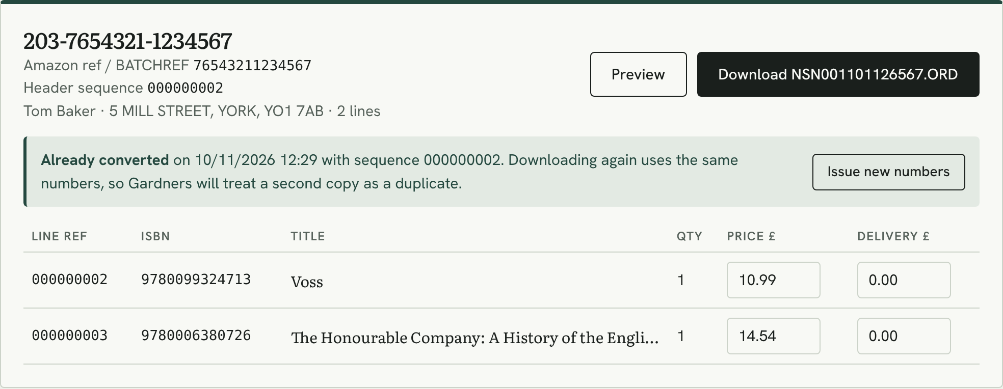
STEP 5
Orders that were converted before
Numbers stay with the order. An order keeps the numbers it was first given, on any computer.
Already converted shows when and with which sequence. Downloading again reuses the same numbers, so Gardners will treat a second copy as a duplicate and not send it twice.
Issue new numbers only for a deliberate resend, e.g. after Gardners reject a file. Click it twice to confirm.

Slide 13
STEP 6
Download the .ORD files
How a file is named
Download on an order card saves that one order.
Download all (.zip) saves every ready order in one zip file.
Send the .ORD files to Gardners as agreed with your account manager.
NSN001
091126
567
.ORD
Gardners Account ID
Today’s date (DDMMYY)
Last 3 digits of the Amazon order
Gardners file type

Slide 14
REFERENCE
How order numbers work
ONE PER ORDER
ONE PER BOOK
Header sequence
Line reference
Counts
one number per order file
Counts
one number per book line, across all orders
After 999999999
carries on: 1000000000 … (up to 20 characters)
After 999999999
starts again at 000000001
Repeats
never. A repeated sequence is rejected by Gardners
Format
9 digits, numbers only
Kept on the hosting. Both counters are stored by the number service for your Gardners Account ID, so every computer and browser carries on from the same numbers.

Slide 15
REFERENCE
Inside an .ORD file
Single-line order
Multi-line order
One book
Two books, one file, one parcel (same BATCHREF)
"HEADER","NSN001","09/11/2026","N","000000001"
"DETAIL",000000001,"12345677654321","9780099530398",1,0
"DNAME","Smith" "DADDR1","12 ROSE LANE" ...
"PRICE",999 "SERVICE",001 ...
"TRAILER",000001
"HEADER","NSN001","09/11/2026","N","000000002"
"DETAIL",000000002,"76543211234567","9780099324713",1,0
name, address, price for book 1 ...
"DETAIL",000000003,"76543211234567","9780006380726",1,0
name, address, price for book 2 ...
"TRAILER",000002
HEADER appears once: your account ID, the date, the TESTING flag (N = live) and the sequence number.
DETAIL starts each book: its unique line reference, the Amazon order number, ISBN and quantity, then the customer, address, price and BATCHREF lines. BATCHREF is the Amazon order number, so an order’s books ship together.
TRAILER closes the file with the number of DETAIL lines.

Slide 16
HELP
Log-in messages
?
“The customer is not existing”
?
“Wrong Gardners Account ID or PIN”
The account has no PIN yet, or the ID is mistyped. Check the ID; if it is new, confirm the PIN and press Create.
Check both. The message shows how many tries are left before a lock.
?
“Too many wrong PINs”
?
“Your session has ended”
Log-in for that account is locked for 15 minutes. Wait, or use Reset PIN.
The log-in expired after 12 hours or the PIN was reset. Log in again.

Slide 17
HELP
If something doesn’t look right
?
“No orders found”
?
Download buttons are grey
Only the All Orders file is loaded. Add the Unshipped Orders report: it holds the addresses.
Upload an Unshipped Orders report, or check the number service is connected.
?
Prices disappeared
?
An order is missing
Clear or a page reload empties the list. Drop the All Orders file in again.
Orders already marked shipped in Amazon aren’t in the Unshipped report.
?
“Can’t reach the number service”
?
“Already converted”
Downloads are off so numbers are never reused. Check your connection and reload.
The order has numbers from before. Only use Issue new numbers for a deliberate resend.

Slide 18
YOUR DAILY ROUTINE
Every day, in six steps
1
Download the Unshipped Orders and All Orders reports
4
Check every card: fix warnings, note “Already converted”
2
Log in, press Clear, check the LIVE banner
5
Download the .ORD files, or all as one .zip
3
Drop both .txt files onto the upload box
6
Send the files to Gardners

