Slide 1
Glaucoma Treatment Analysis
Rachel Donahue, Jinyu Li, Yujia Wang, Chen Xu

Slide 2
Background
Client: David Swain
Advisor: Babak Eliassi-Rad, MD
Department: BU School of Medicine, Ophthalmology Dept

Slide 3
Topic
Project Description:
Client is studying patients with Glaucoma that have been treated with selective laser trabeculoplasty (SLT), and has data on Humphrey visual field test(HVF) and optical coherence tomography (OCT).
Research Question:
Understand for patients after 5-yrs post-SLT, what factors make patients lower intraocular pressure (IOP) increase and ultimately had subsequent surgical interventions, and what factors make their HVF or OCT decrease while not requiring surgical interventions.
Notes:
The client performed a retrospective chart review of patients’ eyes with glaucoma, treated with SLT, and subsequent follow-up with HVF and OCT exams, I wrote their full names in the slide.
in order to assess the long-term efficacy of SLT on preventing worsening visual fields and thinning of the retinal nerve fiber layer with continued medical therapy.
The goal is understanding for patients after 5-yrs post-SLT, what factors make patients IOP increase and ultimately had subsequent surgical interventions, and what factors make their HVF or OCT decrease while not requiring surgical interventions.

Slide 4
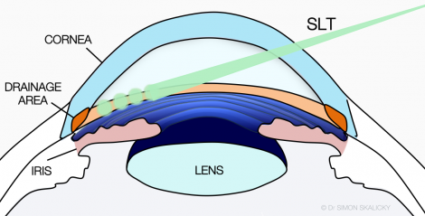
Selective laser trabeculoplasty(SLT)
SLT Procedure:
Laser energy is applied to the drainage tissue in the eye. This starts a chemical and biological change in the tissue that results in better drainage of fluid through the drain and out of the eye.
Result:
This eventually results in lowering of IOP
Notes:
What Causes Glaucoma?
dilating eye drops.
blocked or restricted drainage in your eye.
medications, such as corticosteroids.
poor or reduced blood flow to your optic nerve.
high or elevated blood pressure.

Slide 5
Data
Data Source: Diagnostic data of 51 eyes from patients has Glaucoma and receive a SLT procedure at BU and were collected in Excel.
Diagnostic time point: Pre-SLT, right after SLT, post SLT 3 years, post SLT 5 years.
Important features(55 features in total):
Patient demographics information
Visual Acuity
Measurement of intraocular pressure
The number of glaucoma medications
Humphrey visual field mean deviation
Humphrey visual field pattern standard deviation
OCT thickness
Further intervention needed?

Slide 6
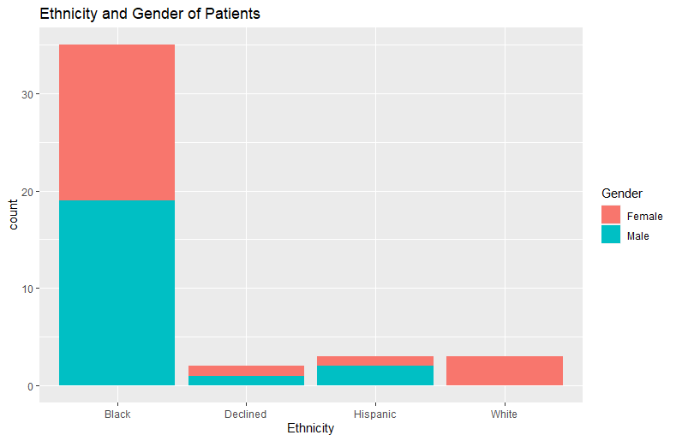
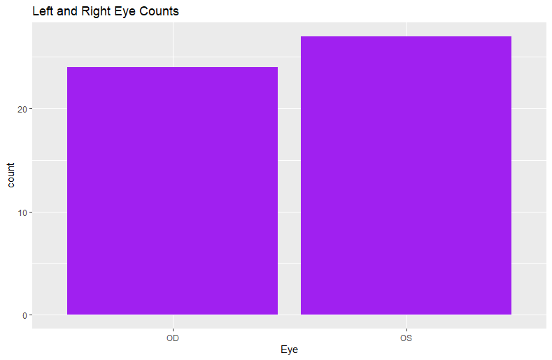
Demographic distribution

Slide 7
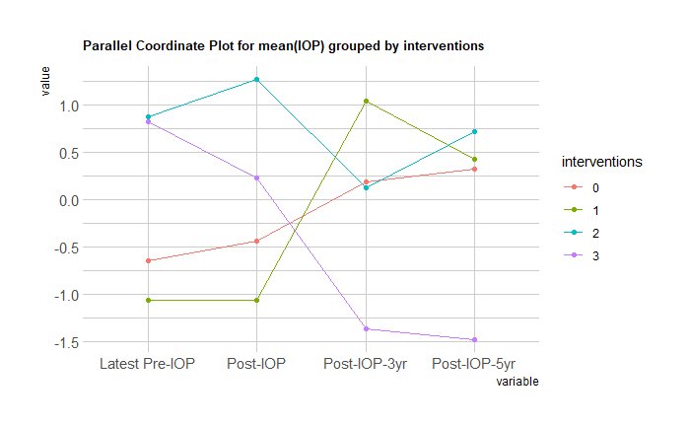
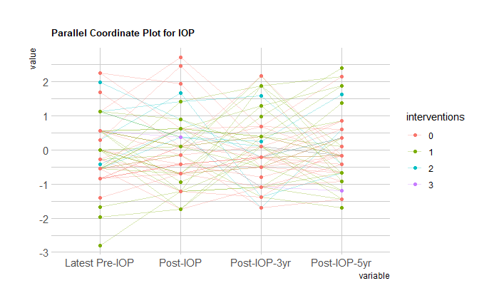
Scaled IOP vs. # interventions
All eyes IOP status over time
Grouped by times of interventions
Notes:
We made Parallel Plot of the IOP over time for 51 observations, grouping them by the times of interventions, which can be considered as the subsequent surgery the eyes got. The left hand side is the plot for all 51 observations and the right side is the plot about the mean of each group. Initially, our client wants to know what features cause the subsequent treatment to happen, and the eye IOP can usually be a key feature to measure if one need to get subsequent treatment, so we made the parallel coordinate plot

Slide 8
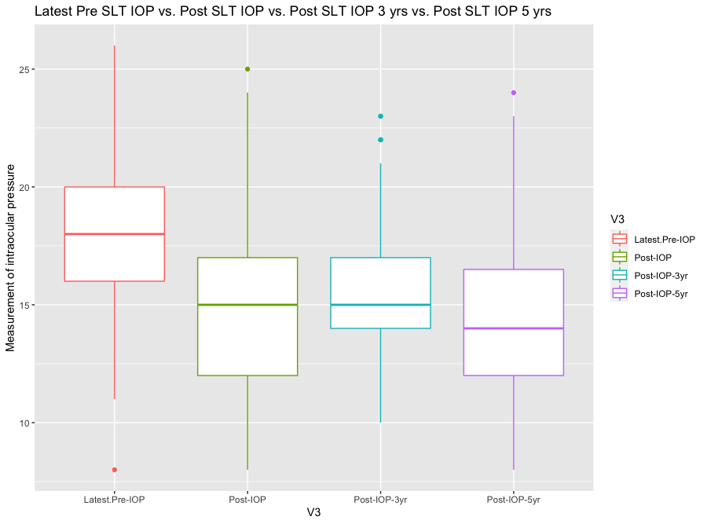
IOP comparison
Normal eye pressure range:
12-22 mm Hg
But High eye pressure just one of the symptoms caused by glaucoma.
Notes:
We conducted boxplot on the Measurement of intraocular pressure from four different diagnosis time points. The normal IOP range is from 12-22mm Hg. we mark the range with red lines. From the boxplot we can see clearly that first SLT can lower IOP very effectively. And a major group of the patients can remain relatively good IOP after 5 years of the procedure. However, high eye pressure alone just one of the symptoms that caused by glaucoma, we need to look into more features to determine if the patient do not need further surgical intervention.

Slide 9
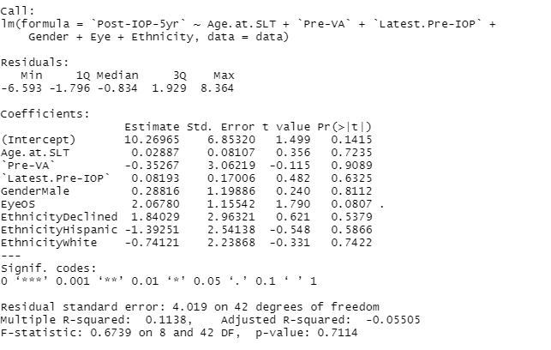
Initial Model
The purpose of our initial model:
Find important relationships between IOP with other features.
Find essential features that could increase the lower IOP.
Notes:
We fit a linear regression on Post 5 year IOP with each of those variables without doing anything to the data. The purpose for fitting a model is to find if there is a linear relationship between IOP with other features and to find essential features that could increase the lower IOP. However, after we fit the model, we certainly can bring up the fact that there's more variables than we're going to present on that are missing as well as the fact that not all these obs are independent.

Slide 10
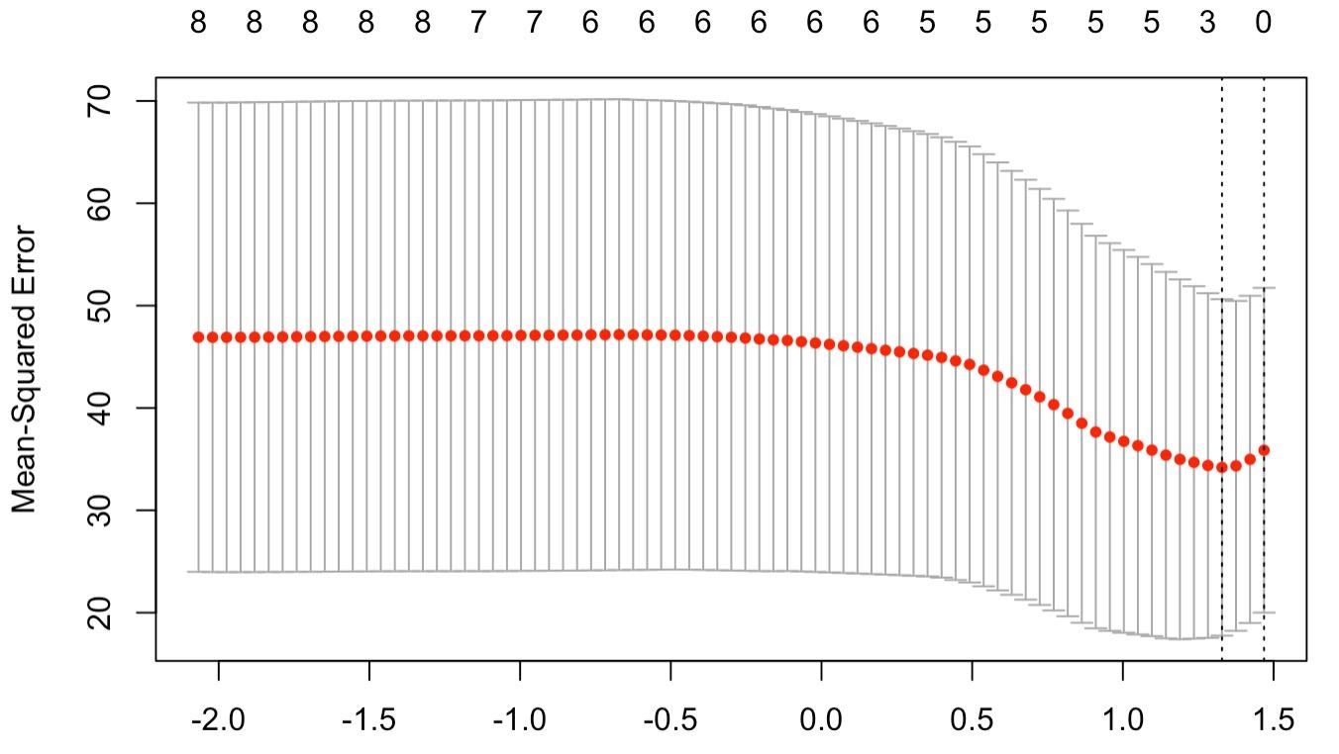
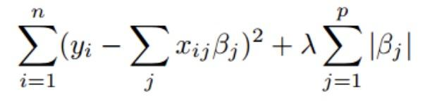
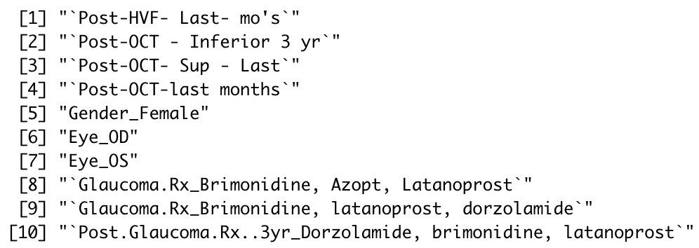
Lasso regression tryout
Data preparation:
Categorical variable: binary encoded
Numeric variable: subset complete cases
11 observations X 138 variables
Lambda selection:
The lambda value that minimizes the test MSE turns out to be 0.07805754
Test MSE = 46.61127
Feature selection:
10 features that can minimize the test MSE
Limitation:
Need to find a way deal with NAs
Need to find a way to expand observation number

Slide 11
Plans and Future Considerations
Consider how to adjust for patients that have one vs two eyes impacted
Consider the additional variables that have missing information
Consider additional techniques for dimension reduction/feature selection

Slide 12
Thank you!

