Slide 1

24x6 LED Display Matrix

Slide 2
About the Project
Project involved making a LED display which can output whatever the user gives it as input and with various patterns
Idea behind the display is multiplexing, a way to split information in pieces and send it one by one
Shift registers have been used to multiply the outputs, hence using less number of Arduino pins

Slide 3
Components Required
The components required for our project are listed below :
144 LEDS
24 resistors
4017 Decade Counter
Six 1000 Ohm resistors
Six 2N3904 Transistors
A long Perfboard
Arduino Uno
Three 74HC595 Shift Register

Slide 4
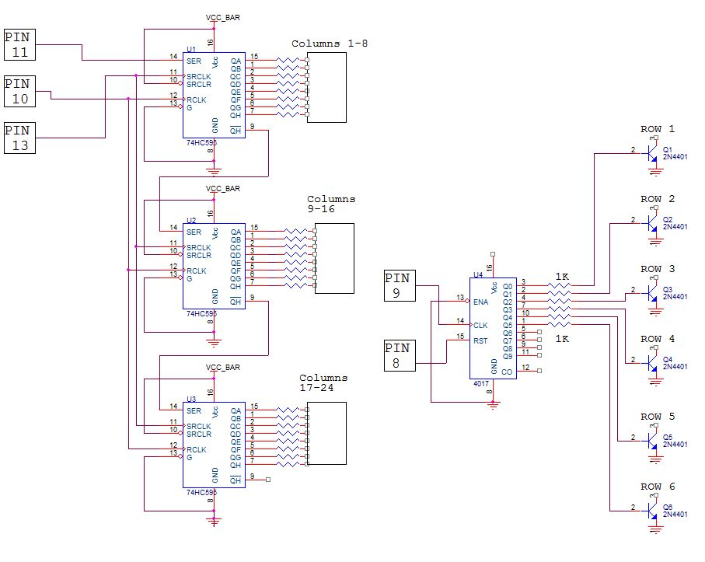
Circuit Design

Slide 5
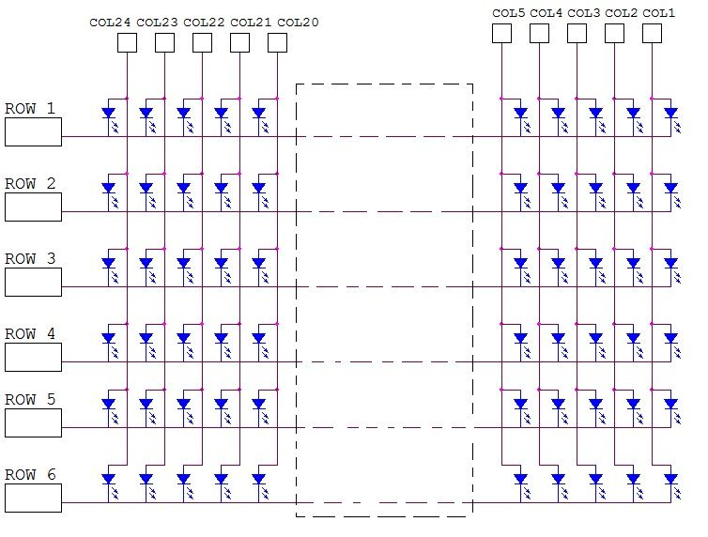
Connection of the LED’s

Slide 6
Connection of the LED’s
As we saw in the last circuit diagram, all the positive leads of the LED’s in a column have been soldered together which have been given inputs using the shift registers.
The negative leads of the LED’s in a row have been soldered together , which have been given input using the decade counter.

Slide 7
Working of the Project
A. 4017 Decade Counter
The 4017 decade counter has ten outputs which go HIGH in sequence when a source of pulses is connected to the CLOCK input and when suitable logic levels are applied to the RESET and ENABLE inputs.
We use the 4017 decade counter to scan the rows, and it can scan up to 10 rows with it because it has only 10 outputs but to control it we need only 2 pins.

Slide 8
Working of the Project
B. 74HC595 Shift Register
The 74HC595 shift register has an 8 bit storage register and an 8 bit shift register. Data is written to the shift register serially, then latched onto the storage register. The storage register then controls 8 output lines.
We have used 3 shift registers which multiply the number of outputs and save lots of Arduino pins. Each shift register has 8 outputs and we only need 3 Arduino pins to control almost an limited numbers of shift registers.

Slide 9
Working of the Project
Programming the Display
Arduino Uno has been used to upload the code and give instructions to the ICs.
We have made a code generator in Microsoft Excel which generates code corresponding to the character given by the user.
We have made a program that gets a word or a sentence from the Arduino IDE serial monitor and displays it on the matrix.

Slide 10
Extension Plans
We are planning to add animations and games to our display for better productivity in terms of using it for marketing and entertainment.
We will try to add fading effect in our display so the characters can be seen differently according to user.

Slide 11
Thank You

