Slide 1
ROUTINELOG / CHANGE REFERENCE
01 · Screen map & shared rules
Today · T
Selected day's routines and editable daily note.
Routines · R
All routines, recent results, management.
Notes · N
Daily notes by date, search and editing.
Insights · I
Overall activity and consistency.
Routine editor · E / Frequency · F
Create/edit identity, schedule and checklist.
Routine calendar · C / Completion checklist · K
Record a dated result / confirm every step.
Notion · S / Android widget · W
Synchronization / home-screen quick actions.
Shared logic: unchecked → done → not done → skipped → unchecked. Future routine results are blocked. Unchecked past deadlines can still count as missed; open flexible targets do not create daily failures. Changes save locally first; Notion sync needs a connection. Routine descriptions and daily notes are separate.
Capture guide: Web-rendered screens with sample data; Android may differ slightly. Widget is a schematic.
Request pattern: “On [screen · section ID], change [behavior/layout] to [result].”
Example request
“On Today · T5, add a word count below the daily note.”
8 NOV 2026 · BASELINE 16963bd
01 / 08

Slide 2
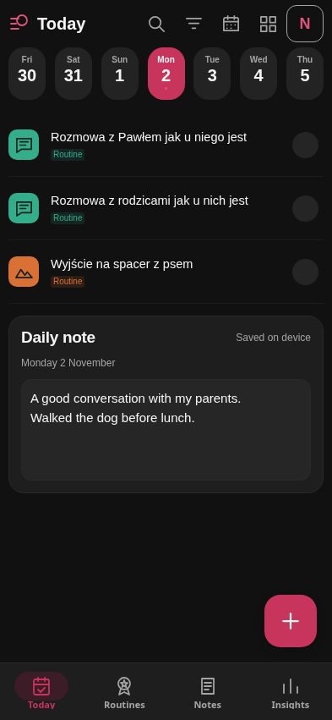
ROUTINELOG / CHANGE REFERENCE
02 · Today
T1 · Toolbar
Search, category filter, date picker, widget and Notion shortcuts; widget shortcut is Android-only.
T2 · Date strip
Select a day; updates both the routine list and daily note.
T3 · Routine rows
Icon, name, status circle. Tap circle to cycle result; tap name for details.
T4 · Expanded details
Schedule, time, category, period progress, routine description and edit icon.
T5 · Daily note
Editable text directly below routines; autosaves, shows save status and retry. One note per date.
T6 · Add routine (+)
Opens a new Routine editor.
Logic: schedule determines the list. Future dates preview routines but allow notes. Completing a routine with steps opens K first.
Current interface · sample data
8 NOV 2026 · BASELINE 16963bd
02 / 08

Slide 3
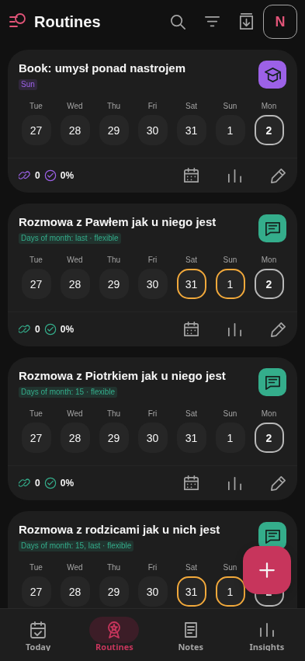
ROUTINELOG / CHANGE REFERENCE
03 · Routines
R1 · Toolbar
Search by name, category filter, paused-only toggle, Notion shortcut.
R2 · Routine card
Name, category icon, schedule badge and paused state.
R3 · Week strip
Last seven days through today; tap a date to cycle that routine's result.
R4 · Card footer
Streak and consistency from the last 30 days; calendar, insights and direct edit icons.
R5 · Routine insights sheet
30-day result counts and consistency; seven-day activity chart.
R6 · Add routine (+)
Opens a new Routine editor.
Logic: the calendar supports manual past/today entries outside the schedule. This does not change future scheduling. Pause/delete are in E; previous results stay preserved.
Current interface · sample data
8 NOV 2026 · BASELINE 16963bd
03 / 08

Slide 4
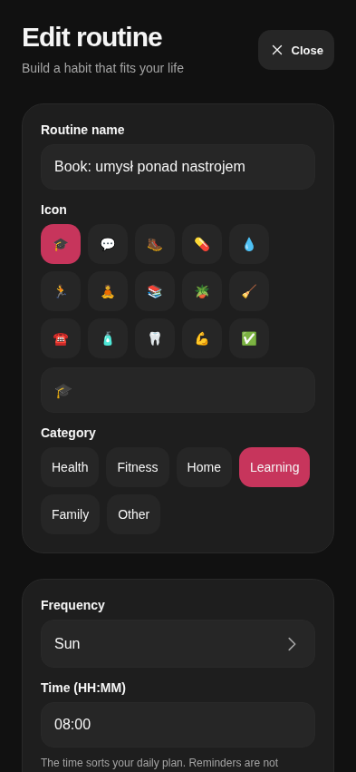
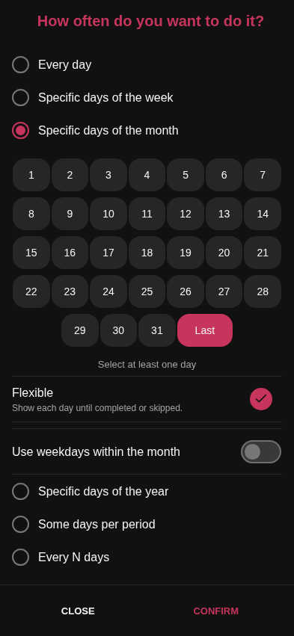
ROUTINELOG / CHANGE REFERENCE
04 · Routine editor & Frequency
E1 · Identity
Name, emoji and category.
E2 · Schedule & time
Frequency picker and HH:MM time. Time orders the plan; notifications are not enabled.
E3 · Routine description & active
Reusable instruction/note; pause or resume the routine.
E4 · Checklist
Add/remove up to 30 steps; every completion requires all steps.
E5 · Save / Cancel / Delete
Save validates fields; Cancel discards form edits; deletion requires confirmation.
F1 · Frequency mode
Daily; weekdays; month days/Last; ordinal weekdays; yearly dates; N per week/month; every N days.
F2 · Frequency options
Relevant day grid, flexible toggle, target or interval/start date. Confirm applies to the form; Save routine persists.
Logic: flexible schedules stay visible until their due work is completed/skipped. Period targets are assessed when their window ends.
8 NOV 2026 · BASELINE 16963bd
04 / 08

Slide 5
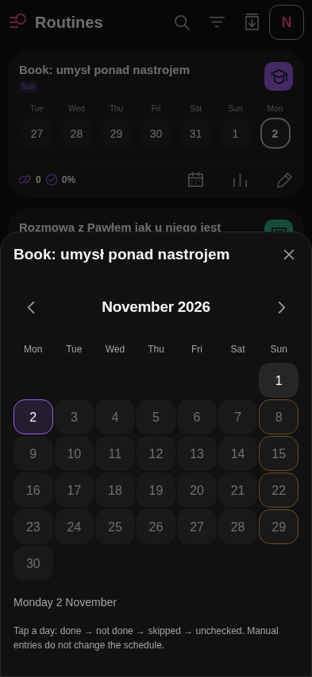
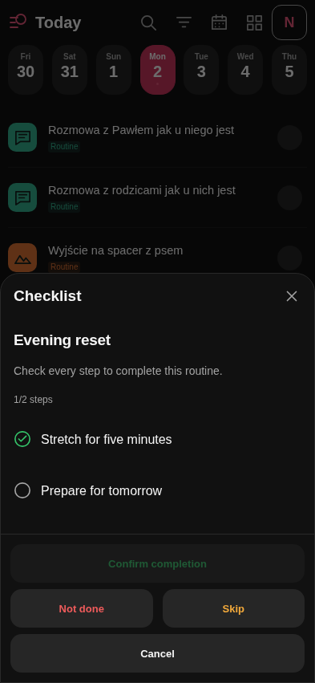
ROUTINELOG / CHANGE REFERENCE
05 · Routine calendar & Checklist
C1 · Month navigation
Previous/next month and month title.
C2 · Day grid
Tap a day to cycle its result directly. Color/icons show due dates and results.
C3 · Date context
Selected date, result and any blocked-entry explanation.
K1 · Step list
Check every step; shows checked/total progress.
K2 · Completion actions
Confirm completion unlocks only after all steps. Not done, Skip and Cancel are also available.
Logic: the general date picker selects dates only; the routine calendar edits results. Future results are blocked. Canceling a checklist leaves the result unchanged; each new completion starts fresh. Checklist confirmations stay local, outside Notion sync.
8 NOV 2026 · BASELINE 16963bd
05 / 08

Slide 6
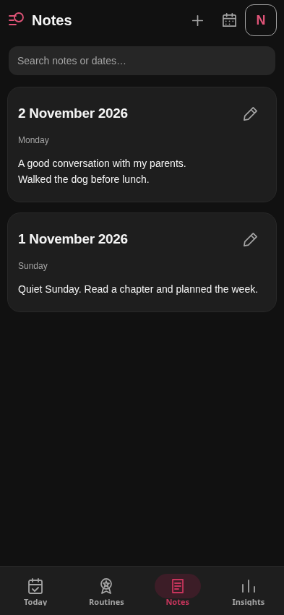
ROUTINELOG / CHANGE REFERENCE
06 · Notes
N1 · Toolbar
+ edits today's note; calendar opens a note for any date; Notion shortcut.
N2 · Search
Matches note text or date.
N3 · Note list
Newest dates first, dated content previews and edit icons.
N4 · Note editor sheet
Same editor/autosave as T5, bound to the chosen date.
Logic: one plain-text note per date, including past/future dates; up to 20,000 characters. Clearing text removes it from the saved list and syncs the clear to Notion. Unsaved text stays visible after a save failure for retry. Notes replaces the History tab; routine results remain stored.
Current interface · sample data
8 NOV 2026 · BASELINE 16963bd
06 / 08

Slide 7
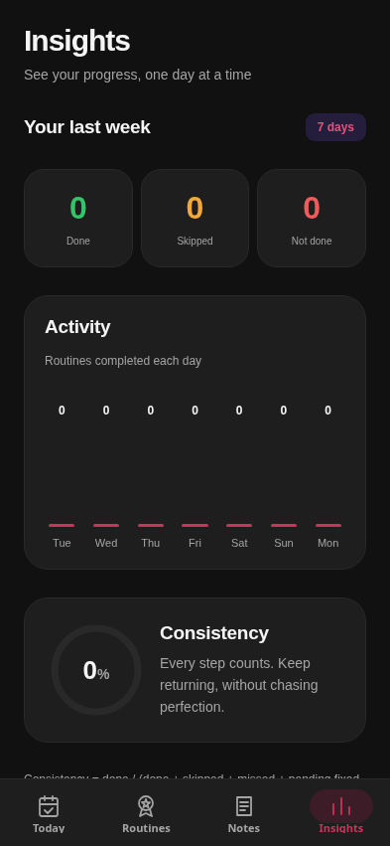
ROUTINELOG / CHANGE REFERENCE
07 · Insights
I1 · Your last week
Seven days through today; done, skipped and not-done counts.
I2 · Activity
Daily completed-routine counts in a seven-bar chart.
I3 · Consistency
Percentage ring based on done versus applicable results/deadlines.
Logic: results update statistics immediately. Consistency = done ÷ (done + skipped + missed + today's pending fixed deadlines). Activity uses the result's assigned date. Open flexible targets do not create daily failures. Routine-specific 30-day statistics are in R5. Daily notes do not affect metrics.
Example: “On Insights · I2, add a 30-day range.”
Current interface · sample data
8 NOV 2026 · BASELINE 16963bd
07 / 08

Slide 8
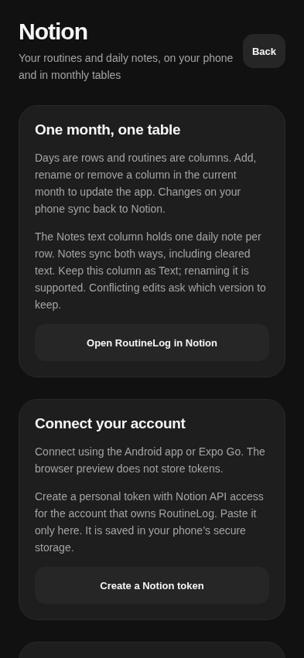
ROUTINELOG / CHANGE REFERENCE
08 · Notion & Android widget
S1 · Monthly tables
Days = rows; routines = columns; Notes = daily text. Routine settings live in column descriptions.
S2 · Connection & sync
Connect/disconnect, last sync, Sync now, errors and conflict choices.
S3 · Sync behavior
Two-way routine settings/results and daily notes; current-month column additions/renames/removals update routines.
W1 · Header
Light home-screen widget: date title, previous/next day; title returns to today.
W2 · Routine rows
Compact names, category stripes and status circles; today's taps cycle results.
Logic: Notion sync runs on app open, after saves and every minute while open; offline data stays local. Conflicts ask which version to keep. Widget browsing outside today is read-only; checklist routines open the app for confirmation. Widget needs the installed Android APK; it does not display daily notes.
Current interface · sample data
Examples: “Today · T3: show time under the name.” / “Notes · N3: group by month.” / “Widget · W2: hide completed routines.”
Today ‹ ›
Call family ○
Walk the dog ✓
Widget schematic · Android only
8 NOV 2026 · BASELINE 16963bd
08 / 08

