Slide 1
Web Basics:
Team: Yaga-Minor
Members:
Elena Rogleva
Nikola Stanchev
Radoslav Takev
Website:
https://radoslav-takev.github.io/WebBasicsTeamProject/PichUni/Solution/

Slide 2
Where we started from….?

Slide 3


Slide 4
Where we are at now…

Slide 5


Slide 6
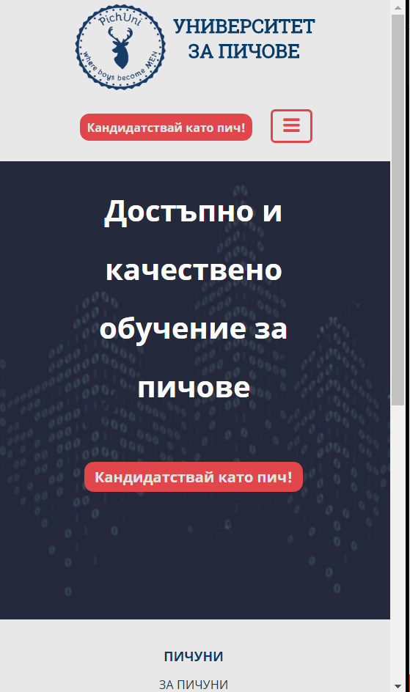
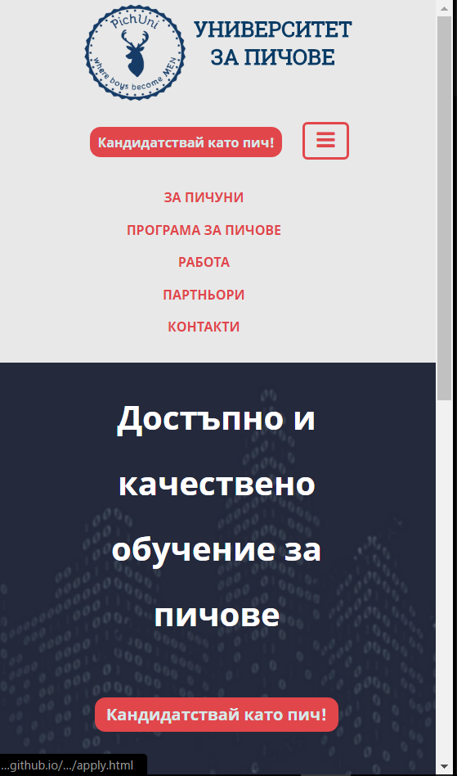
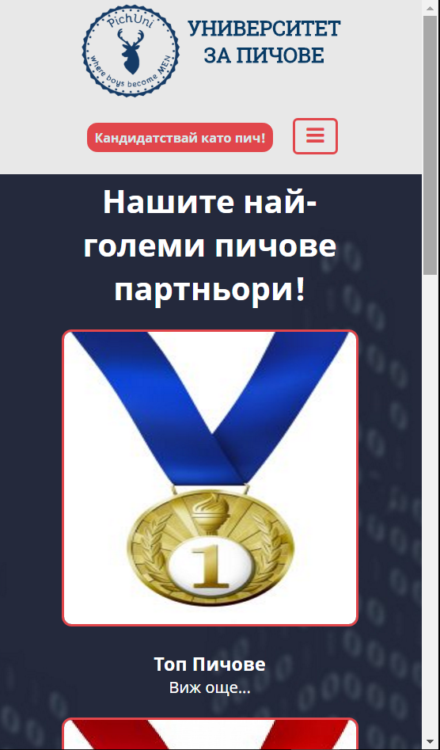
https://radoslav-takev.github.io/WebBasicsTeamProject/PichUni/Solution/

