Slide 1
Web Basics:
Team: Yaga-Minor
Members:
Elena Rogleva
Nikola Stanchev
Radoslav Takev
GitHub source code:
https://github.com/radoslav-takev/WebBasicsTeamProject/tree/master/PichUni/Solution
Website:
https://radoslav-takev.github.io/WebBasicsTeamProject/PichUni/Solution/

Slide 2
Where we started from….?

Slide 3
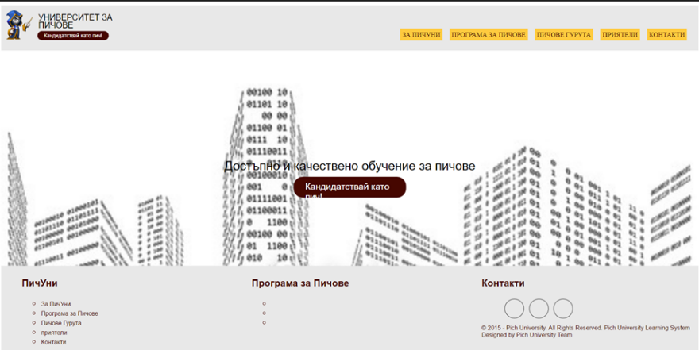

Slide 4
Where we are at now…

Slide 5
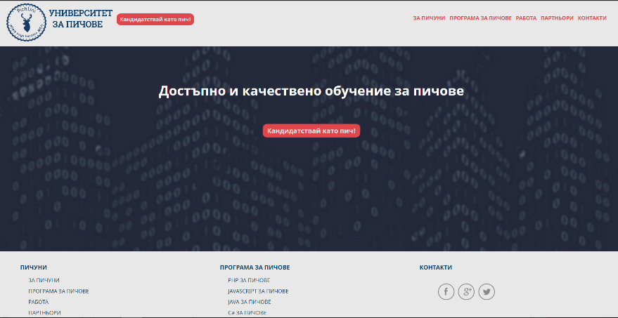

Slide 6
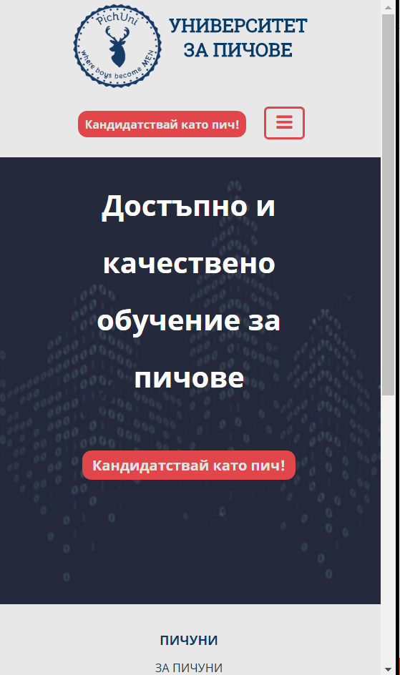
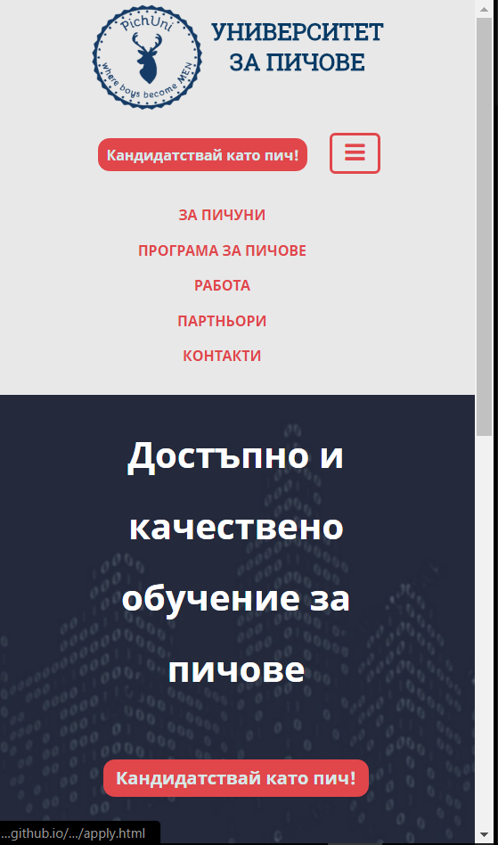
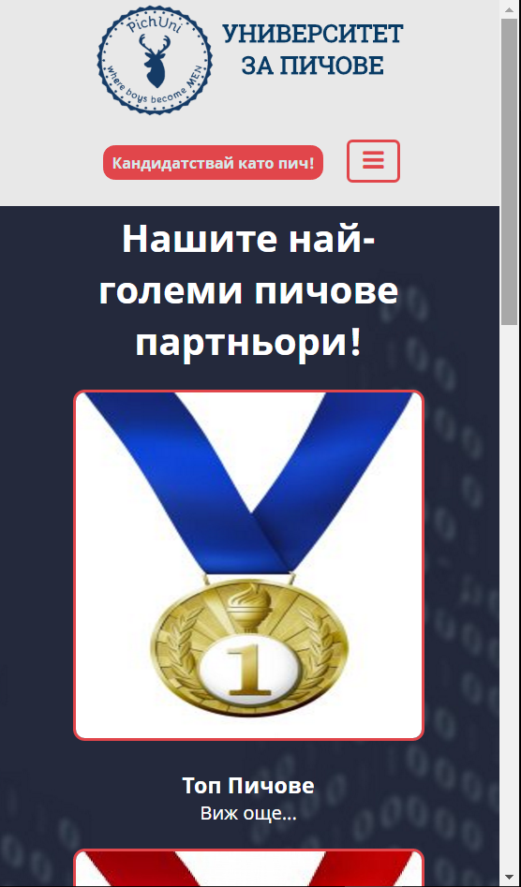
Website:
https://radoslav-takev.github.io/WebBasicsTeamProject/PichUni/Solution/

Slide 7
1. Tools used - Html and CSS based in IntelliJ used one CSS file for the common styles to all pages and unique CSSfile for each page 2. Responsive Design 3. Members (online students) – active participation from all
About the Project
Website:
https://radoslav-takev.github.io/WebBasicsTeamProject/PichUni/Solution/

