Slide 1

Internet Protocol verzia 6
Ing. Pavel Segeč, PhD.
Katedra informačných sietí
FRI ŽU

Slide 2
Prečo IPv6?
Rôzne dôvody
  Protokol IPv4 je už 30 rokov starý
    Niektoré jeho vlastnosti sa časom ukázali ako nevyužívané (možno dokonca nebezpečné)
    Iné vlastnosti potrebné pre súčasné siete mu zasa chýbajú
    Za 30 rokov sa veľa zmení a dá sa veľa dobrým veciam naučiť, prípadne odpozerať ☺
  Najväčším strašiakom je už dlhší čas malý adresový priestor IPv4 – cca 4 mld. adries

Slide 3
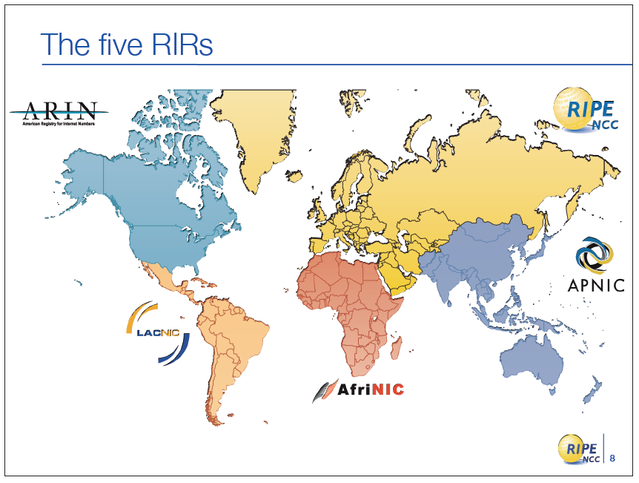
Regional internet registry (RIR)

Slide 4
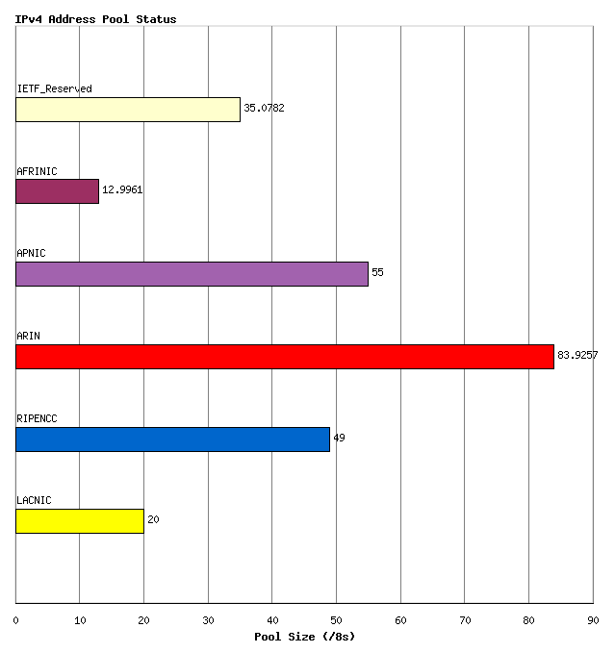
Prideľovanie IPv4 rozsahov
Adresový rozsah rozdelený do sietí s prefixom /8
Ten ďalej pridelený RIR

Slide 5
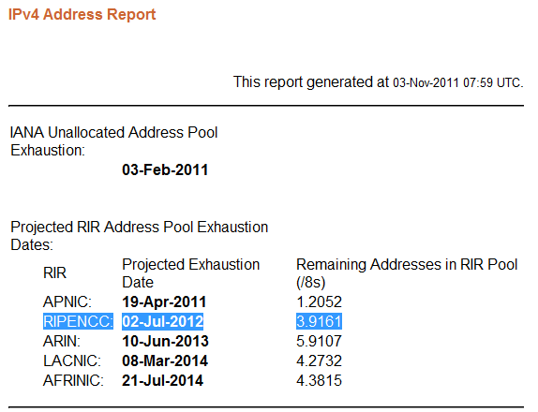
Vyčerpanie IPv4 adries
http://www.potaroo.net/tools/ipv4/index.html

Slide 6
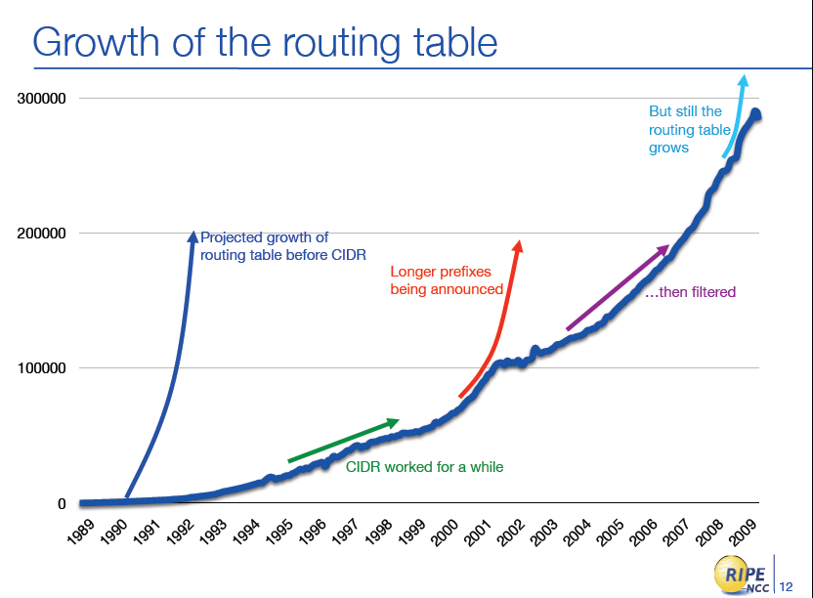
Komplikovaný IPv4 routing

Slide 7
Vlastnosti IPv6
Väčší adresový priestor
Globálna dosiahnuteľnosť
Agregácia
Multihoming
Autokonfigurácia
Komunikácia bez NAT
Mobilita a bezpečnosť
Mobilita pokrytá RFC dokumentom
Povinná podpora IPSec
Jednoduchšia hlavička
Efektívne smerovanie
Bez broadcastov
Bez kontrolných súm
Rozširujúce hlavičky
Flow labels (návestia tokov)
Migrácia
Dual stack
Tunelovanie
Preklad
Notes:
IPv6 is a powerful enhancement to IPv4. There are several features in IPv6 that offer functional improvements. What IP developers learned from using IPv4 suggested changes to better suit current and foreseeable network demands:
Larger address space: Larger address space includes several enhancements: improved global reachability and flexibility; the aggregation of prefixes that are announced in routing tables; multihoming to several Internet service providers (ISPs); autoconfiguration that can include link-layer addresses in the address space; plug-and-play options; and public-to private readdressing end to end without address translation; and simplified mechanisms for address renumbering and modification.
Simpler header: A simpler header offers several advantages over IPv4: better routing efficiency for performance and forwarding-rate scalability; no broadcasts and thus no potential threat of broadcast storms; no requirement for processing checksums; simpler and more efficient extension header mechanisms; and flow labels for per-flow processing with no need to open the transport inner packet to identify the various traffic flows.

Slide 8
Formát IPv6 paketov

Slide 9
Porovnanie hlavičiek IPv4 a IPv6
IPv4 Header
IPv6 Header
Version
IHL
Type of
Service
Total Length
Version
Traffic
Class
Flow Label
Identification
Flags
Fragment
Offset
Payload Length
Next
Header
Hop Limit
Time to Live
Protocol
Header Checksum
Source Address
Source Address
Destination Address
Options
Padding
Polia rovnakého významu
Polia vypustené z IPv6 hlavičky
Polia so zmeneným názvom a polohou
Nové polia v IPv6 hlavičke
Destination Address
Legenda
Notes:
Streamlined
Fragmentation fields moved out of base header
IP options moved out of base header
Header Checksum eliminated
Header Length field eliminated
Length field excludes IPv6 header
Alignment changed from 32 to 64 bits
Revised
Time to Live → Hop Limit
Protocol → Next Header
Precedence and TOS → Traffic Class
Addresses increased 32 bits → 128 bits
Extended
Flow Label field added
The IPv6 header has 40 octets in contrast to the 20 octets in IPv4. IPv6 has a smaller number of fields, and the header is 64-bit aligned to enable fast processing by current processors. Address fields are four times larger than in IPv4.
The IPv6 header contains these fields:
Version: A 4-bit field, the same as in IPv4. It contains the number 6 instead of the number 4 for IPv4.
Traffic Class: An 8-bit field similar to the type of service (ToS) field in IPv4. It tags the packet with a traffic class that it uses in differentiated services (DiffServ). These functionalities are the same for IPv6 and IPv4.
Flow Label: A completely new 20-bit field. It tags a flow for the IP packets. It can be used for multilayer switching techniques and faster packet-switching performance.
Payload Length: Similar to the Total Length field of IPv4.
Next Header: The value of this field determines the type of information that follows the basic IPv6 header. It can be a transport-layer packet, such as TCP or UDP, or it can be an extension header. The next header field is similar to the Protocol field of IPv4.
Hop Limit: This field specifies the maximum number of hops that an IP packet can traverse. Each hop or router decreases this field by one (similar to the Time to Live [TTL] field in IPv4). Because there is no checksum in the IPv6 header, the router can decrease the field without recomputing the checksum. On IPv4 routers the recomputation costs processing time.
Source Address: This field has 16 octets or 128 bits. It identifies the source of the packet.
Destination Address: This field has 16 octets or 128 bits. It identifies the destination of the packet.
Extension Headers: The extension headers, if any, and the data portion of the packet follow the eight fields. The number of extension headers is not fixed, so the total length of the extension header chain is variable.

Slide 10
Položky základnej hlavičky (1)
Version
  Veľkosť: 4 bity
  Pri IPv4 nastavené na 4
  Pri IPv6 nastavené na 6
    Hrubá detekcia verzie
Traffic Class
  Veľkosť: 8 bitov
  Využívané pre QoS účely
Flow Label
  Veľkosť: 20 bitov
  Tok:
    je sada paketov odosielaná z jedného zdroja do jedného alebo viacerých cieľov
    Zvyčajne požadujúca osobitnú obsluhu
  Zamýšľané na podporu QoS aplikácií
Version
Traffic
Class
Flow Label
Payload Length
Next
Header
Hop Limit
Source Address
Destination Address

Slide 11
Položky základnej hlavičky (2)
Payload Length
  Veľkosť: 16 bitov
  Počet bajtov za základnou hlavičkou
  Ak je payload väčší ako 64 kB, pole nesie hodnotu 0 a skutočnú veľkosť popisuje rozširujúca hlavička Jumbo Payload
Hop Limit
  Veľkosť: 8 bitov
  Rovnaký význam ako pole TTL v IPv4 pakete
IPv6 adresy zdroja a cieľa
  Veľkosť: 128 bitov každá
Vďaka odstráneniu nadbytočných polí je celková veľkosť základnej hlavičky len 40 bajtov
  Dvakrát väčšia ako IP hlavička
Version
Traffic
Class
Flow Label
Payload Length
Next
Header
Hop Limit
Source Address
Destination Address

Slide 12
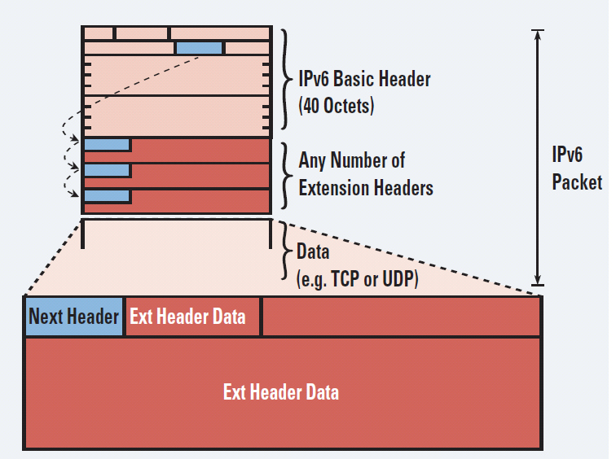
Rozširujúce hlavičky v IPv6
IPv6 má pre množstvo funkcií rozširujúce hlavičky
IPv6 efektívnejšie implementuje voliteľné časti hlavičky
  IPv4 Options musel analyzovať každý router
Počet hlavičiek nie je fixný
  Ich poradie však áno
  Sú spracovávané v poradí
Notes:
There are many types of extension headers. When multiple extension headers are used in the same packet, the order of the headers should be as follows:
IPv6 header: This header is the basic header described in the previous figure.
Hop-by-hop options header: When this header is used for the router alert (Resource Reservation Protocol [RSVP] and Multicast Listener Discovery version 1 [MLDv1]) and the jumbogram, this header (value = 0) is processed by all hops in the path of a packet. When present, the hop-by-hop options header always follows immediately after the basic IPv6 packet header.
Destination options header (when the routing header is used): This header (value = 60) can follow any hop-by-hop options header, in which case the destination options header is processed at the final destination and also at each visited address specified by a routing header. Alternatively, the destination options header can follow any Encapsulating Security Payload (ESP) header, in which case the destination options header is processed only at the final destination. For example, mobile IP uses this header.
Routing header: This header (value = 43) is used for source routing and mobile IPv6.
Fragment header: This header is used when a source must fragment a packet that is larger than the MTU for the path between itself and a destination device. The fragment header is used in each fragmented packet.
Authentication header and Encapsulating Security Payload header: The authentication header (value = 51) and the ESP header (value = 50) are used within IPsec to provide authentication, integrity, and confidentiality of a packet. These headers are identical for both IPv4 and IPv6.
Upper-layer header: The upper-layer (transport) headers are the typical headers used inside a packet to transport the data. The two main transport protocols are TCP (value = 6) and UDP (value = 17).

Slide 13
Poradie rozšírených hlavičiek
Process Order | Extension Header | Next-header value (protocol #) | Processed
1 | Hop-by-hop options header | 0 | Every router
2 | Destination options header | 60 | Only routers in routing header
3 | Routing header | 43 | List of routers to cross
4 | Fragment header | 44 | Destination
5 | Authentication header (AH) and ESP header | ESP = 50 AH = 51 | Destination
6 | Upper-layer header: TCP UDP | TCP = 6 UDP = 17 | Destination
Notes:
http://www.cisco.com/en/US/technologies/tk648/tk872/technologies_white_paper0900aecd80260042.pdf

Slide 14
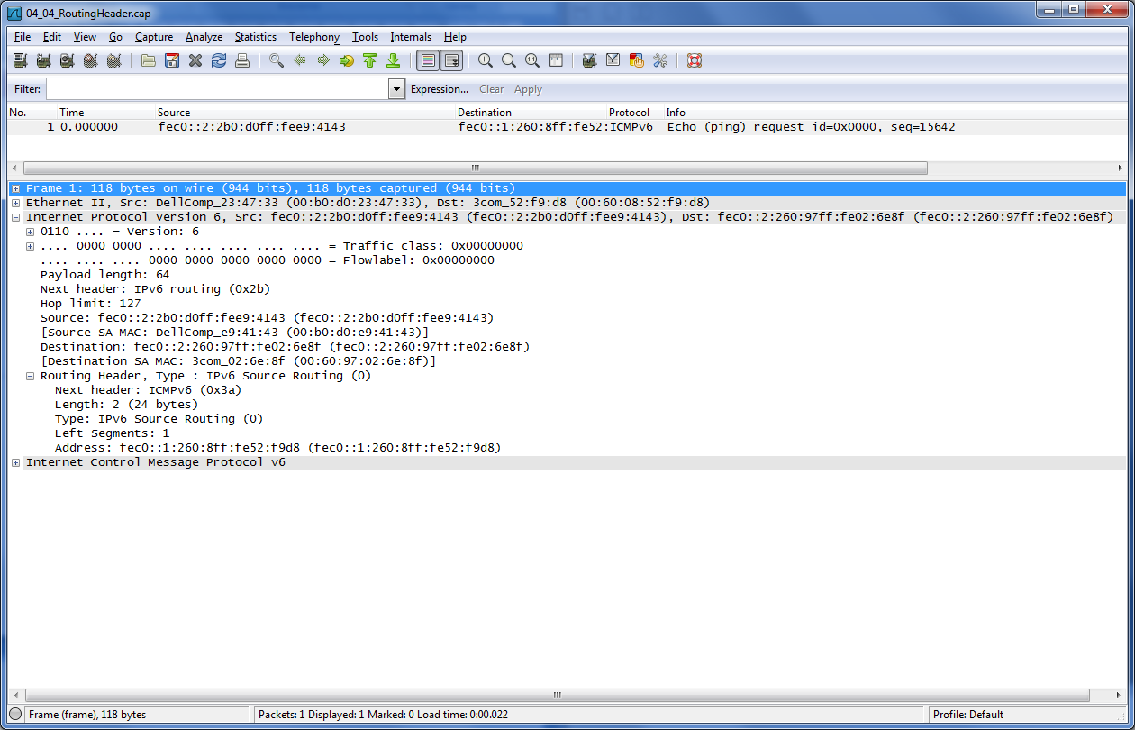
IPv6 hlavička – Routing header
Wireshark

Slide 15
Adresovanie
v IPv6

Slide 16
Väčší adresový priestor
IPv4 = 32 bits
11111111.11111111.11111111.11111111
IPv6 = 128 bits
11111111.11111111.11111111.11111111 | 11111111.11111111.11111111.11111111 | 11111111.11111111.11111111.11111111 | 11111111.11111111.11111111.11111111
IPv4
32 bitov
    ~ 4,200,000,000 adresovateľných uzlov
IPv6
128 bitov (16 bajtov): štvornásobná dĺžka oproti IPv4
    ~ 3.4 * 10³⁸ adresovateľných uzlov
    ~ 340,282,366,920,938,463,374,607,432,768,211,456
    ~ 5 * 10²⁸ adries na osobu
Notes:
IPv6 increases the number of address bits by a factor of 4, from 32 to 128. This factor enables a very large number of addressable nodes; however, as in any addressing scheme, not all the addresses are used or available.
Current IPv4 protocol address use is extended by applying techniques such as NAT and temporary address allocations. But the manipulation of data payload by intermediate devices challenges (or complicates) the advantages of peer-to-peer communication, end-to-end security, and quality of service (QoS).
IPv6 gives every user multiple global addresses that can be used for a wide variety of devices, including cell phones, personal digital assistants (PDAs), and IP-enabled vehicles. Quadrupling the available 32-bit IPv4 address space to 128 bits, IPv6 addresses the need for always-on environments. These addresses are reachable without using IP address translation, pooling, and temporary allocation techniques.
Increasing the number of bits for the address also increases the IPv6 header size. Because each IP header contains a source and a destination address, the size of the header fields that contains the addresses is 256 bits for IPv6 compared to 64 bits for IPv4.
Note: For more IETF information on IPv6 addressing details, refer to RFC 3513.

Slide 17
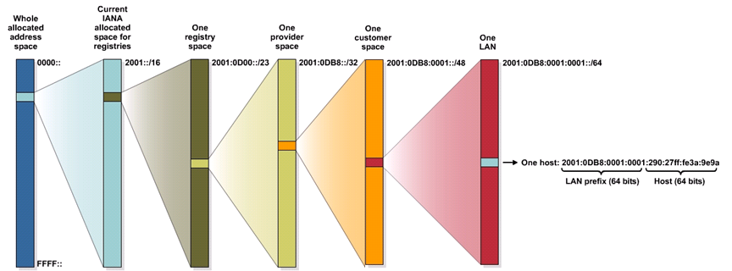
Prideľovanie IPv6 adries
Zatiaľ bolo IANA na RIR alokovaná len malá časť IPv6 globálneho priestoru (asi 12.5%)
  Rozsah 2001::/16

Slide 18
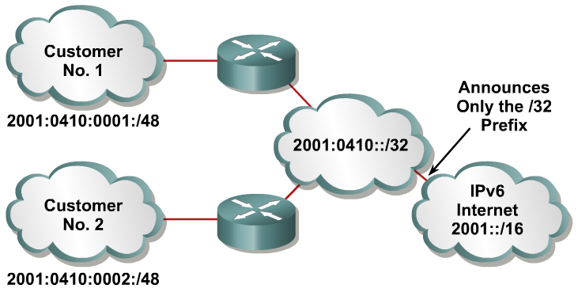
Veľký adresový priestor s efektívnou agregáciou
Do globálnych smerovacích tabuliek sa ohlasujú agregované prefixy
  Do istej miery toto pripomína návrat ku classful smerovaniu, hoci sa to nedá takto v pravom zmysle slova nazvať
Efektívne a škálovateľné smerovanie
Notes:
Larger address spaces make room for large address allocations to ISPs and organizations. An ISP aggregates all the prefixes of its customers into a single prefix and announces the single prefix to the IPv6 Internet. The increased address space is sufficient to allow organizations to define a single prefix for the entire network as well.
Aggregation of customer prefixes results in an efficient and scalable routing table. Scalable routing is necessary to expand broader adoption of network functions. Improved network bandwidth and functionality for user traffic will connect the various devices and applications. Internet usage—both now and in the future—can include these elements:
A huge increase in the number of broadband consumers with high-speed, always-on connections
Users who spend more time online and are generally willing to spend more money on communications services (such as music) and high-value searchable offerings
Home networks with expanded network applications such as wireless Voice over IP (VoIP), home surveillance, and advanced services such as real-time video on demand (VoD)
Massively scalable games with global participants and media-rich e-learning, providing learners with on-demand remote labs or lab simulations

Slide 19
Zápis IPv6 adries
x:x:x:x:x:x:x:x
Skladá sa z osem 16-bitových hexadecimálnych polí
  nazývané “coloned hex”
Úvodné nuly v hexadecimálnom poli sú nepovinné
  2031:0:130F:0:0:9C0:876A:130B
Za sebou idúce polia 0 sa dajú skrátiť zápisom ::, avšak len jedenkrát v danej IPv6 adrese
Prvé nuly zľava sa môže v danom hexa poli vynechať
Reprezentácia
  http://[2001:4118:300:120::2]/
  2031:0000:130F:0000:0000:09C0:876A:130B
  2031:0:130f::9c0:876a:130b
  FF01:0:0:0:0:0:0:1 >>> FF01::1
  0:0:0:0:0:0:0:1 >>> ::1
  0:0:0:0:0:0:0:0 >>> ::
Notes:
IPv6 addresses are shown in hexadecimal and there are appropriate methods for abbreviation of addresses. Colons separate entries in a series of 16-bit hexadecimal fields that represent IPv6 addresses. The hexadecimal digits A, B, C, D, E, and F represented in IPv6 are not case-sensitive. IPv6 does not require explicit address string notation.
Use the following guidelines for IPv6 address string notations:
The leading zeros in a field are optional, so that 09C0 = 9C0 and 0000 = 0.
Successive fields of zeros can be represented as “::” only once in an address.
An unspecified address is written as “::” because it contains only zeros.
Using the “::” notation greatly reduces the size of most addresses. For example, FF01:0:0:0:0:0:0:1 becomes FF01::1.
Note: An address parser identifies the number of missing zeros by separating the two parts and entering 0 until the 128 bits are complete. If two “::” notations are placed in the address, there is no way to identify the size of each block of zeros.

Slide 20
IPv6 adresa
Každá IPv6 adresa pozostáva z dvoch polí (ako ipv4)
  Subnet prefix
    Reprezentujúci sieť ku ktorej je IPv6 host pripojený svojim rozhraním
    Môže byť rôznej dĺžky
      Zvyčajne je však dlhý 64bit (/64)
  Interface ID
    Identifikátor rozhrania
    Zvyčajne dlhý 64bit (/64)
IPv6 = 128 bits
11111111.11111111.11111111.11111111 | 11111111.11111111.11111111.11111111 | 11111111.11111111.11111111.11111111 | 11111111.11111111.11111111.11111111
Subnet prefix
Interface ID

Slide 21
Subnet Prefix
Preto na zápis IPv6 adries sa používa tzv. CIDR zápis
  ipv6-address/prefix-length
Príklad:
fec0:0:0:1::1234/64
je preto reálne
fec0:0000:0000:0001:0000:0000:0000:1234/64
  Kde prvých 64-bitov (fec0:0000:0000:0001) je adresný prefix
  Posledných 64-bitov (0000:0000:0000:1234) je Interface ID.

Slide 22
Adresový model v IPv6
Adresy sa priradzujú rozhraniam
Rozhranie v IPv6 má spravidla niekoľko adries
  V IPv4 má rozhranie typicky len 1 adresu
Adresy majú svoj rozsah (scope)
  Link Local
  Global unicast
  Site-local (zastaralý)
Adresy majú čas platnosti
  Platnosť a preferovaný čas platnosti
  Týka sa adries získaných bezstavovou autokonfiguráciou
Adresy majú svoj typ
Unique
Site Local
Global
Link Local
Notes:
Now we know how to represent IPv6 in IPv6 format lets look at the IPv6 addressing model

Slide 23
Typy adries
Unicast
  Adresa patrí jednému rozhraniu
  Existuje mnoho podtypov (napr. globálne a IPv4-mapované)
Multicast
  Pre one-to-many adresovanie
  Efektívnejšie využíva prostriedky siete
  Používa širší adresový rozsah
Anycast
  One-to-nearest (alokované z unicastového priestoru)
  Viaceré zariadenia zdieľajú tú istú adresu
  Všetky takéto zariadenia by mali poskytovať rovnaké služby
  Zdrojové zariadenia odosielajú pakety na anycast adresu
  Smerovače rozhodnú o najbližšom uzle s danou adresou
  Vhodné pre load balancing a poskytovanie obsahu (content delivery)
Broadcast už neexistuje
Notes:
Broadcasting in IPv4 results in a number of problems. Broadcasting generates a number of interrupts in every computer on the network and, in some cases, triggers malfunctions that can completely halt an entire network. This disastrous network event is known as a “broadcast storm.”
In IPv6, broadcasting does not exist. Broadcasts are replaced by multicasts and anycasts. Multicast enables efficient network operation by using a number of functionally specific multicast groups to send requests to a limited number of computers on the network. The multicast groups prevent most of the problems that are related to broadcast storms in IPv4.
The range of multicast addresses in IPv6 is larger than in IPv4. For the foreseeable future, allocation of multicast groups is not being limited.
IPv6 also defines a new type of address called an anycast address. An anycast address identifies a list of devices or nodes; therefore, an anycast address identifies multiple interfaces. A packet sent to an anycast address is delivered to the closest interface—as defined by the routing protocols in use—identified by the anycast address.
Anycast addresses are syntactically indistinguishable from global unicast addresses because anycast addresses are allocated from the global unicast address space.
Note: Anycast addresses must not be used as the source address of an IPv6 packet.

Slide 24
IPv6 adresy
Global Unicast adresy
Public topology
Site topo
Host
3
45 Bits
16 Bits
64 Bits
Global Routing Prefix
Subnet
Interface ID
001
Adresy typu Global Unicast a Anycast majú rovnaký formát
  Obsahujú tzv. globálny smerovací prefix
  Použitý na agregáciu adries za účelom optimalizácie smerovania
    až po providera
  Anycastová adresa je jednoducho adresa, ktorá je spoločne pridelená viacerým rozhraniam (spravidla na rôznych zariadeniach)
Štruktúrované hierarchicky, aby umožnili agregáciu
Tento formát adries sa používa pre unikátne a verejne viditeľné adresy IPv6 staníc
Notes:
The Aggregatable Global Unicast Addresses correspond to the principal use of IPv6 addresses for the generic IPv6 traffic and consume the most important part of the address space. The structure enables strict aggregation of routing prefixes in order to limit the number of routing table entries in the global routing table.

Slide 25
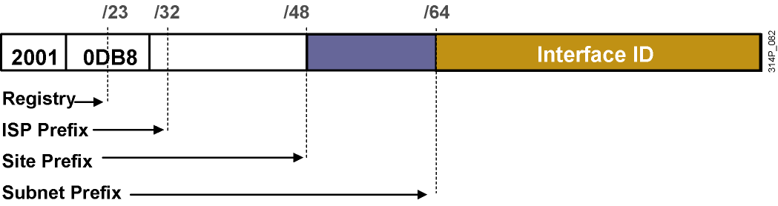
IPv6 adresy
Global Unicast adresy
Adresa typu Global Unicast a Anycast má tri časti
  Global Routing Prefix (/48)
  Subnet ID (/16)
  Interface ID (/64)
Štruktúra GRP a SID nie je fixná
  Požaduje sa, aby Interface ID malo 64 bitov, ak IPv6 adresa začína bitmi inými než 000/3
  V súčasnosti sa prideľujú Global Unicast adresy s prefixom /48 z poolu 2001::/16
    Subnet ID má teda 16 bitov
Notes:
The IPv6 global unicast address is the equivalent of the IPv4 global unicast address. A global unicast address is an IPv6 address from the global unicast prefix. The structure of global unicast addresses enables aggregation of routing prefixes that limits the number of routing table entries in the global routing table. Global unicast addresses used on links are aggregated upward through organizations and eventually to the Internet service providers (ISPs).
Global unicast addresses are defined by a global routing prefix, a subnet ID, and an interface ID.

Slide 26
IPv6 adresy
Global Unicast / IPv6 Interface ID
Ako prideliť zvyšných 64 bitov?
  Bezstavová autokonfigurácia
    Automaticky z IEEE L2 MAC adresy
      Modified extended universal identifier – modified EUI-64
  Dočasne pridelené, náhodne vygenerované číslo
  Hodnota pridelená stavovou konfiguráciou (DHCPv6)
  Manuálne nakonfigurovaná hodnota
Notes:
Use of EUI-64 Format in IPv6 Addresses
The 64-bit interface identifier is an IPv6 address is used to identify a unique interface on a link. A link is a network medium over which network nodes communicate using the link layer. The interface identifier may also be unique over a broader scope. In many cases, an interface identifier will be the same as or is based on the link-layer (MAC) address of an interface. As in IPv4, a subnet prefix in IPv6 is associated with one link.
Interface identifiers used in global unicast and other IPv6 address types must be 64 bits long and constructed in the Extended Universal Identifier (EUI)-64 format. The EUI-64 format interface ID is derived from the 48-bit link-layer (MAC) address by inserting the hexadecimal number FFFE between the upper 3 bytes (Organizational Unique Identifier [OUI] field) and the lower 3 bytes (serial number) of the link layer address. To make sure that the chosen address is from a unique Ethernet MAC address, the seventh bit in the high-order byte is set to 1 (equivalent to the IEEE G/L bit) to indicate the uniqueness of the 48-bit address.

Slide 27

Konverzia MAC adresy na EUI-64
Modified extended universal identifier – modified EUI-64
  Modified EUI-64 sa získa z MAC adresy tým, že:
    Medzi OUI a S/N sa vloží dvojbajt FF:FE
    Invertuje sa bit U/L (druhý najnižší bit 1. bajtu MAC)
Notes:
MAC Address to Modified EUI-64 to IPv6 Interface Identifier
The IPv6 interface identifier for stateless auto-configuration in an Ethernet environment uses the modified EUI-64 format. The transformation begins by taking the MAC address of the interface.
This format expands the 48-bit Ethernet MAC address format to a 64-bit version by inserting "FFFE" in the middle of the 48 bits.
This creates a 64-bit, unique interface identifier.
The 7th bit (starting with the leftmost bit as “1”) in an IPv6 interface identifier is referred to as the Universal/Local bit, or U/L bit.
This bit identifies whether this interface identifier is locally unique on the link or that it is universally unique.
To make sure that the chosen address is from a unique Ethernet MAC address, the universal/local (“u” bit) is set to 1 for global scope and 0 for local scope.
In the case where the interface identifier is created from an Ethernet MAC address, it is assumed that the MAC address is universally unique and, therefore, the interface identifier is universally unique.
The rationale of the U/L bit is for future use of the upper-layer protocols to uniquely identify a connection, even in the context of a change in the leftmost part of the address. However, this is not yet used.
The 8th bit (starting with leftmost bit as “1”), also known as the “G” bit, is a group/individual bit for managing groups. The unicast/group (“g” bit) is set to 1 for group and 0 for unicast.
Because of certain privacy and security concerns, the implementation of autoconfiguration by a host may also create a random interface identifier using the MAC address as a base. This is considered a privacy extension because, without it, creating an interface identifier from a MAC address provides the ability to track the activity and point of connection.
Microsoft Windows XP is currently the only known implementation of this capability and prefers to use this address for outgoing communication, because the address has a short lifetime and will be regenerated periodically.
Note: This process is defined in RFC 3041.

Slide 28
IPv6 adresy
Anycast adresa
IPv6 anycast adresa je adresa typu global unicast, ktorá je priradená viac než jednému rozhraniu
Notes:
An IPv6 anycast address is a global unicast address that is assigned to more than one interface. When a packet is sent to an anycast address, it is routed to the “nearest” interface having that address. In a WAN scope, the nearest interface is found according to the measure of distance of the routing protocol. In a LAN scope, the nearest interface is found according to the first neighbor that is learned about. The following describes the characteristics of the anycast:
Anycast addresses are allocated from the unicast address space, so they are indistinguishable from the unicast address. When assigned to a node interface, the node must be explicitly configured to know that the address is an anycast address.
The idea of anycast in IP was proposed in 1993. For IPv6, anycast is defined as a way to send a packet to the nearest interface that is a member of the anycast group, which enables a type of discovery mechanism to the nearest point.
There is little experience with widespread anycast usage. A few anycast addresses are currently assigned: the router-subnet anycast and the Mobile IPv6 home agent anycast.
An anycast address must not be used as the source address of an IPv6 packet.

Slide 29
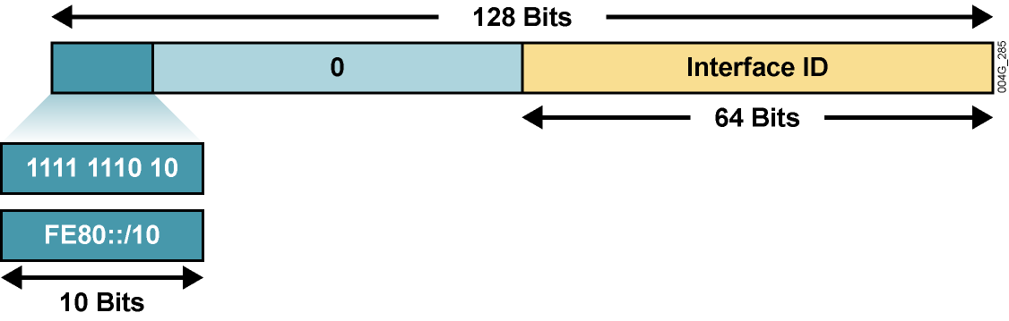
IPv6 adresy
Link-Local Unicast adresa
Remaining 54 bits
Link-local adresa pozostáva z prefixu FE80::/10, ľubovoľných 54 bitov a Interface ID vo formáte EUI-64
Link-local adresy sú povinné pre komunikáciu dvoch susedných zariadení
  Auto konfigurácia, router discovery, neighbor discovery
  Takisto sa využívajú v smerovacích protokoloch ako next-hop adresy
Link-local adresa je vytvorená automaticky
  Hneď ako je aktivovaná podpora IPv6
Sú jedinečné a platné len v rámci broadcastovej domény
  Nie sú smerovateľné
Pri ich použití sa musí špecifikovať aj rozhranie
  Napr. ping na susedovú link-local
Notes:
Link-local addresses have a scope limited to the link and are dynamically created on all IPv6 interfaces by using a specific link-local prefix FE80::/10 and a 64-bit interface identifier.
Interface identifiers in IPv6 addresses are used to identify interfaces on a link. They may also be thought of as the “host portion” of an IPv6 address. Interface identifiers are required to be unique on that link.
Interface identifiers are always 64 bits and are dynamically created based on Layer 2 media and encapsulation.
Link-local addresses are used for automatic address configuration, neighbor discovery, and router discovery. Link-local addresses are also used by many routing protocols.
Link-local addresses can serve as a way to connect devices on the same local network without needing global addresses.
Interface identifiers may also be unique over a broader scope: When the interface identifier is derived directly from the data link layer address of the interface (for example, IEEE 802.1Q MAC), the scope of that identifier is assumed to be universal (global).
When communicating with a link-local address, you must specify the outgoing interface because every interface is connected to FE80::/10.
IPv6 over Data Link Layers
IPv6 is defined on most of the current data link layers, including the following:
Ethernet*
PPP*
High-Level Data Link Control (HDLC)*
FDDI
Token Ring
Attached Resource Computer Network (ARCNET)
Nonbroadcast multiaccess (NBMA)
ATM**
Frame Relay***
IEEE 1394
* Cisco supports these data link layers.
** Cisco supports only ATM permanent virtual circuit (PVC) and ATM LAN Emulation (LANE).
*** Cisco supports only Frame Relay PVC.
An RFC describes the behavior of IPv6 in each of these specific data link layers, but Cisco IOS software does not necessarily support all of them. The data link layer defines how IPv6 interface identifiers are created and how neighbor discovery deals with data link layer address resolution.

Slide 30
IPv6 adresy
Multicastové adresy
128 bits
/8
/16
F F 1111 1111 | 0 0 00xx xxxx | Group ID
Flags:
P = Prefix for unicast-based assignments
T = 0 if permanent, 1 if temporary
Scope:
1 (0001) = Node
2 (0010) = Link
5 (0101) = Site
8 (1000) = Organization
E (1110) = Global
Flags |  |  |  | Scope
0 | 0 | P | T | xxxx
8 bits
Definované prefixom FF00::/8
  Prvý oktet FF
  Druhý oktet obsahuje
    Prefix, platnosť a rozšírenie
    Adresy FF00:: to FF0F:: sú rezervované
      FF02::/16 – všeobecne známe, link local
Multicasty sa v IPv6 využívajú veľmi často
Broadcast sa v IPv6 nepoužíva

Slide 31
IPv6 adresy
Príklady pevných multicastových adries
Reserved Multicast Address | Description
FF02::1 | All nodes on a link (link-local scope).
FF02::2 | All routers on a link.
FF02::9 | All routing information protocol (RIP) routers on a link.
FF02::1:FFxx:xxxx | All solicited-node multicast addresses used for host autoconfiguration and neighbor discovery (similar to ARP in IPv4). The xx:xxxx is the far right 24 bits of the corresponding unicast or anycast address of the node.
FF05::101 | All Network Time Protocol (NTP) servers.
Notes:
The multicast addresses, FF00:: to FF0F::, are reserved. Within that range, the following are some examples of assigned addresses (there are many more assignments made; assignments are tracked by the Internet Assigned Numbers Authority [IANA]):
FF02::1 — All nodes on link (link-local scope)
FF02::2 — All routers on link
FF02::5 — All OSPF routers on link
FF02::6 — All DR routers on link
FF02::9 — All Routing Information Protocol (RIP) routers on link
FF02::1:FFXX:XXXX — Solicited-node multicast on link, where XX:XXXX is the rightmost 24 bits of the corresponding unicast or anycast address of the node. (Neighbor solicitation messages are sent on a local link when a node wants to determine the link-layer address of another node on the same local link, similar to Address Resolution Protocol [ARP] in IPv4.)
FF05::101 — All Network Time Protocol (NTP) servers in the site (site-local scope)
The site-local multicast scope has an administratively assigned radius and has no direct correlation to the (now deprecated) site-local unicast prefix of FEC0::/10.

Slide 32
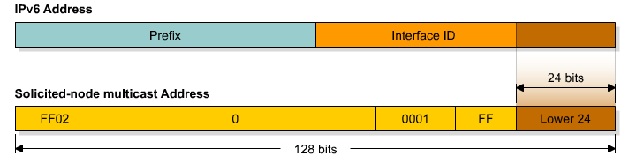
IPv6 multicastové adresy
Solicited-Node mcast adresa
Solicited-node multicast adresa pozostáva z prefixu FF02::1:FF:/104
  Adresa má rozsah link-local
  Má ju každý IPv6 host
Nasadenie
  Neighbor discovery (ND)
    Zistenie link-local adresy suseda, zistenie defaut route, zistenie smerovača na linke
  Bezstavová autokonfigurácia
Typické použitie je v ICMPv6, ktoré nahrádza ARP
  Spodných 24 bitov IPv6 adresy je 24 bitov z IPv6 adresy hľadaného suseda
  ICMPv6 je vo vnútri IPv6 paketu, takže paket musí mať adresu príjemcu, v tomto prípade práve Solicited-Node
Notes:
Solicited-node Address
Solicited-node addresses are multicast addresses used in neighbor solicitation messages to help with neighbor discovery. An IPV6 node must join the multicast group corresponding to each of its unicast and anycast addresses. The solicited-node address is composed of the following: FF02:0:0:0:0:1:FF/104 prefix concatenated by the rightmost 24 bits of the corresponding unicast or anycast address of the node. As a FF02::/16 address, a solicited-node multicast address has the scope of link-local.
In very rare cases, the rightmost 24 bits of the unicast address of the target will not be unique on the link. Solicited–node multicast addresses are used in IPv6 for address resolution of an IPv6 address to a MAC address on a LAN segment. For example, consider two nodes with addresses 2001:DB8:200:300:400:500:aaaa:bbbb and 2001:DB8:200:300:400:501:aaaa:bbbb, where the link prefix is 2001:DB8:200:300::/64. These two nodes, then, would be listening to the same solicited-node multicast address. Each would receive the multicast packet, but only the node whose full address matched the full target address of the multicast packet (embedded in the data field of the multicast packet) would respond with a neighbor advertisement (which includes the actual MAC address). The other node would receive the multicast packet, but upon inspection of the embedded target address would realize that it was not the intended recipient of the request, and would not respond.
The following example describes how this situation would work.
Node A has this characteristic:
Address 2001:DB8:200:300:400:500:1234:5678
Node B has these characteristics:
Address 2001:DB8:200:300:500:AAAA:BBBB
Solicited-node multicast address FF02:0:0:0:0:1:FFAA:BBBB (the same as node C)
Node C has these characteristics:
Address 2001:DB8:200:300:501:AAAA:BBBB
Solicited-node multicast address FF02:0:0:0:0:1:FFAA:BBBB (the same as node B)
Node A desires to exchange packets with node B. Node A sends a neighbor discovery packet to the solicited-node multicast address of B, FF02:0:0:0:0:1:AAAA:BBBB, as described previously. Inside the packet, in addition to other data, is the full IPv6 address that node A is looking for—2001:DB8:200:300:500:AAAA:BBBB. This is called the target address.
Both node B and node C are listening to the same multicast address, so they both receive and process the packet.
Node B sees that the target address inside the packet is its own and responds as described previously.
Node C sees that the target address inside the packet is not its own and does not respond
at all.
In this manner, nodes can have the same solicited-node multicast address on the link without causing neighbor discovery, neighbor solicitation, or neighbor advertisement to malfunction.

Slide 33
IPv6 adresy na rozhraniach IPv6 hosta
Na rozhraní môže byť ľubovoľný počet adries každého typu
Každé IPv6 rozhranie
  Musí mať priradenú prinajmenšom link-local adresu
  Môže mať priradené viaceré unikátne lokálne či globálne adresy
  Má priradenú loopback adresu (::1)
  Môže mať priradené viaceré multicastové adresy
    Node local scope all-nodes multicast adresu (FF01::1)
    Link local scope all-nodes multicast adresu (FF02::1)
    Solicited adresu per každú zo svojich unicast adries
Notes:
The global unicast and the anycast share the same address format. The unicast address space allocates the anycast addresses. To devices that are not configured for anycast, these addresses appear as unicast addresses.
When a unicast address is assigned to more than one interface, thus turning it into an anycast address, the nodes to which the address is assigned must be explicitly configured to use and recognize the anycast address.
A packet that is sent to an anycast address routes to the closest device or interface that shares this address. A sender creates a packet with the anycast as the destination address and forwards it to its nearest router. The source can use the anycast addresses to control the pathway across which traffic flows.
Examples: Multiple ISPs and LANs with Multiple Routers
An example of anycast use in a Border Gateway Protocol (BGP) multihomed network is when a customer has multiple ISPs with multiple connections to one another. The customer can configure a different anycast address for each ISP.
Each router for the given ISP has the same configured anycast address. The source device can choose which ISP to send the packet to; however, the routers along the path determine the closest router to reach that ISP using the IPv6 anycast address.
Another use for an anycast is when a LAN is attached to multiple routers. These routers can have the same IPv6 anycast address so that distant devices need to identify only the anycast address. Intermediate devices can choose the best pathway to reach the closest entry point to that subnet.

Slide 34
IPv6 adresy na rozhraní
R1#sh ipv6 int e0
Ethernet0 is up, line protocol is up
IPv6 is enabled, link-local address is FE80::C203:DFF:FEAC:0
No global unicast address is configured
Joined group address(es):
FF02::1
FF02::2
FF02::1:FFAC:0
MTU is 1500 bytes
ICMP error messages limited to one every 100 milliseconds
ICMP redirects are enabled
ND DAD is enabled, number of DAD attempts: 1
ND reachable time is 30000 milliseconds
ND advertised reachable time is 0 milliseconds
ND advertised retransmit interval is 0 milliseconds
ND router advertisements are sent every 200 seconds
ND router advertisements live for 1800 seconds
Hosts use stateless autoconfig for addresses.
R1#
Adresa Solicited-Node Multicast

Slide 35
IPv6 Adresy na smerovačoch
Unicast adresy:
  Link-local adresa pre každé rozhranie
  Unicast addresa pre každé rozhranie
  Loopback adresa (::1)
Multicast adresy:
  Node-local scope all-nodes multicast adresa (FF01::1)
  Node-local scope all-routers multicast adresa (FF01::2)
  Link-local scope all-nodes multicast adresa (FF02::1)
  Link-local scope all-routers multicast adresa (FF02::2)
  Site-local scope all-routers multicast adresa (FF05::2)
  Solicited-node adresa pre každú unicast adresu
  Multicast adresy skupín s nahláseným členstvom
Anycast adresy
  Voliteľný počet

Slide 36
Neighbor discovery a ICMPv6

Slide 37
Kompetencie protokolu ICMPv6
V IPv6 má protokol ICMP podstatne dôležitejšiu úlohu než v IPv4
  Podporuje všetky dôležité funkcie svojho predchodcu
    Destination Unreachable, Packet Too Big, Time Exceeded, Parameter Problem, Echo/Echo Reply, Redirect
  Pridáva nové funkcie
    Router Solicitation, Router Advertisement (do istej miery nahrádza DHCP)
    Neighbor Solicitation, Neighbor Advertisement (nahrádza ARP)
Pridané funkcie slúžia na
  Vyhľadanie smerovačov
  Propagácia default route
  Automatickú konfiguráciu IPv6 adresy a parametrov IPv6 rozhrania
  Preklad IPv6 na MAC adresy (v IPv4 ARP)
  Detekcia duplikátnej IPv6 adresy v sieti (DAD)

Slide 38
ICMPv6 Neighbor Discovery
Typy paketov
Neighbor Discovery používa 4 typy ICMPv6 správ:
  Neighbor Solicitation a Neighbor Advertisement správy
  Router Solicitation a Router Advertisement správy
ICMPv6 Message | Type | Description
Neighbor Solicitation (NS) | 135 | Posielané hostom na zistenie L2 adresy suseda (ako predtým ARP) Použitá na overovanie dostupnosti suseda Použitá na overovanie duplicity adries (Duplicate Address Detection (DAD)).
Neighbor Advertisement (NA) | 136 | Generovaná ako odpoveď na NS správu. IP host môže poslať aj nevyžiadanú odpoveď ako oznámenie o zmene jeho L2 adresy.
Router Advertisement (RA) | 134 | RA obsahuje prefixy ktoré sa používajú na určenie linky, konfiguráciu adries, hop limit, MTU a podobne RA sú posielané periodicky alebo ako odpoveď na RS správu. Generuje smerovač so zapnutým IPv6 unicast routing
Router Solicitation (RS) | 133 | Použitá pri bootovaní hosta na vyžiadanie RA správy od smerovača. Negeneruje smerovač so zapnutým IPv6 unicast routing

Slide 39


Neighbor Solicitation
A
B
ICMP type: 135 (NS)
Source: IPv6 adresa hosta A
Destination: Solicited-node multicast B (FF02::1:FFxx.xxxx)
Data: Link-layer adresa hosta A
Query: Aká je tvoja link layer adresa?
ICMP type: 136 (NA)
Source: IPv6 adresa hosta B
Destination: IPv6 adresa hosta A
Data: Link-layer adresa hosta B
Výhoda použitia multicastu v ND oproti broadcastu v ARP je zrejmá
  Správa nie je spracovávaná všetkými (bcast)
  Ale len tými uzlami, čo majú danú mcast adresu
Mapovanie IPv6 adresy na ethernet multicast
  Vezmi posledných 32 bitov Ipv6 adresy a pridaj 33-33
  FF02::1:FF68:12CB => 33-33-FF-68-12-CB
Notes:
To send an IPv6 multicast packet over Ethernet, one simply takes the last 32 bits of the destination IPv6 address, prepends 33-33- and uses that as the destination Ethernet address. Thus, an IPv6 packet addressed to FF02::1:FF68:12CB would be sent to the Ethernet address 33-33-FF-68-12-CB. Any host which is interested in packets for that IPv6 address is expected to be listening for the corresponding Ethernet address.

Slide 40

Neighbor Solicitation
2001:DB8::500:AAAA:BBBB
R2
2001:DB8::500:1234:5678
R1
2001:DB8::501:AAAA:BBBB
R3
V prípade, že na sieti je viac hostov s rovnakou solicited-node multicast adresou
  Príjem všetci s danou adresou
  Odpoveď len ten, ktorého IPv6 adresa sedí voči Ipv6 adrese nesenej v tele NS správy

Slide 41
DAD – Duplicite address detection
Používaná IPv6 hostami po tom ako im bola pridelená IPv6 adresa
Za účelom zistenie jedinečnosti danej IPv6 adresy
  Používa ND proces
  Host sa pýta na svoju IPv6 adresu

Slide 42
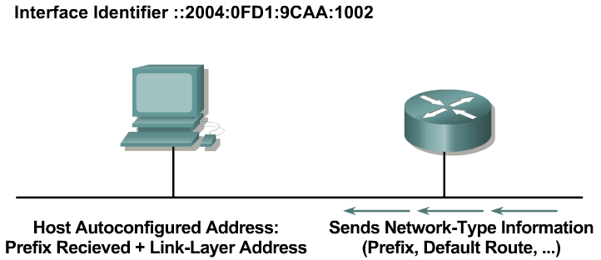
Bezstavová konfigurácia
(Stateless Autoconfiguration)
Každá IPv6 stanica si dokáže sama prideliť adresu
  tak, že pripojí svoj 64-bitový Interface ID k prefixu siete, ktorý prijala od routera v RA správe
Smerovač za týmto účelom posiela rozhraním informácie všetkým uzlom na sieti
  tzv. Router advertisement správy, RA
  RA je posielané periodicky, ale uzol si zaslanie môže vynútiť generovaním správy RS
Notes:
A router on the local link can send network information, such as a 64-bit prefix of the local link network and the default route. It sends this to all the nodes on the local link. A host can autoconfigure itself by appending its IPv6 interface identifier (64-bit format) to the local link prefix (64 bits). This process results in a full 128-bit address that is usable and guaranteed to be globally unique.
A process called duplicate address translation is enabled to detect and avoid duplicate addresses.
Autoconfiguration enables the plug-and-play feature, which allows devices to connect themselves to the network without any configuration and without any servers (like DHCP servers). This key feature enables deployment of new devices on the Internet, such as cellular phones, wireless devices, home appliances, and home networks.
Note: Stateless DHCP is a new concept (February 2004) that strikes a middle ground between stateless autoconfiguration and the thick-client approach of stateful DHCP. Stateless DHCP for IPv6 is also called “DHCP-lite.” See RFC 3736, Stateless Dynamic Host Configuration Protocol (DHCP) Service for IPv6.

Slide 43
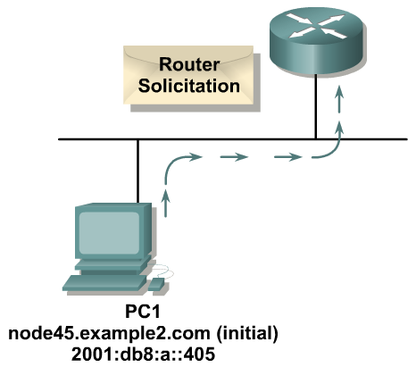
Postup bezstavovej konfigurácie adresy
ICMP type: 133 (RS)
Source: ::
Destination: FF02::2 (All routers mcast)
Query: Žiadam o zaslanie RA
Fáza 1: PC odošle správu „router solicitation (RS)“ a vyžiada si sieťový prefix pre bezstavovú konfiguráciu
Notes:
The PC first configures its link-local address and then sends a router solicitation to request a prefix for stateless autoconfiguration.

Slide 44
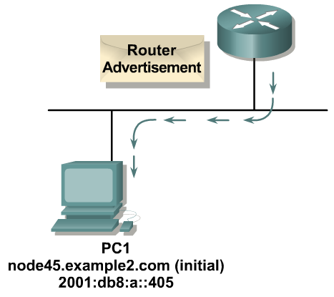
Postup bezstavovej konfigurácie adresy
ICMP type: 134 (RA)
Source: R1 link-local adresa
Destination: FF02::1 (All nodes mcast)
Data: Options, prefixes, lifetime, …
Fáza 2: Router odpovedá správou Router Advertisement, v ktorej uvedie okrem iných údajov aj prefix lokálnej siete
Notes:
The router replies with a router advertisement, including prefix information.

Slide 45
Autokonfigurované adresy
Stavy automaticky nastavenej adresy:
  Tentative (neoverená, pokusná)
    V procese preverovania unikátnosti (Duplicate Address Detection)
    Unicast komunikácia je zakázaná
    Multicast komunikácia – len správy Neighbor Advertisement
  Valid (platná)
    Unikátnosť adresy bola potvrdená
    Adresu je možné používať
    Stav Valid obsahuje v sebe ďalšie 2 stavy: Preferred a Deprecated
      Preferred (normálny stav) – adresa je platná
      Deprecated (neschválená) – adresa je platná, ale je zbavená schopnosti nadväzovať nové spojenia, existujúca komunikácia môže prebiehať ďalej
  Invalid (neplatná)
    Do tohto stavu sa adresa dostane po uplynutí časovača Valid Lifetime
    Adresa v tomto stave nie je použiteľná

Slide 46
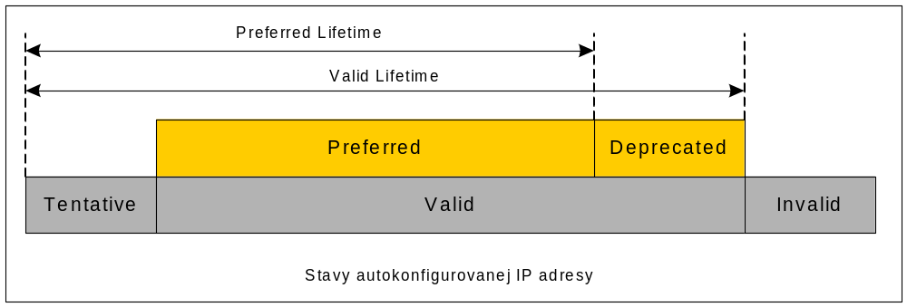
Stavy automatickej IP adresy
Autokonfigurovaná adresa prechádza týmito stavmi cyklicky, trvanie stavov získa zo správy Router Advertisement
Autokonfigurované adresy obvykle patria na koncové stanice, smerovače ich spravidla nevyužívajú

Slide 47
Migrácia medzi IPv4 a IPv6

Slide 48
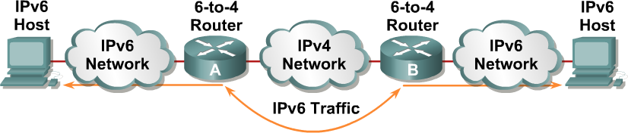
Migrácia medzi IPv4 a IPv6
Pre migráciu z IPv4 na IPv6 je definovaných niekoľko rôznych mechanizmov, a nie je nevyhnutné urobiť skokový prechod
Migračné mechanizmy
  Dual-stack
  Tunneling
    Statické tunely, 6over4 tunely (zriedka používané, RFC 2529), 6to4 tunely (RFC 3056)
    ISATAP tunely (RFC 4214)
    Teredo tunely (RFC 4380)
  Preklady (translations)
    NAT-PT (Protocol Translation)
Notes:
The transition from IPv4 does not require upgrades on all nodes at the same time. Many transition mechanisms enable smooth integration of IPv4 and IPv6. Other mechanisms that allow IPv4 nodes to communicate with IPv6 nodes are available. All of these mechanisms are applied to different situations.
The two most common techniques to transition from IPv4 to IPv6 are as follows:
Dual stack
IPv6-to-IPv4 (6-to-4) tunnels
For communication between IPv4 and IPv6 networks, there can be IPv4 addresses that are encapsulated in an IPv6 address.
The figure shows an example of a transition and integration mechanism. The 6-to-4 routers automatically encapsulate the IPv6 traffic inside IPv4 packets.

Slide 49
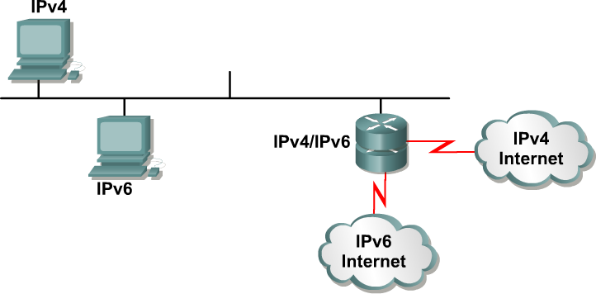
Dual Stack
Dual stack je integračná metóda, kde každá stanica aj router implementuje aj IPv4, aj IPv6
Protokoly sú na sebe úplne nezávislé
Notes:
Dual stack is an integration method where a node has implementation and connectivity to both an IPv4 and IPv6 network, and thus the node has two stacks. This configuration can be accomplished on the same interface or on multiple interfaces.
A dual-stack node chooses which stack to use based on destination address. A dual-stack node should prefer IPv6 when available. The dual-stack approach to IPv6 integration, in which nodes have both IPv4 and IPv6 stacks, will be one of the most commonly used methods. Old IPv4-only applications continue to work as before. New and modified applications take advantage of both IP layers.
A new application program interface (API) is defined to support both IPv4 and IPv6 addresses and Domain Name System (DNS) requests. This new API replaces the “gethostbyname” and “gethostbyaddr” calls. A converted application will be able to make use of both IPv4 and IPv6. An application can be converted to the new API while still using only IPv4.
Past experience in porting IPv4 applications to IPv6 says that, for most applications, it is a minimal change in some localized places inside the source code. This technique is well-known and has been applied in the past for other protocol transitions. It enables gradual application upgrades one-by-one to IPv6.

Slide 50
Dual stack spôsob konfigurácie
Stanica musí mať nakonfigurovanú na rozhraní IPv4 aj IPv6 adresu
Ako sa stanica, ktorá podporuje IPv4 aj IPv6, rozhodne, ktorý protokol má pouţiť?
  Primárne závisí od konfigurácie stanice, ktorý protokol preferuje
    WindowsXP a vyššie preferujú najprv IPv6, potom IPv4
    Linux: /etc/gai.conf
Podľa nastavenej preferencie sa stanica pokúsi v DNS vyhľadať preklad mena na IP adresu daného protokolu
  IPv6: DNS záznam typu AAAA
  IPv4: DNS záznam typu A
Ak sa preklad daného typu nájde, stanica komunikuje daným protokolom,
  ak sa nenájde, stanica vyskúša preklad na ďalší typ adresy
Ak je zadaná IP adresa, potom jej formát určuje, aký protokol bude použitý na komunikáciu
Notes:
Cisco IOS software is IPv6-ready. As soon as IPv4 and IPv6 basic configurations are complete on the interface, the interface is dual-stacked, and it forwards IPv4 and IPv6 traffic.
Using IPv6 on a Cisco IOS router requires that you use the global configuration command ipv6 unicast-routing. This command enables the forwarding of IPv6 datagrams. All interfaces that forward IPv6 traffic must have an IPv6 address. The interface command is as follows:
ipv6 address IPv6-address [/prefix length]
This command specifies an IPv6 network assigned to the interface and enables IPv6 processing on the interface.

Slide 51
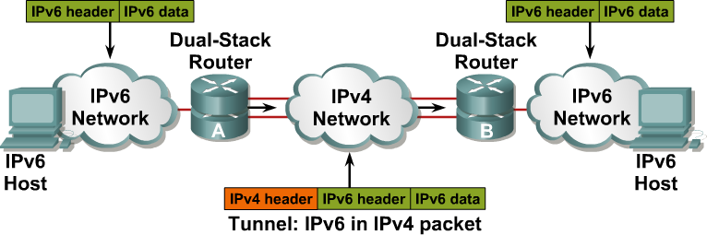
Tunelovanie IPv6 v IPv4
Tunelovanie je integračná metóda, kde sa IPv6 paket zapúzdri do paketu iného protokolu, napr. IPv4 (číslo protokolu 41)
  Overhead tohto tunela je 20B
    hlavička IPv4 bez voliteľných častí
  IPv6 je v roli passenger protokolu a IPv4 je transport (carrier)
  Tento spôsob vyžaduje dual-stacked routery (na okrajoch)
Notes:
Tunneling is an integration method where an IPv6 packet is encapsulated within another protocol, such as IPv4. This method of encapsulation is IPv4 protocol 41:
This includes a 20-byte IPv4 header with no options and an IPv6 header and payload.
This is considered dual stacking.
Tunnels are often used in networking to overlay noncompatible functionality over an existing network. When tunneling IPv6 traffic over an IPv4 network, one edge router encapsulates the IPv6 packet inside an IPv4 packet and then the other router decapsulates it, and vice versa. This enables the connection of IPv6 islands without the need to also convert an intermediary network to IPv6. Tunneling presents these two issues:
The MTU is effectively decreased by 20 octets (if the IPv4 header does not contain any optional field).
A tunneled network is often difficult to troubleshoot. Tunneling is an intermediate integration/transition technique that should not be considered a final solution. Native IPv6 architecture should be the ultimate goal.

Slide 52
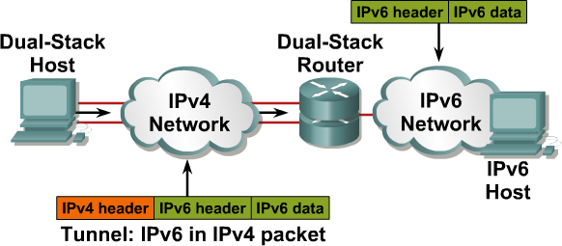
Tunelovanie IPv6 v IPv4
Zapúzdrenie môže realizovať nielen router, ale aj stanica, ak jej operačný systém ovláda príslušný spôsob tunelovania
Notes:
Encapsulation can be done by edge routers between hosts or between a host and a router. This example shows an isolated dual-stack host using an encapsulated tunnel to connect to the edge router of the IPv6 network.
Tunneling will not work if an intermediary node between the two end points of the tunnel, such as a firewall, filters out IPv4 protocol 41, which is the IPv6 in IPv4 encapsulation.

Slide 53
Typy tunelov
Tunely môžu byť vytvorené:
  Staticky
    Statické (manual) IPv6 tunely
    GRE IPv6 tunely
  Automaticky:
    IPv4-Compatible IPv6 Tunely (potláčané)
    6to4 tunely
    ISATAP tunely

Slide 54
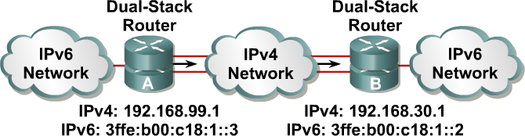
Konfigurácia statických tunelov
Konfigurácia statických tunelov vyžaduje:
  Dual-stack endpointy
  IPv4 a IPv6 adresy konfigurované na oboch koncoch tunela
Výhoda v jednoduchosti, vhodné pre malé siete
Nevýhoda v prácnosti pre komplikované topológie
Notes:
In a manually configured tunnel, you configure both the IPv4 and IPv6 addresses statically. Perform this configuration on the routers at each end of the tunnel.
These end routers must be dual-stacked, and the configuration cannot change dynamically as network and routing needs change. Routing must be set up properly to forward a packet between the two IPv6 networks.
Tunnel end points can be unnumbered, but unnumbered end points make troubleshooting difficult. The IPv4 practice of saving addresses for tunnel end points is no longer an issue.

Slide 55
6to4 tunely (RFC 3056)
6to4 tunely sú (na rozdiel od trvalých statických tunelov) tunely, ktoré môžu mať mnoho koncových bodov
IPv6 prefixy jednotlivých IPv6 ostrovov oddelených IPv4 internetom sú navrhnuté tak, aby v sebe obsahovali priamo IPv4 adresu tunelujúceho routera, ktorý je na okraji tohto ostrova
  IPv6 adresy pri použití 6to4 tunelov využívajú prefix 2002::/16
  Ďalších 32 bitov vyjadruje IPv4 adresu routera, ktorý je na vstupe/výstupe nášho IPv6 ostrova a ktorý realizuje tunelovanie
  Výsledný 48-bitový prefix je prefix spoločný pre celý IPv6 ostrov. Zostáva tak k dispozícii 16 bitov pre Subnet ID a 64 bitov pre Interface ID, rovnako ako v bežných Global Unicast adresách
  Tunel destination nie je treba
    Tunely sú vytvárané automaticky edge smerovačmi
Notes:
1. A tunnel is a logical interface that acts like a logical connection between two endpoints.
It is similar to a loopback interface in that more than one interface is involved.
2. The tunnel mode ipv6ip 6to4 command constructs an automatic tunnel which determines the tunnel’s destination.
3. A 6-4 tunnel uses special IPv6 addresses in the 2002::/16 address range
A 6-4 tunnel does not require a destination address because it is no a point-to-point link.
4. Tunnel source is the interface of the router usually the serial interface that traffic will originate from.
5.

Slide 56
6to4 tunely (RFC 3056)
Príklad:
  Router na vstupe do nášho IPv6 ostrovčeka má verejnú IPv4 adresu 192.0.2.36
  Hexadecimálny prepis tejto adresy je C0.00.02.24
  Všetky IPv6 zariadenia v našom ostrovčeku majú teda IPv6 prefix 2002:C000:0224 ::/48
  Routery na susedných IPv6 lokalitách musia mať akurát vhodne nastavené smerovanie, aby pre prístup do IPv6 sietí s prefixom 2002::/16 používali 6to4 tunel
  Tu je aj nevýhoda:
    Podporované sú statické cesty a BGP, lebo IGP používajú ako next hop link -ocal adresu
Notes:
The 1 at the end of the address is a more specific subnet
The 1 at the end is the host address
/64 is the subnet

Slide 57
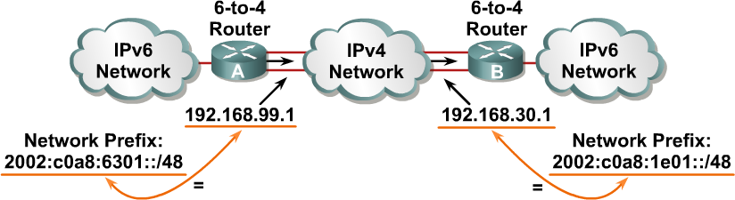
6to4 tunely (RFC 3056)
6to4:
  Na tuneloch nie je potrebné definovať endpoint (druhý koniec)
  Každý IPv6 ostrov má jednoznačný globálne platný prefix
Keď A príjme paket do siete 2002:c0a8:1e01::/48, určí že paket musí isť do tunela
  Smerovač extrahuje z IPv6 adresy IPv4 adresu konca tunela
  Zabalí IPv6 paket do IPv4 paketu , kde cieľová IP je IPv4 adresa B
  Pošle paket do tunela
Smerovač B vykoná deenkapsuláciu
Notes:
The 6-to-4 tunneling method automatically establishes the connection of IPv6 islands through an IPv4 network. The 6-to-4 tunneling method applies a valid IPv6 prefix to each IPv6 island, which enables the fast deployment of IPv6 in a corporate network without address retrieval from the Internet service providers (ISPs) or registries.
The 6-to-4 tunneling method requires a special code on the edge routers, but the IPv6 hosts and routers inside the 6-to-4 site do not require new features to support 6-to-4. Each 6-to-4 site receives a /48 prefix, which is the concatenation of 0x2002 and the hexadecimal IPv4 address of the edge router.
For example, if the IPv4 address of the edge router is 192.168.99.1, the prefix of its IPv6 network is 2002:c0a8:6301::/48, because c0a86301 is the hexadecimal representation of 192.168.99.1. The IPv6 network can substitute any IP address in the space after the first 16-bit section (0x2002).
When an IPv6 packet with a destination address in the range of 2002::/16 reaches the 6-to-4 edge router, the 6-to-4 edge router extracts the IPv4 address that is embedded in the 2002:: destination address (inserted between the third and sixth octets inclusively). The 6-to-4 router then encapsulates the IPv6 packet in an IPv4 packet with the destination IPv4 address that was extracted from inside the IPv6 destination address.
This IPv4 address represents the address of the other 6-to-4 edge router of the destination 6-to-4 site. The destination edge router de-encapsulates the IPv6 packet in the IPv4 packet and then forwards the native packet toward its final destination.

Slide 58
ISATAP tunely
ISATAP (Intra-Site Automatic Tunnel Addressing Protocol) tunely (RFC 5214) sú obdobou 6to4 tunelov
  Cieľom ISATP je pripojenie IPv6 hostov cez IPv4 sieť na najbližší IPv6 smerovač
  Primárne určené na zabezpečenie vnútrofiremnej (intra-site) komunikácie
  Takisto využívajú mapovanie medzi IPv4 a IPv6 adresou
  Tvar ISATAP IPv6 adries:
    Prvých 64 bitov: link-local alebo global unicast prefix
    Ďalších 32 bitov: 0000:5EFE (konštanta)
    Zvyšných 32 bitov: IPv4 adresa stanice
    Dĺžka prefixu: 64 bitov
  Novinka: Využitie pomocných mechanizmov (DHCP, DNS, manuálna konfigurácia) pre lokalizáciu smerovačov schopných zabezpečiť smerovanie medzi rôznymi IPv6 sieťami
ISATAP nepodporuje multicast
  Problém s RIPng a OSPFv3

Slide 59
Preklad s NAT-PT

Slide 60
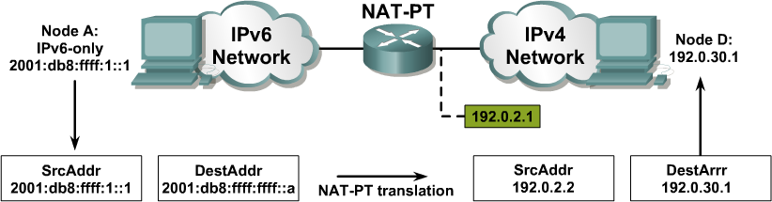
Preklad protokolov: NAT-PT
NAT-Protocol Translation (NAT-PT) je prekladový mechanizmus na rozhraní medzi IPv6 a IPv4 sieťou
Jeho úlohou je prekladať IPv6 pakety na IPv4 a naopak
Tento prístup je vhodný pre umožnenie spolupráce medzi uzlami,
z ktorých jeden je IPv4-only a druhý IPv6-only
  Nie je vhodný do prostredia prepojenia dvoch IPv6 sietí
Notes:
For legacy equipment that will not be upgraded to IPv6 and for some deployment scenarios, techniques that can connect IPv4-only nodes on IPv6-only nodes are available. Translation is basically an extension of NAT techniques.
The example on this page shows the translation of an IPv6 datagram sent from node A to node D. From the perspective of node A, it is establishing a communication to another IPv6 node. One advantage of NAT-PT is that no modifications are required on IPv6 node A; all it needs to know is the IPv6 address mapping to the IPv4 address of node D. This mapping can be obtained dynamically from the DNS server.
IPv4 node D can also send a datagram to node A by using the IPv4 address mapped to the IPv6 address of node A. Again, from the perspective of node D, it is establishing an IPv4 communication to its correspondent. Again, node D requires no modification.

Slide 61
Preklad protokolov: NAT-PT
Smerovač pomocou NAT-PT modifikuje zdrojovú i cieľovú adresu v oboch smeroch toku dát
  Z IPv4 siete do IPv6 siete
  Z IPv6 siete do IPv4 siete
Smerovač musí preto využívať dual stack a mať dve sady prekladov pre obojsmerný preklad
Komunikujúce stanice nemajú tušenie že druhá strana používa inú protokolovú sadu
Notes:
For legacy equipment that will not be upgraded to IPv6 and for some deployment scenarios, techniques that can connect IPv4-only nodes on IPv6-only nodes are available. Translation is basically an extension of NAT techniques.
The example on this page shows the translation of an IPv6 datagram sent from node A to node D. From the perspective of node A, it is establishing a communication to another IPv6 node. One advantage of NAT-PT is that no modifications are required on IPv6 node A; all it needs to know is the IPv6 address mapping to the IPv4 address of node D. This mapping can be obtained dynamically from the DNS server.
IPv4 node D can also send a datagram to node A by using the IPv4 address mapped to the IPv6 address of node A. Again, from the perspective of node D, it is establishing an IPv4 communication to its correspondent. Again, node D requires no modification.

Slide 62
NAT-PT
Pri NAT-PT využívame 96-bitový IPv6 sieťový prefix na reprezentáciu celého IPv4 sveta
  Tento prefix môže byť ľubovoľný dosiahnuteľný prefix v našej IPv6 sieti
  Akákoľvek IPv4 stanica je reprezentovaná z pohľadu IPv6 sveta ako adresa v tomto prefixe
  Tento prefix musí byť ohlasovaný zo smerovača, ktorý robí NAT-PT
    Prevádzka pre tento cieľ musí byť smerovaná na NAT-PT
Keď príde IPv6 paket na cieľovú adresu v priestore tohto prefixu, smerovač ho transformuje na IPv4 paket
  Zmení obe adresy – zdroj i cieľ
  Mapovanie medzi IPv4 a IPv6 adresami je možné konfigurovať staticky alebo dynamicky

Slide 63
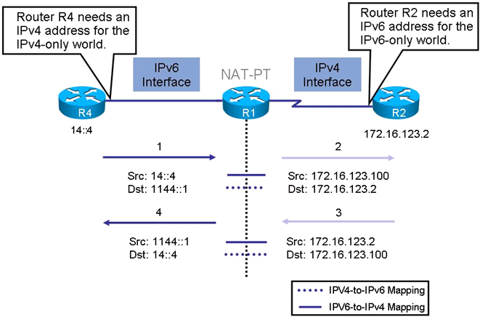
Príklad činnosti NAT-PT

Slide 64
Porovnanie IPv4 a IPv6 (1)
IPv4 | IPv6
Zdrojová a cieľová adresa majú veľkosť 32 bitov | Zdrojová a cieľová adresa majú veľkosť 128 bitov
Podpora IPsec je voliteľná | Podpora IPsec je vyžadovaná štandardom
Žiadna identifikácia tokov paketov používaná smerovačmi na zabepečenie QoS nie je v hlavičke IPv4 prítomná | Identifikácia tokov paketov používaná smerovačmi na zabepečenie QoS je v hlavičke IPv6 prítomná v poli Flow Label
Fragmentácia je zabezpečovaná smerovačmi aj vysielajúcimi stanicami | Fragmentácia je zabezpečovaná výhradne vysielajúcimi stanicami. Smerovače fragmentáciu nezabezpečujú
Hlavička obsahuje kontrolnú sumu na kontrolu integrity paketu | Hlavička kontrolnú sumu na kontrolu integrity paketu neobsahuje
Hlavička obsahuje voliteľné polia (options) | Všetky voliteľné polia sú presunuté do IPv6 rozširujúcich hlavičiek, ktoré nie sú súčasťou základnej hlavičky
Na rozpoznanie adresy linkovej vrstvy (MAC adresy) mapovanej na IPv4 adresu sa používa ARP (Address Resolution Protocol) ako broadcast | ARP funkcie na seba preberá ICMPv6 a využíva multicast

Slide 65
Porovnanie IPv4 a IPv6 (2)
IPv4 | IPv6
Na správu členstva skupín lokálnych sietí sa používa protokol IGMP (Internet Group Management Protocol) | Protokol IGMP je nahradený správami Multicast Listener Discovery (MLD)
Na určenie najlepšej predvolenej brány (default gateway) sa používa obvykle DHCP | Využívajú sa ICMPv6 Router Solicitation a Router Advertisement správy. Implementácia týchto správ je povinne vyžadovaná špecifikáciou
Na adresovanie všetkých uzlov na určitej sieti sa používajú broadcast adresy | V IPv6 neexistujú broadcast adresy. Namiesto toho existuje tzv. link-local scope all-nodes multicast adresa, ktorou môžu byť adresované všetky uzly jednej podsiete naraz
Konfigurácia prebieha manuálne alebo použitím DHCP | Nepotrebuje ani manuálnu konfiguráciu, ani DHCP. Protokol obsahuje autokonfiguráciu
Musí podporovať minimálne 576 bajtový paket (s možnosťou fragmentácie). | Musí podporovať minimálne 1280 bajtový paket (bez fragmentácie).

Slide 66
Benefity z nasadenia IPv6
Dostatočný adresný priestor
Jednoduchšia nasadenie adresovania
End-to-End konektivita bez NAT zariadení
Zvýšená bezpečnosť
  IPSec je súčasť IPv6
Zlepšená mobilita
  Mobile IP
Zlepšená podpora QoS
  Vstavané QoS návestia

