Slide 1
INTERNET OF THINGS / MACHINE TO MACHINE:
Design & Implementation of an OneM2M Testing Framework
Radoslav Vlaskovski, 01. August 2016

Slide 2
Presentation Overview
Introducing the Problem
Test types
Running the tests
Saving the results
Extending the software

Slide 3

WHAT IS ONEM2M
Purpose and goal of oneM2M : technical specifications for a common M2M Service Layer
Involve M2M-related organizations such as:
intelligent transportation, healthcare, utilities,
industrial automation, smart homes etc.

Slide 4
Test types
Functional Tests
Behaviour Tests
Syntax Tests
©Matthias Heyde / Fraunhofer FOKUS
© Matthias Heyde / Fraunhofer FOKUS

Slide 5

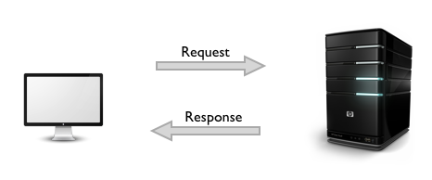
Functional tests
Check status code
Check response parameters
©Matthias Heyde / Fraunhofer FOKUS
© Matthias Heyde / Fraunhofer FOKUS

Slide 6
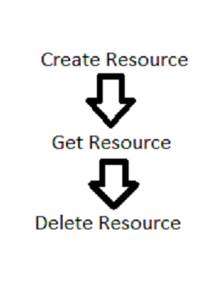
Behaviour tests
Built-in tests – common use cases
Custom tests
Easier ot run multiple functional tests at once
Get one result
©Matthias Heyde / Fraunhofer FOKUS
© Matthias Heyde / Fraunhofer FOKUS

Slide 7
Syntax tests
HTTP Response – check if parameters in the OneM2M standard
Pure OneM2M Primitives
©Matthias Heyde / Fraunhofer FOKUS
© Matthias Heyde / Fraunhofer FOKUS

Slide 8
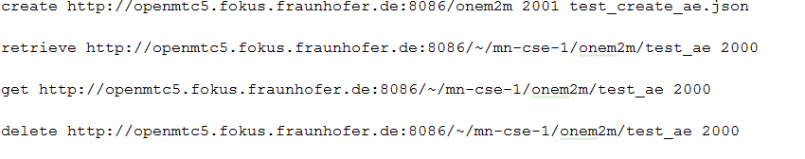
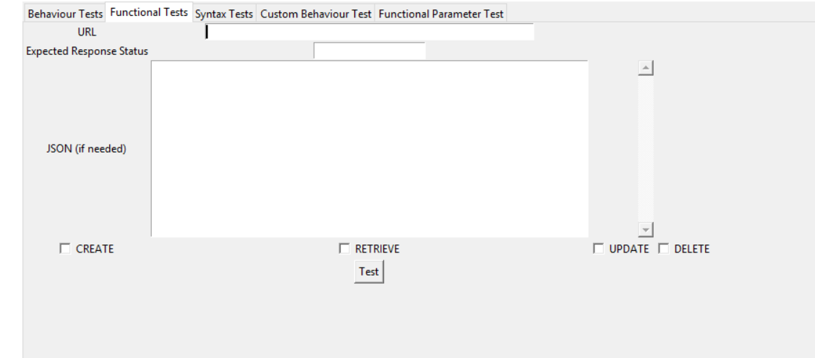
Running the tests
GUI
Console
Test files
©Matthias Heyde / Fraunhofer FOKUS
© Matthias Heyde / Fraunhofer FOKUS

Slide 9
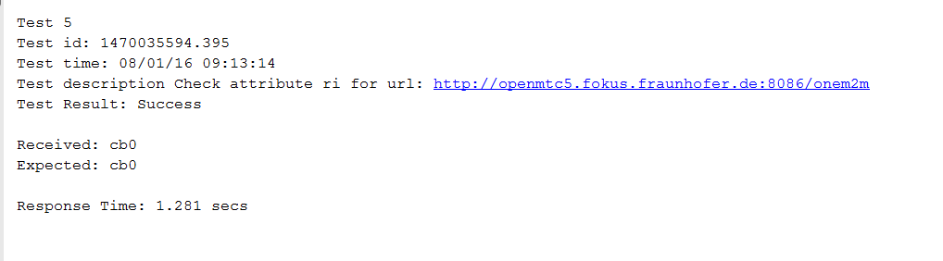
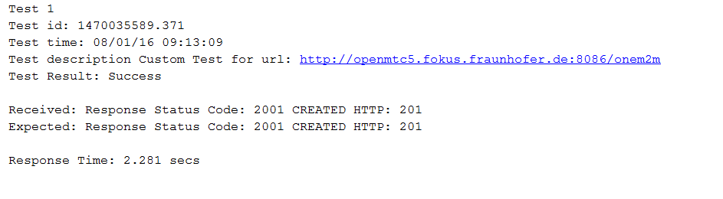
Logging the tests
Logging each test type – special format for each test type
Display result and save in a file
©Matthias Heyde / Fraunhofer FOKUS
© Matthias Heyde / Fraunhofer FOKUS

Slide 10
Adjusting if standard changes
New status codes
New Resource types
New forms of the Primitives
©Matthias Heyde / Fraunhofer FOKUS
© Matthias Heyde / Fraunhofer FOKUS

Slide 11
More Information and Contact
User Documentation – user guide
Implementation Documentation – how the software is structured and where to find what when further developing the project
Email : radoslav.vlaskovsky@gmail.com
Repo : https://github.com/radoslavvlaskovski/onem2mtestingframework
©Matthias Heyde / Fraunhofer FOKUS
© Matthias Heyde / Fraunhofer FOKUS

Slide 12
THANK YOU FOR YOUR ATTENTION !
QUESTIONS ?

