Slide 1
DATA MINING IN BIOINFORMATICS

Slide 2
THE NEED FOR DATA MINING IN BIOINFORMATICS
High-throughput technologies:
Genome and RNA sequencing
Compound screening
Genotyping chips
Bioimaging

Slide 3
DATA MINING
Data mining refers to extracting or “mining” knowledge from large amounts of data. Data Mining (DM) is the science of finding new interesting patterns and relationship in huge amount of data. It is defined as “the process of discovering meaningful new correlations, patterns, and trends by digging into large amounts of data stored in warehouses”. Data mining is also sometimes called Knowledge Discovery in Databases (KDD).

Slide 4
THE NEED FOR DATA MINING IN BIOINFORMATICS
Large collections of molecular data
Gene and protein sequences
Genome sequence
Protein structures
Chemical compounds
Problems in Bioinformatics
Predict the function of a gene given its sequence
Predict the structure of a protein given its sequence
Predict the boundaries of a gene given a genome segment
Predict the function of a chemical compound given its molecular structure
Comparative genomics

Slide 5
THE NEED FOR DATA MINING IN BIOINFORMATICS
Additional challenges
Highly complex
Noisy
Inconsistent
Redundant

Slide 6
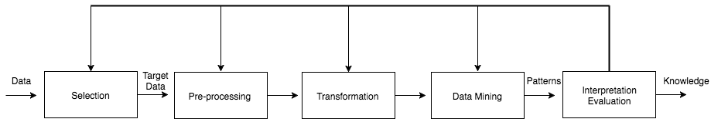
DATA MINING
Data mining and the KDD (Knowledge Discovery in Databases) process:

Slide 7
CRISP-DM (Cross Industry Standard Process for Data Mining)
Defines one standard framework for the process of data mining across multiple industries containing phases, generic tasks, specialised tasks, and process instances (Chalaris et al., 2014) (see figure 2). Jain (2012) discusses that the main tasks for data mining are:
Classification: Classifies a data item to a predefined class
Estimation: Determining a value for unknown continuous variables
Prediction: Records classified according to estimated future behavior
Association: Defining items that are together
Clustering: Defining a population into subgroups or clusters
Description & Visualisation: Representing data
Definition of Data Mining defines the extraction of knowledge. Where we define machine learning within data mining is the automatic data mining methods used, Kononenko and Kukar (2013) state that

Slide 8
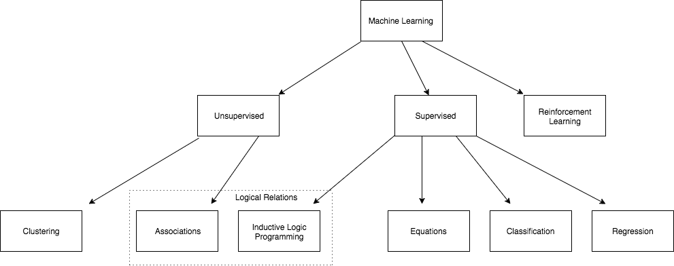
MACHINE LEARNING IN DATA MINING
“Machine Learning cannot be seen as a true subset of data mining, as it also compasses the other fields, not utilized for data mining”

Slide 9
DATA MINING
Selection:
data selection (to extract subsets of data that are concerned by the
analysis)
Pre-processing:
data cleaning (to remove noise)
data integration (combine multiple data source)
Transformation:
data transformation (to transform data into convenient formats that are required from data mining algorithms).
Data mining:
applying computational methods to extract knowledge from data.
Post-processing:
evaluation
validation
interpretation of the discovered knowledge

Slide 10
DATA MINING
What do we concretely do?
Clustering
grouping of similar objects into sets (K-means, mean-
shift, DBSCAN, Spectral Clustering, …)
Classification
Identifying to which category an object belongs to
(SVM, KNN, Decision Trees, Neural Networks, …)
Pattern mining
Finding existing (hidden) patterns in data (associations,
correlations, subsequences, subgraphs, ….)

Slide 11
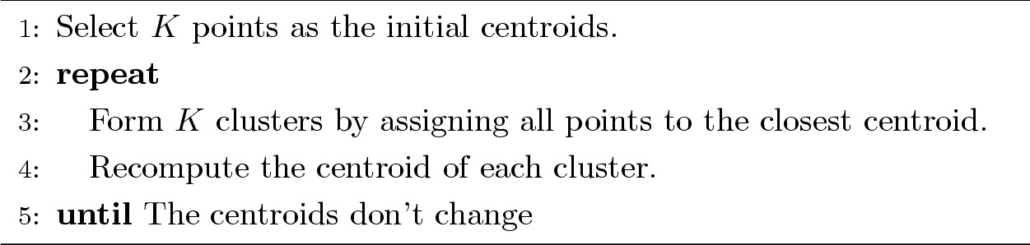
DATA MINING
Clustering: K-means
Partitional clustering approach
Each cluster is associated with a centroid (center point)
Each point is assigned to the cluster with the closest centroid
Number of clusters, K, must be specified
The basic algorithm is very simple

Slide 12





Classification: K-Nearest Neighbors
X
X
X
(a) 1-nearest neighbor (b) 2-nearest neighbor (c) 3-nearest neighbor
Compute distance between two points:
K-nearest neighbors of a record x are data points that have the k smallest distance to x
Takes the majority vote of class labels among the k-nearest
neighbors

Slide 13





















































Pattern Mining: Frequent Subgraph Mining
Finding subgraphs that occur in graph data, giving a minimum support
Example:
S
T
T
S
S
A
K
T
G
G
K
K
V
S
G
M
S
S
F
T
F M
Graph database
F
M
S
T
T
T
S
T
T
S
K
S
S
S K
K
K
K
K
S
S
S
S
S
S
F
F
Frequent Subgraphs
(minimum support = 3)
F
F

Slide 14
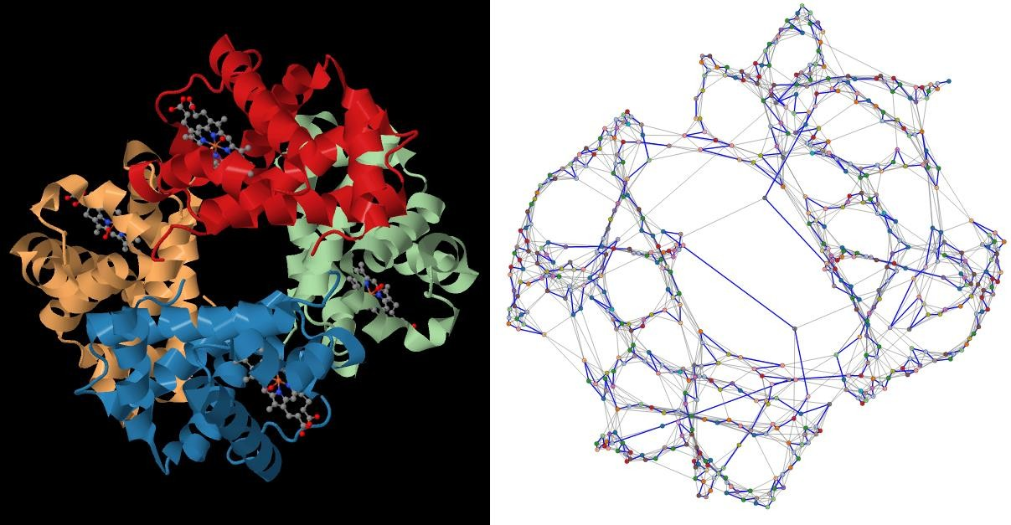



A real world example:
The Human Hemoglobin protein 3D-structure (PDB-id: 1GZX) and its
corresponding graph (Main Atom, C-alpha).
Protein 3D structure
Protein graph

Slide 15
Sources
https://arxiv.org/ftp/arxiv/papers/1205/1205.1125.pdf
https://littlefield.co/an-introduction-into-data-mining-in-bioinformatics-964511e9ea21
https://doc.lagout.org/Others/Data%20Mining/Data%20Mining%20for%20Bioinformatics%20%5BDua%20%26%20Chowriappa%202012-11-06%5D.pdf
https://www.sciencedirect.com/book/9780081001004/data-mining-for-bioinformatics-applications

