Slide 1
Secure Collaborative Editing
Itay Radozki, Roey Shamir, Eyal Shoham

Slide 2
Motivation
Why not just use google docs?
Not encrypted end to end
The server know everything
Tooki- Edit documents online with friends from anywhere
Web based solution
End to End encrypted by signal protocol (whatapp, google, facebook)
Forward secrecy
All parties know who the session participants are

Slide 3
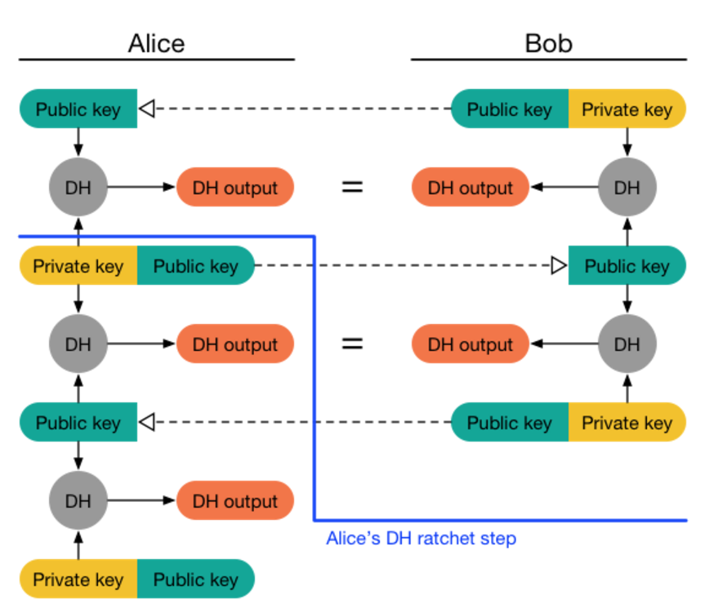
Signal protocol overview
Encryption and authentication of messages
Implement Each user have Identity key, a lot of one-time prekeys + signed prekey=> Unique session key for the ratchet key pair
Axolotl (DH+Symmetric-key) ratchet for
Backward secrecy (symmetric-key ratchet)
forward secrecy - can’t passively decrypt future messages (DH ratchet)

Slide 4
Operational transformation Algorithm
Needs to merge between messages sent by two or more clients at once
Usually done by the server (timestamp)
Tie break for the same version is done by comparing the messages hash
Increments the version after each operation

Slide 5
Implementation
Enc(Kp(A),M1`)
Alice
snapshot
Journal
Server
Queue
transform
Alice
Alice
operations
Enc(K(A), M1)
Bob
snapshot
Bob
Bob
transform
Enc(Kp(B), M1)
operations
Enc(K(C), M1)
Charlie
Key Directory
Charlie
Charlie
snapshot
transform
operations
Enc(Kp(C),M1`)

Slide 6
Implementation - Client
Editing the document
Sends a message to the server with the client’s operation - Insert / Delete, Version, Unique hash
Messages are encrypted with signal protocol
Login –PBKDF2
Decrypt private key using the second half of the PBKDF2
Fetch the queue and journal.
New Member:
Must be invited by someone from the group
They exchange keys
Transformation algorithm

Slide 7
Implementation – The Server know nothing
Queue for each client - holds the operations from other clients
Encrypted by signal protocol
Journal – contain the client operations that was read, signed out and signed back in again
encrypted with his secret half of PBKDF2 (AES-GCM)
Key directory
The client private key encrypted his secret half of PBKDF2
Public keys of all clients
What the server do know:
Who are the connected users
Timing and amount of messages that every user sends
Size of the messages
Malicious server – can only erase messages

Slide 8
Demo

Slide 9
Questions?

