Slide 1

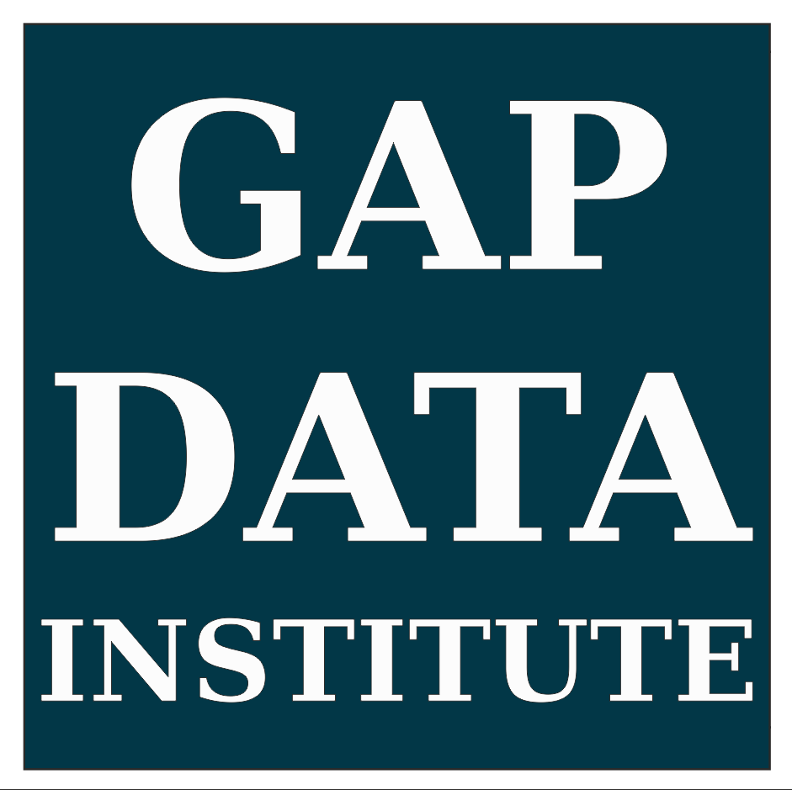
Data Science & Data Visualization in Python.
How to harness power of Python for social good?
(PyData Berlin 2017, HTW Berlin; #PyData)
1. 7. 2017
Radovan Kavický, GapData Institute
Notes:
(30s.)
3 parts:
Introduction (non-Python part) & Why to do it?/Motivation (7-10 min.)
Main (Python part) & How to do it? (17-20 min.)
Conclusion (the end of talk +vision), Potential & Results (7-10 min.)

Slide 2
Talk Structure
  1. Introduction (non-Python part) & Why to do it?/Motivation (7-10 min.)
  - Why Data Science and why more people should be really interested?
  - Open Data, Open Government Partnership, Open Public Administration & all the advantages of Open Data Science & Python.
  2. Main (Python part) & How to do it? (17-20 min.)
  - Python & Data Science (Data Science Workflow, IDE-s)
  - Data Science & Visualization Tools (best libraries will be shown for the specific purpose; focus particularly on Bokeh, Seaborn, Plotly and Jupyter Notebook)
  - How to "unlock" the insights hidden in data and how to use it to transform not only public administration or business, whole society and economy towards the insight & knowledge based?
  3. Conclusion (the end of talk +vision), Potential & Results (7-10 min.)
  - Data-Driven Approach. Everywhere. Now.
Data Science & Data Visualization in Python.
How to harness power of Python for social good?
1/14
Notes:
(1-2 min.)
Introduction (non-Python part)
Why Data Science and why more people should be really interested?
Open Data, Open Government Partnership, Open Public Administration & all the advantages of Open Data Science & Python.
2. Center (Python part)
Python & Data Science (Data Science Workflow, IDE-s)
Data Science & Visualization Tools (best libraries will be shown for the specific purpose; focus particularly on Bokeh, Seaborn, Plotly and Jupyter Notebook)
3. Conclusion
How to "unlock" the insights hidden in data and how to use it to transform not only public administration or business, whole society and economy towards the insight & knowledge based?
Data-Driven Approach. Everywhere. Now. (the end of talk +vision)

Slide 3

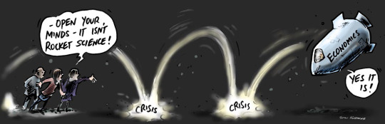
About me
  Economist (Macro, Finance, Statistics)
  R, Python, Tableau > Matlab, SAS, Stata
  Data Science & Open Data & Public Policy
  PyData Bratislava, R <- Slovakia, skczTUG (Tableau User Group)
Data Science & Data Visualization in Python.
How to harness power of Python for social good?
2/14
Notes:
(1-2 min.)
Basic information about GapData Institute
Economic Research & Public Policy & Data Science think-tank (data-tank)
Data. Think. Change.
GapData Institute (GDI) is a non-profit nonpartisan research institution harnessing power of data & wisdom of economics for public good.
Transparent account (from day #1; SK7383300000002200933920 https://www.fio.sk/ib2/transparent?a=2200933920)
Partnership (openness, transparency)

Slide 4

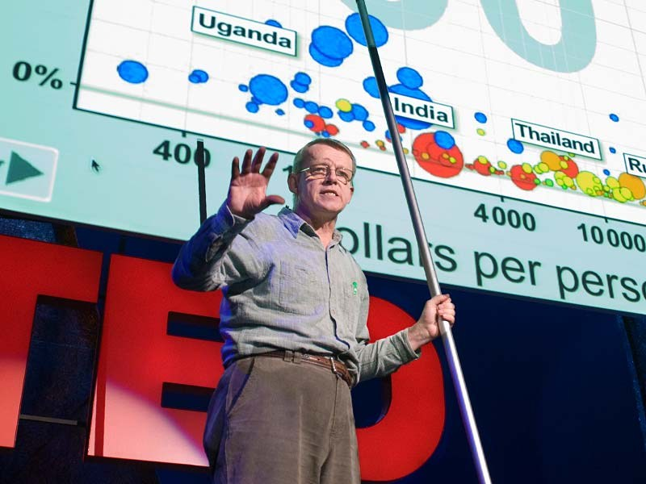
Picture the media shows us & the reality
  Post-Factual World & Fake News
  Post-Truth Politics & Public Policy done via Twitter (21st century!)
  Some Funny Guy with little hands tweeting “covfefe” at 1:00am
  vs.
Data Science & Data Visualization in Python.
How to harness power of Python for social good?
3/14
Notes:
(1-2 min.)

Slide 5
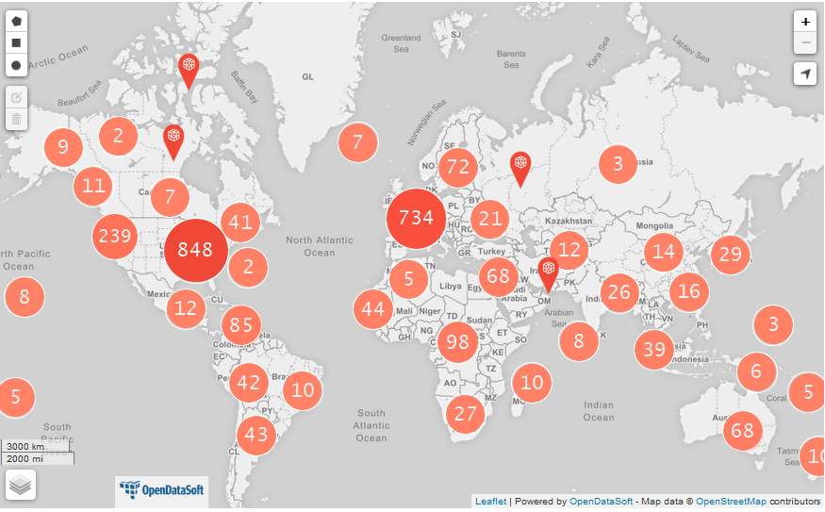
How many “Open Data” are there?
Source: https://www.opendatasoft.com/a-comprehensive-list-of-all-open-data-portals-around-the-world/
Data Science & Data Visualization in Python.
How to harness power of Python for social good?
4/14
Notes:
(1-2 min.)
The rate of urban migration around the world is rising at an alarming rate. Experts estimate that 70 percent of the world’s population (more than six billion people!) will reside in urban areas by 2050. In response, government officials are investing in data sharing technologies to discover ways to provide public services more efficiently.
This form of city planning has invariably been described as “smart”, “intelligent”, “responsive”, “resilient”, and, more recent, “senseable”. But how do these initiatives use open data to address the concerns of residents? In answering this question we discovered projects whose originality left us speechless and dedication to social justice inspired.
We’ve assembled the list below both to recognize these accomplishments and promote more work with open data!

Slide 6
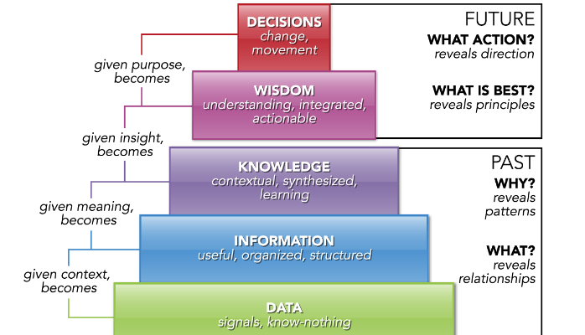
Data, Information, Knowledge, Wisdom, Decision Pyramid
Source: https://www.linkedin.com/pulse/handy-concept-better-dikwd-pyramid-peter-j-korsten
Data Science & Data Visualization in Python.
How to harness power of Python for social good?
5/14
Notes:
(1-2min.)

Slide 7
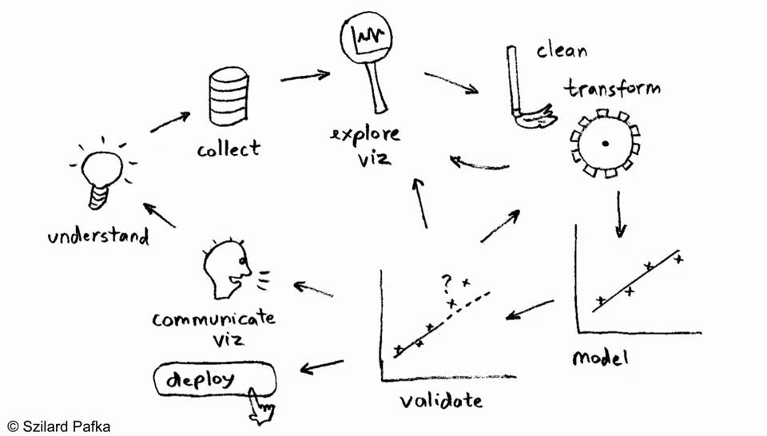
How to do it? (Data Science Process/Workflow)
Source: https://blog.dominodatalab.com/video-huge-debate-r-vs-python-data-science/
Data Science & Data Visualization in Python.
How to harness power of Python for social good?
6/14
Notes:
(1-2min.)

Slide 8





IDE-s for Python, R & Tableau as Data Science Platform (Data Science Toolbox)
  Anaconda/Spyder
  Rodeo (IDE for Python & R)
  Jupyter Notebook
  PyCharm (IDE for Python)
  R-Studio (IDE for R +rpy2)
  Wing + VIM/NeoVim (IDE for Python)
  Tableau Public (Python & R code implementation +TabPy)
Data Science & Data Visualization in Python.
How to harness power of Python for social good?
7/14
Notes:
(1-2min.)
Anaconda/Spyder
Rodeo (IDE for Python & R)
Jupyter Notebook
PyCharm (IDE for Python)
R-Studio (IDE for R +rpy2)
Wing + VIM/NeoVim (IDE for Python)
Tableau Public (Python & R code implementation +TabPy)

Slide 9




Python (best tools @ Data Science)
  Data Collection – Feather (binary file format/non-csv/Apache Arrow/Wes McKinney), Ibis (remote/Hadoop +SQL & bridge it with pandas), ParaText (parallel reading of csv/C++)
  Data Visualization – Seaborn (matplotlib based/static), Bokeh (interactive/d3.js like), Plotly (declarative dataviz), Altair (static/js), Geoplotlib (maps)
  Data Cleaning & Transform - datacleaner (automate cleanining your data in Pandas), Blaze (NumPy/pandas-like), xarray (pandas-like), Dask (parallel computing)
  Data Modeling – StatsModels +Patsy (describe statistical models), PyStan (Bayes/C++), PyMC3 (Bayes/statistical modeling), Keras (TensorFlow/DL)
Data Science & Data Visualization in Python.
How to harness power of Python for social good?
8/14
Notes:
(1-2min.)
Data Collection – Feather (binary file format/non-csv/Apache Arrow/Wes McKinney), Ibis (remote/Hadoop +SQL & bridge it with pandas), ParaText (parallel reading of csv/C++)
Data Visualization – Seaborn (matplotlib based/static), Bokeh (interactive/d3.js like), Plotly (declarative dataviz), Altair (static/js), Geoplotlib (maps)
Data Cleaning & Transform - datacleaner (automate cleanining your data in Pandas), Blaze (NumPy/pandas-like), xarray (pandas-like), Dask (parallel computing)
Data Modeling – StatsModels +Patsy (describe statistical models), PyStan (Bayes/C++), PyMC3 (Bayes/statistical modeling), Keras (TensorFlow/DL)

Slide 10
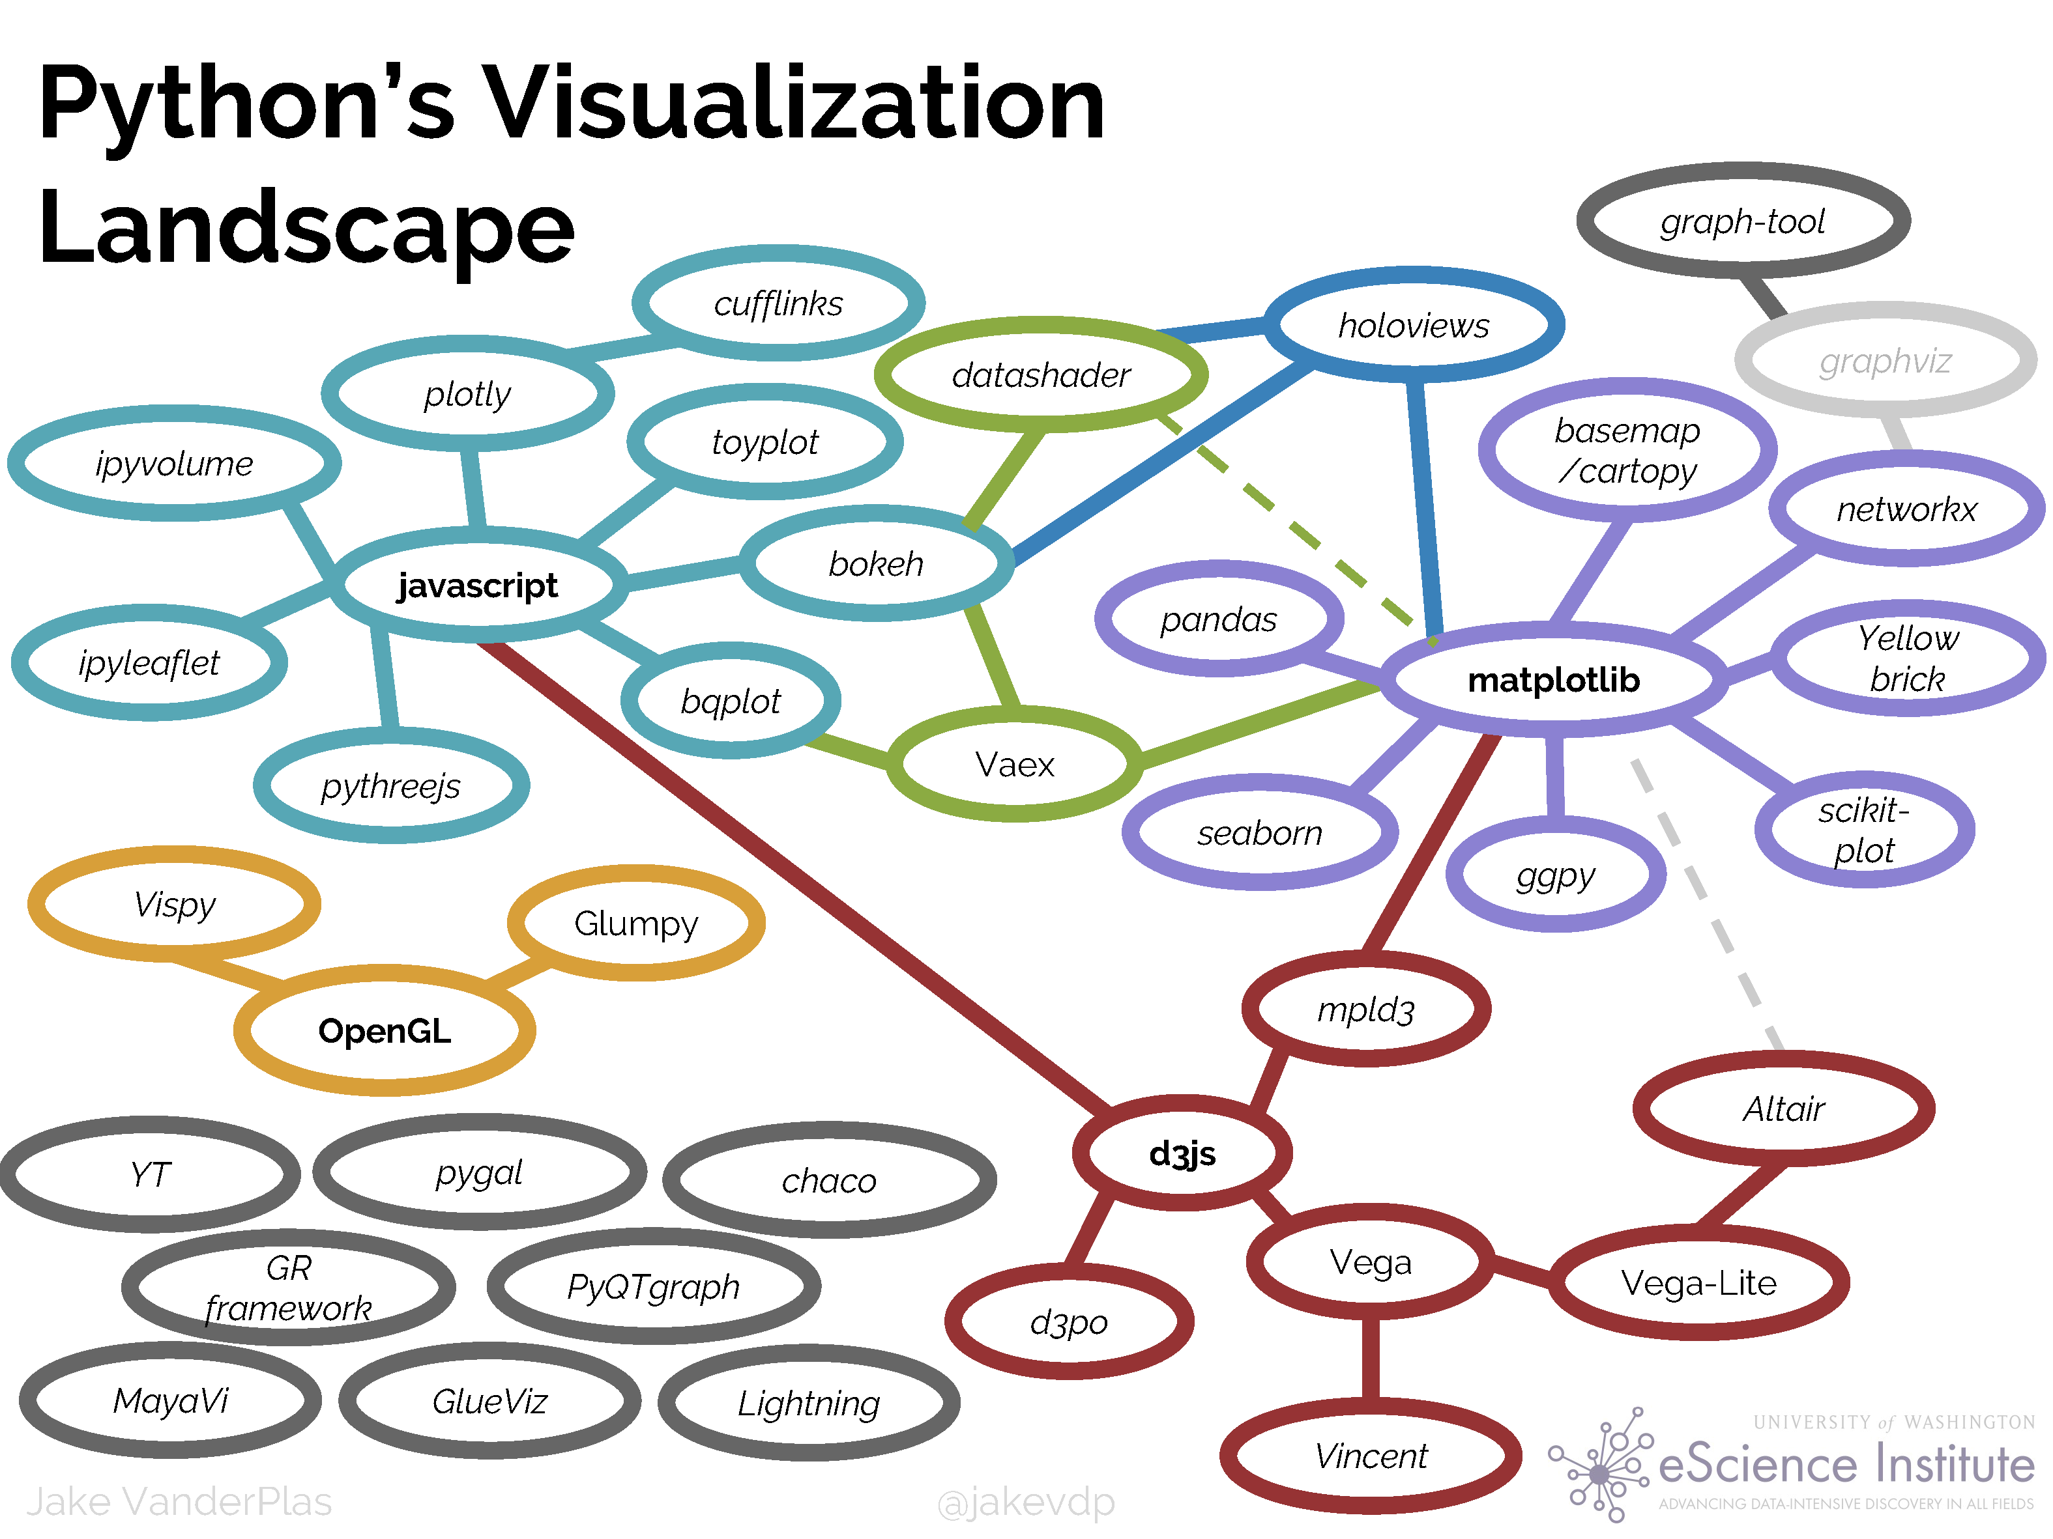
How to visualize your data in Python?
Source: https://speakerdeck.com/jakevdp/pythons-visualization-landscape-pycon-2017
Data Science & Data Visualization in Python.
How to harness power of Python for social good?
9/14
Notes:
(1-2min.)

Slide 11


Jupyter Notebook +Seaborn
  IPython/Project Jupyter (Julia, Python + R)
  Jupyter notebook (.ipynb rendering via web browser) +nbviewer
  Jupyter as Data Science Front-End f.e. in Bloomberg, Microsoft, IBM Watson, and Netflix
  Very powerful tool for collaborative data science and making analysis actionable.
  JupyterHub (Jupyter notebook server/multi-user data science teams)
  Seaborn (dataviz/matplotlib based/static)
Data Science & Data Visualization in Python.
How to harness power of Python for social good?
10/14
Notes:
(1-2min.)
IPython/Project Jupyter (Julia, Python + R)
Jupyter notebook (.ipynb rendering via web browser) +nbviewer
Jupyter as Data Science Front-End f.e. in Bloomberg, Microsoft, IBM Watson, and Netflix
Very powerful tool for collaborative data science and making analysis actionable.
JupyterHub (Jupyter notebook server/multi-user data science teams)
Seaborn (dataviz/matplotlib based/static)

Slide 12

Bokeh +D3.js
  Interactive visualization (JavaScript-like) library and platform Python
  Gallery: http://bokeh.pydata.org/en/latest/docs/gallery.html
  Bindings with R (rBokeh) +Scala (bokeh-scala)
  D3 (DataViz, JavaScript)
  Goal is to provide elegant, concise construction of novel graphics in the style of Protovis/D3, while delivering high-performance interactivity over large data to thin clients
  standalone HTML documents, or server-backed apps
  No Java-Script; HoloViews & GeoViews (annotate data +visualize/render with Bokeh)
Data Science & Data Visualization in Python.
How to harness power of Python for social good?
11/14
Notes:
(1-2min.)
Interactive visualization (JavaScript-like) library and platform Python
Gallery: http://bokeh.pydata.org/en/latest/docs/gallery.html
Bindings with R (rBokeh) +Scala (bokeh-scala)
D3 (DataViz, JavaScript)
Goal is to provide elegant, concise construction of novel graphics in the style of Protovis/D3, while delivering high-performance interactivity over large data to thin clients
standalone HTML documents, or server-backed apps
No Java-Script; HoloViews & GeoViews (annotate data +visualize/render with Bokeh)

Slide 13
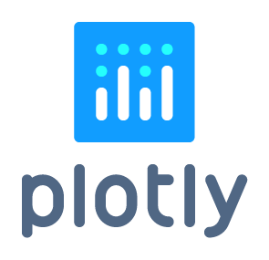

Plotly +Dash (R’s Shiny for Python)
  Plotly (descriptive data visualization .json converter)
  DataViz @ Matlab, R, Python, Julia, Perl, Arduino, REST
  Python +Django framework; only front end is JS
  Not just plots/data visualizations, but also presentations and dashboards/web-apps
  Dash (Interactive, reactive web apps in pure Python/js-free), analytical web application
Data Science & Data Visualization in Python.
How to harness power of Python for social good?
12/14
Notes:
(2 min.)
Plotly (descriptive data visualization .json converter)
DataViz @ Matlab, R, Python, Julia, Perl, Arduino, REST
Python +Django framework; only front end is JS
Not just plots/data visualizations, but also presentations and dashboards/web-apps
Dash (Interactive, reactive web apps in pure Python/js-free), analytical web application

Slide 14
Potential of Data Science
  Citizen Data Scientists
  Open Data (only the 1st necessary step)
  Smart Cities
  Economic Reforms (any area)
  Data-Driven Public Policy Making
  Data Visualization (Interactive DataViz Tools)
  Data-Driven mobility/self-driving vehicles
  Data Science in the center of Digital transformation
  Age of Data with Data as the new currency
  Nearly any current problem can & will be solved by data
Data Science & Data Visualization in Python.
How to harness power of Python for social good?
13/14
Notes:
(1-2min.)

Slide 15
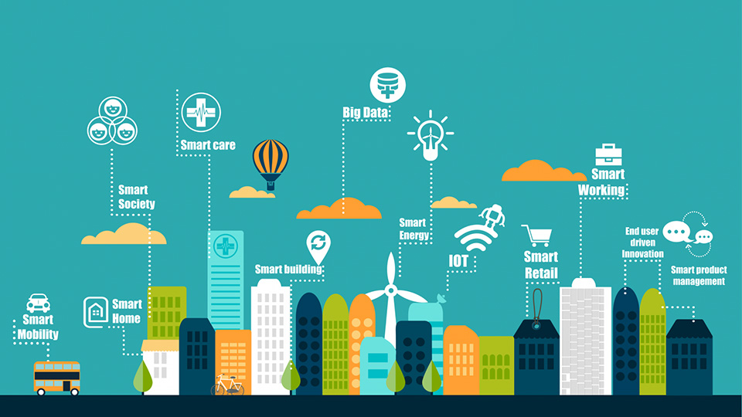
Why smart cities… why not? It’s necessary.
Data Science & Data Visualization in Python.
How to harness power of Python for social good?
14/14
Notes:
(1-2min.)
Data Science (Urban) + Data Visualization
OSMnx
- https://github.com/gboeing/osmnx
CARTO.com (maps + predictions)
QGIS.org (Open Source GIS)
Tableau Desktop 10.2 (interactive DataViz)
OpenStreetMap.org
Openlayers.org
Leaflet (JS, R + maps +ggmap)
Mapbox (3D maps/C++, OpenGL)
Google fusion tables
OSMnx Python for street networks
Retrieve, construct, analyze, and visualize street networks from OpenStreetMap: full overview.
OSMnx is a Python 2+3 package that lets you download spatial geometries and construct, project, visualize, and analyze street networks from OpenStreetMap's APIs. Users can download and construct walkable, drivable, or bikable urban networks with a single line of Python code, and then easily analyze and visualize them:
So how will 'smart' cities help us deal with tackling climate change and growth at the same time? There are 5 key areas emerging for 'smart' services that enable a sustainable, low carbon city.
1. Monitoring and managing the "footprint" of the city for decision-makers
2. Connected mobility solutions to enable modal shift, and electric vehicles
3. Distributed and community energy solutions
4. Smarter buildings that are transparent about energy consumption, use and generation
5. Smart energy, water and waste management
Behind these key areas are technology solutions like 'smart meters' and the 'smart grid', which have been widely covered in the news.
But how much more efficient could we really make our lifestyles, today? Could we turn down the office heating without sacrificing comfort? Could we work flexibly, modify our travel patterns, and still achieve the business and mobility services we have come to rely on?

Slide 16
Future is awesome.
All we have to do now is to build it.
Data Science & Data Visualization in Python.
How to harness power of Python for social good?
#PyData
Notes:
(1-2 min.)
PyData Bratislava, R <- Slovakia, skczTUG
Open Data (only the 1st necessary step)
Python, R, Tableau community activities
Economic Research (studies, papers, publications)
Quantitative & Qualitative Analyses (Data/center of it all)
Data Visualization (Interactive DataViz Tools)
Public Policy (Public Budget, Public Finance)
Economic Reforms (any area)
PyCon SK 2017 (10th-12th of March 2017, FIIT UK)

Slide 17


GapData Institute (GDI)
  Economic Research & Public Policy & Data Science think-tank (data-tank)
  Data. Think. Change.
  GapData Institute (GDI) is a non-profit nonpartisan research institution harnessing power of data & wisdom of economics for public good.
  Transparent account (from day #1; SK7383300000002200933920 https://www.fio.sk/ib2/transparent?a=2200933920)
  Partnership (openness, transparency)
  Slides (this talk): tiny.cc/pydata2017berlin
  https://github.com/radovankavicky/PyDataBerlin2017
Data Science & Data Visualization in Python.
How to harness power of Python for social good?
#PyData
Notes:
(1-2 min.)
Basic information about GapData Institute
Economic Research & Public Policy & Data Science think-tank (data-tank)
Data. Think. Change.
GapData Institute (GDI) is a non-profit nonpartisan research institution harnessing power of data & wisdom of economics for public good.
Transparent account (from day #1; SK7383300000002200933920 https://www.fio.sk/ib2/transparent?a=2200933920)
Partnership (openness, transparency)

Slide 18






Thank you for your attention
  Contact:
  Radovan Kavicky
  radovan.kavicky@gapdata.org
  radovan.kavicky@gmail.com
  +420 777 595 262 (CZ)
  +421 949 716 214 (SK)
  http://www.linkedin.com/in/radovankavicky
  https://gapdata.slack.com/messages/py-data/
  https://github.com/radovankavicky
  https://github.com/GapData/PyDataBratislava
  @radovankavicky, @PyDataBA, @GapDataInst
In case you have any question, feel free to ask.
#PyData
Notes:
Contact:
Radovan Kavicky
radovan.kavicky@gapdata.org
+420 776 467 159 (CZ)
+421 949 716 214 (SK)
http://www.linkedin.com/in/radovankavicky
https://gapdata.slack.com/messages/py-data/
https://github.com/radovankavicky
https://github.com/GapData/PyDataBratislava
@radovankavicky, @PyDataBA, @GapDataInst

