Slide 1



Explainable AI (xAI) & Future of Artificial Intelligence/ML (HLAI & AGI)
1st/old version presented @ CODECON 2023 #CODECON, #CODECON2023
(#AIslovakIA, #AIRadioMeetup, Bratislava, Slovakia) #AIslovakIA @ sli.do
21. 2. 2024
Radovan Kavický, AIslovakIA & GapData Institute
Notes:
(30s.)
3 parts:
Introduction (non-Python part) & Why to do it?/Motivation (7-10 min.)
Main (Python part) & How to do it? (17-20 min.)
Conclusion (the end of talk +vision), Potential & Results (7-10 min.)

Slide 2


Join at slido.com
#AIslovakIA
ⓘ Start presenting to display the joining instructions on this slide.
Explainable Machine Learning/AI (xAI) & Future of Artificial Intelligence
#AIslovakIA @ sli.do
Notes:
📣 This is Slido interaction slide, please don't delete it.
✅ Click on 'Present with Slido' and the joining instructions will appear when you get to this slide.

Slide 3
Structure of the talk
- 1. Current development and what’s next/what to do now? [15 min.]
Sora, Gemini 1.5, Copilot/ChatGPT & GitHub Copilot
- 2. Future of AI (path towards HLAI/AGI, when? why?) [20 min.]
Strong/Wide AI vs. Weak/Narrow AI, Machine Learning vs. Machine Reasoning
- 3. Ethics & Transparency in AI/Trustworthy AI/Responsible AI/Applied AI/Growth potential [10 min.]
Brain/Neuroscience Research and theory of consciousness
- 4. Explainable AI/xAI, Shapley values, Mathematics of AI [20 min.]
- 5. Conclusion & position of Slovakia/Europe [10 min. + Q&A/15-20 min]
—--------------------------------------------------------------------------------------------------------------------------------------------------------------------------------------------------------------------------------------------------------------------------------------------------------------------------------------------------------------------------------------------------------------------------------------------------------------------------------------------------------------------------------------------------------------------------------------------------------------------------------------------------------------
- Data Science (definition): collection of scientific results and methods for transformation of data from raw form to meaningful information, knowledge and wisdom, which should support better decisions
- AI (definition) - theory and development of computer systems able to perform tasks normally requiring human intelligence, such as visual perception, speech recognition, decision-making, translation and others
Explainable Machine Learning/AI (xAI) & Future of Artificial Intelligence
1/24 #AIslovakIA @ sli.do
Notes:
(1-2 min.)

Slide 4

Which programming language do you prefer for AI? (Python, C, Scala, R, Julia, MATLAB, whatever)
ⓘ Start presenting to display the poll results on this slide.
Explainable Machine Learning/AI (xAI) & Future of Artificial Intelligence
2/12 #AIslovakIA @ sli.do
Notes:
📣 This is Slido interaction slide, please don't delete it.
✅ Click on 'Present with Slido' and the poll will launch automatically when you get to this slide.

Slide 5




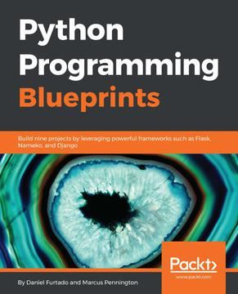
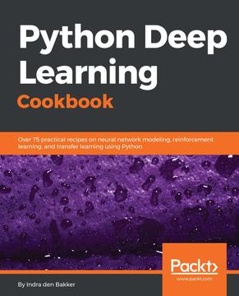

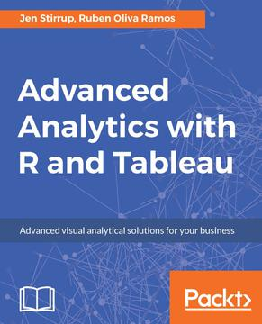
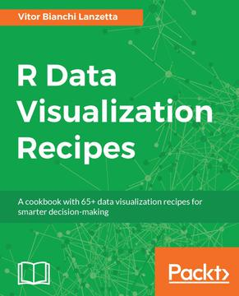
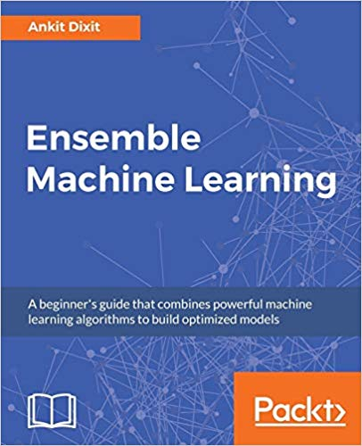
About me
  Economist (Ing./Macro, Finance/NHF); Slovak Economic Association (SEA)
  AI Expert, PhD. (xAI & Data Science/TUKE, prof. Sinčák), AI & Data Science Evangelist @ AIslovakIA (National platform for AI development in Slovakia), President & Principal Data Scientist (GapData), Consulting (public, private)
  Member of Slovak.AI (currently AIslovakIA), CLAIRE, European AI Alliance, TAILOR (TrustworthyAI @ EU)
  Data Science Instructor @ DataCamp, BaseCamp.ai, Learn2Code/Skillmea, robime.it, GapData +others
  Founder of PyData Slovakia/Bratislava (#PyDataBA), R <- Slovakia (#RSlovakia),
  Julia Users Group Slovakia (#JUGSlovakia) & SK/CZ Tableau User Group (#skczTUG)
  Analýza systému súdnictva a jeho výkonnosti do r. 2010 - Ministerstvo spravodlivosti SR (gov.sk), https://www.justice.gov.sk/tlacovespravy/tlacova-sprava-1581/
Explainable Machine Learning/AI (xAI) & Future of Artificial Intelligence
3/24 #AIslovakIA @ sli.do
Notes:
(1-2 min.)
Basic information about GapData Institute
Economic Research & Public Policy & Data Science think-tank (data-tank)
Data. Think. Change.
GapData Institute (GDI) is a non-profit nonpartisan research institution harnessing power of data & wisdom of economics for public good.
Transparent account (from day #1; SK7383300000002200933920 https://www.fio.sk/ib2/transparent?a=2200933920)
Partnership (openness, transparency)

Slide 6

What IDE you are using for your AI projects/where you create/train your models? (cloud, locally, etc.)
ⓘ Start presenting to display the poll results on this slide.
Explainable Machine Learning/AI (xAI) & Future of Artificial Intelligence
4/24 #AIslovakIA @ sli.do
Notes:
📣 This is Slido interaction slide, please don't delete it.
✅ Click on 'Present with Slido' and the poll will launch automatically when you get to this slide.

Slide 7





AI, AGI, HLAI > Palantir, Flawless, Sora and beyond… Frankie.AI goes to Hollywood
- Complex, modern-day ML algorithms, where deep learning & ensemble methods dominate
- really hard to fully understand, but the decision process behind them
- ChatGPT is not transparent/open (at all/bans and restrictions)
- can & need to be transparent and trustworthy for decision makers
- AI & BI coming together
- critical domains as finance, healthcare or public sector & governmental services, where TRUST is a MUST
- Explainability vs. Simplicity
- growing regulatory pressure also outside these areas Explainable AI (xAI) will be necessity for any organization soon
- understand the inner workings of these ML algorithms & how to design systems that imitate intelligence in a transparent way
- overview of current trends in Explainable AI/ML & the challenges that are ahead of us
- Next big thing?
Explainable Machine Learning/AI (xAI) & Future of Artificial Intelligence
5/24 #AIslovakIA @ sli.do
Notes:
(1-2 min.)

Slide 8
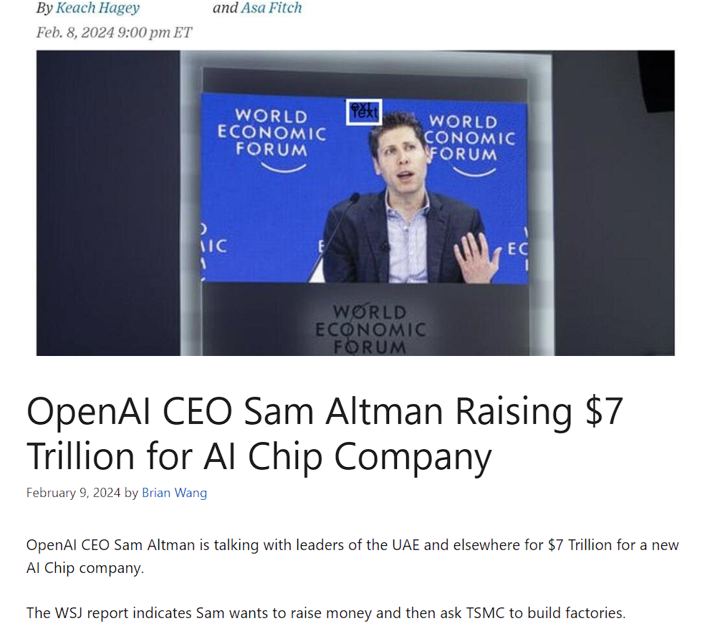

Global GDP ≈ $100 Trillion USD
$100,562,000,000,000 (2022, nominal/per year)
US: 25.5 Trillion USD/year (GDP)
China: 17.9 Trillion USD/year (GDP)
Japan: 4.2 Trillion USD/year (GDP)
Germany: 4 Trillion USD/year (GDP)
India: 3.4 Trillion USD/year (GDP) +UK, France,
Russia, Canada, Italy (about 2 Trillion USD/year)
Explainable Machine Learning/AI (xAI) & Future of Artificial Intelligence
6/24 #AIslovakIA @ sli.do
Notes:
(1-2 min.)

Slide 9
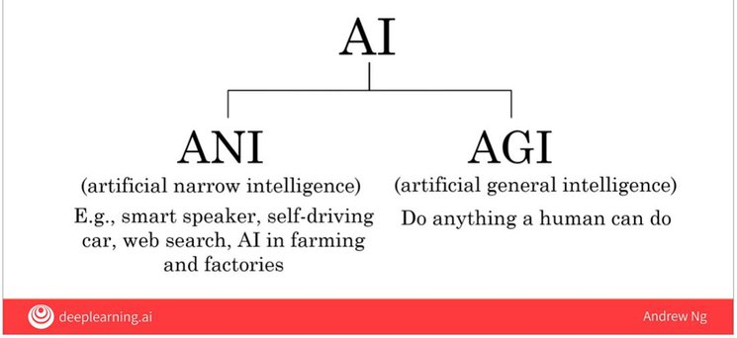
Explainable Machine Learning/AI (xAI), Era of Chatbots, AI & BI collide
- Complex, modern-day ML algorithms, where deep learning & ensemble methods dominate
- really hard to fully understand, but the decision process behind them
- ChatGPT is not transparent/open (at all/bans and restrictions)
- can & need to be transparent and trustworthy for decision makers
- AI & BI coming together
- critical domains as finance, healthcare or public sector & governmental services, where TRUST is a MUST
- Explainability vs. Simplicity
- growing regulatory pressure also outside these areas Explainable AI (xAI) will be necessity for any organization soon
- understand the inner workings of these ML algorithms & how to design systems that imitate intelligence in a transparent way
- overview of current trends in Explainable AI/ML & the challenges that are ahead of us
- Next big thing?
Source: Andrew Ng, deeplearning.ai
Explainable Machine Learning/AI (xAI) & Future of Artificial Intelligence
7/24 #AIslovakIA @ sli.do
Notes:
(1-2 min.)

Slide 10
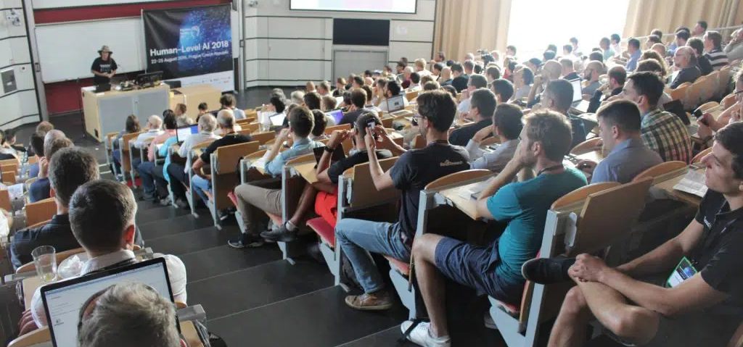
Explainable Machine Learning/AI (xAI), Era of Chatbots, AI & BI collide
- Complex, modern-day ML algorithms, where deep learning & ensemble methods dominate
- really hard to fully understand, but the decision process behind them
- ChatGPT is not transparent/open (at all/bans and restrictions)
- can & need to be transparent and trustworthy for decision makers
- AI & BI coming together
- critical domains as finance, healthcare or public sector & governmental services, where TRUST is a MUST
- Explainability vs. Simplicity
- growing regulatory pressure also outside these areas Explainable AI (xAI) will be necessity for any organization soon
- understand the inner workings of these ML algorithms & how to design systems that imitate intelligence in a transparent way
- overview of current trends in Explainable AI/ML & the challenges that are ahead of us
- Next big thing?
Source: HLAI Conference | GoodAI https://www.goodai.com/hlai/ Ben Goertzel, 2018 (Good.AI & GapData Institute, PyData Slovakia/partnership)
Explainable Machine Learning/AI (xAI) & Future of Artificial Intelligence
8/24 #AIslovakIA @ sli.do
Notes:
(1-2 min.)

Slide 11
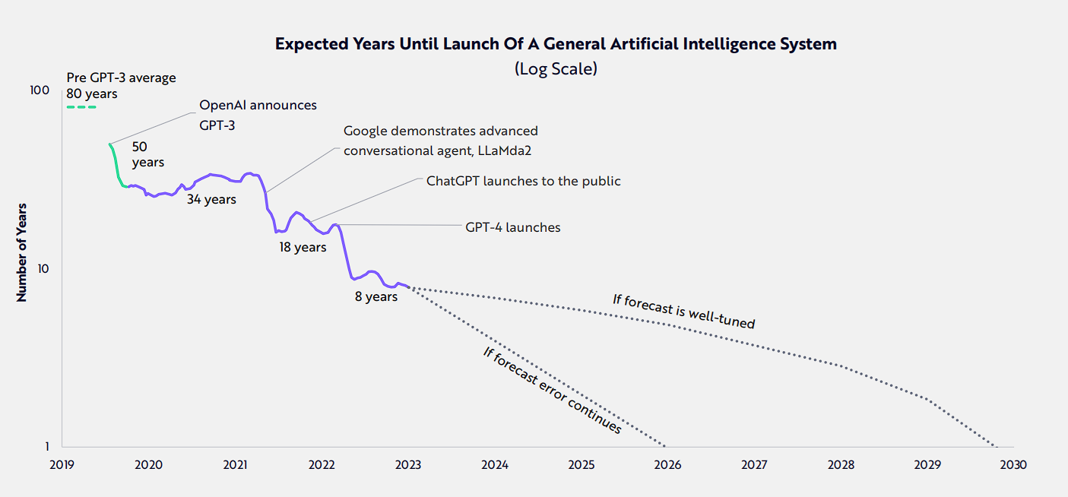
Explainable Machine Learning/AI (xAI), Era of Chatbots, AI & BI collide
- Complex, modern-day ML algorithms, where deep learning & ensemble methods dominate
- really hard to fully understand, but the decision process behind them
- ChatGPT is not transparent/open (at all/bans and restrictions)
- can & need to be transparent and trustworthy for decision makers
- AI & BI coming together
- critical domains as finance, healthcare or public sector & governmental services, where TRUST is a MUST
- Explainability vs. Simplicity
- growing regulatory pressure also outside these areas Explainable AI (xAI) will be necessity for any organization soon
- understand the inner workings of these ML algorithms & how to design systems that imitate intelligence in a transparent way
- overview of current trends in Explainable AI/ML & the challenges that are ahead of us
- Next big thing?
Source: https://ark-invest.com/big-ideas-2024 + https://www.youtube.com/watch?v=hFg1TMACw4I
Explainable Machine Learning/AI (xAI) & Future of Artificial Intelligence
9/24 #AIslovakIA @ sli.do
Notes:
(1-2 min.)

Slide 12

Explainable Machine Learning/AI (xAI), Era of Chatbots, AI & BI collide
“The year is 2052 and the world is a dangerous and chaotic place. Terrorists operate openly - killing thousands; drugs, disease and pollution kill even more. The world's economies are close to collapse and the gap between the insanely wealthy and the desperately poor grows ever wider.”
Source: Warren Spector/Deus Ex (6/2000) + https://www.youtube.com/watch?v=tffX3VljTtI
Explainable Machine Learning/AI (xAI) & Future of Artificial Intelligence
10/24 #AIslovakIA @ sli.do
Notes:
(1-2 min.)

Slide 13

Explainable Machine Learning/AI (xAI), Era of Chatbots, AI & BI collide
- Complex, modern-day ML algorithms, where deep learning & ensemble methods dominate
- really hard to fully understand, but the decision process behind them
- ChatGPT is not transparent/open (at all/bans and restrictions)
- can & need to be transparent and trustworthy for decision makers
- AI & BI coming together
- critical domains as finance, healthcare or public sector & governmental services, where TRUST is a MUST
- Explainability vs. Simplicity
- growing regulatory pressure also outside these areas Explainable AI (xAI) will be necessity for any organization soon
- understand the inner workings of these ML algorithms & how to design systems that imitate intelligence in a transparent way
- overview of current trends in Explainable AI/ML & the challenges that are ahead of us
- Next big thing?
Explainable Machine Learning/AI (xAI) & Future of Artificial Intelligence
5/12 #AIslovakIA @ sli.do
AI is here, and it's making movies. Is Hollywood ready? - Los Angeles Times (latimes.com) FLAWLESS, flawlessai.com)
Notes:
(1-2 min.)

Slide 14
AI & Ethics (food for thought & main challenges for the future)
- we should all be humble & think all the time about ethical implications of our work
- data in not (at least our) reality & need of transparency (explainable AI/HLAI/Superintelligence)
- we have no programming of common sense (fails/CYC)
- we need both left and right brain/lobe thinking
- we don't know how we really think (and if you think you know, well… good luck)
- we don't know what intelligence is (unknown processes)
- we are not walking neural nets (but if some of you are, please, let me know)
- design perceptron (imitate brain without knowing how the brain really works), real research of brain started (Brain Initiative/public and private research, 2013 +DARPA, IARPA)
- we need to rethink the basic design of neural nets (mathematics of deep learning)
- we can count all the neurons in our brains (10's of billions and 1000’s of billions synapses)
- we need rules (ethical & law standards/technology is currently before ethics)
“But the big feature of human-level intelligence is not what it does when it works but what it does when it's stuck.”
-- Marvin Minsky
Explainable Machine Learning/AI (xAI) & Future of Artificial Intelligence
11/24 #AIslovakIA @ sli.do
Notes:
(1-2 min.)
Basic information about GapData Institute
Economic Research & Public Policy & Data Science think-tank (data-tank)
Data. Think. Change.
GapData Institute (GDI) is a non-profit nonpartisan research institution harnessing power of data & wisdom of economics for public good.
Transparent account (from day #1; SK7383300000002200933920 https://www.fio.sk/ib2/transparent?a=2200933920)
Partnership (openness, transparency)

Slide 15
Explainable Machine Learning/AI (xAI), Era of Chatbots, AI & BI collide
- Complex, modern-day ML algorithms, where deep learning & ensemble methods dominate
- really hard to fully understand, but the decision process behind them
- ChatGPT is not transparent/open (at all/bans and restrictions)
- can & need to be transparent and trustworthy for decision makers
- AI & BI coming together
- critical domains as finance, healthcare or public sector & governmental services, where TRUST is a MUST
- Explainability vs. Simplicity
- growing regulatory pressure also outside these areas Explainable AI (xAI) will be necessity for any organization soon
- understand the inner workings of these ML algorithms & how to design systems that imitate intelligence in a transparent way
- overview of current trends in Explainable AI/ML & the challenges that are ahead of us
- Next big thing?
Explainable Machine Learning/AI (xAI) & Future of Artificial Intelligence
12/24 #AIslovakIA @ sli.do
Notes:
(1-2 min.)

Slide 16
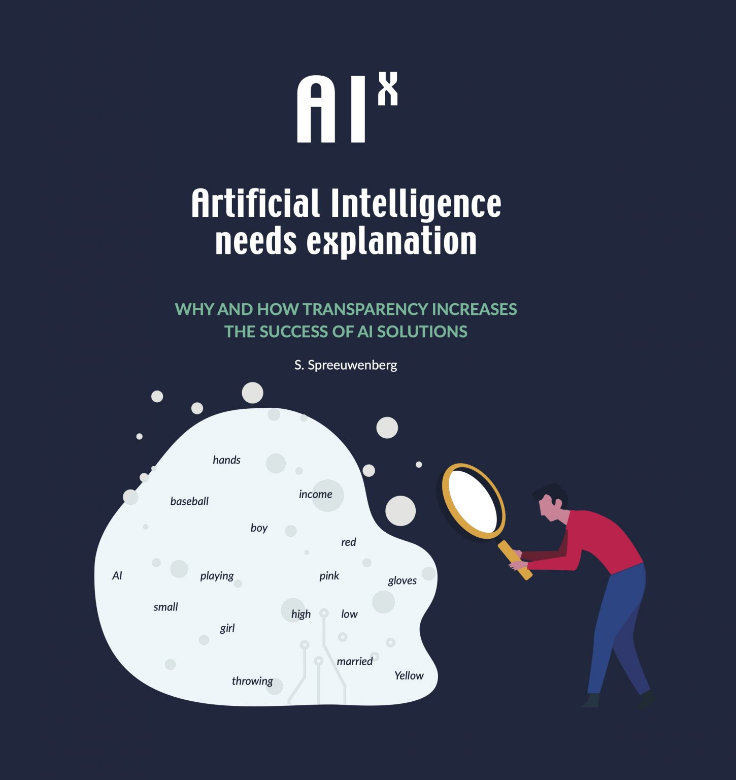
Explainability & Tools (LIME, SHAP & others)
- LIME (Local Interpretable Model-agnostic Explanations)
- explainable AI method that helps to illuminate a machine learning model
- make its predictions individually comprehensible
- method explains the classifier for a specific single instance (suitable for local explanations)
- model agnostic tool which can give explanations for any supervised learning model
- one of the most popular XAI tools out there due to its simplicity and intuitiveness
https://github.com/marcotcr/lime
- SHAP (SHapley Additive exPlanations)
- game theoretic approach to explain the output of any machine learning model.
- connects optimal credit allocation with local explanations using the classic Shapley values from game theory and their related extensions
https://github.com/slundberg/shap
+
Others (100+ tools), f.e.:
- Alibi (Algorithms for explaining machine learning models)
https://github.com/SeldonIO/alibi
- Captum (Model Interpretability for PyTorch)
https://captum.ai/
Explainable Machine Learning/AI (xAI) & Future of Artificial Intelligence
13/24 #AIslovakIA @ sli.do
Notes:
(1-2 min.)

Slide 17
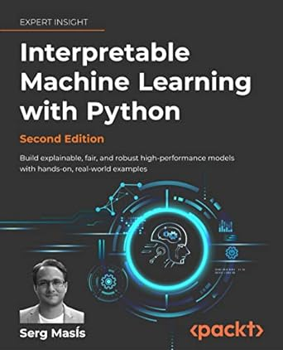

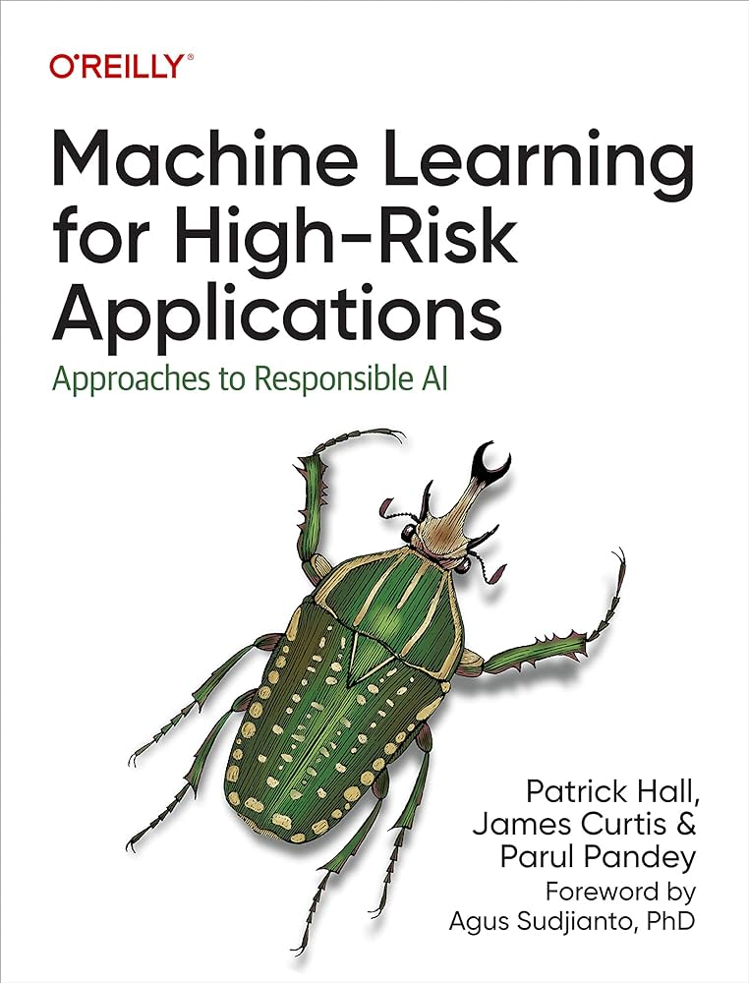
Explainable AI/xAI + key literature
Source: https://christophm.github.io/interpretable-ml-book/
https://www.amazon.com/Machine-Learning-High-Risk-Applications-Responsible/dp/1098102436
https://www.amazon.com/Interpretable-Machine-Learning-Python-hands/dp/180323542X/
Explainable Machine Learning/AI (xAI) & Future of Artificial Intelligence
14/24 #AIslovakIA @ sli.do
Notes:
(1-2 min.)

Slide 18
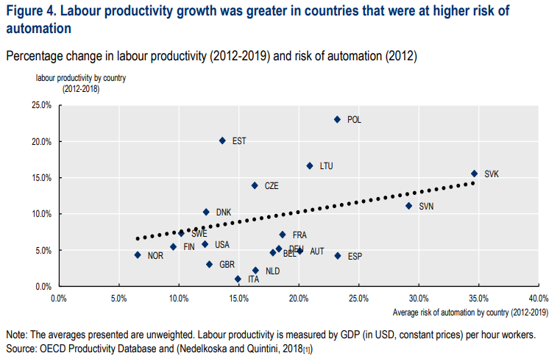
AI & Slovakia or why should you even care?
Source: https://www.oecd.org/future-of-work/reports-and-data/what-happened-to-jobs-at-high-risk-of-automation-2021.pdf
+
AI Strategies and Policies in Slovak Republic - OECD.AI, https://oecd.ai/en/dashboards/countries/Slovakia
+
AI, automation, and the future of work: Ten things to solve | McKinsey Global Institute
Explainable Machine Learning/AI (xAI) & Future of Artificial Intelligence
15/24 #AIslovakIA @ sli.do
Notes:
(1-2 min.)

Slide 19


AI & Slovakia, what exactly are you talking about? What future?
- OECD.AI that provides an overview of AI strategies and policies in Slovakia. It includes an action plan for the transformation of Slovakia into a successful digital country and development of the digital single market. The action plan offers a set of concrete steps on how to start building a sustainable and human centric, and trustworthy AI.
- AIslovakIA, which is a neutral, independent and non-profit platform with an ambition to develop excellence and bring together experts and those interested in artificial intelligence in Slovakia.
- The national platform of artificial intelligence (AIslovakIA) is part of the Center for Artificial Intelligence (hereinafter referred to as “CAI”), a non-profit organization
- AI/ML augmented analytics (scenarios for data-driven decision making)
- build and deploy highly accurate machine learning models without writing a single line of code, experiment, simulate and compare different scenarios using various models/scenarios to identify the best strategy or test ideas before committing resources
- focus on the right data to analyze, get predictive insights with explanations in your dashboards + run simulations to get actionable prescriptive guidance on what to do next and get instant visual response
- Alphaa.ai (world’s 1st AI voice analyst/not just regular “chat bot”)
Explainable Machine Learning/AI (xAI) & Future of Artificial Intelligence
16/24 #AIslovakIA @ sli.do
Notes:
(1-2 min.)

Slide 20
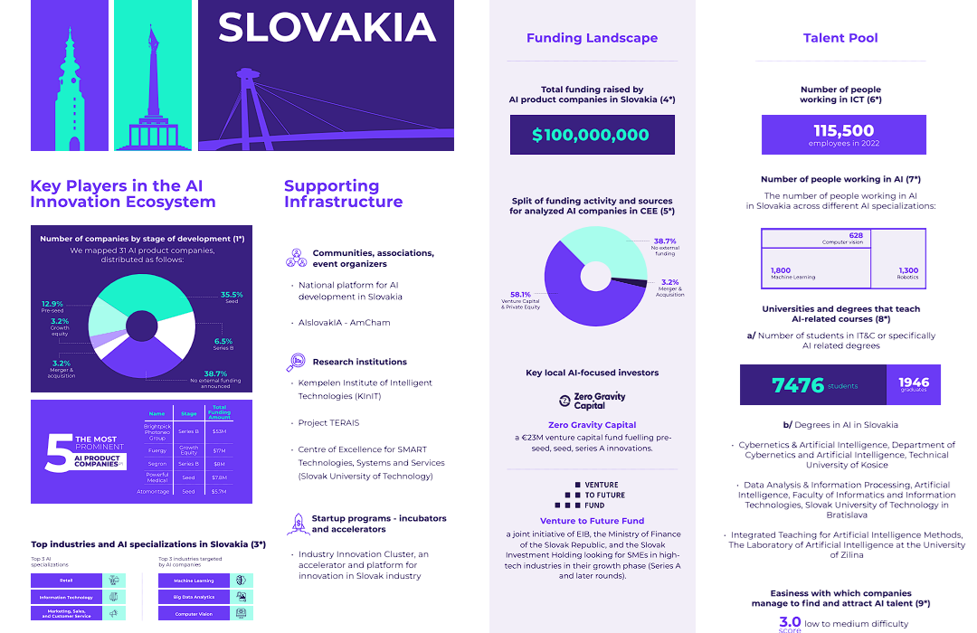

- OECD.AI that provides an overview of AI strategies and policies in Slovakia. It includes an action plan for the transformation of Slovakia into a successful digital country and development of the digital single market. The action plan offers a set of concrete steps on how to start building a sustainable and human centric, and trustworthy AI.
- AIslovakIA, which is a neutral, independent and non-profit platform with an ambition to develop excellence and bring together experts and those interested in artificial intelligence in Slovakia.
- The national platform of artificial intelligence (AIslovakIA) is part of the Center for Artificial Intelligence (hereinafter referred to as “CAI”), a non-profit organization
- AI/ML augmented analytics (scenarios for data-driven decision making)
- build and deploy highly accurate machine learning models without writing a single line of code, experiment, simulate and compare different scenarios using various models/scenarios to identify the best strategy or test ideas before committing resources
- focus on the right data to analyze, get predictive insights with explanations in your dashboards + run
Source: https://therecursive.com/ai-trends-central-and-eastern-europe-report/,
Interview: https://therecursive.com/collaboration-is-the-key-to-success-radovan-kavicky-on-fostering-ai-innovation-in-slovakia/
Explainable Machine Learning/AI (xAI) & Future of Artificial Intelligence
#AIslovakIA @ sli.do
Notes:
(1-2 min.)

Slide 21

Who's on the picture?
Click Present with Slido or install our Chrome extension to activate this poll while presenting.
ⓘ
Explainable Machine Learning/AI (xAI) & Future of Artificial Intelligence
17/24 #AIslovakIA @ sli.do
Notes:
📣 This is Slido interaction slide, please don't delete it.
✅ Click on 'Present with Slido' and the poll will launch automatically when you get to this slide.

Slide 22
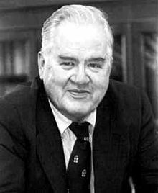
Future of AI/ML and Data Science
- Back to Basics
What Machine Learning/Artificial Intelligence is? What Data Science is?
“Artificial intelligence is the science of making machines do things that would require intelligence if done by men.”
-- Marvin Minsky
- Data Science (definition): collection of scientific results and methods for transformation of data from raw form to meaningful information, knowledge and wisdom, which should support better decisions
- Data Science: Statistics + programming; data analysis + Computer Science, modelling + Econometrics, Big Data, ML/DL
- Expectation/Prediction: Data Scientists, one of the first “victims” of automation
- Is Data Reality? Do we model reality? (noise/signal)
Explainable Machine Learning/AI (xAI) & Future of Artificial Intelligence
18/24 #AIslovakIA @ sli.do
Notes:
(1-2 min.)

Slide 23
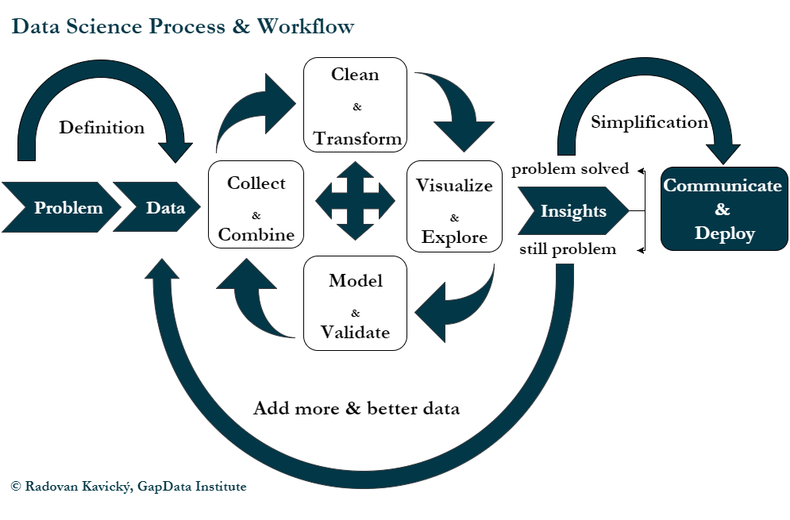
Explainable Machine Learning/AI (xAI) & Future of Artificial Intelligence
19/24 #AIslovakIA @ sli.do
Notes:
(1-2min.)

Slide 24
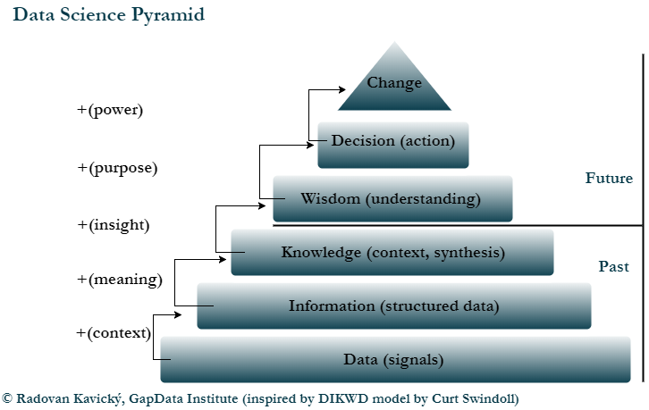
Explainable Machine Learning/AI (xAI) & Future of Artificial Intelligence
20/24 #AIslovakIA @ sli.do
Notes:
(1-2min.)

Slide 25
Is data reality?
ⓘ Start presenting to display the poll results on this slide.
Explainable Machine Learning/AI (xAI) & Future of Artificial Intelligence
21/24 #AIslovakIA @ sli.do
Notes:
📣 This is Slido interaction slide, please don't delete it.
✅ Click on 'Present with Slido' and the poll will launch automatically when you get to this slide.

Slide 26
Data is not reality.
And if you think so, you should quit doing so… right now.
Source: Me :), H2O.ai Meetup, Prague 2019, https://www.meetup.com/Prague-Artificial-Intelligence-Deep-Learning/events/264335458/
Explainable Machine Learning/AI (xAI) & Future of Artificial Intelligence
22/24 #AIslovakIA @ sli.do
Notes:
(1-2 min.)
PyData Bratislava, R <- Slovakia, skczTUG
Open Data (only the 1st necessary step)
Python, R, Tableau community activities
Economic Research (studies, papers, publications)
Quantitative & Qualitative Analyses (Data/center of it all)
Data Visualization (Interactive DataViz Tools)
Public Policy (Public Budget, Public Finance)
Economic Reforms (any area)
PyCon SK 2017 (10th-12th of March 2017, FIIT UK)

Slide 27
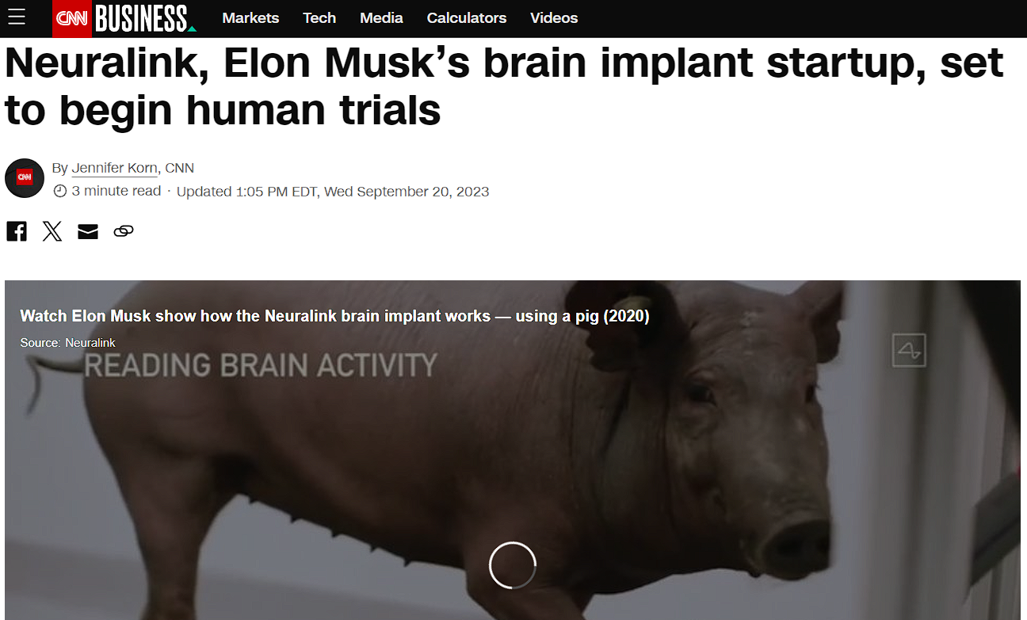

AI & Ethics of AGI (Transhumanism & Empathy/future challenges)
Neuralink, Elon Musk’s brain implant startup, set to begin human trials | CNN Business
Source: https://edition.cnn.com/2023/09/20/tech/musk-neuralink-human-trials/index.html
Explainable Machine Learning/AI (xAI) & Future of Artificial Intelligence
23/24 #AIslovakIA @ sli.do
Notes:
(1-2 min.)
Basic information about GapData Institute
Economic Research & Public Policy & Data Science think-tank (data-tank)
Data. Think. Change.
GapData Institute (GDI) is a non-profit nonpartisan research institution harnessing power of data & wisdom of economics for public good.
Transparent account (from day #1; SK7383300000002200933920 https://www.fio.sk/ib2/transparent?a=2200933920)
Partnership (openness, transparency)

Slide 28
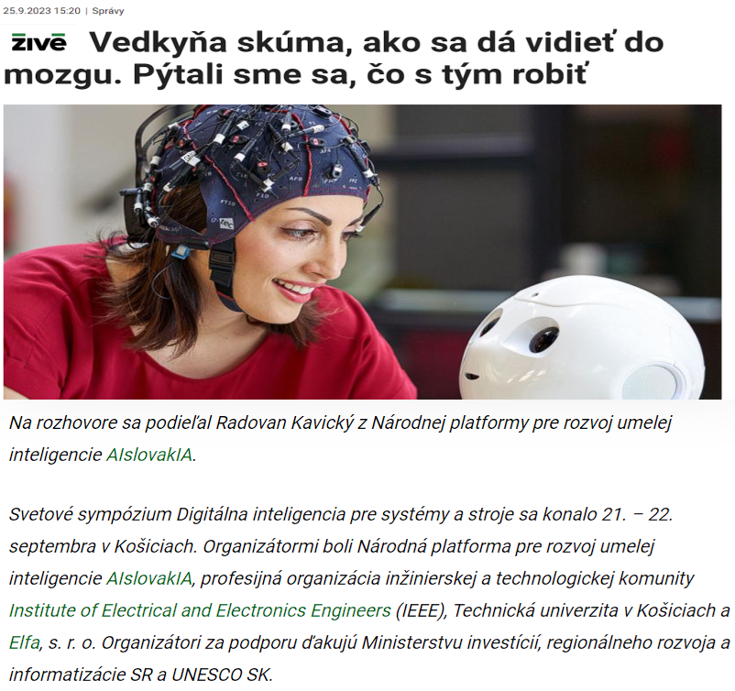

AI, Consciousness & Ethics of AGI (Transhumanism & Empathy/future challenges)
Neuralink, Elon Musk’s brain implant startup, set to begin human trials | CNN Business
Maryam Alimardani — Tilburg University Research Portal, https://research.tilburguniversity.edu/en/persons/maryam-alimardani
Vedkyňa skúma, ako sa dá vidieť do mozgu. Pýtali sme sa, čo s tým robiť (aktuality.sk)
Explainable Machine Learning/AI (xAI) & Future of Artificial Intelligence
24/24 #AIslovakIA @ sli.do
Notes:
(1-2 min.)
Basic information about GapData Institute
Economic Research & Public Policy & Data Science think-tank (data-tank)
Data. Think. Change.
GapData Institute (GDI) is a non-profit nonpartisan research institution harnessing power of data & wisdom of economics for public good.
Transparent account (from day #1; SK7383300000002200933920 https://www.fio.sk/ib2/transparent?a=2200933920)
Partnership (openness, transparency)

Slide 29
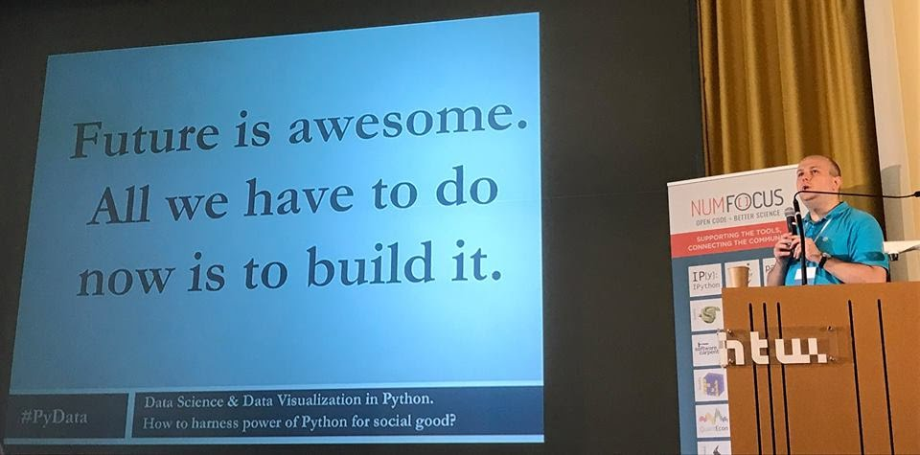
Future is awesome.
All we have to do now is to build it.
Source: PyData Berlin 2017 (w/Marek Rosa), Talk on YouTube: https://www.youtube.com/watch?v=I5578BhU4sE
Explainable Machine Learning/AI (xAI) & Future of Artificial Intelligence
#AIslovakIA @ sli.do
Notes:
(1-2 min.)
PyData Bratislava, R <- Slovakia, skczTUG
Open Data (only the 1st necessary step)
Python, R, Tableau community activities
Economic Research (studies, papers, publications)
Quantitative & Qualitative Analyses (Data/center of it all)
Data Visualization (Interactive DataViz Tools)
Public Policy (Public Budget, Public Finance)
Economic Reforms (any area)
PyCon SK 2017 (10th-12th of March 2017, FIIT UK)

Slide 30







PyData Slovakia & activities within CEE + V4
  300+ members
  3000+ on mailing list
  800+ followers
  Partners: O'Reilly, robime.it, codecon.sk, TouchIT.sk
  Sponsors: H2O.ai, Microsoft, kiwi.com
  WeAreDevelopers World Congress (“GAPDATA-25” & “PYDATA-25”), Berlin, 17.-19. July 2024
  Machine Learning Prague (“pydatask15” for 15% discount), Prague/O2 , 22.-24. April 2024
  WebExpo, Prague/Lucerna, 29.-31. May 2024 (“pydatask15” for 15% discount)
  Our meetups (26.2., 15:00 PyData Slovakia & Bratislava 16:00 skczTUG/SK & CZ Tableau User)
Explainable Machine Learning/AI (xAI) & Future of Artificial Intelligence
#AIslovakIA @ sli.do
Notes:
(1-2min.)
Anaconda/Spyder
Rodeo (IDE for Python & R)
Jupyter Notebook
PyCharm (IDE for Python)
R-Studio (IDE for R +rpy2)
Wing + VIM/NeoVim (IDE for Python)
Tableau Public (Python & R code implementation +TabPy)

Slide 31


GapData Institute (GDI) and how to support us.
  Economic Research & Public Policy & Data Science + AI think-tank (data-tank)
  Data. Think. Change.
  GapData Institute (GDI) is a non-profit nonpartisan research institution harnessing power of data & wisdom of economics for public good.
  Transparent account (from day #1; SK7383300000002200933920 https://www.fio.sk/ib2/transparent?a=2200933920)
  Partnership (openness, transparency)
  Slides (this talk): tinyurl.com/slides-xAI
  https://github.com/radovankavicky/aislovakia2024
Explainable Machine Learning/AI (xAI) & Future of Artificial Intelligence
#AIslovakIA @ sli.do
Notes:
(1-2 min.)
Basic information about GapData Institute
Economic Research & Public Policy & Data Science think-tank (data-tank)
Data. Think. Change.
GapData Institute (GDI) is a non-profit nonpartisan research institution harnessing power of data & wisdom of economics for public good.
Transparent account (from day #1; SK7383300000002200933920 https://www.fio.sk/ib2/transparent?a=2200933920)
Partnership (openness, transparency)

Slide 32







Thank you for your attention
Contact:
Radovan Kavicky
radovan.kavicky@aislovakia.com
radovan.kavicky@gapdata.org
radovan.kavicky@gmail.com
radovan.kavicky@student.tuke.sk
+421 949 716 214 (SK)
+420 777 595 262 (CZ)
http://www.linkedin.com/in/radovankavicky
https://gapdata.slack.com/
https://github.com/radovankavicky
https://www.facebook.com/groups/356635138031671
@radovankavicky, @PyDataBA, @GapDataInst
In case you have any question, feel free to ask.
#AIslovakIA @ sli.do
Notes:
Contact:
Radovan Kavicky
radovan.kavicky@gapdata.org
+420 776 467 159 (CZ)
+421 949 716 214 (SK)
http://www.linkedin.com/in/radovankavicky
https://gapdata.slack.com/messages/py-data/
https://github.com/radovankavicky
https://github.com/GapData/PyDataBratislava
@radovankavicky, @PyDataBA, @GapDataInst

Slide 33


Oh, and one more thing… :)
  Meetup.com
https://www.meetup.com/Julia-Users-Group-Slovakia/
  Facebook
https://www.facebook.com/groups/379292635993253/
Hashtag: #JUGSlovakia
More to come... soon. Stay tuned.
Explainable Machine Learning/AI (xAI) & Future of Artificial Intelligence
#AIslovakIA @ sli.do
Notes:
(1-2min.)
Data Science (Urban) + Data Visualization
OSMnx
- https://github.com/gboeing/osmnx
CARTO.com (maps + predictions)
QGIS.org (Open Source GIS)
Tableau Desktop 10.2 (interactive DataViz)
OpenStreetMap.org
Openlayers.org
Leaflet (JS, R + maps +ggmap)
Mapbox (3D maps/C++, OpenGL)
Google fusion tables
OSMnx Python for street networks
Retrieve, construct, analyze, and visualize street networks from OpenStreetMap: full overview.
OSMnx is a Python 2+3 package that lets you download spatial geometries and construct, project, visualize, and analyze street networks from OpenStreetMap's APIs. Users can download and construct walkable, drivable, or bikable urban networks with a single line of Python code, and then easily analyze and visualize them:
So how will 'smart' cities help us deal with tackling climate change and growth at the same time? There are 5 key areas emerging for 'smart' services that enable a sustainable, low carbon city.
1. Monitoring and managing the "footprint" of the city for decision-makers
2. Connected mobility solutions to enable modal shift, and electric vehicles
3. Distributed and community energy solutions
4. Smarter buildings that are transparent about energy consumption, use and generation
5. Smart energy, water and waste management
Behind these key areas are technology solutions like 'smart meters' and the 'smart grid', which have been widely covered in the news.
But how much more efficient could we really make our lifestyles, today? Could we turn down the office heating without sacrificing comfort? Could we work flexibly, modify our travel patterns, and still achieve the business and mobility services we have come to rely on?

Slide 34

How would you rate this talk? (scale 1-10, 10/awesome, 5/meh, 1/worst talk ever, but "try again, fail again, fail better")
Click Present with Slido or install our Chrome extension to activate this poll while presenting.
ⓘ
#AIslovakIA @ sli.do
Explainable Machine Learning/AI (xAI) & Future of Artificial Intelligence
Notes:
📣 This is Slido interaction slide, please don't delete it.
✅ Click on 'Present with Slido' and the poll will launch automatically when you get to this slide.

Slide 35
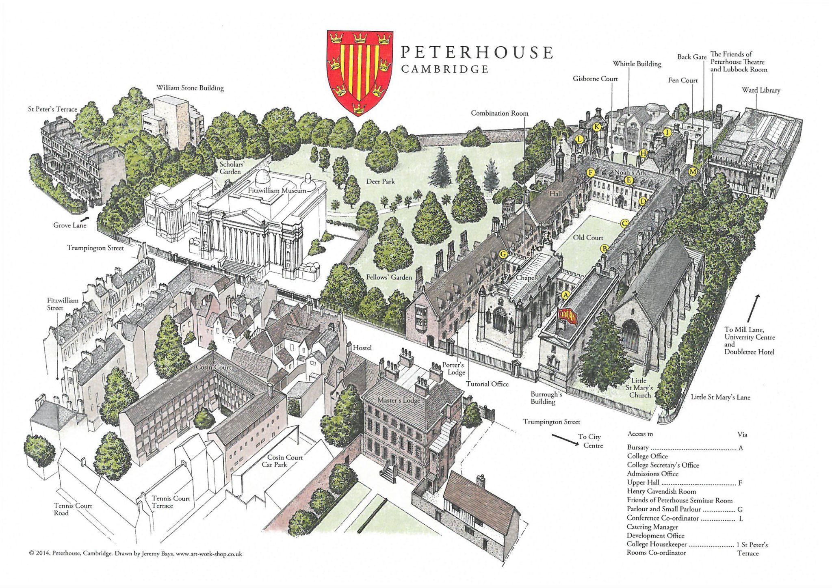
(xAI) English Exam (translation/Slovak)
Thank you MIRRI/MIRDI & AIslovakIA
(Viera Borðoy
& Nikola Dobrovská)!
Source: http://www.bcs-sgai.org/ai2023/
AI-2023 Forty-third SGAI International Conference on Artificial Intelligence
CAMBRIDGE, ENGLAND 12-14 DECEMBER 2023
AI-2023 is the 43-rd Annual International Conference of the British Computer Society's Specialist Group on Artificial Intelligence (SGAI)
Alan Turing studied (math, 1931, Cambridge)
Explainable Machine Learning/AI (xAI) & Future of Artificial Intelligence
#AIslovakIA @ sli.do
Notes:
(1-2 min.)

Slide 36
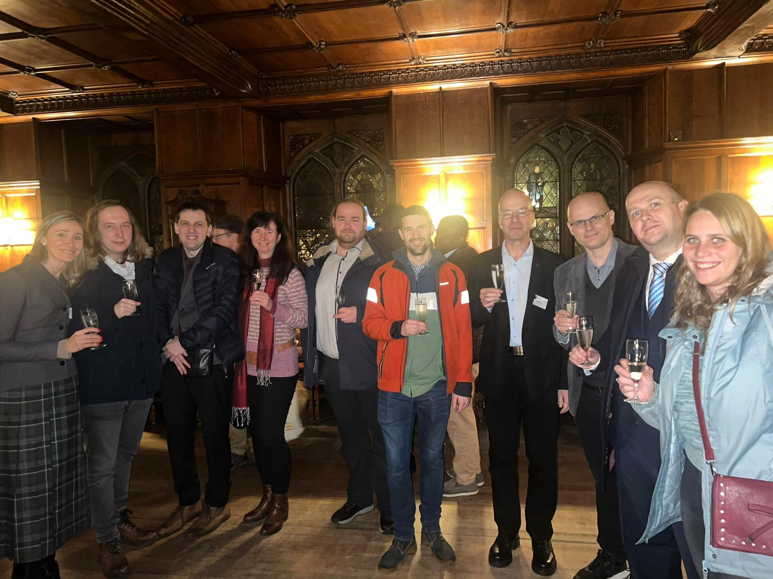
(xAI) English Exam (translation/Slovak)
Source: Jana Novohradská, MIRRI/MIRDI
AI-2023 Forty-third SGAI International Conference on Artificial Intelligence
CAMBRIDGE, ENGLAND 12-14 DECEMBER 2023
AI-2023 is the 43-rd Annual International Conference of the British Computer Society's Specialist Group on Artificial Intelligence (SGAI)
Alan Turing studied (math, 1931, Cambridge), Stephen Hawking lived few meters from Peterhouse College
Explainable Machine Learning/AI (xAI) & Future of Artificial Intelligence
#AIslovakIA @ sli.do
Notes:
(1-2 min.)

Slide 37
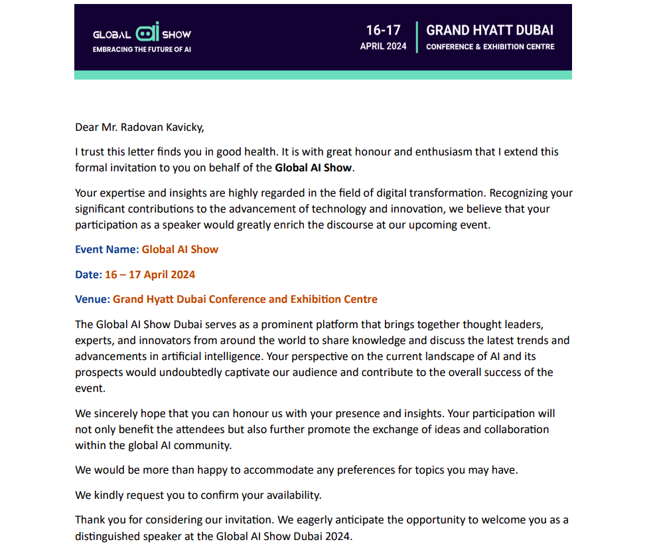
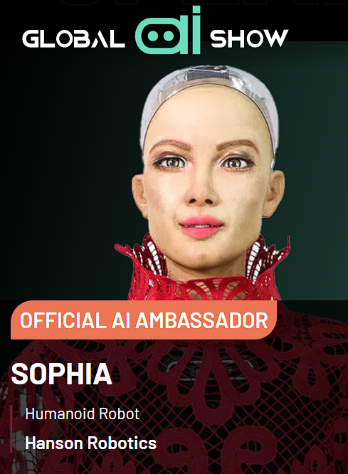
One more thing… Global AI Show: The World's Premier AI & ML Event https://www.globalaishow.com/
10000+ attendees, 3000+ companies
AI-2023 Forty-third SGAI International Conference on Artificial Intelligence
CAMBRIDGE, ENGLAND 12-14 DECEMBER 2023
AI-2023 is the 43-rd Annual International Conference of the British Computer Society's Specialist Group on Artificial Intelligence (SGAI)
(xAI) English Exam (translation/Slovak)
Explainable Machine Learning/AI (xAI) & Future of Artificial Intelligence
#AIslovakIA @ sli.do
Notes:
(1-2 min.)

Slide 38

Audience Q&A Session
ⓘ Start presenting to display the audience questions on this slide.
Explainable Machine Learning/AI (xAI) & Future of Artificial Intelligence
#AIslovakIA @ sli.do
Notes:
📣 This is Slido interaction slide, please don't delete it.
✅ Click on 'Present with Slido' and the questions from your audience will appear when you get to this slide.

