Slide 1
Student performance Analysis
Forecasting final grade of students with a Regression Model.
Audience: Ministry of Education
Presenter: Raj Dholakia (100813041)

Slide 2
Table of contents
Description of the problem
Exploratory Data Analysis
Model Overview and Model Performance Evaluation
The External Dataset
Dataset and Model Comparison
Conclusion
Recommendations

Slide 3
Description of the problem
The Ministry of Education would like to understand if there are any particular factors that impact the performance of students completing their secondary education.
Student grades and 33 other variables are all provided in two datasets, one for collected from a Math Course and the Other from Portuguese.
The Ministry of Education aims to build a regression model using the datasets to predict the final grades (variable `G3`) of a student.
Problem statement
Explore the datasets and create a book analysis report that provides key insights that will be helpful in developing a regression model that predicts the final grades of students.
Additionally, the Ministry of Education would like use an external dataset to compare the insights.

Slide 4
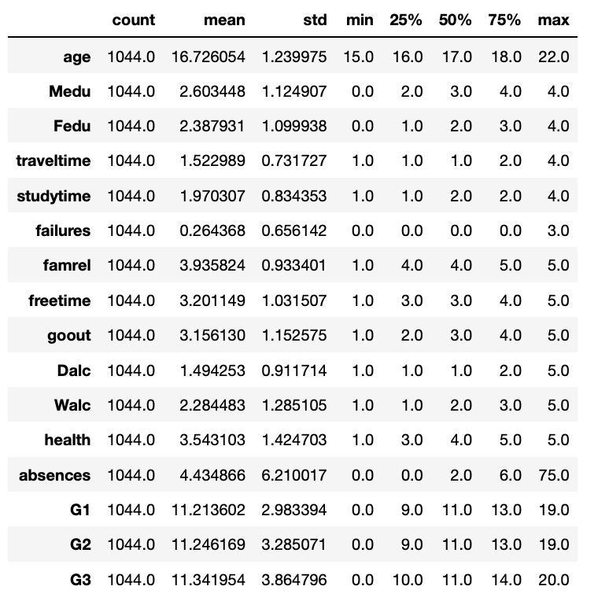
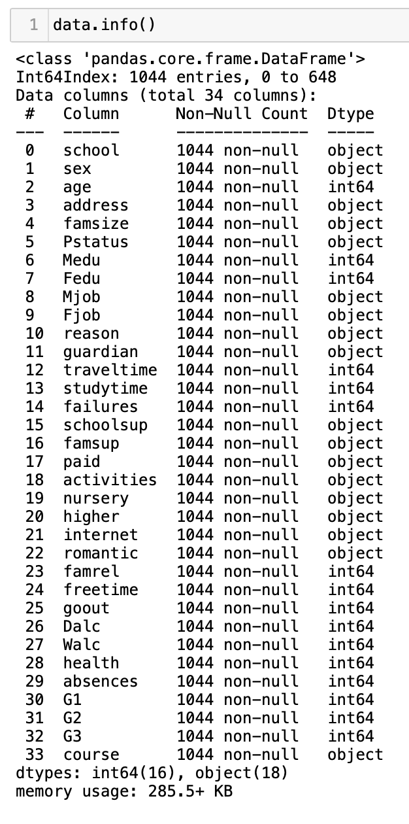
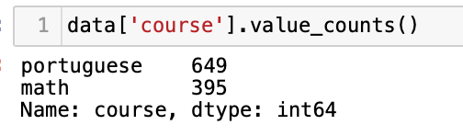
About the datasets
The datasets have a total of 1044 samples, with math course having 395 samples and Portuguese having 649 samples.
There are 34 variables, out of which 18 are `object` datatype and 16 are `numerical`.
The response or target variable is `G3`.
`G1` and `G2` are grades from the first and second periods, respectively. `G3` is the final grade.
The dataset has no missing values.
The mean of `G3` is 11.34, hence a good regression model will have a RMSE value of 1.13 or below (10% of mean).

Slide 5
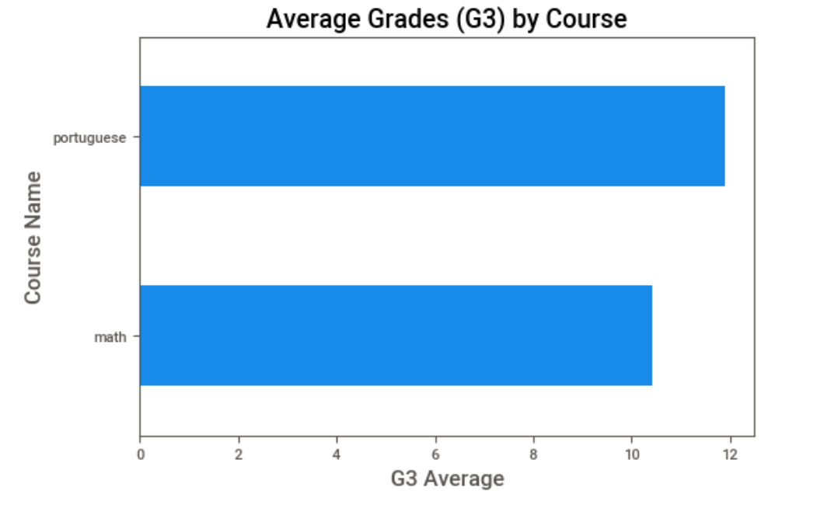
Exploratory Data Analysis - Key insights
On average, student studying `Portuguese Course` have a higher grade than students doing the `Math course`.
Hence, in general, the value of G3 should be higher when the course is `Portuguese` compared to `Math`.

Slide 6
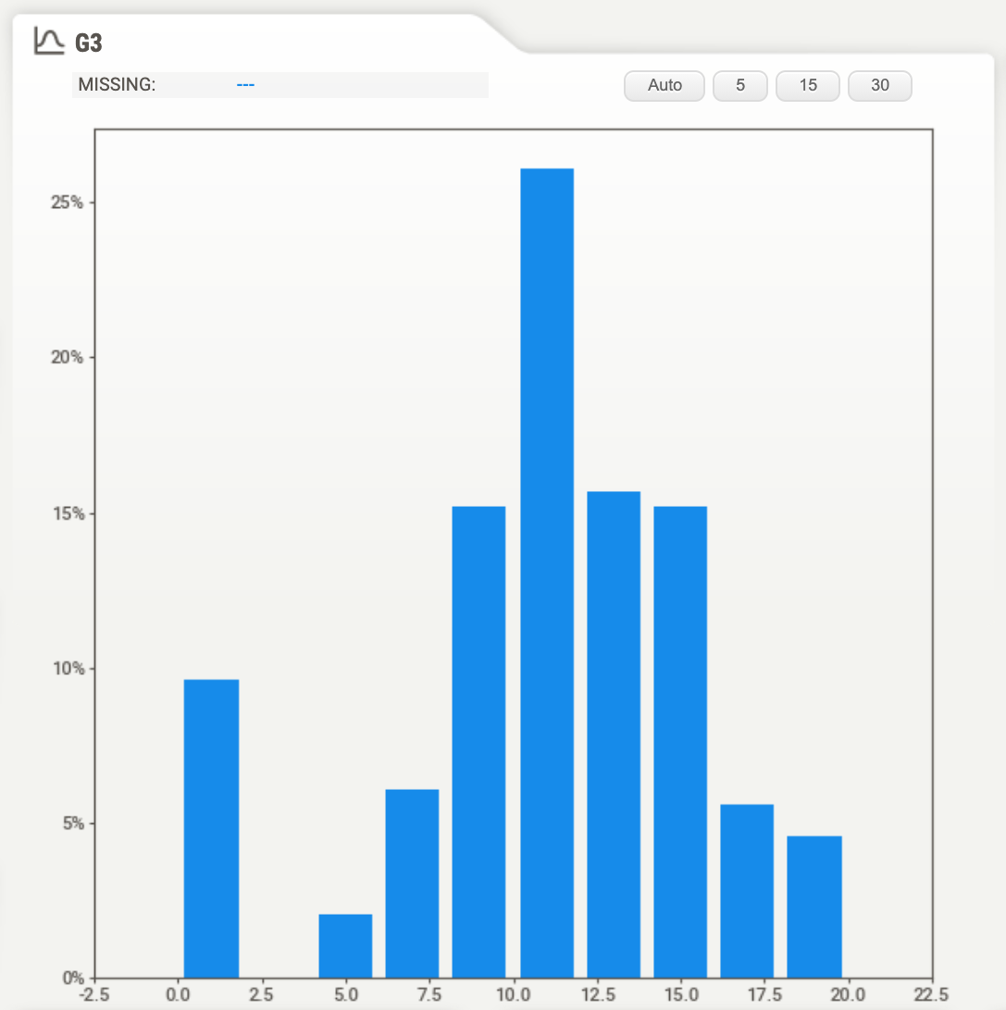
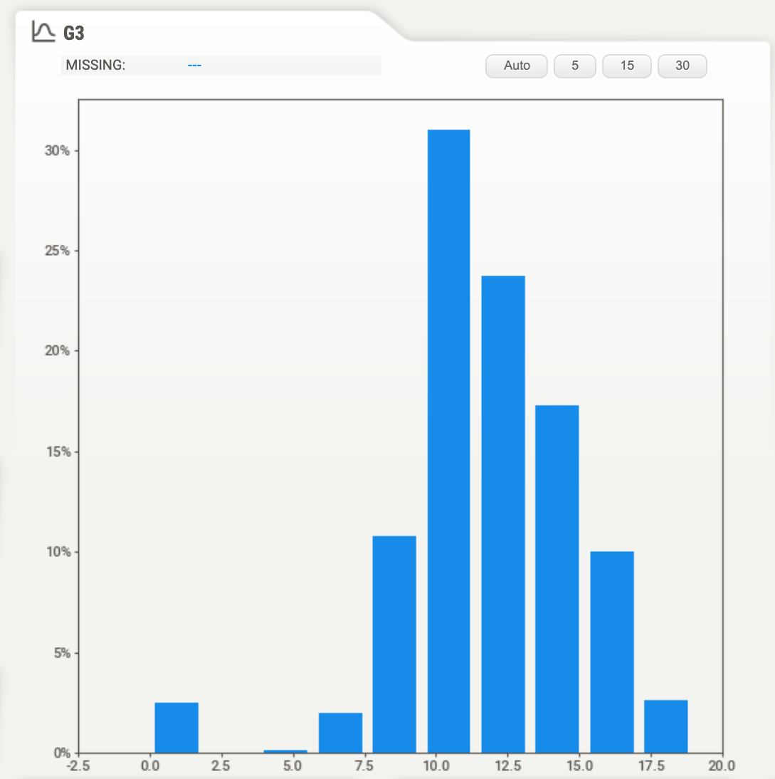
Exploratory Data Analysis - Key insights
G3 distribution is similar for both subject – an almost normal distribution.
However, more student have gotten a `0` in math than in `Portuguese`.
Math – G3 Distribution
Portuguese – G3 Distribution

Slide 7
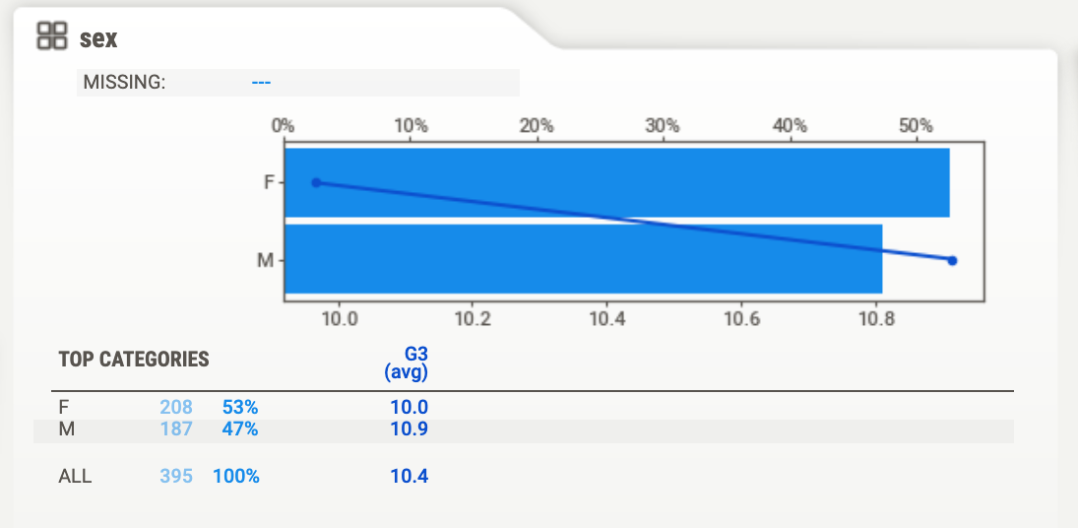
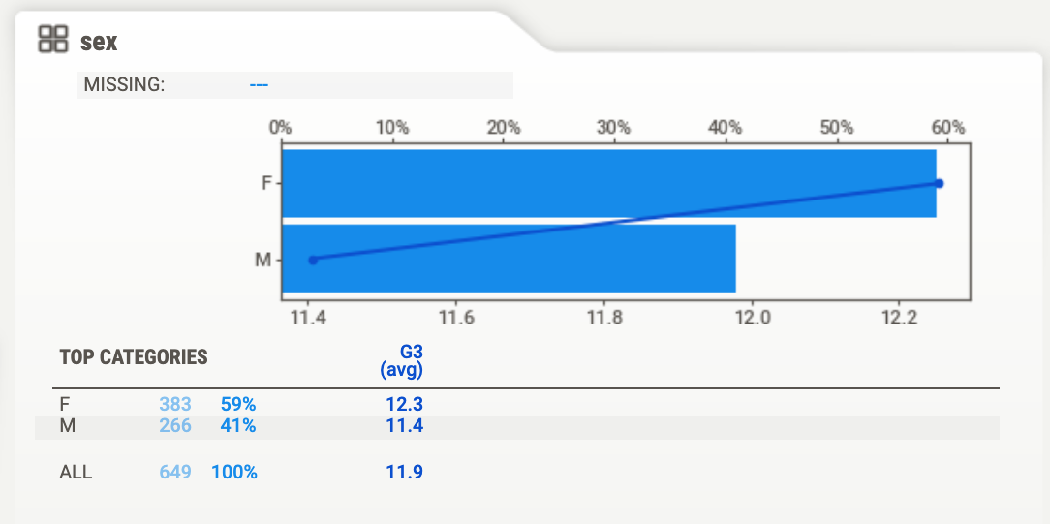
Exploratory Data Analysis - Key insights
Math – Sex Distribution
Most of the variables (over 20) have the distribution of samples between classes and these variables have a higher average G3 for Students doing the `Portuguese` course compared to the `Math` course.
Sex is an example of the above. The female-to-male ratio has a small discrepancy of 6% between the course, the grades scored have a significant difference.
Average `G3` for both the course and sexes is different. Males have a higher average score than females in math and it is vice-versa for the Portuguese course.
Portuguese – Sex Distribution

Slide 8
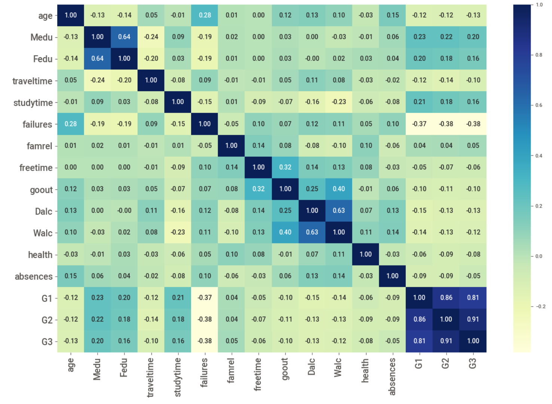
Exploratory Data Analysis - Key insights
G3 has strong positive correlations with:
G1
G2
G3 has moderate negative correlations with:
failures
G3 has weak/moderate positive correlation with:
Medu (mother’s education)
Fedu (father’s education)
Studytime

Slide 9
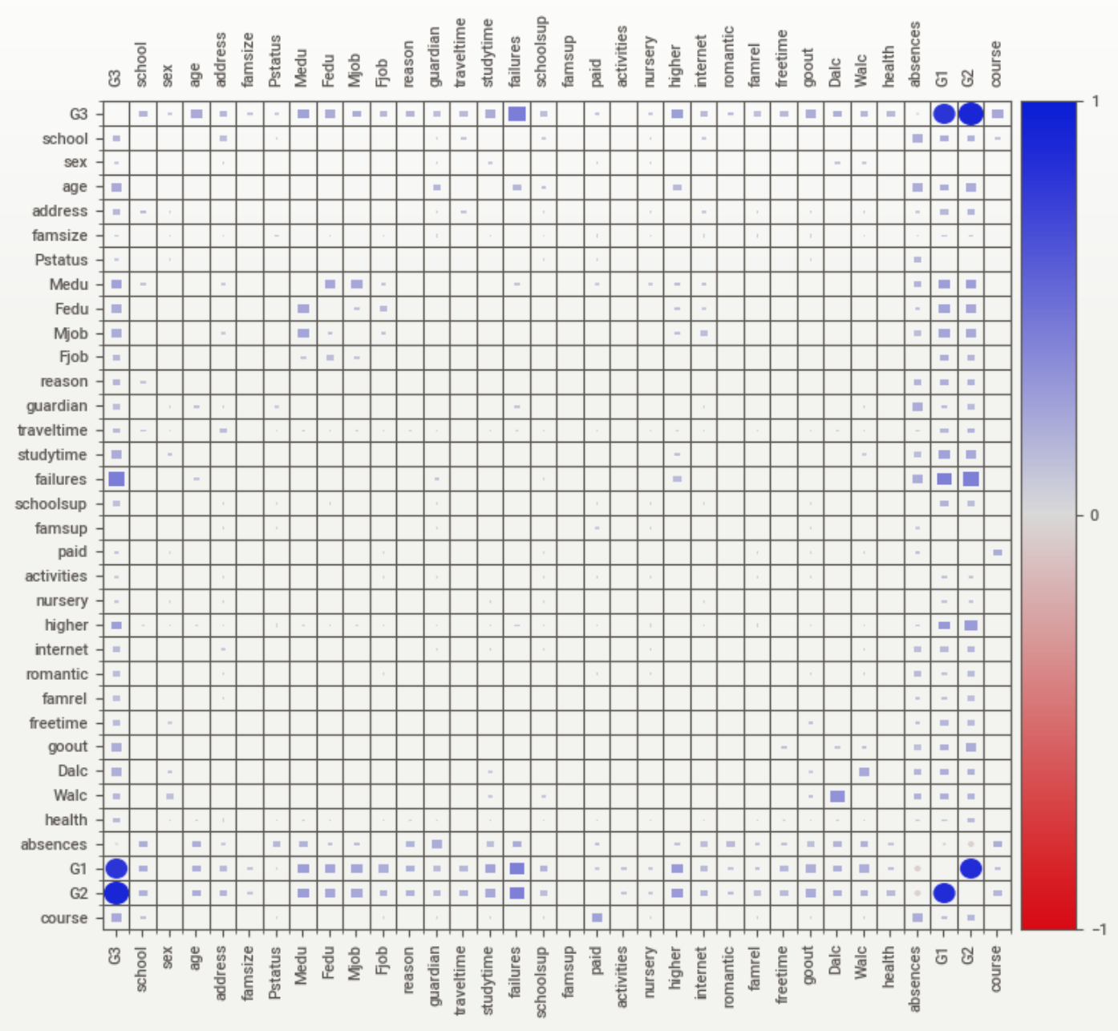
Exploratory Data analysis – Key insights
Other Categorical variables that have a significant association with G3:
Course - `math` or `Portuguese`
Mjob – Mother’s job
higher – wants to take higher education (yes or no)

Slide 10
What Does A Regression Model Require?
There are a few assumptions that need to managed before creating a regression model. Ensuring the dataset meets these assumptions will prepare a regression model that performs well.
Considering the insights from the exploratory data analysis of the datasets, it was decided that the analysis should focus at meeting two assumptions.
Assumption | Description | Identification process
Multi-collinearity | A dataset with highly correlated independent variables can make it difficult to infer the features that important for predicting the response variables (in this case grades – `G3`). | Use Variance Inflation Factor (VIF) to know which variables have a high multicollinearity. A value higher than 10 is ideally considered to be concerning.
Normal distribution of the error terms | Having a non—normal distribution of error terms will make the confidence intervals unstable, which will make it difficult to have an accurate representation of the coefficients, hence difficulty carrying our feature importance. | Use Q-Q plots to determine if the distribution of errors is normal or no. “Presence of non – normal distribution suggests that there are a few unusual data points which must be studied closely to make a better model.” (Source: Analytics Vidhya)

Slide 11
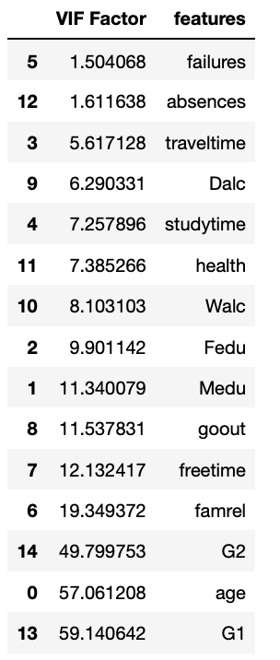
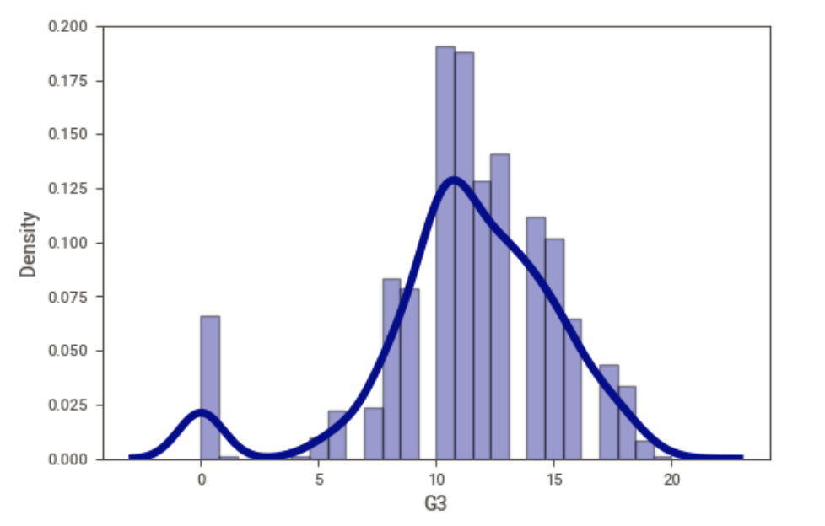
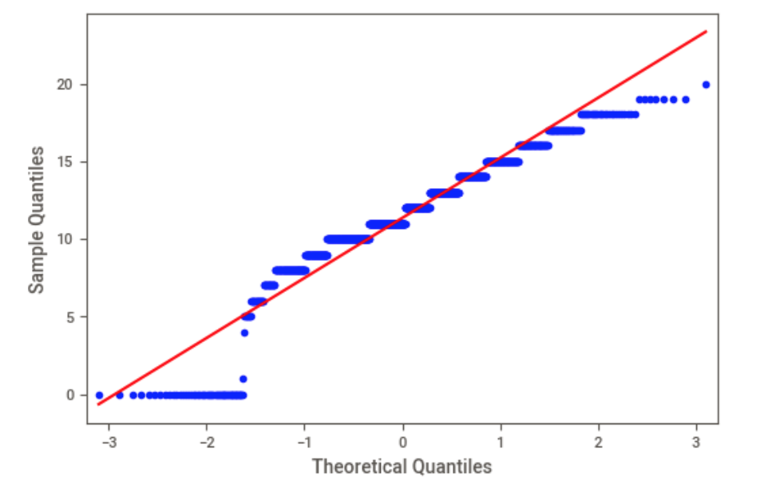
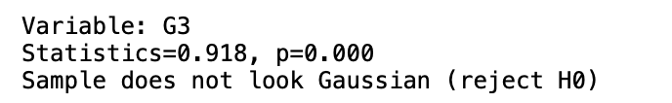
Do the Datasets meet the assumptions?
There are seven (7) variables with a VIF factor greater than 10. These variables have high multi-collinearity with the independent variables.
The histogram shows that the distribution of G3 is not close to a normal distribution because of all the zeros students have received.
The QQ-plot states that the distribution is not perfectly normal.
The Shapiro-Vilko test proved that the sample does not look Gaussian.
Histogram of G3
QQ-plot of G3
G3 - Shapiro-Vilko Normality Test Result

Slide 12
How to prepare the data?
It is complicated to adjust the dataset if it already does not meet the assumptions. However, first step is to identify the problem.
A few methods can be used to ensure the regression model performs well on the data.
Variables with a high VIF can be removed and the model performance compared to the one with and without these variables.
To ensure that the distribution of errors is normal, specific data points will have to be identified and manipulated. It is a long process and beyond the scope of this assignment.

Slide 13
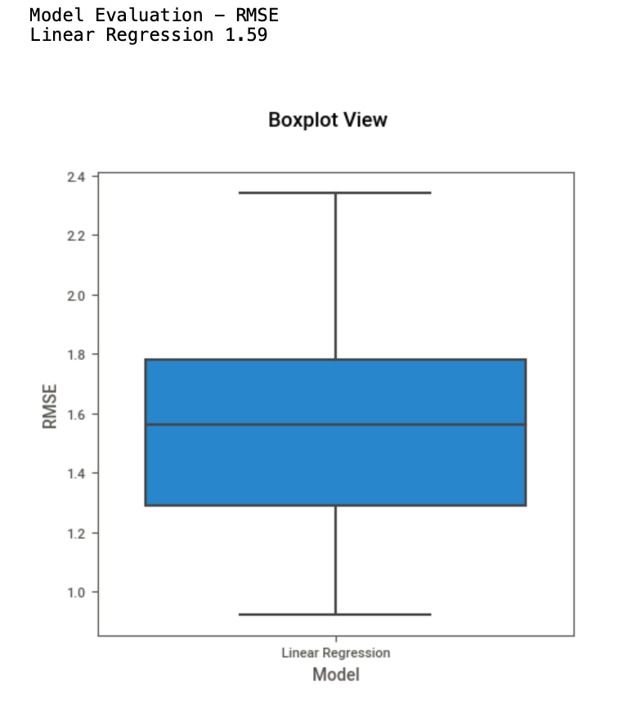
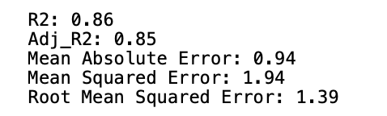
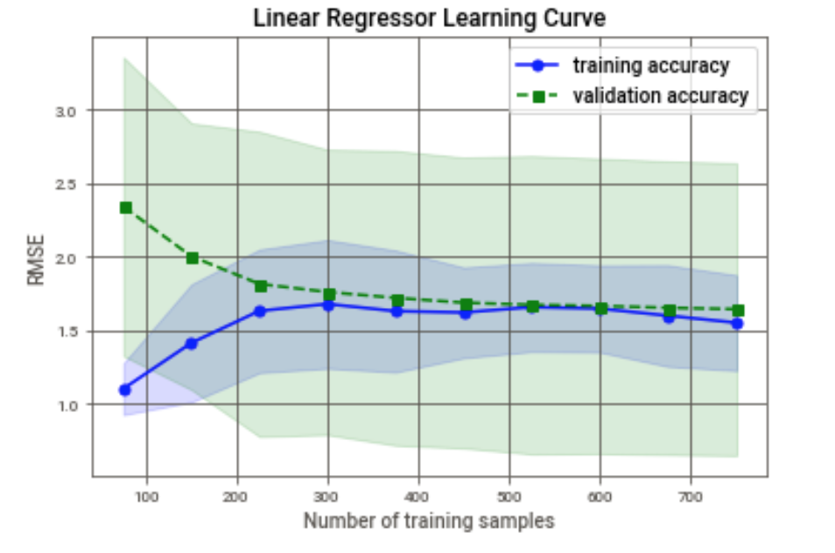
How did the baseline Regression models perform?
The baseline model performed well with a R2 score of 0.86 and an Adjusted R2 score of 0.85.
The learning curves follows the ideal learning paths, indicating that the model is not overfitting the dataset. The variance is low as the difference between the training and validation curves closes in.
The box plots shows the cross validated RMSE results. The mean is 1.59, which is higher than the threshold (1.13) RMSE value.

Slide 14
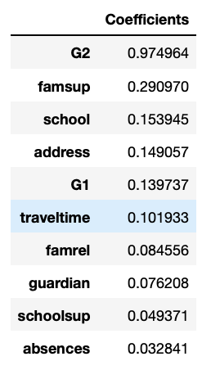
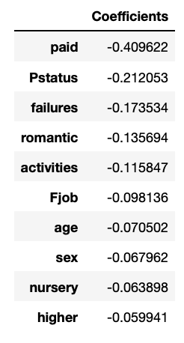
What were the most important features?
Feature importance in a regression model involves observing the coefficients of the regression equation. The larger the value of the coefficient, the larger the impact of the variable on the response or target variable.
The top 10 positive and negative coefficients are studied separately to understand the type of impact the variables have on the target variable.
Some interesting discoveries here:
Being involved in extra-curricular activities, in a romantic relationship and getting extra classes (paid) for the course has a negative impact on the a student’s final grade.
On the positive end, family support, school and grades in the first two periods (G1 and G2) have a positive impact on a student’s grades.
sex has a small effect on the grades of a student.

Slide 15
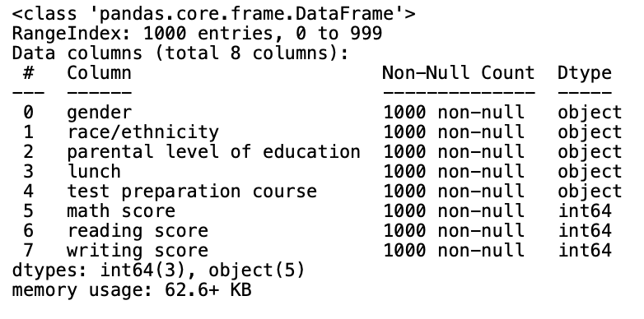
A little about the external dataset
The external dataset was found on Kaggle.
It contains marks achieved by students for various subjects.
Three key numerical variables reflect the grades of a student: `math score`, `reading score` and `writing score`.
There are five other variables in the dataset.
Two variables that are common between the datasets are:
Gender
Parental level of education.

Slide 16
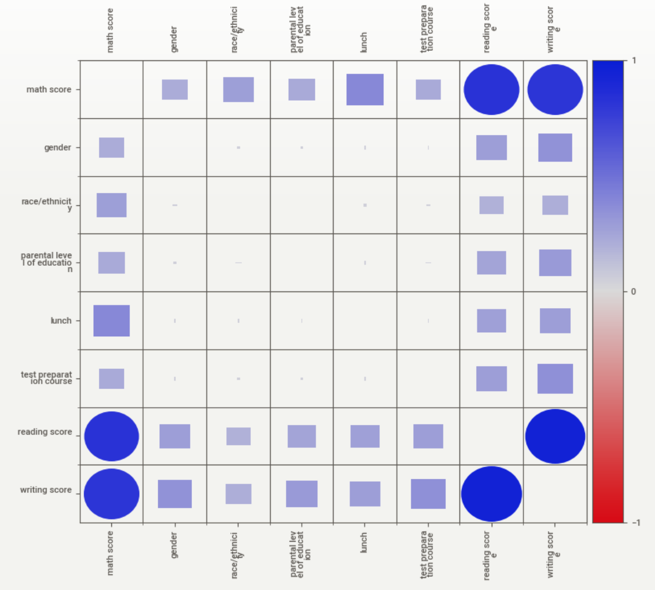
EDA – External Dataset
From the associations plot, it is evident that
`math score` is highly correlated to `reading score` and `writing score`.
After that the categorical variables seem to have a moderate correlation with `math score`.

Slide 17
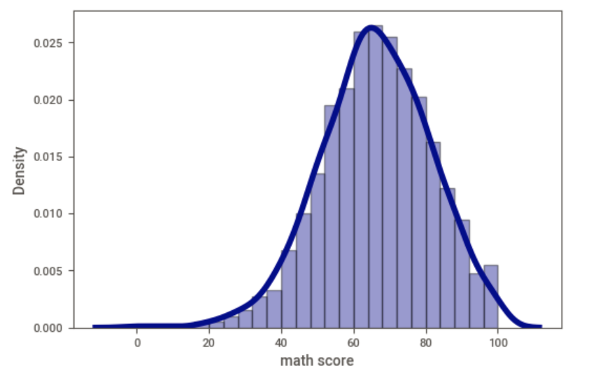
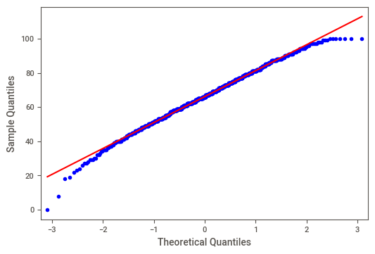
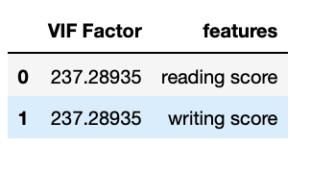
Does the external dataset meet the assumptions?
The histogram shows a good normal distribution of the data.
The QQ-plot shows that the distribution of errors follows a normal distribution for this dataset, unlike the previous one.
The VIF values are very high for both the variables and should be taken into considering when building a regression model.

Slide 18
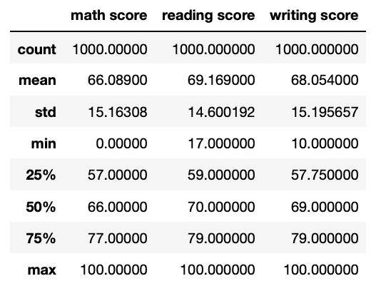
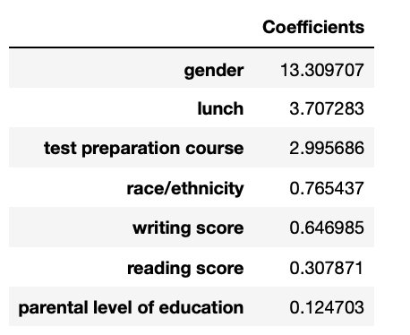
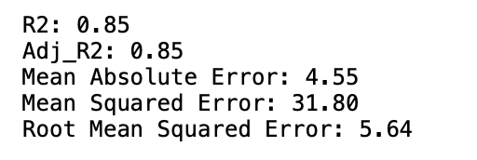
What about the performance and coefficients of this dataset?
The performance of the regressor model on the external dataset is the same as the one on `Math ` and `Portuguese`: R2 of 0.85 and Adjusted R2 of 0.85.
As the mean of `math score` is 66.1, the RMSE threshold falls under 6.61. The model’s RMSE is 5.64, hence, the performance of the model can be deemed good.
Finally, `gender` is playing the most important role in determining the grade achieved by a student, which is followed by `lunch` and `test preparation course`. The original model did not have a large coefficient for gender.

Slide 19
Putting it all together - Conclusion
The Ministry of Education wanted to analyze student performance datasets to create a regression model to predict the final grade of a student.
Exploratory data analysis of the datasets was carried out to understand the relationships in the data.
These relationships were then used to determine if two assumptions of a regression model are met, using VIF and QQ-plots.
The performance of a regression model was evaluated and feature importance carried out. Feature importance showed that family support, school and grades in the first two periods (G1 and G2) had a positive impact on a student’s grades.
A similar analysis was carried out on an external dataset.
The external dataset met the regression model assumptions better, hence yielded a better performing algorithm (in terms of RMSE).
Finally, feature importance of the external dataset showed that gender was the most important feature, while for the original dataset, `sex` have a small coefficient.

Slide 20
Some recommendations
Gather more data to gain a better understanding of the features that have a large impact on a student’s grades.
Improve the regression model through feature selection (removing variables with a high VIF value) and hyperparameter tuning.
Integrate survey results into the datasets to improve the understanding of the data.

Slide 21
Thank you!

