Slide 1

Our First Ideas An overview of the Spoiler Blocker Extension Capstone Project.
Spoiler Busters
Arunpriya Gobinath || 100841238
Jugnu Sheffin || 100814025
Ramasubramanian Dharumaperumal || 100810343
Raj Dholakia || 100813041
Sourabh Potdar || 100844478
Product Manager: Marcos Bittencourt
Notes:
Our first ideas, like first impressions from the project.

Slide 2
Contents of the Presentation
Splitting the Problem
Ideas – ML Algorithm
Ideas – Web Browser Extension
Ideas – Technologies
Concepts we might encounter

Slide 3









Splitting the Problem
Algorithm
Web Browser Extension
Data Sources
Product Manager
Notes:
A web browser extension that blocks any spoilers detected on the webpage. The solution to the spoiler problem can be
A machine learning algorithm will perform textual analysis and determine the content that needs to be hidden.
A web browser extension will provide an interface for users to make use of the machine learning
Deadline: 24/11/2021.
Product Manager: Marcos Bittencourt (weekly meetings)

Slide 4
Ideas – ML Algorithm
Data is the most important.
Train and test a model using Kaggle’s IMDb dataset.
Improve the model by scraping data from the IMDb website. A labelled dataset will be created using the reviews on IMDb, which are tagged with spoilers (if any).
Data can then be scraped from numerous other webpages that have reviews of film, series, book, etc. Examples: Goodreads, TVtropes
Algorithm
A classification algorithm will be needed to detect whether a piece of text contains any spoilers.
The specifics of the algorithm will be determined after some exploratory data analysis.
Read research papers to carry out background literature when taking a decision.
Notes:
Watch this video: https://www.youtube.com/watch?v=wdFaYKU5q3Y
Data is the most important.
Train and test a model using Kaggle’s IMDb dataset.
Improve the model by scraping data from the IMDb website. A labelled dataset will be created using the reviews on IMDb, which are tagged with spoilers (if any).
Data can then be scraped from numerous other webpages that have reviews of film, series, book, etc. Examples: Goodreads, TVtropes
Algorithm
A classification algorithm will be needed to detect whether a piece of text contains any spoilers.
The specifics of the algorithm will be determined after some exploratory data analysis.
Read research papers to carry out background literature when taking a decision.

Slide 5
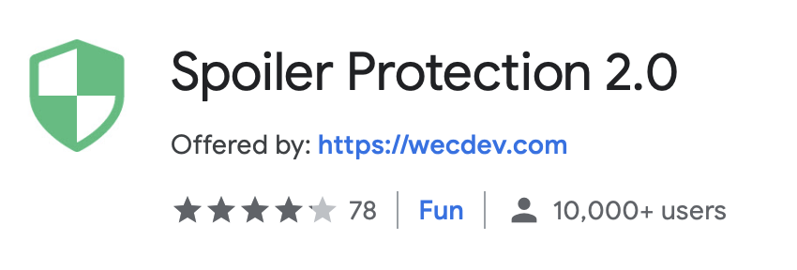
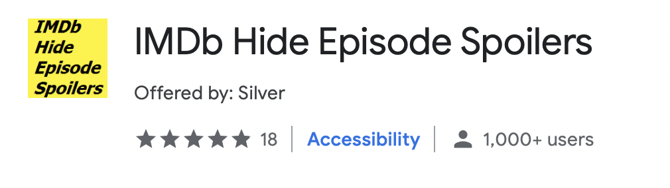
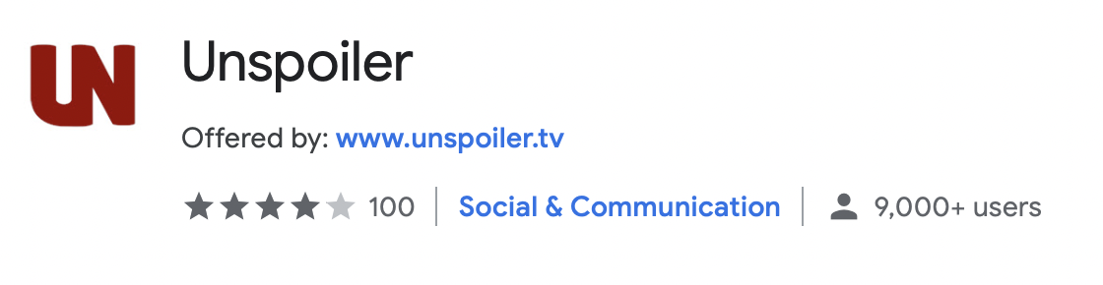
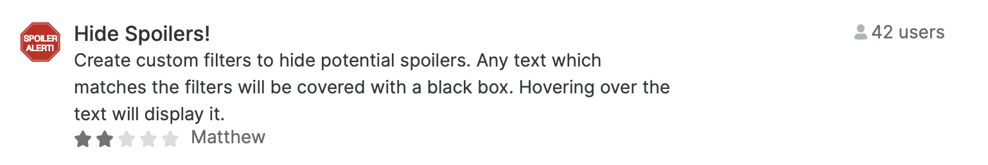
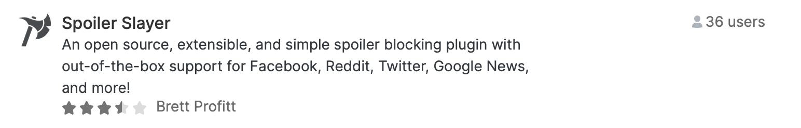
Ideas – Web Browser Extension
Understand the current extensions in the market by going through the Chrome Store and user ratings.
1
Extension can have the feature of replacing spoilers with multiple options.
2
Focus will be on creating a Web Browser extension that is easy to use over one that looks fancy.
3

Slide 6





Ideas – Technologies
Google Cloud Platform can be used to build, manage and deploy the spoiler detector algorithm.
Google Natural Language Processing capabilities.
Jupyter Notebooks and Google Colab Notebooks.

Slide 7
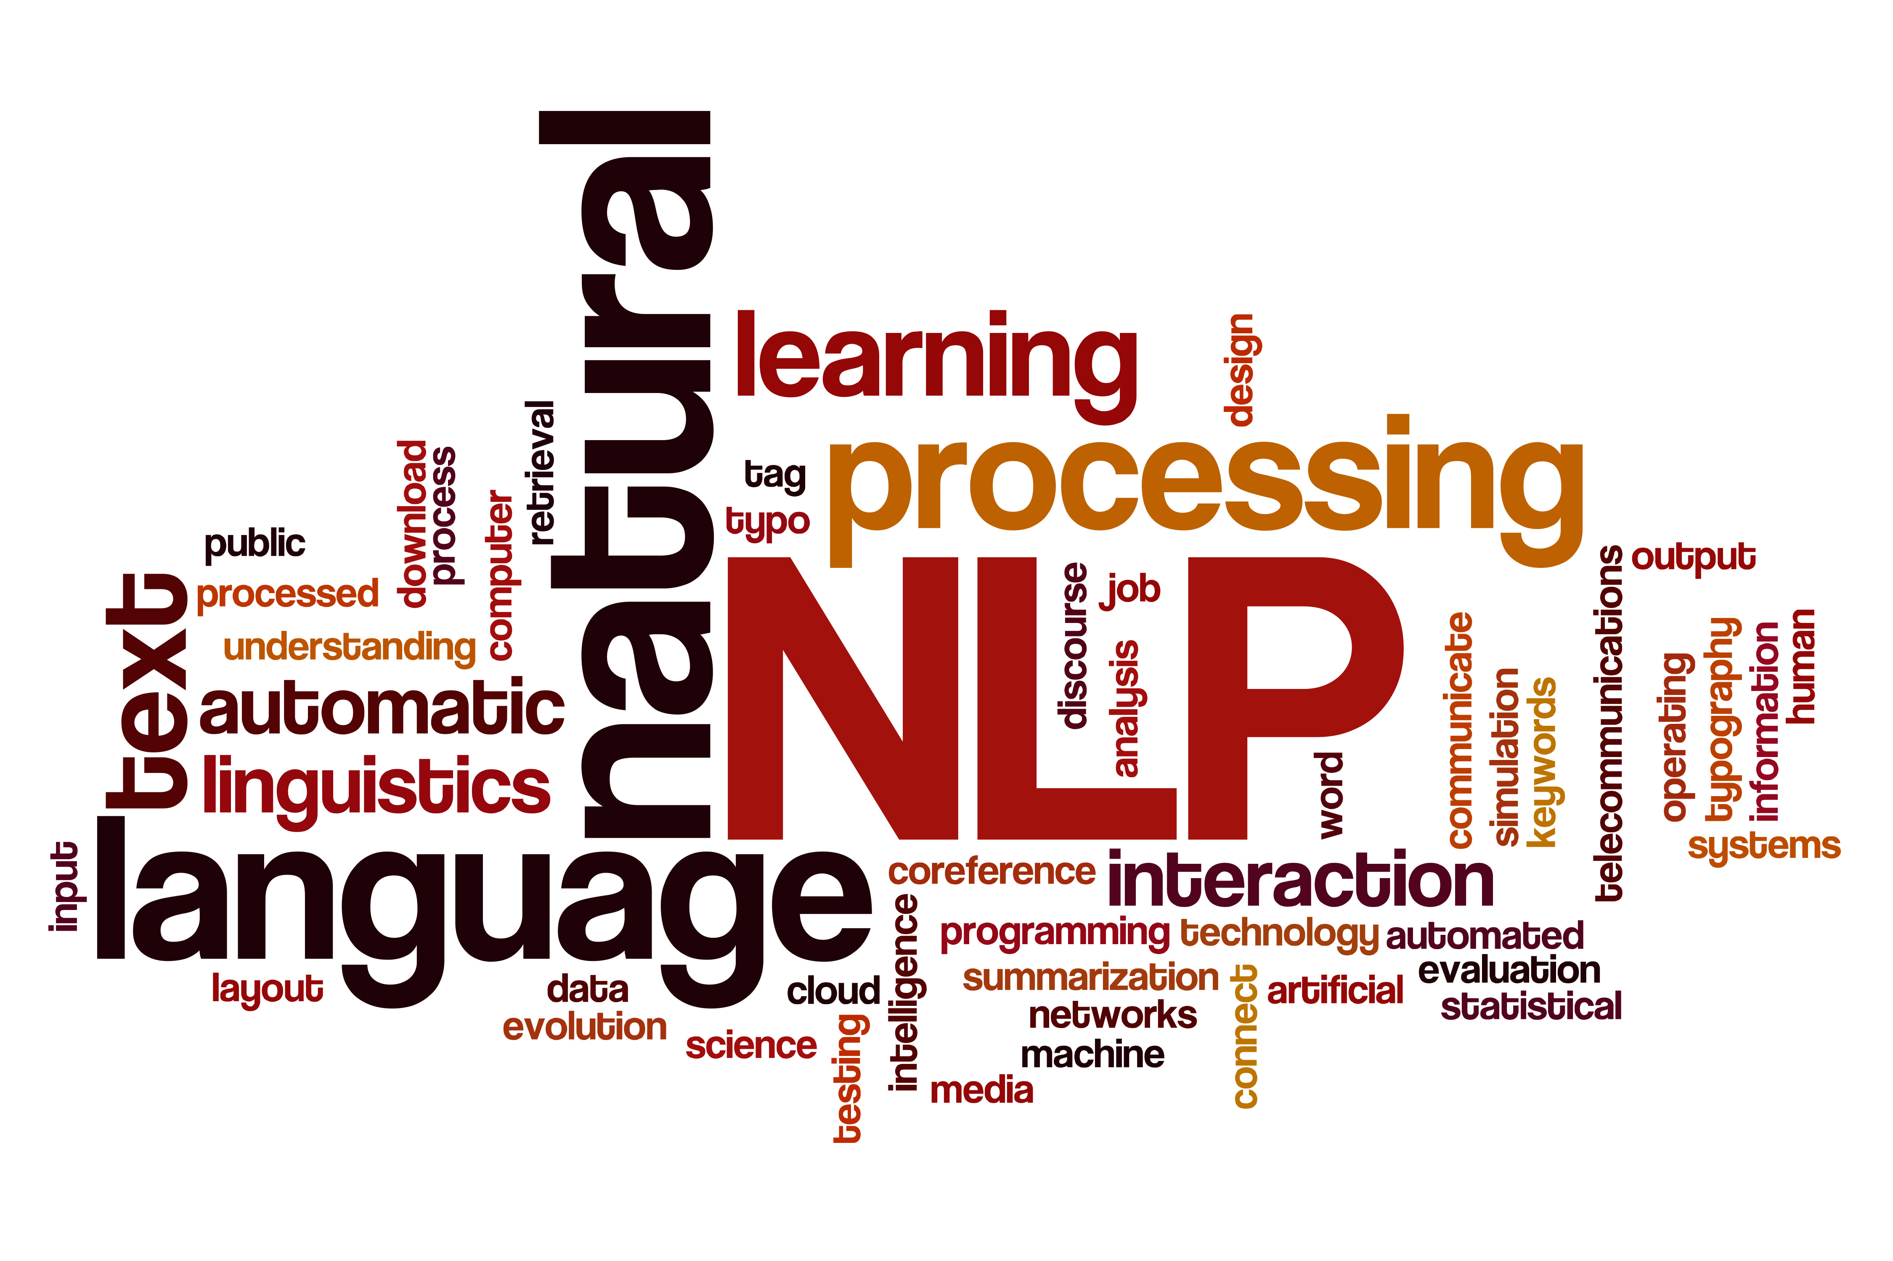
Concepts we might encounter
Natural Language Processing
Tokenization
Bag of Words
Neural Networks – TensorFlow
Transfer Learning
Creating Web Browser Extensions
https://aclanthology.org/P19-1248/
https://github.com/zhiming-xu/spoiler-detector

Slide 8
Thank you for listening! Any feedback?

