Slide 2
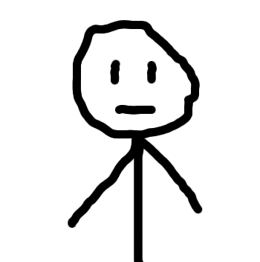
Meet Johnny
Johnny is a freshman
Johnny has a 251 quiz tomorrow
Johnny didn't got to office hours when he had the chance
All of Johnny's smart friends are busy doing smart things

Slide 3
Johnny is distressed.

Slide 4
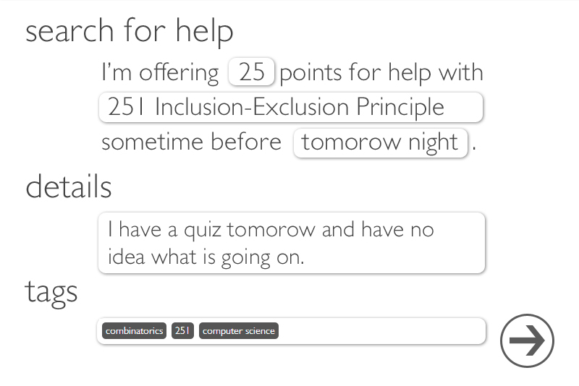

Slide 5
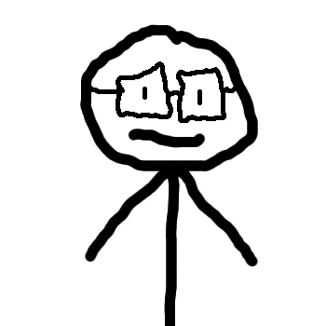
Meet Apoorv
Apoorv is a CS grad student
Apoorv likes tutoring for money
Apoorv is a busy dude

Slide 6
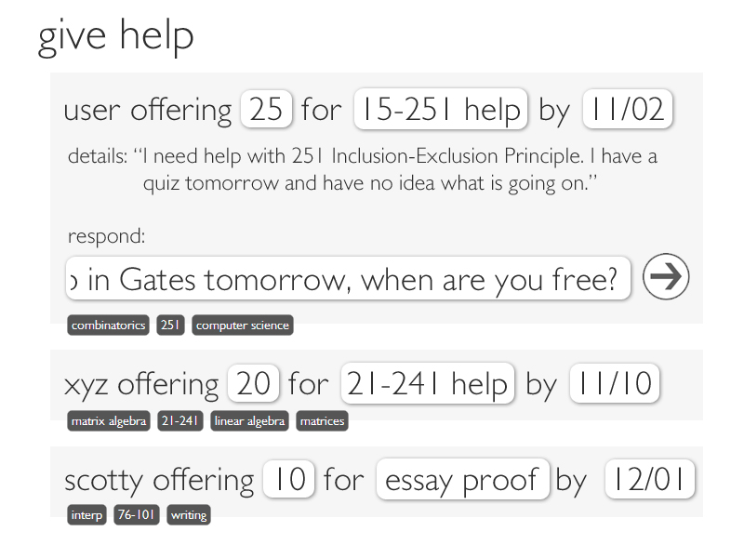

Slide 7
Cash Out
$$$$
Credit
Cash In
$$$$$
Credit

