Slide 1
Project: ADAS Framework
WHAT:
libs which dedicated to ADAS service
abstract/common modules , not depends on platform or project
modules designed for function improvement including
function safe
lesson & learn
use case management
key/KPI event monitoring

Slide 2
Project: ADAS Framework
WHY:
to setup baseline of adas service quickly, especially multi project ongoing at same time
to understand system more easily, a fixed and stable framework is required
HOW:
Code refactoring existed module from multi - project
identify common/key part to core, dedicated part to project
Framework shall be Improved by best practice, team review
Framework quality shall be guaranteed by core use case

Slide 3
Project: ADAS Framework
Module design:
1 main thread manager
2 module base
3 modules
3 case client
The purpose of ADAS Framework libs(four libs) is:
Abase.so: provide baseline ADAS application including RVC, SVC, AVM, MOD, PDC, APA, etc…
AGraphic.so: driver and graphic processing, including algorithm core for CoC team
AFoundation.so: basic class and component to support application development
CaseCleint.so: dedicate to support development use case management

Slide 4
Project: ADAS Framework
Main thread
Class name: manager
Major process:
Init system
Block on IPC message
Dispatch IPC message – module handle message
Module after handle

Slide 5
Project: ADAS Framework
Main thread
Class name: module control
Major process:
Init module
Call module handle

Slide 6
Project: ADAS Framework
Use Case Manager
caseclient
tool
init
Loading usecase
run usecase
Send dbus or string to caseclient deamon
PC
Use case management
dbus
dbus command to dbus deamon
caseclient
deamon
init
Connect with case client tool
Receive one message from client tool
Dbus or string ?
string
String to caseclient lib
Caseclient.lib
String-api map inited
Connect with case client deamon
Receive string ?
yes
use cases of app proj, dbus based use case is preferred, no register required for dbus based use case
adas application or
Adas core
init
Register to
String-API map
call API
IPC callback
use cases of app core, string-api based use case is preferred
HU

Slide 7
Project: ADAS Framework
RVCProj
RVCBase
Map<int, ID pfunc> m_map
vRegMap();
ModuleBase
Handle()=0;
afterHandle ()=0;{stateupdate()}
stateupdate(0=0;
showCamPrj()
showguidelinePrj()
IPCprj()
StateUpdatePrj\()
HandlePrj()
afterHandlePrj()

Slide 8
Project: ADAS Framework
Create projCamera
RegMap
Create ModuleCtrl
Create prjPDC
Message dispatch
Camera
Manager
ModuleCtrl->handle

Slide 9
Project: ADAS Framework
ADAS -QNX | ADAS -ANDROID | ADAS -LINUX
HMI
HMI
HMI
IPC(DBUS)
ADAS Service APIs
Franca IDL /Common API
JNI
ADAS Service
ADAS Service
IPC (Binder)
Guide
Line
RVC
PA
Calibration
DVR
SVC
RVC
MOD
Calibration
AVM
Native ADAS Service
Guide
Line
RVC
PA
Calibration
DVR
ADAS Framework
Presentation Controller-ADAS Framework
ADAS Framework
Info ADAS
OPGL
EGL
Screen(driver)
OPGL
EGL
V4L
OPGL
EGL
HAL
Vision SDK
QNX
Android
SYS/BIOS
Orinoco(Linux)

Slide 10
Deliverable : ADAS Framework
GWMV2 ADAS Service(Presentation Control)
GWMV2 ADAS Service(Presentation Control)
IPC GWMv2
Message handler GWMv2
ADAS manager GWMv2
RVC/SVC
GWMv2
AVM/MOD
GWMv2
PDC
GWMv2
APA
GWMv2
Diagnosis
GWMv2
ABase.so
AGraphc.so
AFoundation.so
CaseClient.so
Graphic engine
Presentation Core
Common
app framework
Abstract
IPC
ADAS Manager
Exception
Manager
Utility
Signal
Graphic Shell
Runable
Case Client
Conn
Mgr
Basic
RVC/SVC
Basic
PDC
Basic
PA
Basic
AVM
…
Cam
Hub
Fail
Safe
Config
Msg
Define
Graph
Thread
Event
IPC
mocker
Timer
Abstract
Client
Cam
State
Sns
Hub
Park
Assist State
AVM/MOD State
signal State
(driver)
Diagnosis
Command Line
Data
Type
Observer
Mocker
IPC/API
Cam Driver
Thread
(early)
Abstract
Server
Prio
Ctrl
Sns
State
Queue
Algorithm
Core
AVM/MOD
(CoC)
Msg
Handler
CommonAPI
Adapter
Over
ride
Ctrl
LookUp
Table
State
State machine
ADAS Framework
OS/Driver

Slide 11
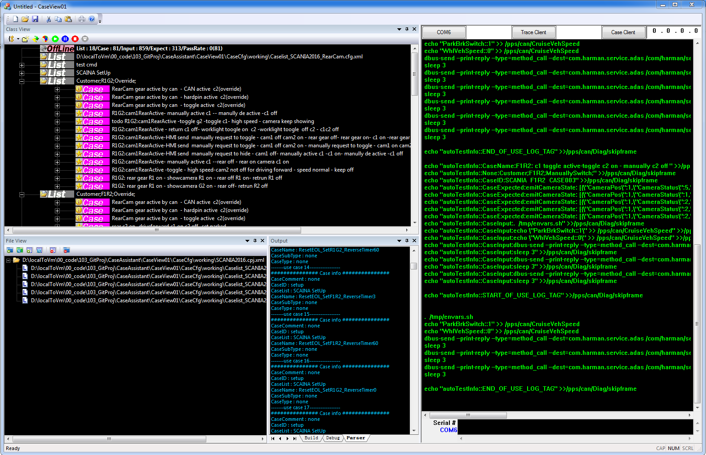
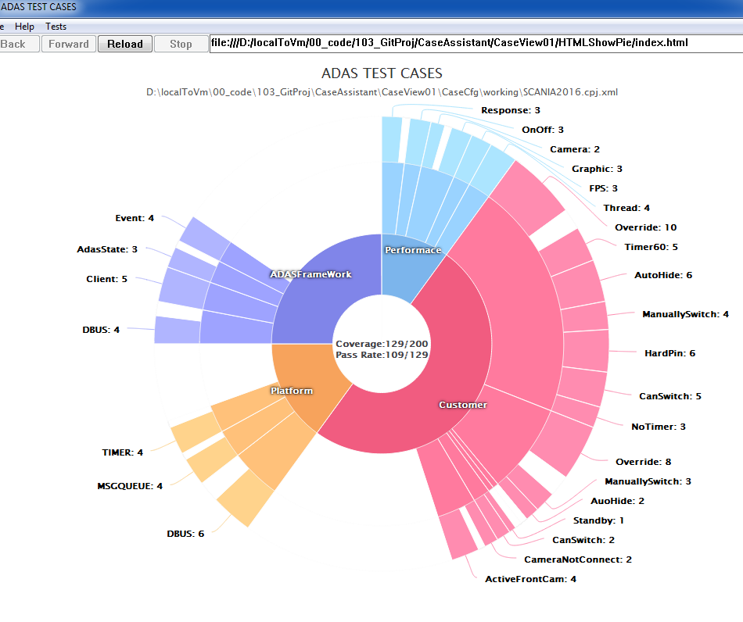
Project: Case Client

