Slide 1


Rapid Realization of Communication Services System
Design Document
The Fantastic 5/4’s
CEN5064/CEN4021 SRAD
Denis Antoine(Team Leader)
Harika Chirumamilla(Time Keeper)
Marcelo Lopez(Minute Taker)
Jean-Marc Rodriguez(Cross Functional/ Development)

Slide 2

Denis Antoine
Team Leader
Phase II:
Jean Rodriguez
GMF developer
Harika Chirumamilla
Minute Taker
Marcelo R. Lopez, Jr.
GMF Consultant
Jean Rodriguez
Team Leader
Marcelo R. Lopez, Jr.
Team Leader
Phase I:
Phase III:
Denis Antoine
Minute Taker
Harika Chirumamilla
Time Keeper
Marcelo R. Lopez, Jr.
Cross functional
/Development
Jean Rodriguez
GMF developer
Harika Chirumamilla
Minute Taker
Marcelo R. Lopez, Jr.
GMF Consultant

Slide 3
Overview of the System
Our system will be broken down into several subsystems. The two chosen architecture patterns are repository and model view control. We will illustrate the metamodel used to create the model in the Communication Modeling Environment. Also, the architecture will be represented by some UML profiles, which will consequently lead to the transformations expected from the architecture to the platform. Finally, the object interactions will be illustrated by two sequence diagrams.

Slide 4
System Requirements
The system shall:
1) Allow health care professionals to create communication models based on the CML language.
Use cases: All use cases related to General Connection.
Use Case ID(s): C01_GeneralConnection, C02_TextOnlyConnection, C03_TextAudioConnection and Ca04_Audio Video Connection.
2) Allow health care professionals to communicate with one or many users using audio, video and text conversations.
Use cases: All use cases related to General Connection.
Use Case ID(s): C01_GeneralConnection, C02_TextOnlyConnection, C03_TextAudioConnection and C04_Audio Video Connection.
3) Allow health care professionals to establish a conversation with either Skype or GoogleTalk.
Use cases: All use cases related to General Connection.
Use Case ID(s): C01_GeneralConnection, C02_TextOnlyConnection, C03_TextAudioConnection and C04_Audio Video Connection.

Slide 5
System Requirements continued
4) Allow health care professionals to use a workflow model to establish communication models that can execute alternate conversation activities.
Use cases: All use cases related to General Connection and Workflow Connection.
Use Case ID(s): C01_GeneralConnection, C02_TextOnlyConnection, C03_TextAudioConnection, C04_Audio Video Connection, W01_WorkflowWithAlternate and W02_WorkflowWithRetry.
5) Allow health care professionals to use workflow to build communication models that can try a conversation activity repeatedly until a connection is established.
Use cases: All use cases related to General Connection and Workflow Connection.
Use Case ID(s): C01_GeneralConnection, C02_TextOnlyConnection, C03_TextAudioConnection, W01_WorkflowWithAlternate and W02_WorkflowWithRetry.
6) Allow health care professionals to send and receive files within a conversation.
Use cases: All use cases related to File Transfer.
Use Case ID(s): F01_SendFile, F02_SendFileFailed, F03_ReceiveFile, F04_ReceiveFileFailed, F05_ RejectUnwantedFile, T506, F07_FileTransferCancelled

Slide 6
Design Methodology
The software development model that has been used in the project is Unified Software Development Process (USDP). It is a component-based, use case driven, architecture centered, iterative and incremental developmental process that uses the Unified Modeling Language (UML) to represent models of the software system to be developed.
The main reason is because it provides traceability features, which is important as it provides means for mapping model artifacts among several stages of the project, & it is use case driven. The iterative & incremental features help refine the final product as we get to know specific implementation platforms, namely Eclipse GMF and the Skype library. The use case approach for gathering the systems requirements was also suitable to collect the functional requirements in this project.
In addition, we eased the design of the system by using architectural and design patterns. The architectural patterns used are: Model View Controller, Pipe and Filter. We used the UML 2.0 notation for specifying the different artifacts of the system. The UML models used in the project are: uses case diagrams, class diagrams, sequence diagrams, UML profiles.

Slide 8
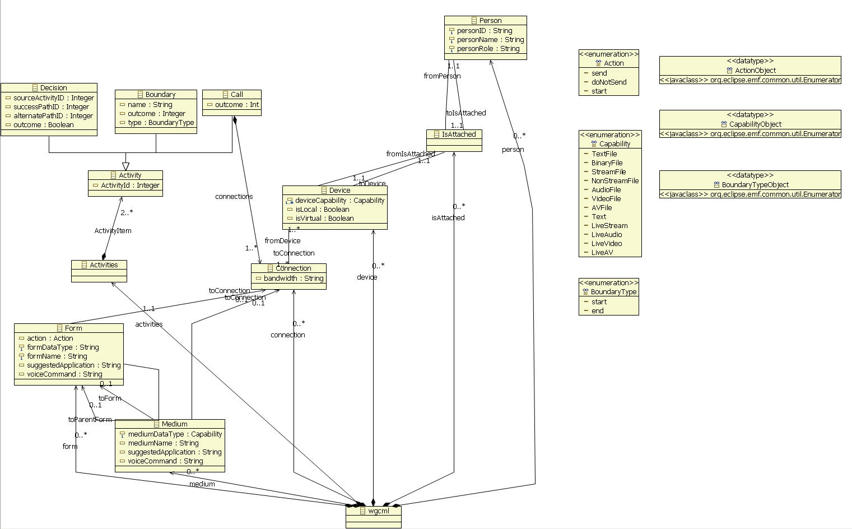
Metamodel for CML

Slide 9
Software Architecture

