Slide 1
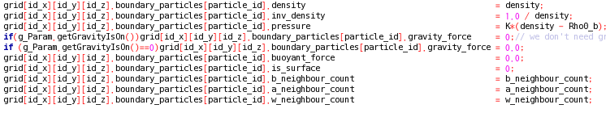
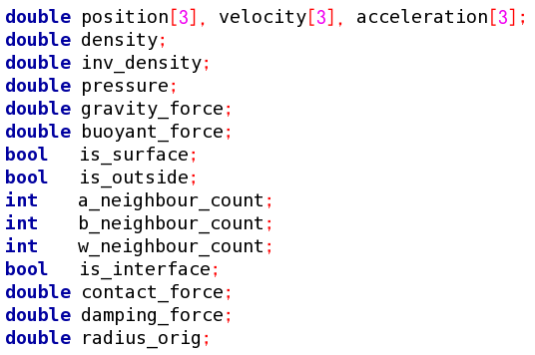


To change or look at a property you have to go to the right location. It works the same way that computer folders work.
For example:
to open a file on your computer
  C:/Users/travis/document/file.txt
To change the density of a water particle5 to 3
  grid[4][7][1].water_particle[5].density =3
grid[4][7][1]
Water_particle1
Water_particle2
Water_particle3
Water_particle4
Water_particle5
Water_particle6
…..
….
boundary_particle1
boundary_particle2
boundary_particle3
boundary_particle4
boundary_particle5
boundary_particle6
…..
….
air_particle1
air_particle2
air_particle3
air_particle4
air_particle5
air_particle6
…..
….
Grid[4][7][1]
Water_particle5
density

Slide 2
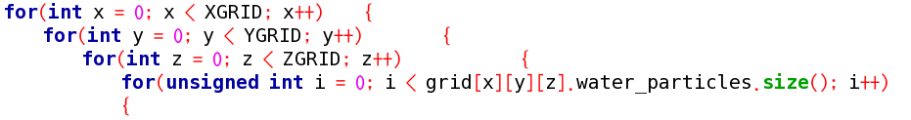
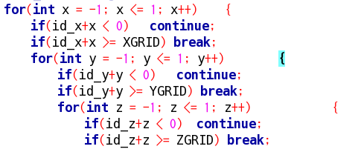
Search through all grids
  search through all water particles.
Total number of water particles in this grid index
The current grid location is grid[id_x][id_y][id_z]when
Iterator x,y,z =0
Ex: grid[4][5][9]
When int x = -1 y=0 z=0
Grid[3][5][9] is a neighbor grid that is just left in the x direction of the current grid. We want to search all the surrounding grids as well as the current grid.
In total this loop will iterate through 27 grids and go through all the water particles in each grid

