Slide 1



DITA and Markdown
Alex Jitianu
alex_jitianu@oxygenxml.com
@AlexJitianu
© 2019 Syncro Soft SRL. All rights reserved.

Slide 2
Agenda
Content and markup
Structured authoring
Markdown
DITA
Markdown and DITA inside a documentation project

Slide 3
It all starts with the content
Create a Google account
How to create or set up your Google Account on your mobile phone.
From a Home screen, swipe up to access Apps.
Tap Settings > Accounts
Tap Add account > Google.
A typical task
Notes:
“Through content we convey knowledge to the reader”

Slide 4
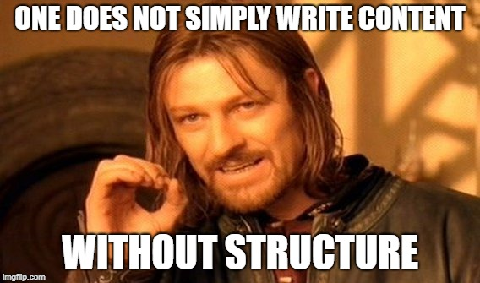
Content alone is not enough

Slide 5
Why do we need structure?
Defines the organization/model of content
Helps us enforce the defined model
Increases consistency
Automatic processing
Faster publishing workflows
Notes:
Consider, for example, a simple structured document—a recipe. A typical recipe requires several components: a name, a list of ingredients, and instructions. The style guide for a particular cookbook states that the list of ingredients should always precede the instructions.
In an unstructured authoring environment, the cookbook editor must review the recipes to ensure that the author has complied with the style guideline. In a structured environment, the recipe structure requires and enforces the specified organization
Automatic processing (reduces errors)
Doing things manually can insert a lot errors. If you are able to automate (like quality checks) you reduce the errors/delays.
“We are not just gaining consistency, we also get a content that can be automated!”
“Nobody wants to get back to those dark days. The only way forward is structure!”
“”Faster publishing workflows: Quality Assurance is done faster, thanks to the structure. Everything is automated.

Slide 6
What Meaning Lies Beneath
Title
Create a Google account
How to create or set up your Google Account on your mobile phone.
From a Home screen, swipe up to access Apps.
Tap Settings > Accounts
Tap Add account > Google.
Short description
Procedure

Slide 7
Encode it with a Markup Language
Title
Create a Google account
How to create or set up your Google Account on your mobile phone.
From a Home screen, swipe up to access Apps.
Tap Settings > Accounts
Tap Add account > Google.
Short description
Procedure

Slide 8

Markdown
Create a Google account
============
How to create or set up your **Google Account** on your mobile phone.
* From a Home screen, swipe up to access Apps.
* Tap **Settings** > **Accounts**
* Tap **Add account** > **Google**.
Easy to learn
Minimalistic
Many authoring
tools available
Publishing tools

Slide 9
XML
e(X)tensible (M)arkup (L)anguage
Define your own tags/markup
Powerful mechanisms to enforce valid content structure (DTD/Schema/Schematron)
Notes:
“instead of starting from scratch, inventing our own model, we can choose an existing XML-based standard, and that’s what DITA is”

Slide 10

DITA
DITA is an XML-based open standard for structuring, developing, managing, and publishing content.
Semantic markup (separates formatting from content)
Strong content reuse concepts
Restrictions and specializations
Huge ecosystem of publishing choices
Notes:
“The bird on the logo is actually a finch”
Semantic markup tends to be one of the least-appreciated strengths in DITA. In authoring environments oriented toward the presentation of content, writers tag their content with elements such as <p> (paragraph), <li> (list item>, or <b> boldfaced. Looking at the tags, it is impossible to determine what type of content should actually be captured by those tags. In contrast, DITA makes available a baseline set of tags that describe the meaning (semantics) of the content captured by those tags. To capture a sequence of GUI menu selections, for example, you would enter <menucascade><uicontrol>File</uicontrol><uicontrol>Export</uicontrol><uicontrol>to PDF</uicontrol></menucascade>. To capture a formal step in a procedure, I would enter <step><cmd>Select the node in your
TODO Exemplul cu emphasis: publicat in HTML este un amarat de bold, dar in audio este “tone of voice”.
“With MD you'll never have this but perhaps, in some cases, you wont need it....”

Slide 11
Side by side
<task id="create_google_account">
<title>Create a Google account</title>
<shortdesc>How to create or set up your <term>Google Account</term> on your mobile phone.</shortdesc>
<taskbody>
<steps>
<step>
<cmd>From a Home screen, swipe up to access Apps.</cmd>
</step>
<step>
<cmd>Tap <menucascade>
<uicontrol>Settings</uicontrol>
<uicontrol>Accounts</uicontrol>
</menucascade></cmd>
</step>
<step>
<cmd>Tap <menucascade>
<uicontrol>Add account</uicontrol>
<uicontrol>Google</uicontrol>
</menucascade></cmd>
</step>
</steps>
</taskbody>
</task>
Create a Google account
============
How to create or set up your **Google Account** on your mobile phone.
1. From a Home screen, swipe up to access Apps.
1. Tap **Settings** > **Accounts**
1. Tap **Add account** > **Google**.
Notes:
“When you put them side by side, the same content appears, the markup is different. The DITA part may look more intimidating but...”

Slide 12
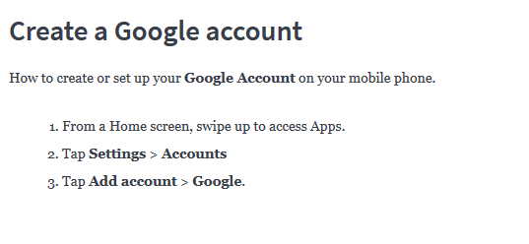
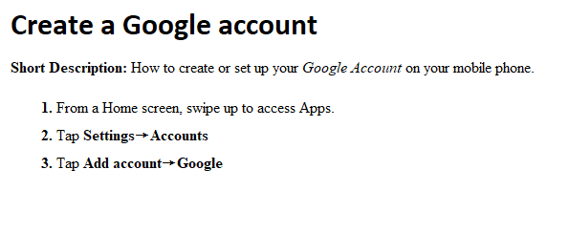
Side by side – visual mode
Notes:
“... if you switch to visual mode they look pretty much the same. There are quite many editors that support this so the structure complexity is not a real issue.”

Slide 13
Scenario
Main documentation project written in DITA
Contributors (devs) sending content in Markdown
Notes:
“In the wild you get all sorts of setups. You have documentation teams using MD or DITA exclusively but we will focus on this scenario and see how these two markup languages fare together.”

Slide 14
[1] Convert MD to DITA
MD => HTML => DITA
  https://pandoc.org/
  http://dita-ot.sourceforge.net/1.5.2/readme/DITA-h2d-ant.html#h2d-ant
MD => DITA
  DITA-OT plugin developed by Jarno Elovirta
  https://github.com/jelovirt/dita-ot-markdown
  Oxygen Batch Converter plugin
  https://github.com/oxygenxml/oxygen-resources-converter
Notes:
If this is a one time thing, you can just convert them and move forward, never looking back.
http://blog.oxygenxml.com/2019/01/migrating-various-document-formats-to.html

Slide 15
[2] Keep MD and use it in DITA
Dynamic conversion (custom URL)
  https://en.wikipedia.org/wiki/URL
  <topicref href="md2dita:/topic.md" format=”dita"/>
  https://github.com/oxygenxml/dita-glass
Scheme
Domain name
Path
Notes:
Motivation! “The conversion aproach is not great if the MD evolve. They are changed both by you and the by SMEs (devs). In such cases the conversion becomes cumbersome.”
[Demo] Show a map, publish it
[TODO] Why?
These MD topics evolve. They are changed both by you and the devs. In this casethe conversion can become cumbersome.
“Over the years, both we, at oxygen, and the DITA community have searched for solutions. So now you can have your pick.”
md2dita encodes a conversion pipeline from Markdown to DITA, applied as the URL is read.
Any processing workflow using URLs can use it!

Slide 16
[2] Keep MD and use it in DITA
Dynamic conversion (custom URL)
  <topicref href="md2dita:/topic.md" format=”dita"/>
  https://github.com/oxygenxml/dita-glass
Refer MD files directly in your map
  <topicref href="tasks/changingtheoil.md" format="markdown"/>
Seamless publishing
Notes:
Motivation! “The conversion aproach is not great if the MD evolve. They are changed both by you and the by SMEs (devs). In such cases the conversion becomes cumbersome.”
[Demo] Show a map, publish it
[TODO] Why?
These MD topics evolve. They are changed both by you and the devs. In this casethe conversion can become cumbersome.
“Over the years, both we, at oxygen, and the DITA community have searched for solutions. So now you can have your pick.”
md2dita encodes a conversion pipeline from Markdown to DITA, applied as the URL is read.
Any processing workflow using URLs can use it!

Slide 17
Using specific DITA concepts in MD
Metadata
Specialization types
Titles and document structure
Image and Key references
https://github.com/jelovirt/dita-ot-markdown/wiki/Syntax-reference
Notes:
[TODO] Samples

Slide 18
[2] Keep MD and use it in DITA
Dynamic conversion (custom URL)
  <topicref href="md2dita:/topic.md" format=”dita"/>
  https://github.com/oxygenxml/dita-glass
Refer MD files directly in your map
  <topicref href="tasks/changingtheoil.md" format="markdown"/>
  <topicref href="tasks/changingtheoil.md" format="mdita"/>
Seamless publishing
Notes:
Motivation! “The conversion aproach is not great if the MD evolve. They are changed both by you and the by SMEs (devs). In such cases the conversion becomes cumbersome.”
[Demo] Show a map, publish it
[TODO] Why?
These MD topics evolve. They are changed both by you and the devs. In this casethe conversion can become cumbersome.
“Over the years, both we, at oxygen, and the DITA community have searched for solutions. So now you can have your pick.”
md2dita encodes a conversion pipeline from Markdown to DITA, applied as the URL is read.
Any processing workflow using URLs can use it!

Slide 19
What is Lightweight DITA?
LwDITA is a proposed standard for expressing simplified DITA documents in XML, HTML5, and Markdown.
The core goals of LwDITA:
  Provide a simpler DITA experience
  Provide mappings between XML, HTML5, and Markdown that enable individuals to:
    Author content in the format of their choice
    Easily exchange and publish content whose source exists in these different markup languages

Slide 20
What is Lightweight DITA?
LwDITA is a proposed standard for expressing simplified DITA documents in XML, HTML5, and Markdown.
The core goals of LwDITA:
  Provide a simpler DITA experience
  Provide mappings between XML, HTML5, and Markdown that enable individuals to:
    Author content in the format of their choice
    Easily exchange and publish content whose source exists in these different markup languages

Slide 21
Advantages
Single sourcing across DITA and Markdown
Collaboration on Markdown source
Use DITA features and publishing options with Markdown
Use Markdown publishing options
  https://github.com/jelovirt/dita-ot-markdown#generating-markdown-output
  Make use of publishing platforms like Jekyll, Vuepress, Mkdocs etc.
    https://nostalgic-hamilton-b6dae0.netlify.com/
Notes:
- “Single source doesn't necessarily means ONE format. “

Slide 22
Disadvantages
Markdown lacks semantics
  https://github.com/IBM-Cloud/docs-services/tree/staging#getting-started-template
  https://raw.githubusercontent.com/IBM-Cloud/docs-services/staging/getting_started_template/servicename_task.md
Notes:
1. “The biggest loss is the lost of semantics! ”
2. “How to you ensure you are getting GOOD Markdown. One that converts to LW, maybe, that has strict requirements? The only possiblity that I’ve encounter is to deploy a good-o’l-fashion Styleguide! Seems like a step backwards...relying on people reading and remembering big styleguides, not being able to enforce them on the fly!!”
3. In MD you can’t put lists inside a table. If, for sme reasons, you need to do that, then you have no other choice than to convert to DITA.
4. If you want to track changes, to see differences, things get more complicated. In MD you can not add annotations so you don’t have a way to encode track changing into the document.
TODO: Maybe have a diagram for the flow
TODO: The second flow is a bit difficult to digest... Someone that chose to convert MD->DITA, did the Reviewing like this:
When done on the Markdown source
Hard to see changes (diffs needed). No standardized review/change tracking.
When converting Markdown to DITA
Overhead. Encoutered workflow: Writer generates PDF => Devs review on PDF => Writer incorporates Review.

Slide 23
Disadvantages
Markdown lacks semantics
Consistency challenges (not a standard, can receive different flavors)
  https://github.com/IBM-Cloud/docs-services/tree/staging#getting-started-template
  https://raw.githubusercontent.com/IBM-Cloud/docs-services/staging/getting_started_template/servicename_task.md
Notes:
1. “The biggest loss is the lost of semantics! ”
2. “How to you ensure you are getting GOOD Markdown. One that converts to LW, maybe, that has strict requirements? The only possiblity that I’ve encounter is to deploy a good-o’l-fashion Styleguide! Seems like a step backwards...relying on people reading and remembering big styleguides, not being able to enforce them on the fly!!”
3. In MD you can’t put lists inside a table. If, for sme reasons, you need to do that, then you have no other choice than to convert to DITA.
4. If you want to track changes, to see differences, things get more complicated. In MD you can not add annotations so you don’t have a way to encode track changing into the document.
TODO: Maybe have a diagram for the flow
TODO: The second flow is a bit difficult to digest... Someone that chose to convert MD->DITA, did the Reviewing like this:
When done on the Markdown source
Hard to see changes (diffs needed). No standardized review/change tracking.
When converting Markdown to DITA
Overhead. Encoutered workflow: Writer generates PDF => Devs review on PDF => Writer incorporates Review.

Slide 24
Disadvantages
Markdown lacks semantics
Consistency challenges (not a standard, can receive different flavors)
Markdown language restrictions
No reuse mechanisms
Review/Collaboration tracking challenges
  When done on the Markdown source
    No support for tracking changes
    Difficult to visualize changes (diffs needed)
  When done on converted content, like PDF
    Writer Generate PDF => Devs review on PDF => Writer incorporates Review.
    Extra overhead to incorporate review into source
Notes:
1. “The biggest loss is the lost of semantics! ”
2. “How to you ensure you are getting GOOD Markdown. One that converts to LW, maybe, that has strict requirements? The only possiblity that I’ve encounter is to deploy a good-o’l-fashion Styleguide! Seems like a step backwards...relying on people reading and remembering big styleguides, not being able to enforce them on the fly!!”
3. In MD you can’t put lists inside a table. If, for sme reasons, you need to do that, then you have no other choice than to convert to DITA.
4. If you want to track changes, to see differences, things get more complicated. In MD you can not add annotations so you don’t have a way to encode track changing into the document.
TODO: Maybe have a diagram for the flow
TODO: The second flow is a bit difficult to digest... Someone that chose to convert MD->DITA, did the Reviewing like this:
When done on the Markdown source
Hard to see changes (diffs needed). No standardized review/change tracking.
When converting Markdown to DITA
Overhead. Encoutered workflow: Writer generates PDF => Devs review on PDF => Writer incorporates Review.

Slide 25
Markdown Consistency Challenges
What can we do?
Notes:
TODO: add a Schematron rule presentation as well

Slide 26
Vale
A syntax-aware linter for prose built with speed and extensibility in mind. https://errata-ai.github.io/vale/
Supports plain text, markup (Markdown, reStructuredText, AsciiDoc, and HTML)
YAML-based extension system
Notes:
TODO: add a Schematron rule presentation as well

Slide 27
Vale
Support the following types of rules/styles:
  Existance
  Substitution
  Occurrence
  Repetition
  ….......
extends: existence
message: "Don’t use end punctuation in headings."
link: https://docs.microsoft.com/en-us/style-guide/punctuation/periods
nonword: true
level: warning
scope: heading
tokens:
- '[a-z0-9][.?!](?:\s|$)'
https://errata-ai.github.io/vale/styles/#creating-a-style
https://github.com/errata-ai/Microsoft/blob/master/Microsoft/HeadingPunctuation.yml
Notes:
TODO: add a Schematron rule presentation as well

Slide 28

Markdown Consistency Challenges
XML/DITA has Schematron
It does structure checks too
<sch:pattern>
<sch:rule context="topic">
<sch:assert test="shortdesc">Please add a short description.</sch:assert>
</sch:rule>
</sch:pattern>
Notes:
TODO: add a Schematron rule presentation as well

Slide 29
Schematron for Markdown
Markdown syntax maps to a subset of HTML tags
HTML maps to XHTML
Apply Schematron on XHTML with backmapping support
Notes:
TODO: add a Schematron rule presentation as well

Slide 30
Why do Devs tend to use Markdown?
It has a low learning curve
You do things fast
Don't have time to learn another language
They don’t need any additional tool installed on their system
Notes:
Why to some SMEs (especially devs) insist on using another format, like MD? Because:
- it has a low learning curve,
- you do things fast. They don't need the full expresiveness of DITA for what they want to do.
- without a strong incentive, don't have time to learn another language
“In the end is all about empowering these casual contributors!”

Slide 31
[3] Could Devs write DITA?
Learn it as you use it through Markdown2DITA controlled conversions. Like a “Learning assistant”.
  Powered by Schematron Quick Fixes
  https://github.com/oxygenxml/ditaMark
Give Devs specialized editing enviroments (cloud based):
  Specialized UI (e.g. HTML form) that generates consistent DITA
  Specialized Web based DITA editors
    Oxygen XML Web Author
    Oxygen Content Fusion
Notes:
“Teansition to DITA”
Hint: “Web-based because you don't want to force devs to install software, just have them follow a link.”

Slide 32
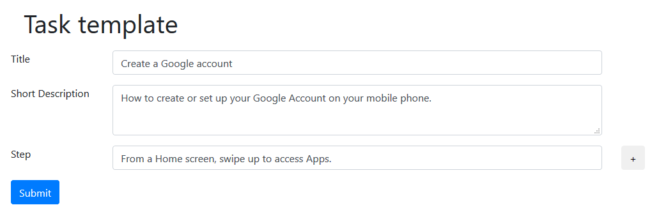
Could Devs write DITA?
Notes:
“Transition to DITA”
Hint: “Web-based because you don't want to force devs to install software, just have them follow a link.”

Slide 33
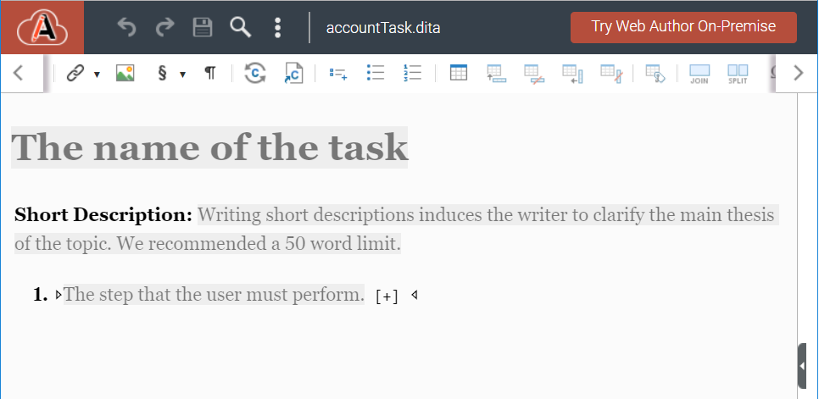
Could Devs write DITA?
Notes:
“Transition to DITA”
Hint: “Web-based because you don't want to force devs to install software, just have them follow a link.”
https://www.oxygenxml.com/oxygen-xml-web-author/app/oxygen.html?url=gdrive%3A%2F%2F%2F108285114201499919509%2Fdrive%2F0AJftbVBvwB6eUk9PVA%2FContul%2Bmeu%2BDrive%2FaccountTask.dita&author=Alex%20Jitianu

Slide 34
Conclusion
There is no one-size-fits-all solution
Convert if it's a one time thing
Keep them together and achieve single sourcing
Consistency/Collaboration might require a switch to DITA
Notes:
- Not all solutions work for everyone
- some things can be converted, like those that are unlikely to change. For example “Release notes”.
- If they will change over time then either:
---keep the MD as the single source of truth
---make them contribute DITA content to surpass the MD language limitations and collaboration chalenges

Slide 35
THANK YOU!
Any questions?
Alex Jitianu
alex_jitianu@oxygenxml.com
@AlexJitianu
© 2019 Syncro Soft SRL. All rights reserved.

