Slide 1



Improve Your Online Content by Getting Feedback from Your Audience
Radu Pisoi
radu_pisoi@oxygenxml.com
© 2019 Syncro Soft SRL. All rights reserved.
Notes:
Today, I will show you how to improve online documentation content by getting feedback from your website audience.
To demonstrate this, we’ll use a simple documentation sample written in DITA and two applications that are tightly interconnected:
Oxygen XML Editor to edit documentation sources and to publish it
and Oxygen Feedback to get feedback from our community.

Slide 2

What is Oxygen XML Editor?
https://www.oxygenxml.com/xml_editor.html
The Premier All-In-One XML Editing Suite
A complete solution for content authors and XML developers
Full support for DITA authoring and publishing
Also includes built-in support for DocBook, XHTML, TEI, and other frameworks.
Notes:
Oxygen XML Editor is the complete XML editing solution, both for XML developers and content authors. It includes built-in support for all the popular publishing frameworks.
It has been in development for more than 20 years, so it has has a lot of powerful features.
Today, I will show you a small set of features related to DITA authoring and publishing.

Slide 3

What is Oxygen Feedback?
http://feedback.oxygenxml.com
A modern comment management platform
It is very easy to configure and integrate
Provide simple interface for comment moderation
Support for versioned comments
Notes:
Oxygen Feedback is a modern comment management platform that provides a simple and efficient way for your community to interact and offer feedback.
it is very easy to configure and integrate.
You can moderate new comments, that means new comments should be approved or rejected by a moderator until they become visible to your community.
Another powerful feature is to associate a version with community comments and choose if comments from previous versions are visible in newer versions.
This strategy is useful when publishing technical documentation for a product that has multiple versions in production.

Slide 4

Agenda
Generate online documentation with Oxygen
Install Oxygen Feedback commenting system
Use commenting system to add some comments
Moderate community comments
View comments directly in Oxygen to efficiently update the source content
Regenerate online documentation after integrating the community feedback
Notes:
Presentation agenda is:
1. First, we’ll see how to generate online documentation using Oxygen XML Editor tool
2. Then, I will embed Oxygen Feedback commenting system in the online documentation
3. Next, we’ll use feedback commenting system to add some comments and replies.
4. After that, we’ll use the Feedback Admin application to manage community comments and users (we’ll moderate some posts, search for comments by using different search criteria)
5. Next, we’ll use Oxygen XML editor to update the documentation source content analyzing community feedback.
6. And, to conclude our presentation, we’ll regenerate online documentation after addressing community feedback.

Slide 5

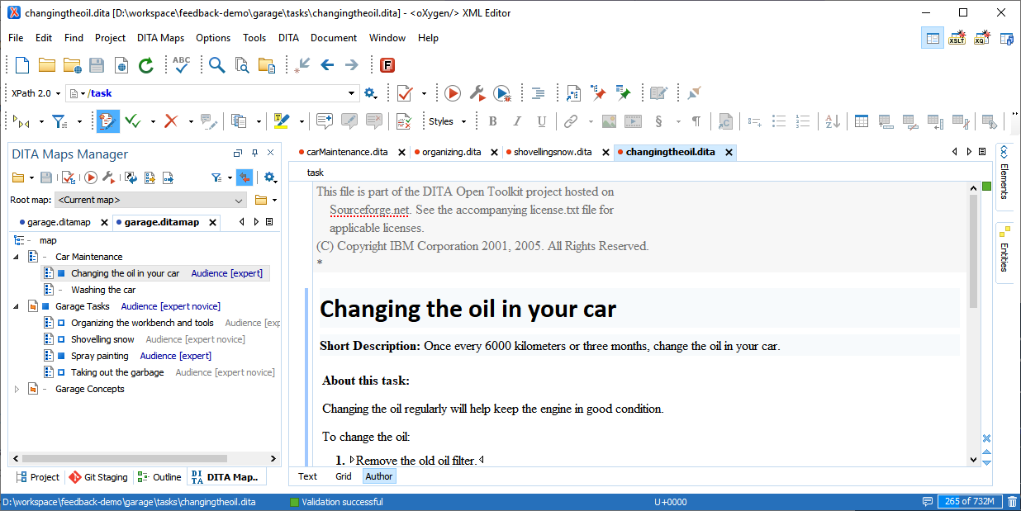

1. Generate online documentation
Online documentation
Oxygen XML Editor
Notes:
First, we’ll see how to use Oxygen XML Editor to generate online documentation for a DITA documentation project.

Slide 6
Present with XML Editor
Notes:
Let's switch to the application and quickly explore the DITA sample project that I will use in my presentation.
It’s a sample project for managing or administrating a garage. It contains topics explaining how to maintain a car like: changing the oil or washing the car.
Let's open a topic to see how it looks. Oxygen XML Editor has a very good support for editing DITA files in a visual manner. We'll use the editing part when we'll integrate user's feedback.
To generate online documentation for this sample project, I will open the transformation scenario dialog and select the “Garage webhelp” transformation scenario and click transform.
While transforming, let me give you more information about the DITA framework:
DITA is an XML-based open standard for structuring, managing, and publishing content. It has a very good adoption rate in the technical documentation world.
I see that the transformation is ready and we can quickly explore it to see how it looks…
The main page presents a tile for each main topic.
In the upper part we have the publication logo and menu. We can open any of the topics, for instance let's open the Changing the oil topic.

Slide 7

Install Oxygen Feedback commenting system
Generate online documentation
Install Oxygen Feedback commenting system
Use commenting system to add some comments
Moderate community comments
Update documentation content and regenerate online documentation
Notes:
We saw how to use Oxygen XML Editor to generate online documentation for a DITA project.
Now, let’s see how easy is to install Oxygen Feedback commenting system in online documentation.

Slide 8
Install Oxygen Feedback commenting system
Login to Oxygen Feedback
Create a site configuration
Regenerate documentation
Notes:
Oxygen Feedback was designed to be very easy to install. Basically, this can be done in 3 steps:
1. Login to the Oxygen Feedback platform
2. Create a site configuration, mainly it specifies the URL where your documentation is hosted. At the end of this step you will get installation instructions
3. Follow the installation instructions and regenerate documentation

Slide 9
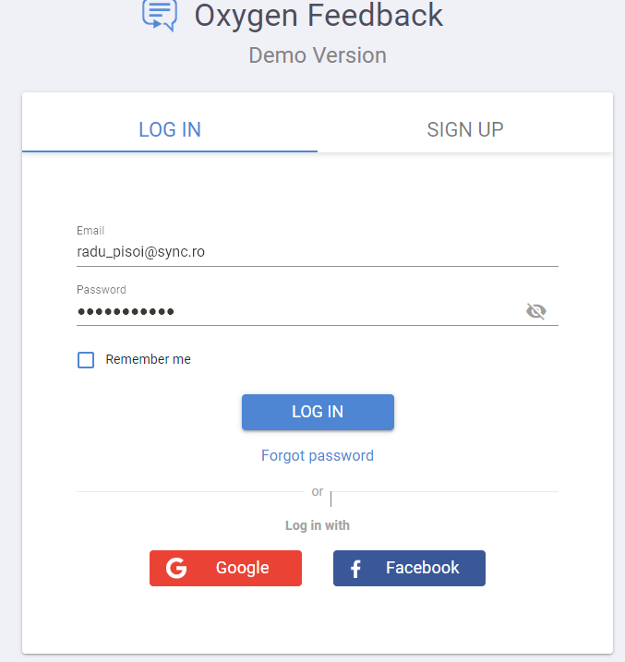
Log IN/SIGN UP
Notes:
[This step is in browser]
Now, let’s see the installation process.
In a browser, open the feedback.oxygenxml.com. This is the main page for Oxygen feedback platform.
If this is your first time using Oxygen Feedback, you need to sign up for a Feedback account from the Log In page.
To do this, you can click on Log in with Google or Log in with Facebook to create an account using your Google or Facebook credentials, or click the Sign Up tab to create an account using your name and email address.
In my case, I will login using my Google account

Slide 10
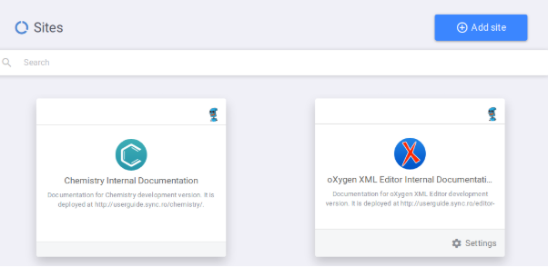
Sites page
Notes:
[This step is in browser]
When you log in to the administration interface, you start with the Sites page.
This is where you can add site configurations and manage existing ones.
Each site configuration is displayed as a tile. Each tile displays the logo, name, and description for the particular site configuration.

Slide 11
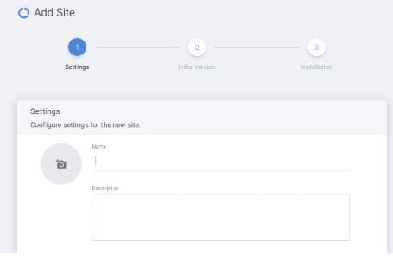
Create a site
Notes:
To create a new site configuration, click the Add site button.
This will initiate a three-step wizard.
The first page of the site creation wizard is the Settings page. This page includes the following options:
Name - The name of the site configuration. In my case I will create “Garage”
The site configuration name is unique per user. Each user cannot have more than one site configuration with the same name.
To add a Logo click anywhere in the circle that contains the camera icon. select an image to use for the logo for this site configuration. The logo will be displayed in the tile for this site configuration in the Sites page.
Description
The description of this site configuration. In my case it is:
A documentation project with useful topics regarding car maintenance.
Regarding comments Moderation we have two options:
All - Select this option if you want all comments to require approval by an Owner, Admin, or Moderator before they are posted for all users to see.
When you use this option, each Owner, Admin, and Moderator for the site configuration will receive an email when a user adds a comment notifying them that there is a comment waiting for approval. This is the option I will use for my presentation.
None - Select this option if you want all comments to be automatically approved and posted for all users to see.
The last option is: Allow Anonymous Users
Select this option if you want to allow comments to be posted anonymously without requiring the user to log in.

Slide 12
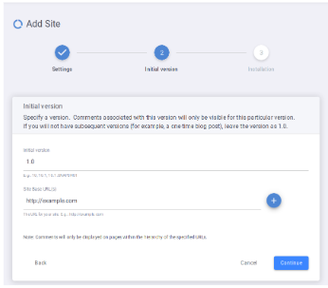
Create site - initial version
Notes:
The second page of the site creation wizard is the Initial Version page.
This wizard page includes the following options:
Initial Version
Each site configuration can have multiple versions. This is useful if you plan to have multiple versions of the output (for example when publishing technical documentation for a product that has multiple versions in production). This Initial Version option specifies the starting version. In most cases (especially if you do not plan to have multiple versions), you can leave the initial version as 1.0 as I will do.
Site Base URL(s)
Use this option to specify the Base URL for your website (you can add additional URLs by clicking the Add button). This option is very important because comments component will only appear on pages within the hierarchy of this base URL.
In our case we'll specify the URL where we publish our documentation.

Slide 13
Create Site - installation page
Notes:
The third page of the site creation wizard is the Installation page. This page give us installation instructions.
There are three options:
Oxygen XML Editor
Choose this option if you are adding the Feedback system to WebHelp Responsive documentation using Oxygen XML Editor/Author.
Oxygen XML WebHelp
This option is for adding the Feedback system to WebHelp Responsive documentation using a command-line script.
Any Platform
This option is for adding the Feedback system to any website (for example, blog site).
In our case, I will use the first option to install it in WebHelp Responsive documentation using Oxygen.
I will put a browser window and Oxygen side by side to make it easy to follow the installation instructions.
Open the transformation scenario dialog, edit the scenario used to generate documentation. In the Feedback tab, paste the installation fragment. Save and regenerate the documentation.
While the documentation is generated, I will switch to the Feedback platform to finish the site creation procedure.
The newly created site configuration will be displayed as a tile in Sites page. Notice that the site’s logo, name and description are displayed on tile.

Slide 14
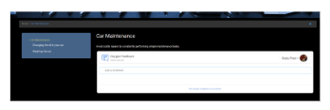
Explore online documentation
Notes:
The documentation was generated, let’s see how looks.
We can see that Oxygen Feedback Comments application was installed in the bottom part of the page.

Slide 15
Use Oxygen Feedback to add some comments
Generate online documentation
Install Oxygen Feedback commenting system
Use commenting system to add some comments
Moderate community comments
Update documentation content and regenerate online documentation
Notes:
We saw how to install Oxygen Feedback in online documentation
Now, let’s see how easy is to use the Oxygen Feedback commenting system from the perspective of a community member.

Slide 16
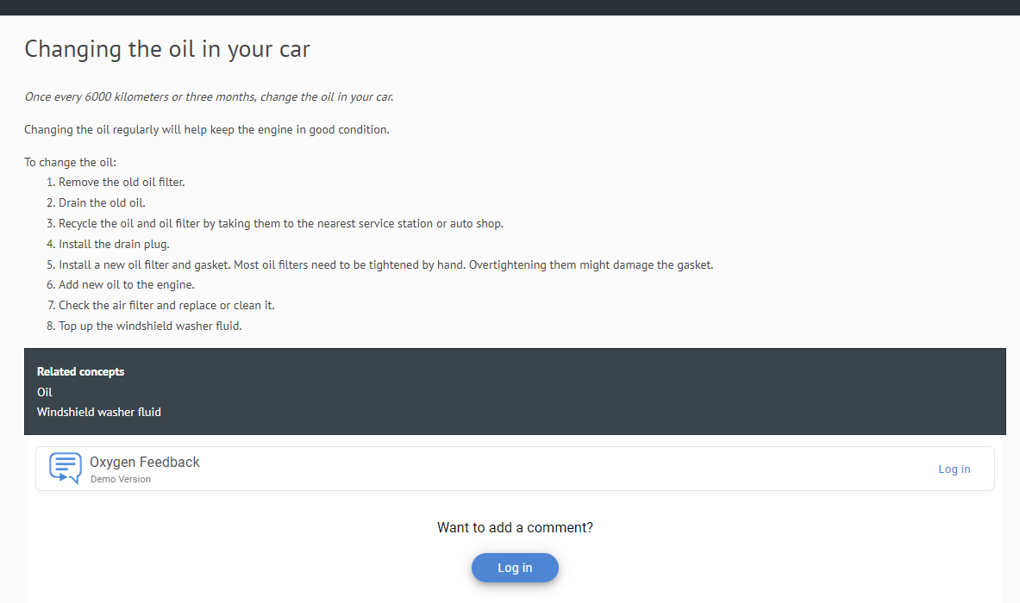
Use Oxygen Feedback to add some comments
Notes:
Now I’ll go back to the online documentation and add some comments.
In this case, I will login to the platform using a simple member account.
Let’s open the ‘Changing the oil in your car’ topic. This topic explains how drain the oil but does not say anything about how to recycle it.
We know that car’s oil is extremely pollutant so it is highly advisable to recycle it. So, I want to give this feedback to the documentation administrator by adding a comment.
To add a comment click anywhere in the text box where you see Add a comment.
I will write: Oil is extremely pollutant so it is highly advisable to recycle it.
We can use the various toolbar actions to style your text. You can also type Markdown syntax in the comment box to style your text.
Let’s emphasis the extremely pollutant.
You can see the results of the styling in the Preview section.
Click Add or Ctrl+Enter to post the comment.
You can see the state of the added comment is Waiting for approval.
This means that the newly added comment is not visible for other users until it is approved by an Administrator or Moderator.
We can add more comments in the same manner, but I think it is enough to demonstrate how simple is for your community to post new comments.

Slide 17
Moderate community comments
Generate online documentation
Install Oxygen Feedback commenting system
Use commenting system to add some comments
Moderate community comments
Update documentation content and regenerate online documentation
Notes:
Next, we’ll see how to manage community comments and users.
To speed up my presentation, I will use another Feedback account where I have configured the Garage site with some comments already added.

Slide 18
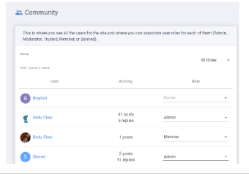
Site Community
Notes:
So, I’ll open the Oxygen Feedback main page and login using a Facebook account this time.
When you log in to the administration interface, again you start with the Sites page.
We already saw that each site configuration is displayed as a tile.
In my case, I want to administrate the Garage site. So, I’ll click the Garage tile.
First, we’ll go to the Community page. This page is where you can see all members/users that make up the site community.
It displays members of the site management team (Owner, Admin, or Moderator) and any other user who has posted a comment on the website where the Feedback system is installed for the particular site configuration.
To filter the list or search for a particular user, start typing a name in the text field at the top of the page. Let’s search for John. We see that only users named john are displayed.
You can also filter the list by user role. For instance we can display all users with Member role.
This page is accessible to users with a role of Owner or Admin.

Slide 19
Site User Roles
Banned
Cannot post new comments
Member
has rights to post new comments.
If the site is moderated, comments posted by this type of user require approval by a user with a role of Owner, Admin, or Moderator.
Trusted
Comments posted by this type of user are automatically approved (this includes existing and future comments).
Moderator
moderate comment posts (edit, approve, reject, or delete).
Admin
moderate comment posts (edit, approve, reject, or delete)
configure site settings, versions, team members, and user roles
Owner
moderate comment posts (edit, approve, reject, or delete)
configure site settings, versions, team members, and user roles
delete or transfer the ownership of the site configuration.
Notes:
The possible user roles are:
Banned - This type of user cannot post comments.
Member - This type of user has rights to post new comments. If the site is moderated, like it is in our case, comments posted by this type of user require approval by a user with a role of Owner, Admin, or Moderator.
Trusted - Comments posted by this type of user are automatically approved.
Moderator - This type of user has rights to moderate comment posts (edit, approve, reject, or delete).
Admin - This type of user has the same rights as a moderator but also rights to configure site settings, versions, team members, and user roles.
Owner (This role is automatically assigned when the site configuration is created) - This type of user has the same rights as an Admin but also rights to delete or transfer the ownership of the site configuration.

Slide 20
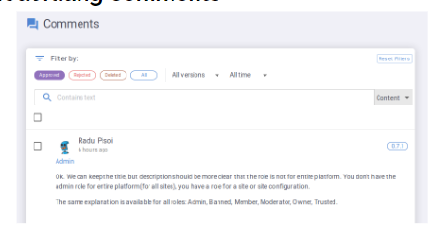
Site Comments
Notes:
Now, let’s move on to the Comments page, where we can manage and moderate comments. This page is visible to the site owner, admins and moderators.
The upper part of the page presents a filtering area.
There are several options for filtering the comments:
You can click one of the comment status filter buttons to search for comments with a specific status. Possible comment statuses are:
Pending- Pending comments are not visible on the website until they are approved by a moderator.
Approved comments are visible by anyone who visits the site. They were reviewed and approved by a moderator.
Rejected and Deleted comments are not visible because they were rejected by a moderator or deleted.
You can also filter the comment by content, user or page title.
Let’s demonstrate this to display all comments added by Paul.
or we can filter comments by page title, in our case, Changing the oil.

Slide 21
Site Comments
Notes:
Now, let’s see how easy is to moderate comments. To do this, press the Pending filter.
We will accept some comments, and promote a user as trusted.
Reject some comments and ban a user.

Slide 22
Integrate user's feedback
Generate online documentation
Install Oxygen Feedback commenting system
Use commenting system to add some comments
Moderate community comments
Update documentation content and regenerate online documentation
Notes:
So far we have seen how easy is to use Oxygen Feedback commenting system to register and manage user’s feedback.
Now, let’s move forward to the next part from presentation and see how to update documentation content by integrating the user feedback into Oxygen.

Slide 23
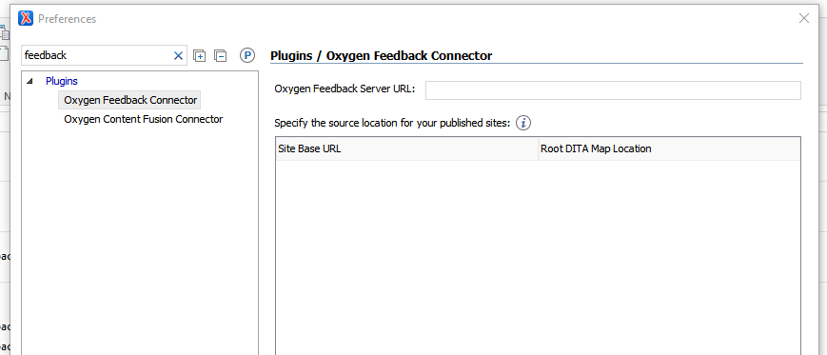
Configure Oxygen Feedback plugin
Notes:
To integrate the comments into Oxygen, it requires an additional plugin that I have already installed. So, I’ll switch back to the Oxygen XML Editor.
First, we’ll configure the Oxygen Feedback Plugin from the application preferences page.
Open preferences page, search for feedback
In this page, the first thing is to specify the URL to the Oxygen Feedback platform and login. The login is performed in the Browser.
After we are logged in, we have to register a mapping between the documentation source and where it is published.
The application proposes a list of configured site URLs. I will choose …
I will browse for my DITA map location, and after I click OK, the mapping is configured.

Slide 24
Integrate user's feedback
Notes:
Now we can close the preferences dialog.
The users comments are now displayed in the Oxygen Feedback view. Let's open the view to see them.
This view displays the user’s posts associated with current edited topic.
Now, let’s analyze feedback from our users:
John advised us to tell the user that oil should be recycled because it is extremely pollutant.
So I will add a new step to:
Recycle the oil and oil filter.
Also, John asked us to add a related link to "Oil filter". Let’s add it.
In the same manner we can analyze and update our documentation source content to integrate all user feedback. But, for our audience to really see these changes we need to regenerate the online documentation.

Slide 25
Integrate user's feedback
Generate online documentation
Install Oxygen Feedback commenting system
Use commenting system to add some comments
Moderate community comments
Update documentation content and regenerate online documentation
Notes:
So, let’s move forward to the last part of the presentation when we’ll regenerate the online documentation content.
We can simply generate the online documentation as we do in the beginning of the presentation.
But, in this case, all user’s comments will be preserved and most of them are outdated because we changed the documentation.
To fix this, for the cases when you significantly change the documentation, we can choose to increase it’s version.
Also, we have to increase it’s version on the Oxygen Feedback platform.

Slide 26
Versioning online documentation and feedback
Online documentation
v1
Users Feedback
v1
Users Feedback
v2
Online documentation
v2

Slide 27
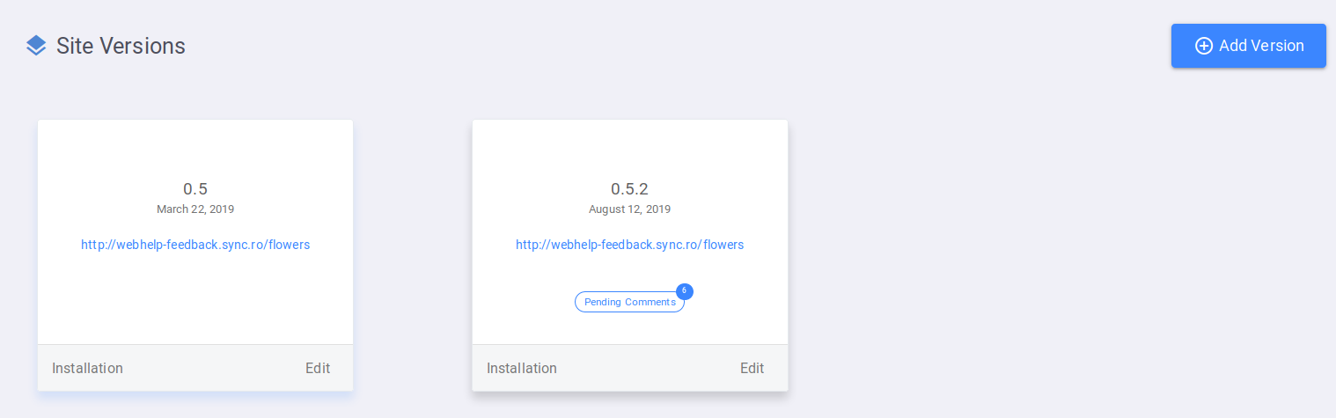
Create a new version for Site configuration
Notes:
Since I changed the documentation and the old comments no longer apply, I can choose to version it. So let’s create a new version for the Garage site configuration on the Oxygen Feedback platform.
Select the Garage Site, click Settings button, and select the Site Versions page.
This page can be used to add or edit versions for a site configuration.
In our case, I want to create a new version. To do that, click the Add Version button.
In the version field, I’ll type 2.0.
For the website URL, we’ll use the http://localhost/feedback/v2/garage
Click continue to get the installation instructions.
In our case, we use Oxygen XML editor for publishing option again.
I will duplicate my Garage transformation scenario and change its name to Garage v2.
In the feedback tab, I will copy the installation fragment. Click Ok to save changes and Apply associated to start publishing process.
And now you can see that a new version is published with the updated content and those outdated comments are no longer visible.

Slide 28
Conclusion
Use Oxygen XML Editor to publish online documentation
Use Oxygen Feedback as a commenting platform
Use Oxygen XML Editor to integrate feedback from our audience
Notes:
In conclusion:
We have seen how to use Oxygen XML Editor and Oxygen Feedback to continuously improve online documentation by integrating our community feedback.
We have used Oxygen XML Editor to generate online documentation in WebHelp Responsive format.
Then, we used Oxygen Feedback commenting platform to get feedback from website audience and to manage this feedback.
Finally, we used Oxygen XML Editor to integrate users feedback by changing documentation source content and to generate an updated version of the documentation.

Slide 29
THANK YOU!
Any questions?
Radu Pisoi
alex_jitianu@oxygenxml.com
@AlexJitianu
© 2019 Syncro Soft SRL. All rights reserved.

