Slide 1
Formal development of the theory of regular languages
Radu Ciobanu (rxc00u)
MSci Computer Science with AI (40 cred.)
(G54MIA)
Supervised by: T. Altenkirch(txa)

Slide 2
Motivation
Aim: Formally prove mathematical properties of regular languages
finite automata
regular expressions
pumping lemma, Myhill Nerode theorem
decidability of equivalence of regular expressions, etc
How? Coq proof assistant
Regular language - recognized by a finite automaton

Slide 3
What is Coq?
Interactive theorem prover
Based on calculus of inductive constructions
(Thierry Coquand )
Type Theory (Per Martin-Löf)
Proof requires tactics (strategies to solve goals)

Slide 4
Quick example:
Definition Word(x:Alphabet) := list (Fin x).
Definition Language (a:Alphabet):= Word a -> Prop.
Definition allexp1 : forall (n : nat) , (Fin n -> bool) -> Fin (2^n).
intros.
apply allexp.
intro. tactics
exact (f0 1).
Defined.

Slide 5
The alphabet of a finite automaton is the set where symbols come from: { 0,1} The language of a finite automaton is the set of strings that it accepts
11
1
0
0,1
q1
1
0111
111
1
0
q0
0
q3
1
q3
Finite automata in 1 slide:

Slide 6
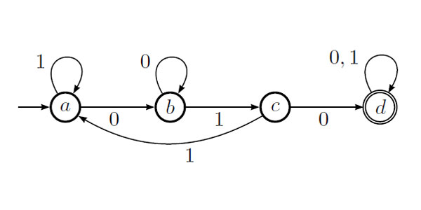
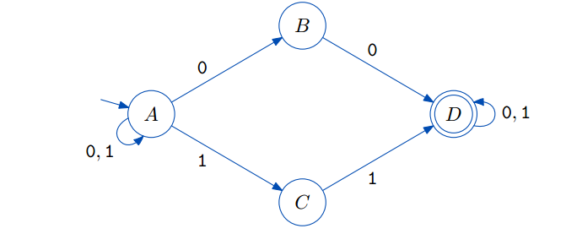
Record DFA (n:nat) (a:Alphabet) :Type:= DFA {
states := Fin n; (*finite sets*)
symbol := Fin a;
delta : states->symbol-> states;
q0 : states; (*only 1 initial state*)
final :states-> bool (*multiple states*)
}.
Record NFA (n:nat)(a:Alphabet) := NFA {
nstates :=Fin n;
nsymbol := Fin a;
ndelta : nstates - > nsymbol->Fin (2^n);
ninitial : nstates-> bool (* multiple states*);
nfinal : nstates-> bool
}.
≈ 280 lines of code including lemmas for later development

Slide 7
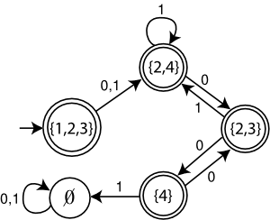
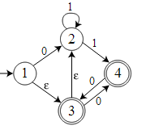
NFA => DFA (subset constr.)
Definition nfa2dfa (n:nat) (a:Alphabet) (nr: nfa n a) : dfa (2^n) a :=
DFA (fun k:Fin (2^n)=> fun a : Fin a =>
allexp1 (prepare nr k a))
(allexp1 (ninitial nr ))
(fun k:Fin (2^n)=>existsf1(fun q:Fin n=> (allexp2 k q ) && nfinal nr q)).
NFA A
DFA A

Slide 8
Equivalence between DFA and NFA
Theorem nfa2dfa_correct : (n:nat)(a:Alphabet)(w:Word a) (nr:nfa n a),
dfa_lang (nfa2dfa nr) w <- > nfa_lang nr w.
Definition dfa2nfa (n:nat) (a:Alphabet) (d:dfa n a): nfa n a :=
NFA(fun k : Fin n => fun a : Fin a =>
(allexp1 ( fun x:Fin n => eqf x (delta d k a) )))
(fun x:Fin n => eqf x (q0 d))
(final d).
≈ 120 lines needed for equivalence of DFA and NFA

Slide 9


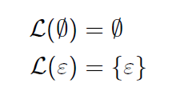
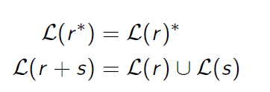
Regular expressions
Example:
L ( a+ b)* = L(a*b*)*

Slide 10
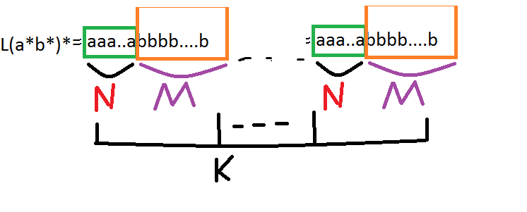
L(a+b)* = {a,b,aa,ab,ba,bb,aaa,aab,aba,abb,aaaa,…}

Slide 11
Regular expr. to Finite Automata
Proof structured given the inductive definition of regex
Build a Fin. automaton for every constructor of fin automaton
≈ 600 lines of code (not simple)
- definitions
- correctness lemmas
Lemma kleene : forall(a:Alphabet)(w:Word a)
(r: RegExp a),
nfa_lang (re_to_nfa r) w <-> reg2lang r w.

Slide 12
Pumping lemma
Use to show that a language is not regular( can’t be recognized by a Finite automaton )
First prove a slightly modified pumping theorem, valid for all finite automata
Theorem pump_lemma : forall (alph:Alphabet)
exists (n:nat), dfa_lang d w -> length w >= n -> exists (xs ys zs : Word alph),
w = xs ++ ys ++ zs /\ (length ys > 0) /\
forall (k:nat), dfa_lang d (xs ++ (wmult k ys) ++ zs)/\ length (xs++ys) <= n.

Slide 13
Proof. (not described on this slide)
Then, the original statement of the theorem is equivalent to this one because RE and FA are isomorphic (shown)
≈ 800 lines of code (not trivial)
Code fragments
(necessary ): Implemented a finite set library and lemmas about types that are isomorphic - ≈ 300 lines
Fin(2^n) ↔ Fin n -> bool

Slide 14
Ideas about Myhill Nerode
Show that a language is not regular by using the finite number of equivalence classes of a relation
it implies that there exists a unique minimal DFA with minimum number of states.
Use : minimization of automata ( reducing states that may be redundant)

Slide 15
Completed:
Languages and words : operations, properties
Finite sets construction
Constructing finite automata: (and lemmas)
Subset construction
Regex to finite automata(correctness lemmas)
Pumping Lemma
Significant part of Myhill Nerode
Equivalence of regex. and finite automata(90%)

Slide 16
To do:
Finish Myhill Nerode theorem
Minimization using table filling algorithm
Decidability of equivalence of regular expressions
2 way finite automata
Omega regular languages
Model using category theory

Slide 17
L – regular, exists n , s.t for any w ∈ L , we can split w in:
ASIDE
(Pumping Lemma explained)
w = xyz
Length(y)>0
...
...
...
...
x
z

