Slide 1
Formal development of the theory of regular languages
Radu Ciobanu (rxc00u)
MSci Computer Science with AI (40 cred.)
(G54MIA)
Supervised by: T. Altenkirch(txa)

Slide 2
Motivation
Aim: Formally prove mathematical properties of regular languages
- finite automata
- regular expressions
-decidability of equivalence of regular expressions
-pumping lemma, Myhill Nerode, etc.
How? Coq proof assistant
Regular language - recognized by an automaton

Slide 3
What is Coq?
Interactive theorem prover
Based on calculus of inductive constructions (Thierry Coquand )
Type Theory (P.Martin Lof)
Proof requires tactics (strategies to solve goals)

Slide 4
Quick example:
Definition Word(x:Alphabet) := list (Fin x).
Definition Language (a:Alphabet):= Word a -> Prop.
Definition allexp1 : forall (n : nat) , (Fin n -> bool) -> Fin (2^n).
intros.
apply allexp.
intro. tactics
exact (f0 1).
Defined.

Slide 5
The alphabet of a finite automaton is the set where symbols come from: { 0,1} The language of a finite automaton is the set of strings that it accepts
11
1
1
0,1
1
0111
111
1
0
0
1
Finite automata in 1 slide:

Slide 6
Finite automata (def.)
Finite Automata (FA) over an alphabet Σ consist of
- a set of states Q,
- initial state(s) s ∈ Q,
- a set of final states F ⊆ Q,
- a transition relation δ
a) Deterministic (DFA)
b) Non-deterministic (NFA)

Slide 7
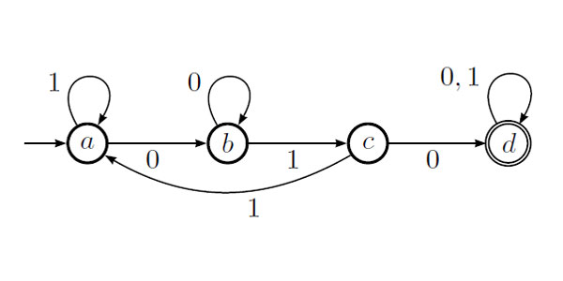
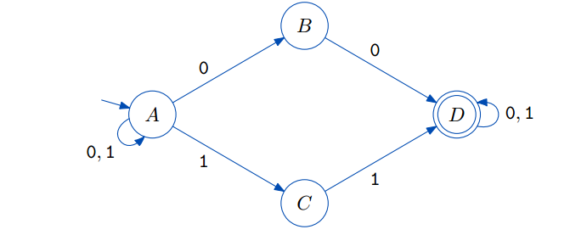
Record DFA (n:nat) (a:Alphabet) :Type:= DFA {
states := Fin n; (*finite sets*)
symbol := Fin a;
delta : Fin n ->Fin a -> Fin n;
q0 : Fin n ; (*only 1 initial state*)
final :Fin n -> bool (*multiple states*)
}.
Record NFA (n:nat)(a:Alphabet) := NFA {
nstates :=Fin n;
nsymbol := Fin a;
ndelta : Fin n-> Fin a ->Fin (2^n);
ninitial : Fin n -> bool (* multiple states*);
nfinal : Fin n -> bool
}.
≈ 280 lines of code including lemmas for later development

Slide 8
Fixpoint deltah (n:nat)(a:Alphabet)(d: dfa n a)(q: Fin n) (w: Word a) : (Fin n):=
match w with
| nil => q
| h :: t => (deltah d (delta d q h ) t)
end. (DFA extended transition function)
Fixpoint ndeltah (n : nat) (a:Alphabet) (nr: nfa n a) (qs : (Fin (2^ n)))
(w:Word a) :(Fin (2^n)) :=
match w with
| nil => qs
| h :: t => (ndeltah nr (allexp1 (prepare nr qs h)) t)
end. (NFA extended transition function)
( Aside, but necessary ): Implemented a finite set library and lemmas about types that are isomorphic - ≈ 300 lines

Slide 9
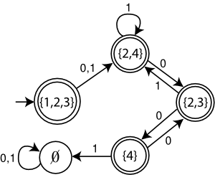
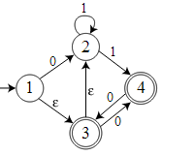
NFA => DFA (subset constr.)
Definition nfa2dfa (n:nat) (a:Alphabet) (nr: nfa n a) : dfa (2^n) a :=
DFA (fun k:Fin (2^n)=> fun a : Fin a =>
allexp1 (prepare nr k a)) (allexp1 (ninitial nr ))
(fun k:Fin (2^n)=>existsf1(fun q:Fin n=> (allexp2 k q ) && nfinal nr q)).
NFA A
DFA A

Slide 10
Equivalence between DFA and NFA
Definition dfa2nfa (n:nat) (a:Alphabet) (d:dfa n a): nfa n a :=
NFA(fun k : Fin n => fun a : Fin a =>
(allexp1 ( fun x:Fin n => eqf x (delta d k a) ))) (fun x:Fin n => eqf x (q0 d)) (final d).
Theorem nfa2dfa_correct : (n:nat)(a:Alphabet)(w:Word a) (nr:nfa n a),
dfa_lang (nfa2dfa nr) w <- > nfa_lang nr w.
≈ 120 lines needed for equivalence of DFA and NFA

Slide 11



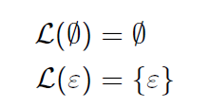
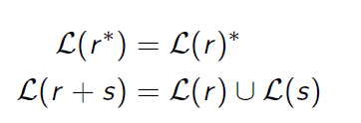

Regular expressions
( )
( ) )
=

Slide 12
Regular expr. to FA
Proof structured given the inductive definition of RE
Build a FA for every constructor of FA
≈ 600 lines of code (not simple)
- definitions
- correctness lemmas
Lemma kleene : ∀(a:Alphabet)(w:Word a)
(r: RegExp a),
nfa_lang (re_to_nfa r) w <=> reg2lang r w.

Slide 13
Pumping lemma

Slide 14
L – regular, exists n , s.t for any w ∈ L , we can split w in:
w = xyz
Length(y)>0
...
...
...
...
x
z

Slide 15
Pumping lemma
Use to show that a language is not regular( can’t be recognized by a FA )
First prove a slightly modified pumping theorem, valid for all FA
Theorem pump_lemma : forall (alph:Alphabet)
exists (n:nat), dfa_lang1 d w -> length w >= n -> exists (xs ys zs : Word alph),
w = xs ++ ys ++ zs /\ (length ys > 0) /\
forall (k:nat), dfa_lang1 d (xs ++ (wmult k ys) ++ zs)/\ length (xs++ys) <= n.

Slide 16
Proof. (to write in presentation)
Then, the original statement of the theorem is equivalent to this one because RE and FA are isomorphic (shown)
≈ 600 lines of code (not trivial)
Code fragments

Slide 17
Ideas about Myhill Nerode

