Slide 1
Proiect Sortari
Savin Radu Andrei
Birsan Alex Cristian
Albu Victor Stefan
Echipa:

Slide 2
Test 1 - Interval input: 1 – 1000
Sortare: | Merge | Quick | Radix | Insertion | Shell | Heap
Nr elemente
10^3 | 0.003 | 0.00192 | 0.0030 | 0.002 | 0 | 0.00054
10^4 | 0.017 |  | 0.0038 | 0.111 | 0.0028 | 0.003
10^5 | 0.171 | 0.02168 | 0.007 | 11.4159 | 0.0311 | 0.033
2*10^5 |  |  |  | 46.1384
5*10^5 |  |  |  | 282.705
10^6 | 1.8678 | 1.3184 | 0.038 |  | 0.3268 | 0.3614
10^7 | 20.5769 | 118.473 | 0.39 |  | 3.918 | 4.5276
25*10^6 | 53.7283 | - |  |  | 9.7 | 12.1579
5*10^7 | 109.399 |  |  |  | 20.8814 | 25.5117
10^8 | 219.553 |  | 3.917 |  | 42.8811 | 52.4594
3*10^8 |  |  |  |  | 141.162 | 163.631
5*10^8 |  |  |  |  | 245.149
10^9 |  |  | 41.177
10^10
10^11 |  |  | 73.773

Slide 3
Test 4 - Interval input: 10^15 – 10^18
Sortare: | Merge | Quick | Radix | Insertion | Shell | Heap | Ins aproape sortat | C++
Nr elemente
10^3 | 0 | 0 | 0.0082 | 0.00845 | 0.0082 | 0.0014 | 0.0005 | 0.001
10^4 | 0.004 | 0.0081 | 0 | 0.1193 | 0.0081 | 0.0063 | 0.0017 | 0.005
10^5 | 0.0413 | 0.0214 | 0.008 | 11.1452 | 0.0533 | 0.038 | 0.0062 | 0.0271
2*10^5 |  |  |  | 44.0181
5*10^5 |  |  |  | 288.749
10^6 | 0.3008 | 0.2363 | 0.0454 | - | 0.438 | 0.4677 | 0.0521 | 0.2206
10^7 | 3.3041 | 5.4557 | 0.5114 |  | 6.149 | 6.399 | 0.4865 | 2.298
25*10^6 | 8.1217 | 27.096
5*10^7 | 17.1329 | 103.757 |  |  | 35.2944 | 37.9284 | 2.54138 | 12.8728
10^8 | 34.9537 |  | 7.3307 |  | 95.7323 | 80.7 | 5.067 | 27.4743
3*10^8 |  |  |  |  | 294.78 | 260.539 | 15.7889 | 87.9572
5*10^8 | 191.75
10^9 |  |  | 207.023 |  |  |  | 77.5854 | 365.68
10^10 |  |  | -
10^11

Slide 4
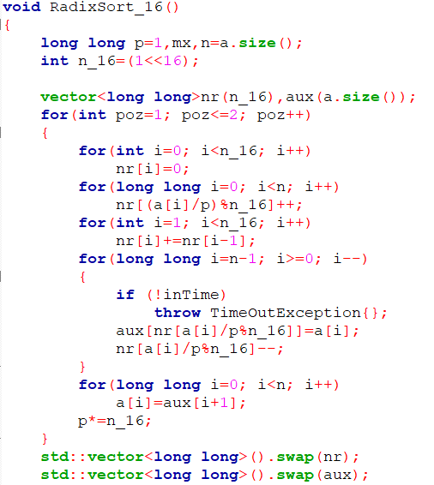
Radix(baza 2)

Slide 5
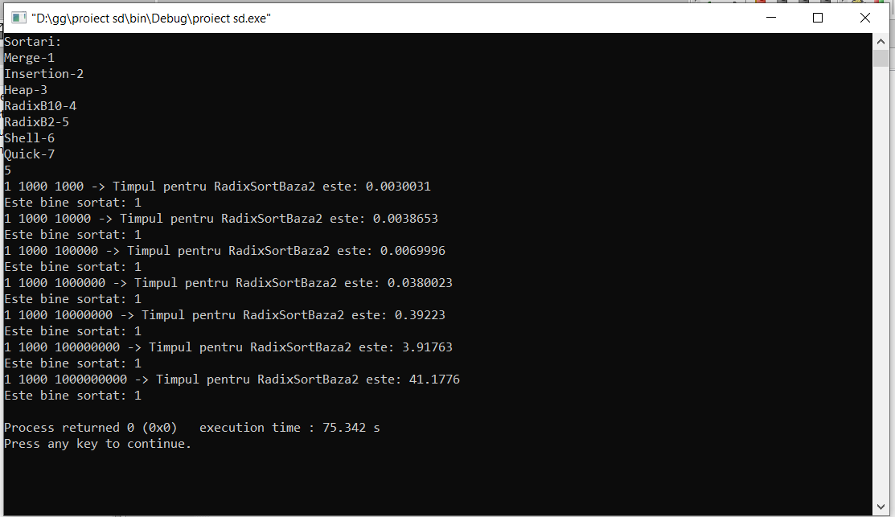
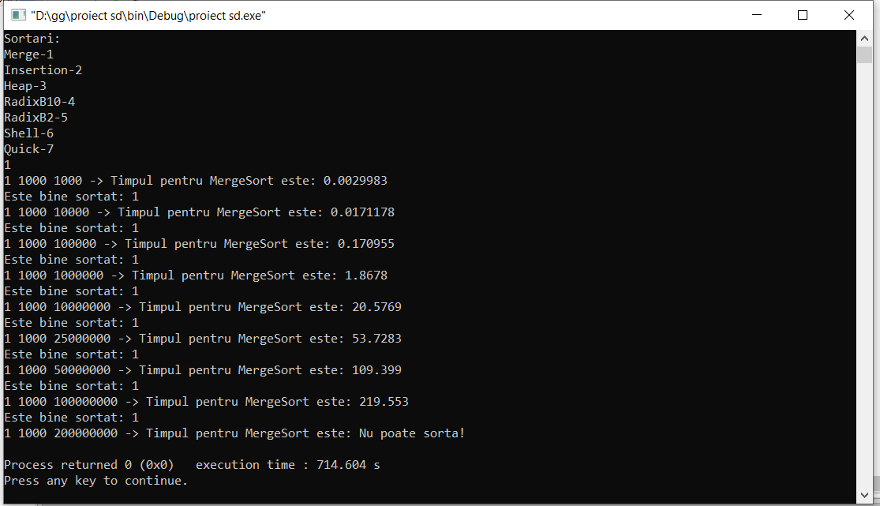
Test 1

Slide 6
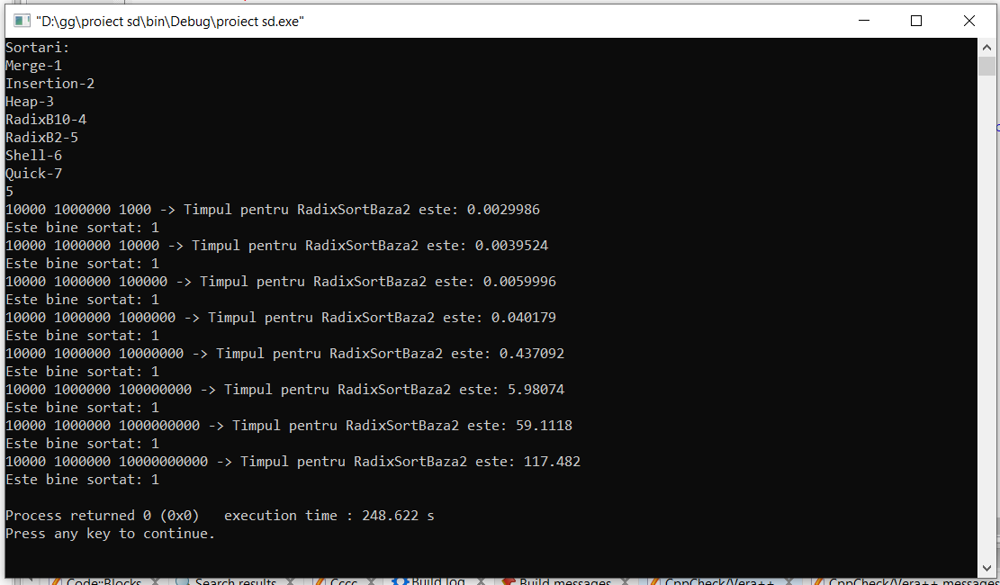
Test 2

Slide 7
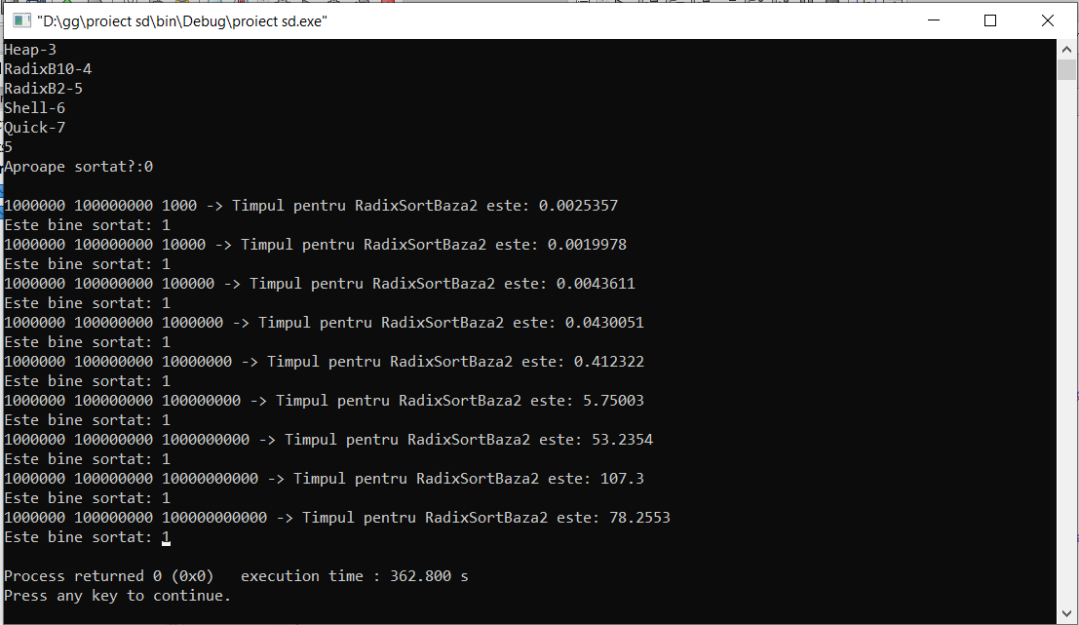
Test 3

Slide 8
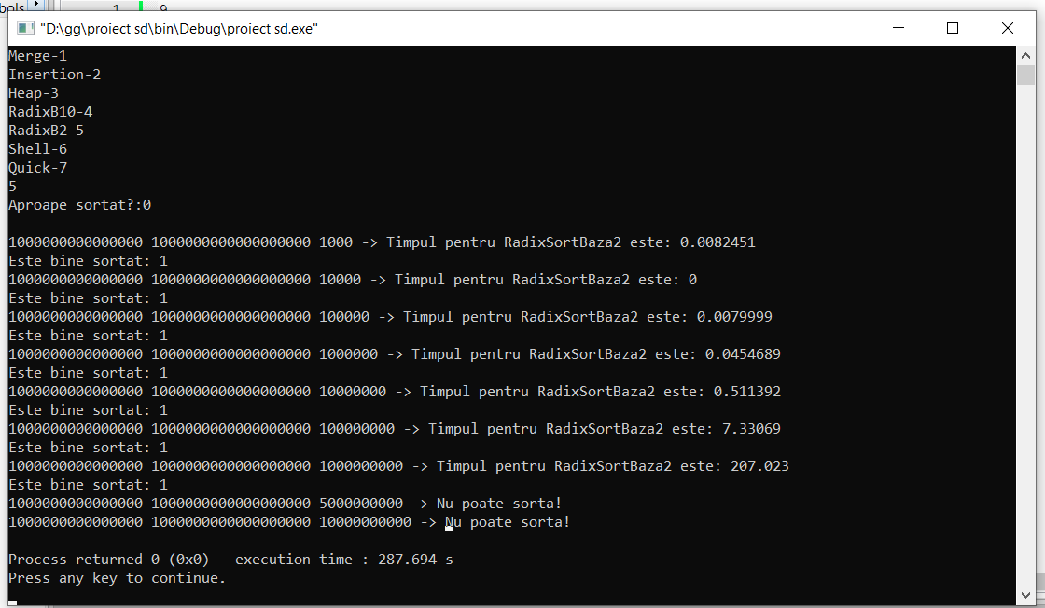
Test 4

Slide 9
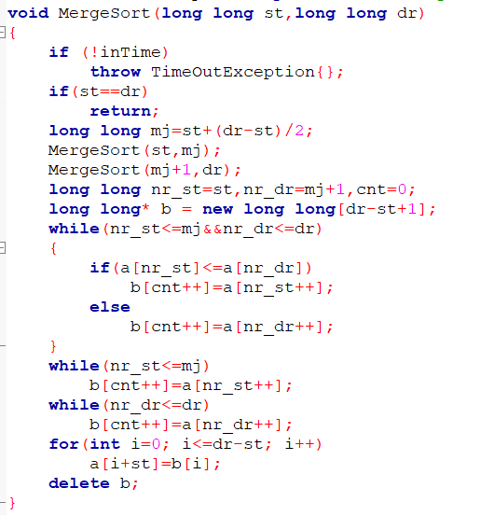
Merge

Slide 10
Test 1

Slide 11
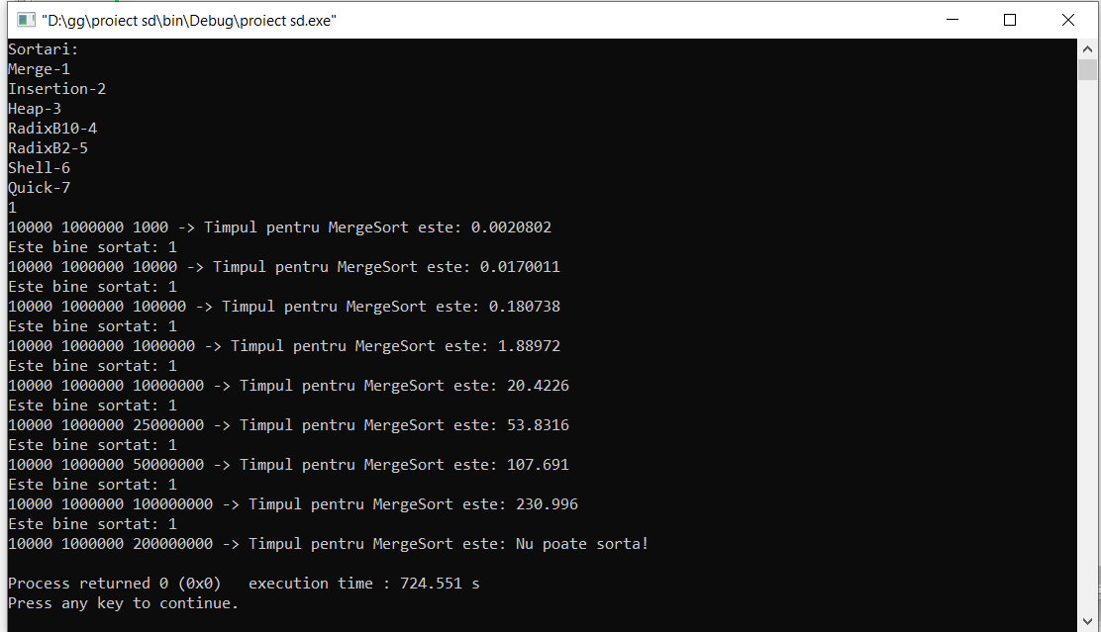
Test 2

Slide 12
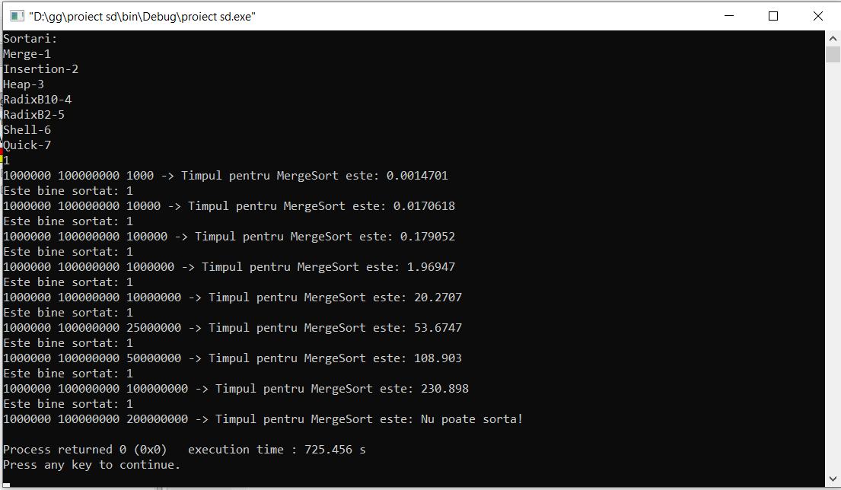
Test 3

Slide 13
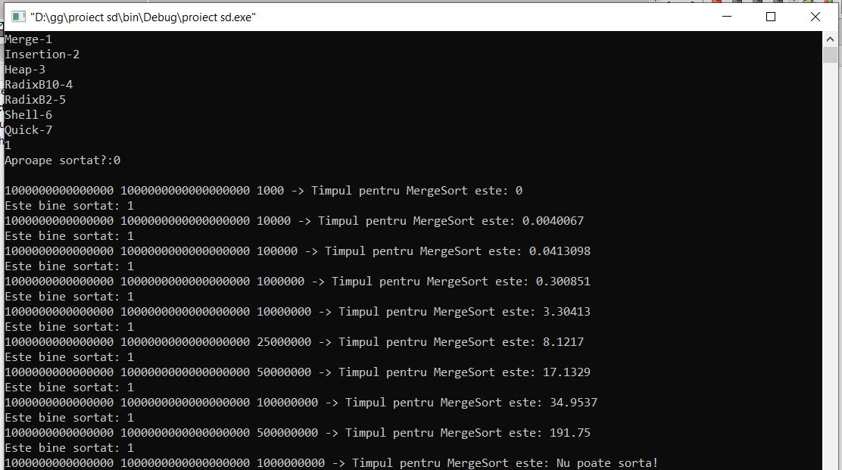
Test 4

Slide 14
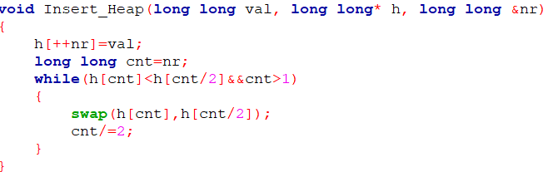
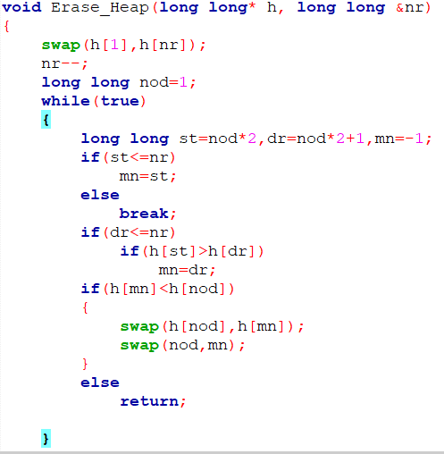
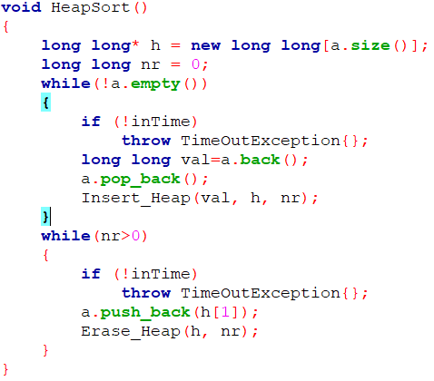
Heap

Slide 15
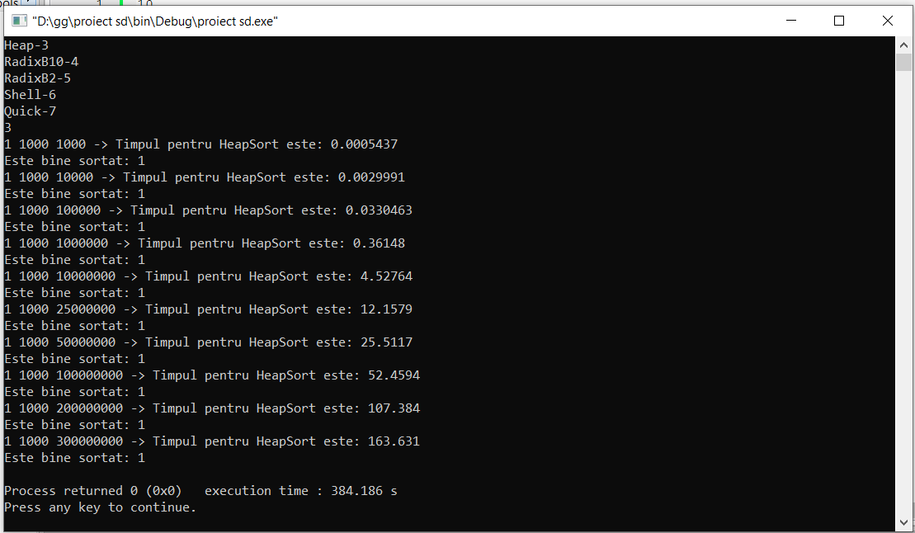
Test 1

Slide 16
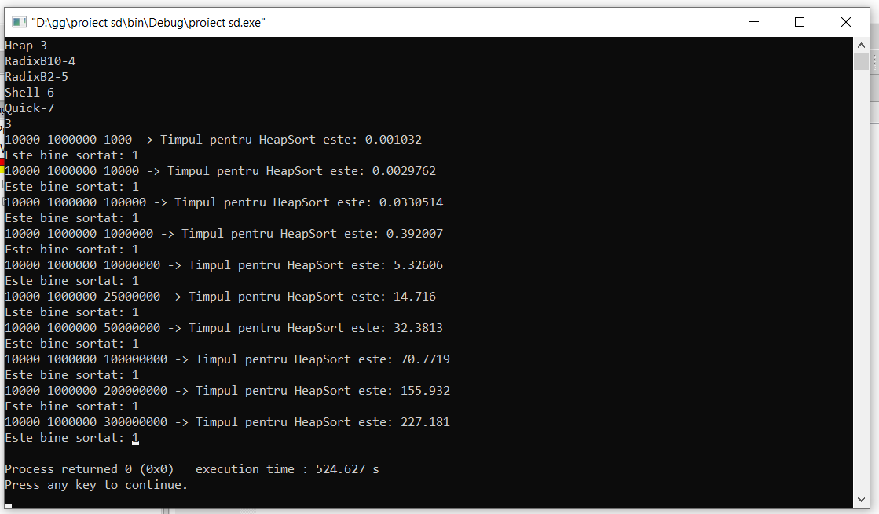
Test 2

Slide 17
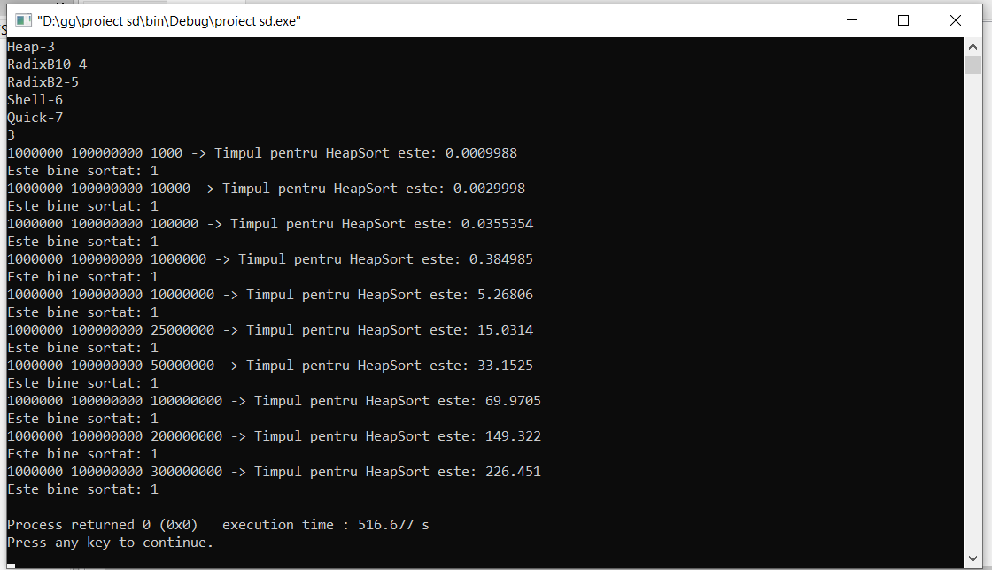
Test 3

Slide 18
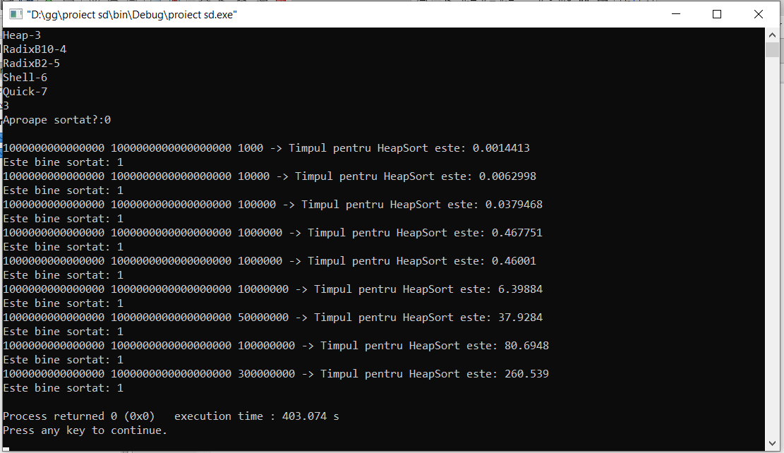
Test 4

Slide 19
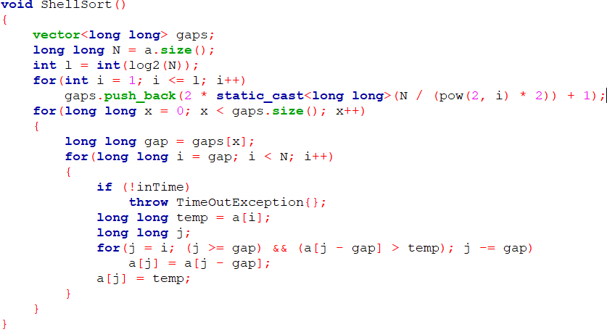
Shell

Slide 20
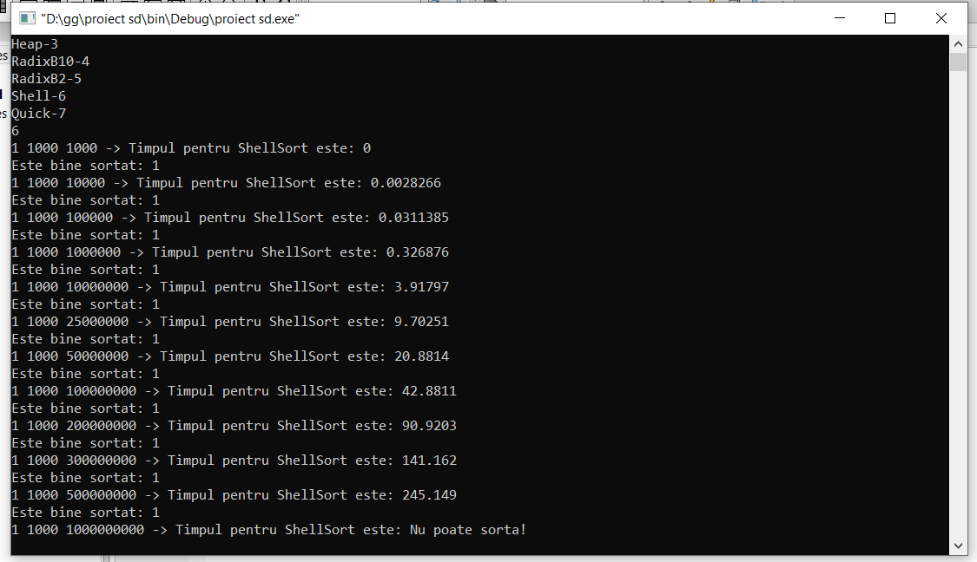
Test 1

Slide 21
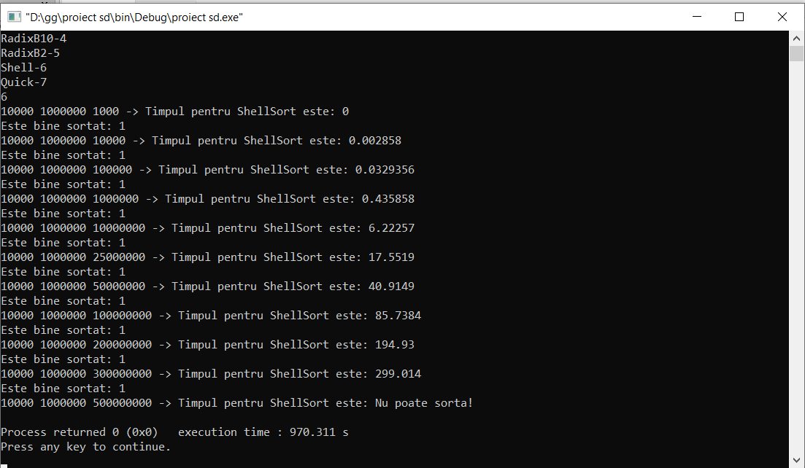
Test 2

Slide 22
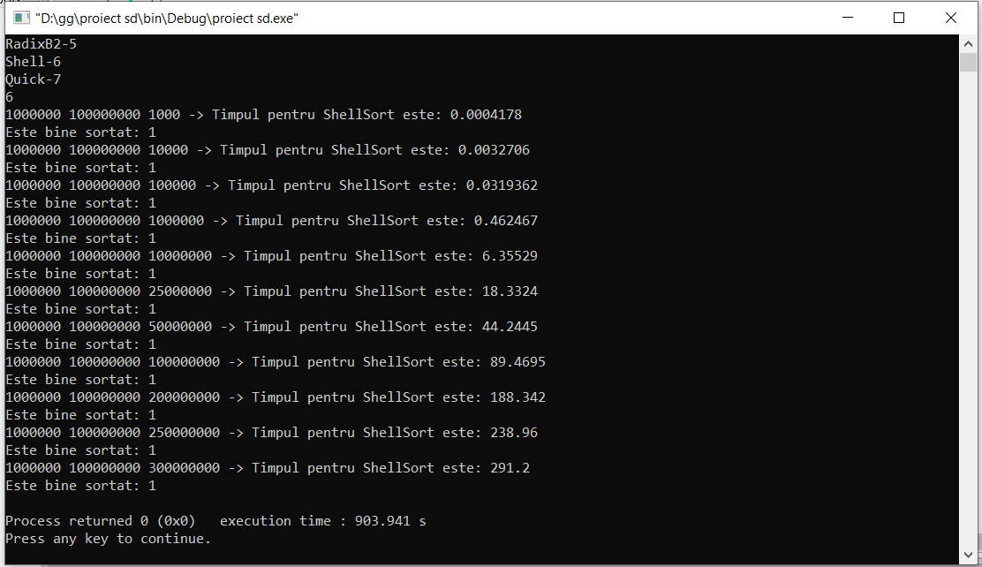
Test 3

Slide 23
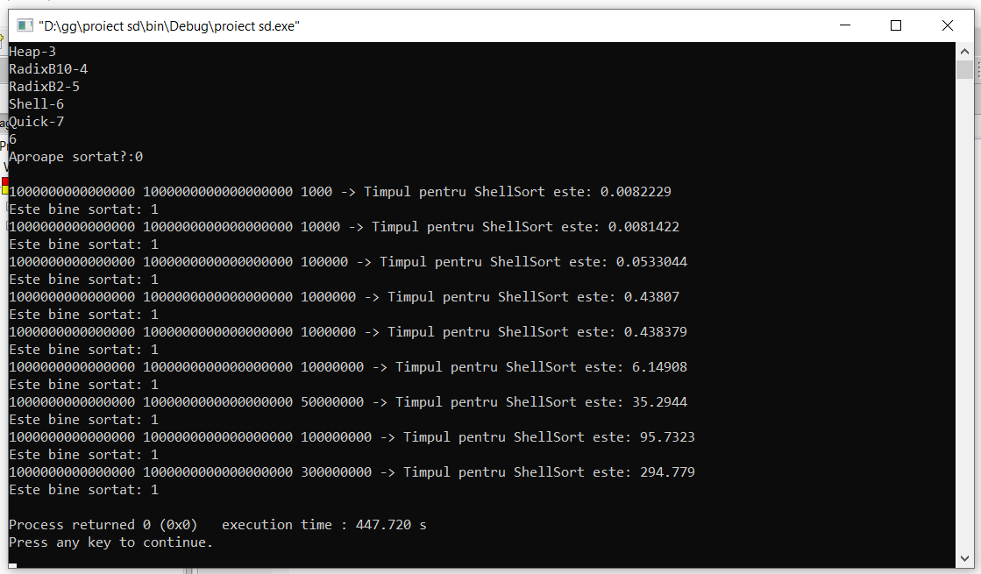
Test 4

Slide 24
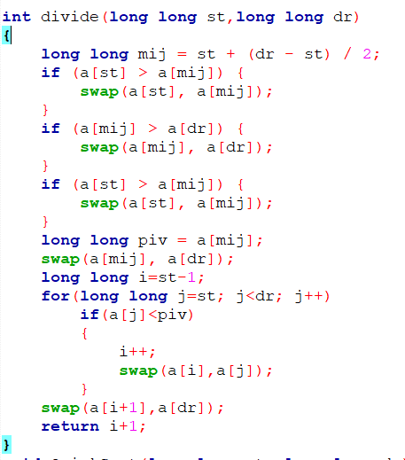
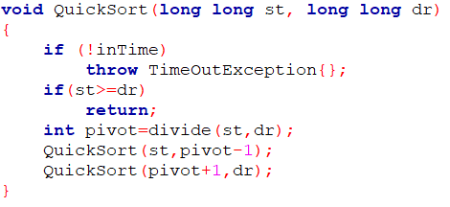
Quick

Slide 25
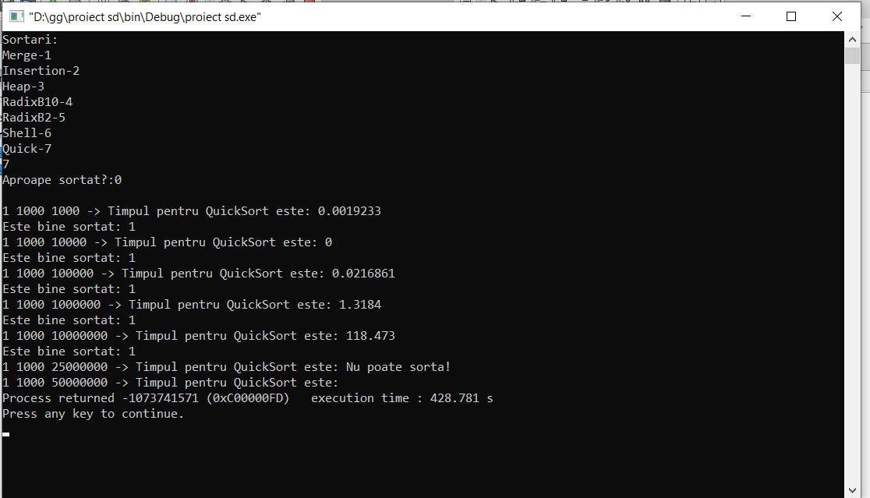
Test 1

Slide 26
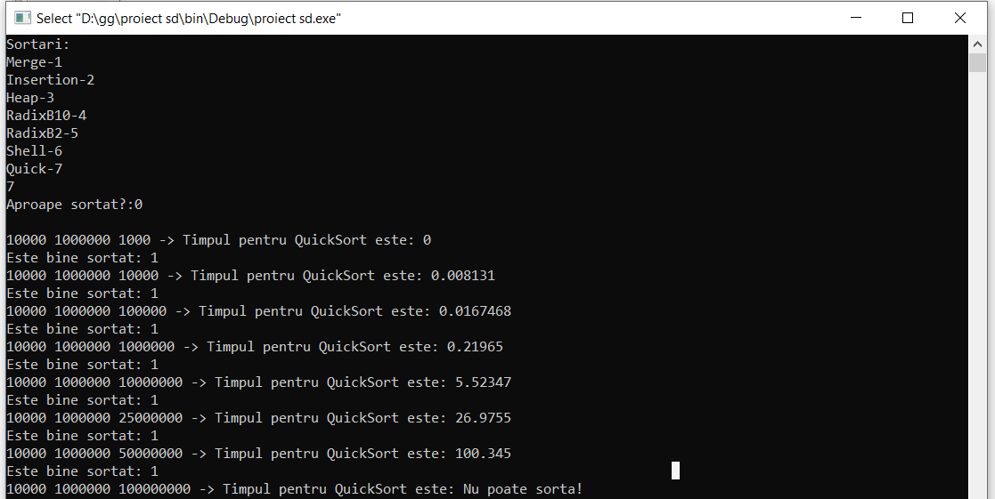
Test 2

Slide 27
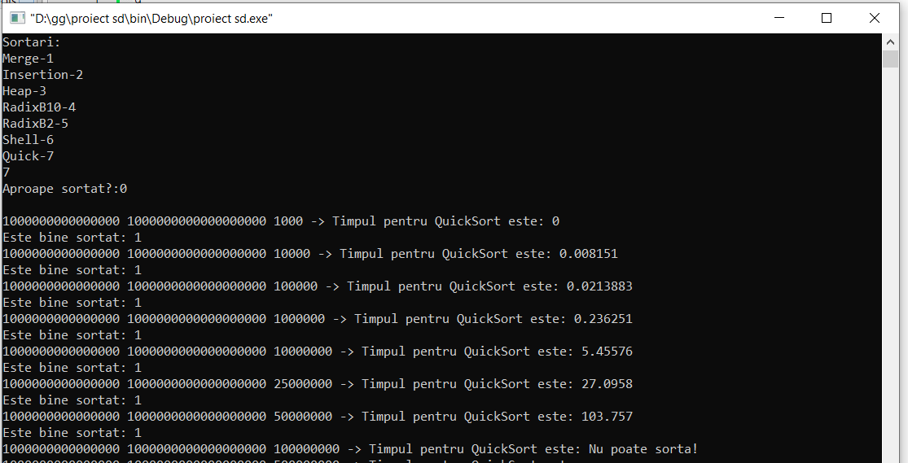
Test 4

Slide 28
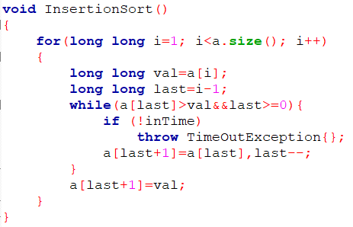
Insertion

Slide 29
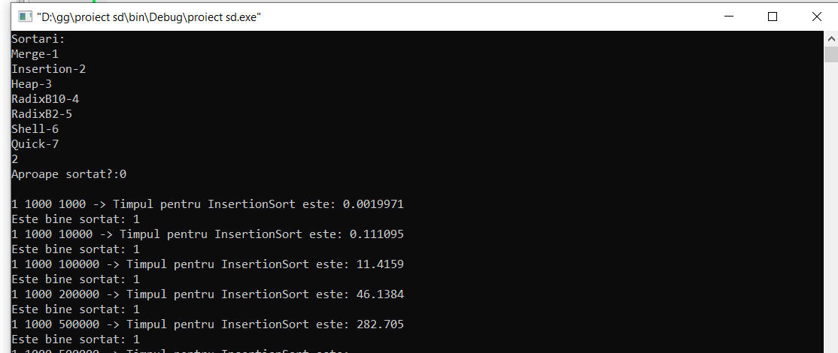
Test 1

Slide 30
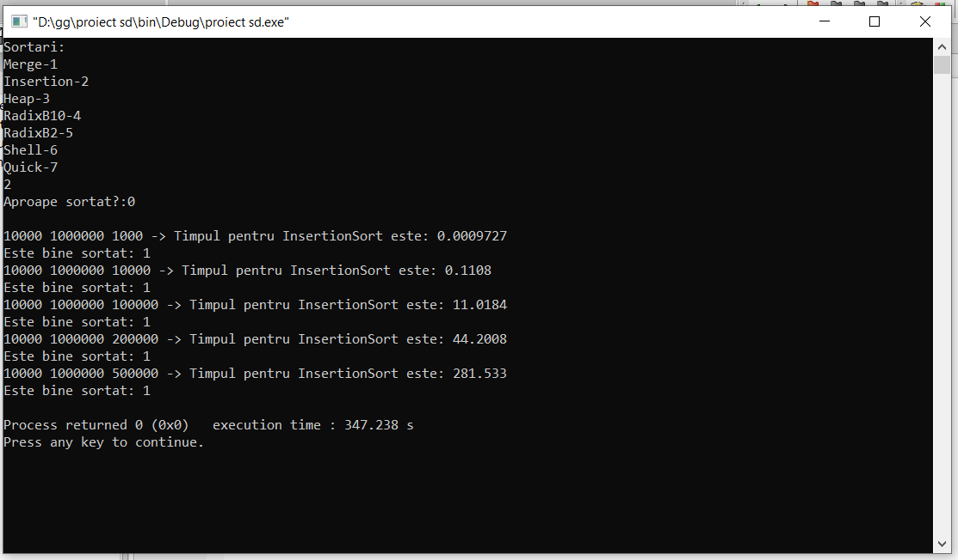
Test 2

Slide 31
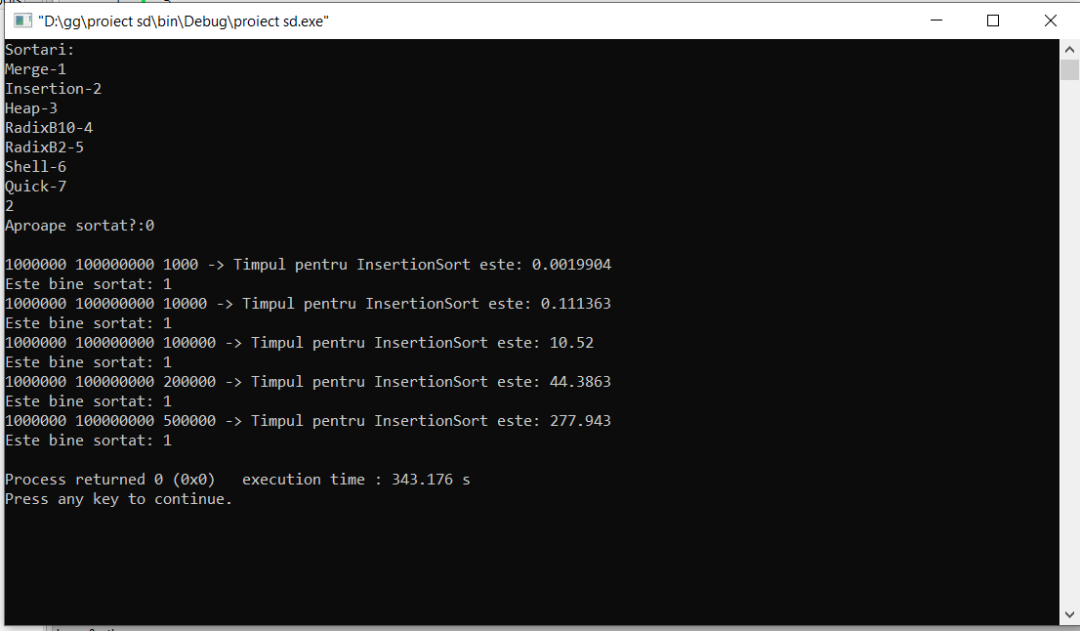
Test 3

Slide 32
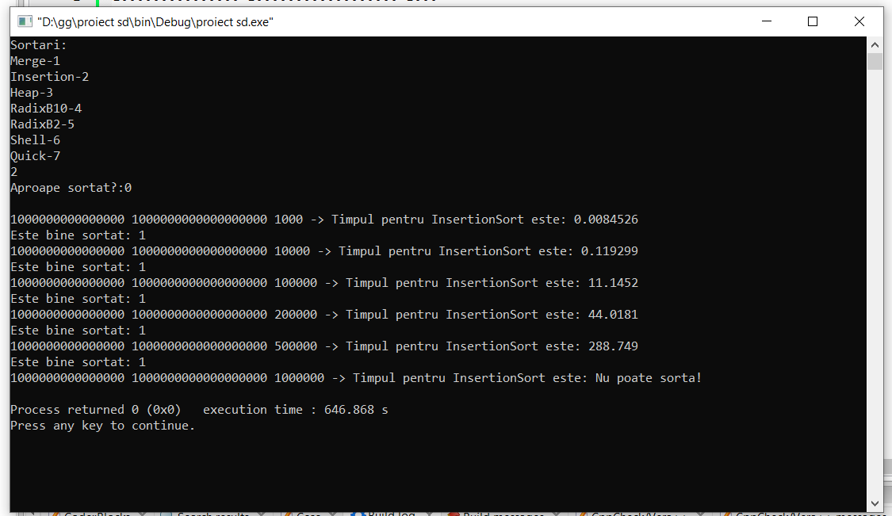
Test 4

Slide 33
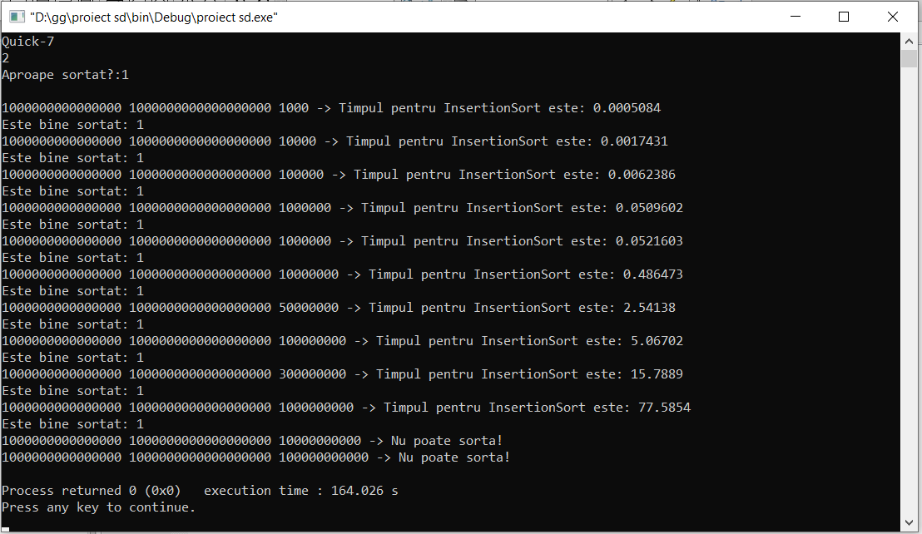
Test 5 – aproape sortat

Slide 34
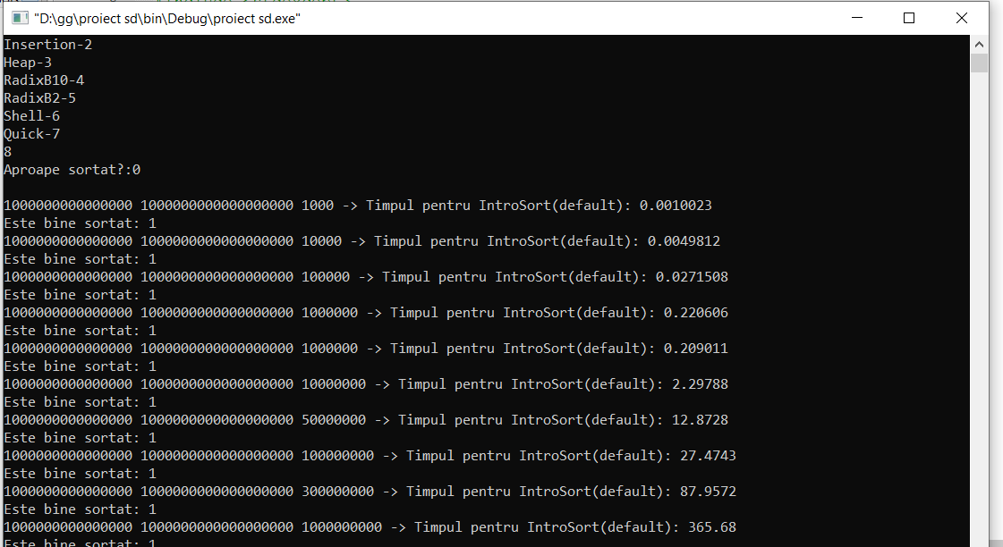
IntroSort din C++

