Slide 1
2021-10-05-FESD-Nashua
Week 1 – 2021-10-12

Slide 2
What is programming?
Programming is a way to instruct the computer to perform various tasks. (hacker.io)
Programming is a collaboration between humans and computers. (codecademy.com)
Programming is the process of giving machines a set of instructions that describe how a program should be carried out. (freecodecamp.org)
Programming is the process of creating a set of instructions that tell a computer how to perform a task. (khanacademy.com)

Slide 3
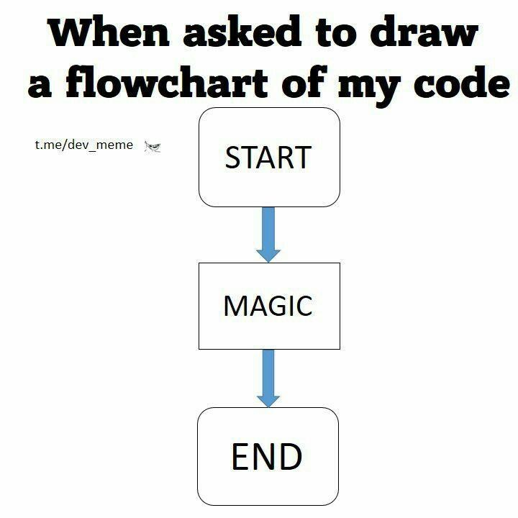
What is programming?
To me programming is all of those definitions and more.
Learning to program and being a programmer require logical thinking, but also a fair amount of creativity.
It is much more than just simply giving instructions to a computer and then having the computer process those instructions.
Programming requires you to think about the problems you need to solve and find ways to use a program language to craft those solutions.

Slide 4
Why JavaScript?
JavaScript the language of the web

Slide 5
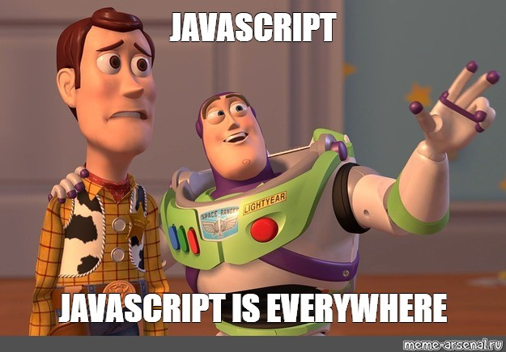
Why JavaScript
Buzz Lightyear is not wrong!
JavaScript has been the programming language of the web for almost two decades!
Since the release of ES2015 or ES6, JavaScript has corrected many of its prior problem areas.

Slide 6
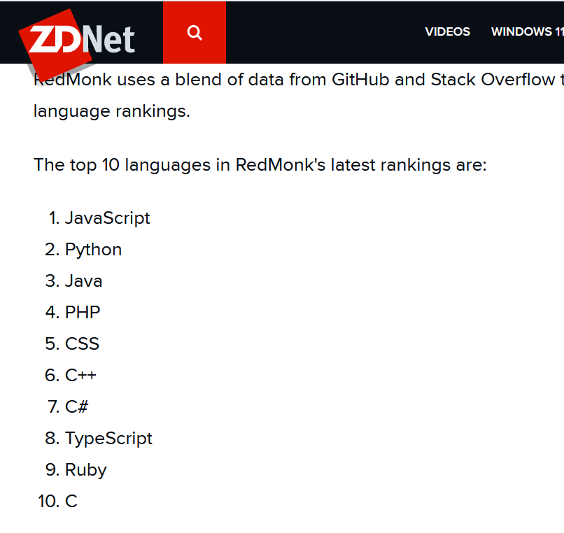
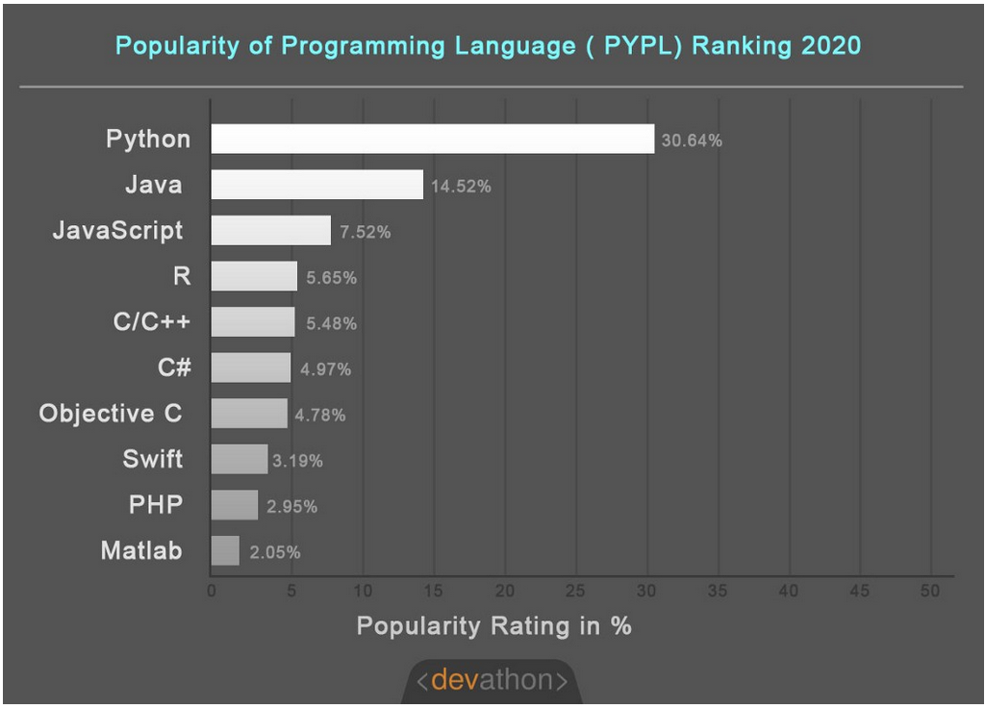
Why JavaScript?

Slide 7
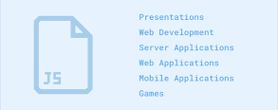
JavaScript is much more than the language of the web
Smart watches, desktop applications, VR development, and more!

Slide 8

Why JavaScript?
JavaScript has a number of libraries and frameworks that have helped it grow into a robust solution for solving software problems
With the addition of frameworks such as Electron, Node.js (technically not a framework, but often referred as one), backbone.js, and many more, JavaScript has become much more powerful in what can be accomplished!
For example, if you downloaded the Slack app, that is a desktop app built with
JavaScript using the Electron framework.

Slide 9
Variables and data types
How to set values in JavaScript and what does that even mean?

Slide 10
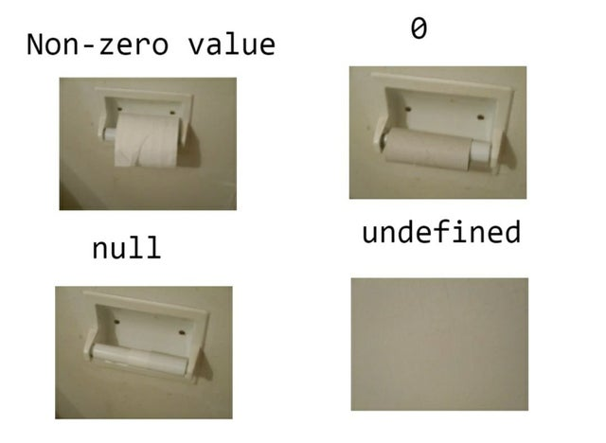
Variables and data types
JavaScript has the following data types
String
Numbers
Booleans
Null
Undefined
BigInt (won’t really use)
Symbol (won’t really use)

Slide 11
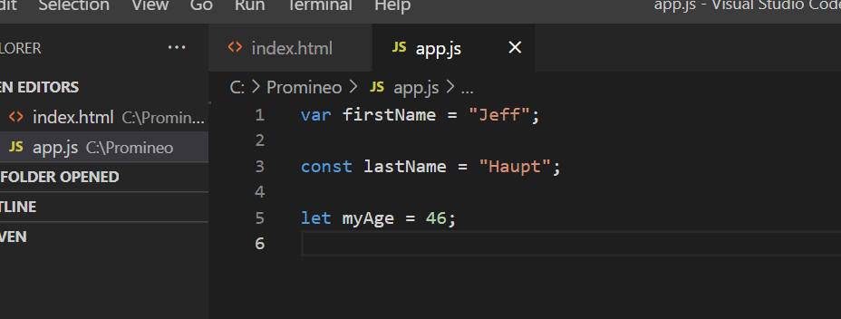
Variables and data types

Slide 12
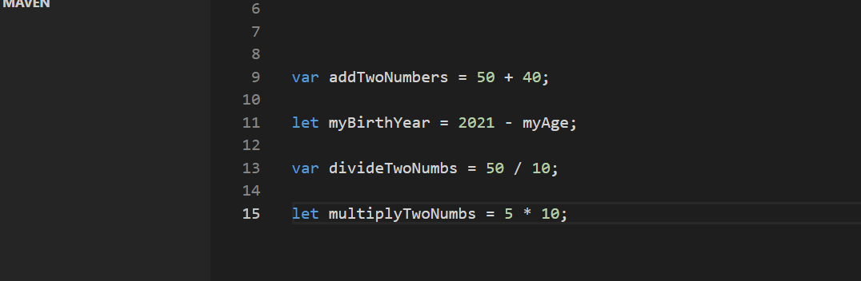
Operations in JavaScript

