Slide 1


Welcome
Radu Jianu
radu.jianu@city.ac.uk
Bootcamp’s Moodle page
Guest password:
yfizde3m
No access? Email now: ug.cs@city.ac.uk

Slide 2
Bootcamp, an intense programming taster
Two weeks and many hours of programming
Notes:
Two intense weeks of programming - 45 hours on campus and possibly a few more at home learning many different aspects of programming from the very basics to quite sophisticated, albeit small, applications of programming.

Slide 3
Bootcamp, an intense programming taster
Two weeks and many hours of programming
A taster of programming – an essential part of your computer science degree
Notes:
The point is to get a taster of programming – knowing to program is essential for a computer scientists and programming is part of many if not most of our modules at City. So getting a sense of what programming involves, what it’s like, and what it lets you do as early as possible – in the first two weeks of term – is essential!

Slide 4
Have the right expectations
We acknowledge your programming experience
is mixed – Bootcamp has something for everyone
Notes:
Poll – how many have no experience, some exposure, experienced?
We acknowledge this spread – you don’t need to know anything, we start from complete scratch; on the other hand if you’re a more experience programmer there will be plenty of opportunity to challenge yourself.
Don’t look over your shoulder at what others are doing – because you all start at different points it’s more important that you focus on your own learning. I have some great examples of students who came in knowing nothing about programming and by the end of year one they had developed into quite proficient ones.
Programming is a skill – just like riding a bike or a foreign language. We can tell you how things work but ultimately it’s all about the practice.
We don’t expect you to master programming in two weeks – if you know how to program by the end of year one that’s great, and if you’re a competent programmer by the end of your degree, and if you are an expert programmer only about 5 years from now… well, that’s the normal progression. That’s how long it typically takes to really master programming – many years. So, these two weeks are your first steps, just a taster really.
However far you get is fine!

Slide 5
Have the right expectations
We acknowledge your programming experience
is mixed – Bootcamp has something for everyone
Programming is a skill – practice is essential
Notes:
Poll – how many have no experience, some exposure, experienced?
We acknowledge this spread – you don’t need to know anything, we start from complete scratch; on the other hand if you’re a more experience programmer there will be plenty of opportunity to challenge yourself.
Don’t look over your shoulder at what others are doing – because you all start at different points it’s more important that you focus on your own learning. I have some great examples of students who came in knowing nothing about programming and by the end of year one they had developed into quite proficient ones.
Programming is a skill – just like riding a bike or a foreign language. We can tell you how things work but ultimately it’s all about the practice.
We don’t expect you to master programming in two weeks – if you know how to program by the end of year one that’s great, and if you’re a competent programmer by the end of your degree, and if you are an expert programmer only about 5 years from now… well, that’s the normal progression. That’s how long it typically takes to really master programming – many years. So, these two weeks are your first steps, just a taster really.
However far you get is fine!

Slide 6
Have the right expectations
We acknowledge your programming experience
is mixed – Bootcamp has something for everyone
Programming is a skill – practice is essential
We don’t expect you to master programming in two weeks – however far you get is fine!
Notes:
Poll – how many have no experience, some exposure, experienced?
We acknowledge this spread – you don’t need to know anything, we start from complete scratch; on the other hand if you’re a more experience programmer there will be plenty of opportunity to challenge yourself.
Don’t look over your shoulder at what others are doing – because you all start at different points it’s more important that you focus on your own learning. I have some great examples of students who came in knowing nothing about programming and by the end of year one they had developed into quite proficient ones.
Programming is a skill – just like riding a bike or a foreign language. We can tell you how things work but ultimately it’s all about the practice.
We don’t expect you to master programming in two weeks – if you know how to program by the end of year one that’s great, and if you’re a competent programmer by the end of your degree, and if you are an expert programmer only about 5 years from now… well, that’s the normal progression. That’s how long it typically takes to really master programming – many years. So, these two weeks are your first steps, just a taster really.
However far you get is fine!

Slide 7

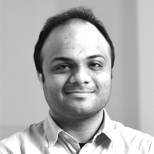
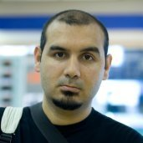

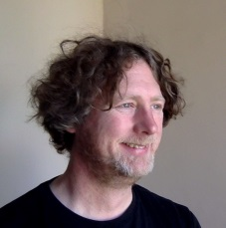
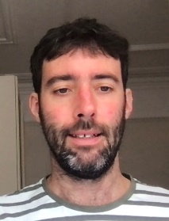

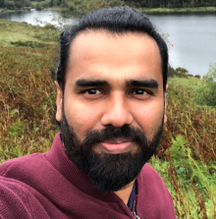

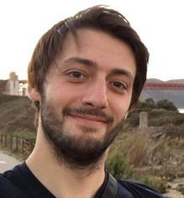
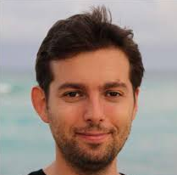
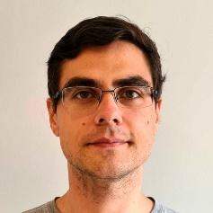

Bootcamp team – lots of support
Andy
Pranava
Cefa
Olga
Charlie
Jason
Martin
Aravin
Aidan
Sevinj
Robab
Giacomo
Radu
Faris
Belen

Slide 8
Practicalities
Bootcamp’s Moodle page
Guest password:
yfizde3m
No access? Email now:
ug.cs@city.ac.uk

Slide 9
Practicalities
(almost) Fully on-campus; attendance mandatory
You need a laptop!
Know your group and schedule
A wrap-up party with demos
Bootcamp is not assessed!

Slide 10
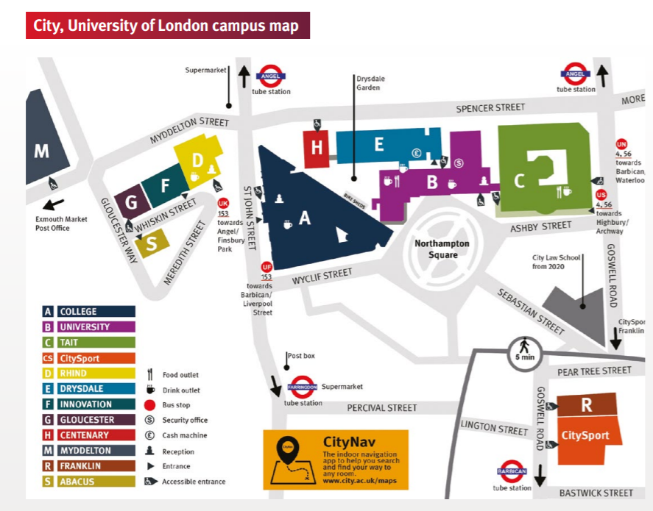
Example: ALG11 = College Building (A), lower ground (LG), room 11

Slide 11
Radu radu.jianu@city.ac.uk
I teach
Bootcamp
Java in term 2

Slide 12

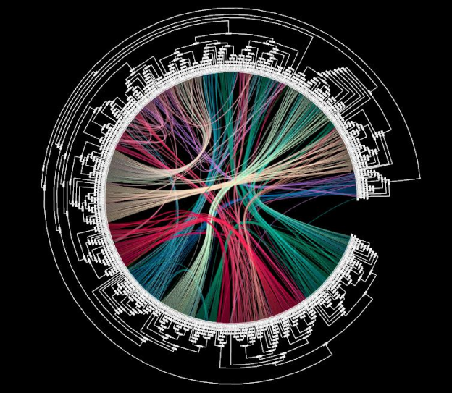
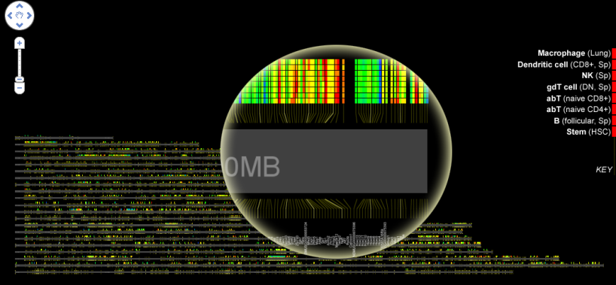
Radu radu.jianu@city.ac.uk
I teach
Bootcamp
Java in term 2
I research
Data visualization and interaction

Slide 13
Radu radu.jianu@city.ac.uk
Beyond City

Slide 14


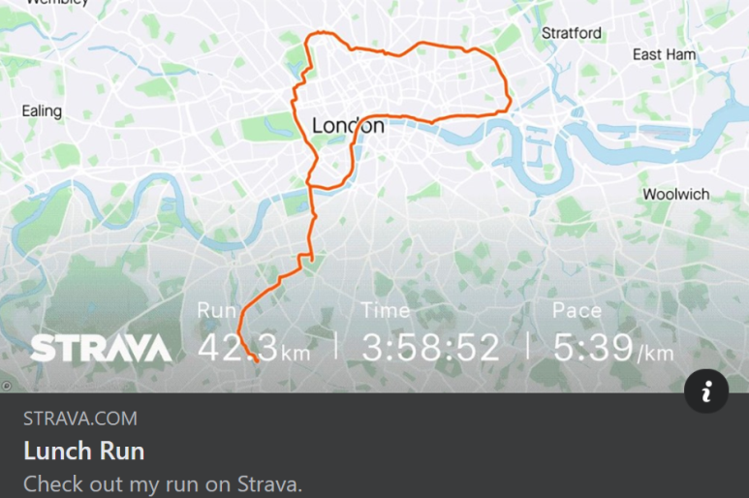
Radu radu.jianu@city.ac.uk
Beyond City

