Slide 1
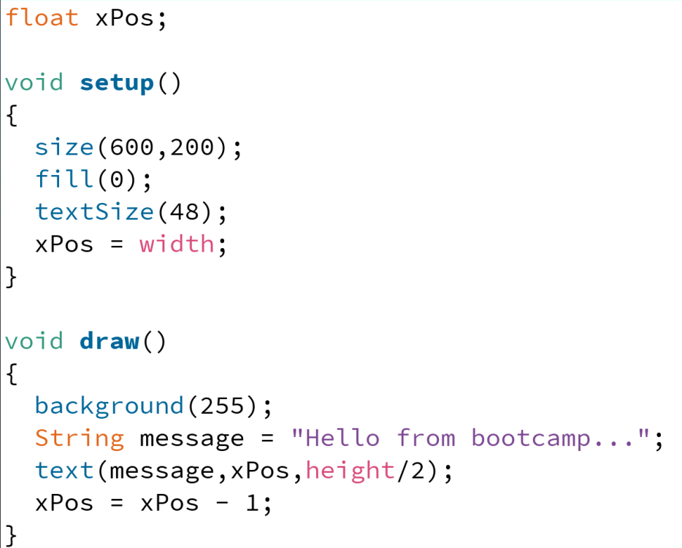
global scope
xPos = 0

Slide 2
global scope
xPos = 0

Slide 3
global scope
xPos = 600

Slide 4
global scope
xPos = 600
draw scope

Slide 5
global scope
xPos = 600
draw scope
message = “Hello from bootcamp…”

Slide 6
global scope
xPos = 600
draw scope
message = “Hello from bootcamp…”
“Hello from bootcamp…”

Slide 7
global scope
xPos = 599
draw scope
message = “Hello from bootcamp…”
“Hello from bootcamp…”

Slide 8
global scope
xPos = 599
“Hello from bootcamp…”

Slide 9
global scope
xPos = 599
draw scope
“Hello from bootcamp…”

Slide 10
global scope
xPos = 599
draw scope
message = “Hello from bootcamp…”
“Hello from bootcamp…”

Slide 11
global scope
xPos = 599
draw scope
message = “Hello from bootcamp…”
“Hello from bootcamp…”

Slide 12
global scope
xPos = 598
draw scope
message = “Hello from bootcamp…”
“Hello from bootcamp…”

Slide 13
global scope
xPos = 598
“Hello from bootcamp…”

Slide 14
global scope
xPos = 598
draw scope
“Hello from bootcamp…”

Slide 15
global scope
xPos = 598
draw scope
message = “Hello from bootcamp…”
“Hello from bootcamp…”

Slide 16
global scope
xPos = 598
draw scope
message = “Hello from bootcamp…”
“Hello from bootcamp…”

Slide 17
global scope
xPos = 597
draw scope
message = “Hello from bootcamp…”
“Hello from bootcamp…”

Slide 18
global scope
xPos = 597
“Hello from bootcamp…”

Slide 20
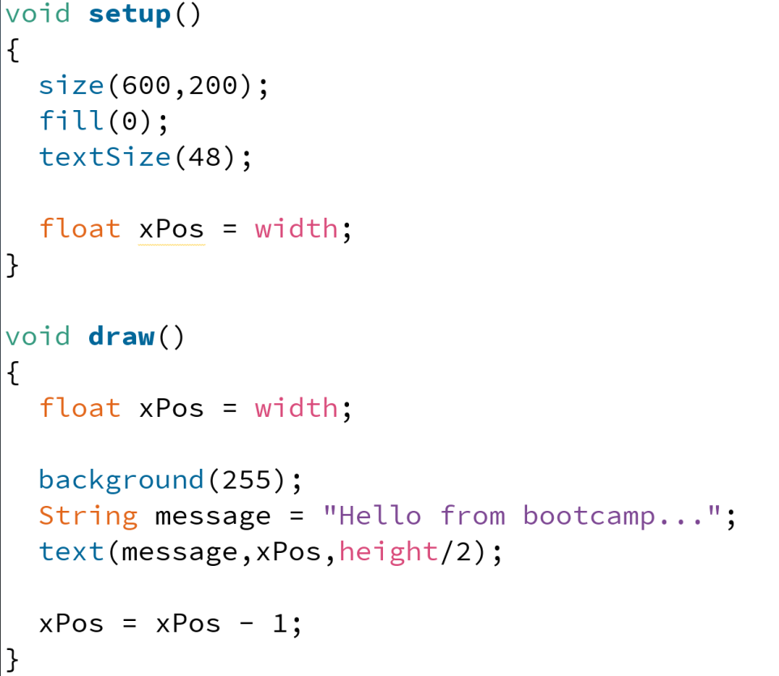
global scope

Slide 21
global scope
setup scope

Slide 22
global scope
setup scope
xPos = 600

Slide 23
global scope

Slide 24
global scope
draw scope
xPos = 600

Slide 25
global scope
draw scope
xPos = 600

Slide 26
global scope
draw scope
xPos = 600
message = “Hello from bootcamp…”

Slide 27
global scope
draw scope
xPos = 600
message = “Hello from bootcamp…”
“Hello from bootcamp…”

Slide 28
global scope
draw scope
xPos = 599
message = “Hello from bootcamp…”
“Hello from bootcamp…”

Slide 29
global scope
“Hello from bootcamp…”

Slide 30
global scope
draw scope
xPos = 600

Slide 31
global scope
draw scope
xPos = 600

Slide 32
global scope
draw scope
xPos = 600
message = “Hello from bootcamp…”

Slide 33
global scope
draw scope
xPos = 600
message = “Hello from bootcamp…”
“Hello from bootcamp…”

Slide 34
global scope
draw scope
xPos = 599
message = “Hello from bootcamp…”
“Hello from bootcamp…”

Slide 35
global scope
“Hello from bootcamp…”

Slide 37

Jason

Slide 38
Jason
Jason

Slide 39
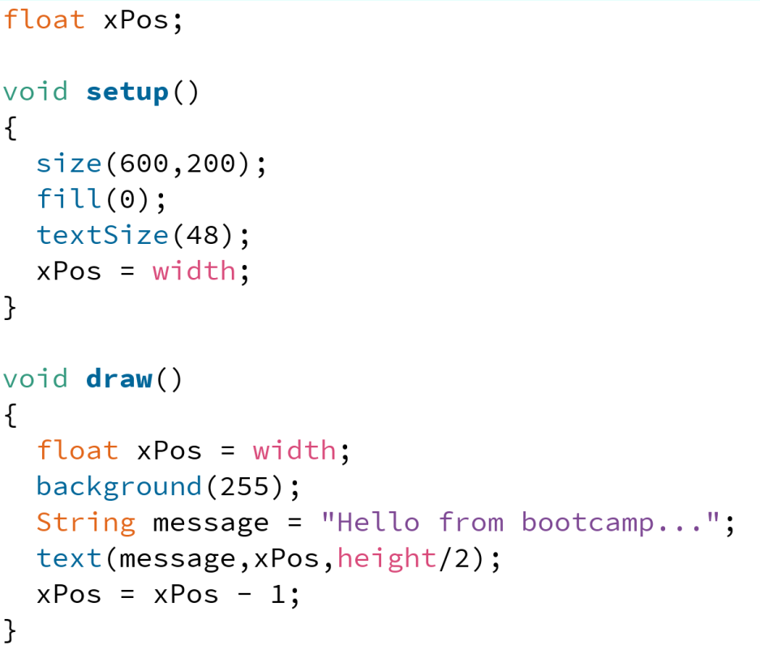
global scope
xPos = 0

Slide 40
global scope
xPos = 0
setup scope

Slide 41
global scope
xPos = 600
setup scope

Slide 42
global scope
xPos = 600

Slide 43
global scope
xPos = 600
draw scope
xPos = 600

Slide 44
global scope
xPos = 600
draw scope
xPos = 600
message = “Hello from bootcamp…”

Slide 45
global scope
xPos = 600
draw scope
xPos = 600
message = “Hello from bootcamp…”
“Hello from bootcamp…”

Slide 46
global scope
xPos = 600
draw scope
xPos = 599
message = “Hello from bootcamp…”
“Hello from bootcamp…”

Slide 47
global scope
xPos = 600
“Hello from bootcamp…”

Slide 48
global scope
xPos = 600
draw scope
xPos = 600

Slide 49
global scope
xPos = 600
draw scope
xPos = 600
message = “Hello from bootcamp…”

Slide 50
global scope
xPos = 600
draw scope
xPos = 600
message = “Hello from bootcamp…”
“Hello from bootcamp…”

Slide 51
global scope
xPos = 600
draw scope
xPos = 599
message = “Hello from bootcamp…”
“Hello from bootcamp…”

Slide 52
global scope
xPos = 600
“Hello from bootcamp…”

Slide 53
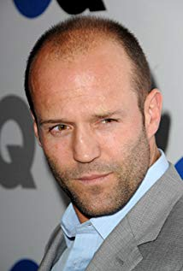
Jason
Jason

