Slide 1
Data Mining – Text Processing
Radu Manolescu
Reference Data

Slide 2
Data Mining: Extract information from text
Examine a body of text and determine topics, similarity, clusters
Illustrated here with data from Yelp reviews
Restaurant reviews are tagged with the specific cuisine e.g. “Japanese” / “Asian Fusion” / “Thai”, etc.
Find the topics that run through the reviews
Find similarities between cuisines, and cuisine clusters
Our documents will be the concatenated reviews for each cuisine
These techniques are applicable at BofA: e.g.
take collection of digitized documents and categorize them
extract entities: dates, the names of the parties, contract terms, etc.

Slide 3
Step 1: text pre-processing
Raw text is generally pre-processed to reduce variability and noise
Split into words, convert to lower case, remove numbers
Lemmatize: walk, walked, walks, walking => walk
Similar: stemming – does not always produce actual words
Add bigrams and trigrams: “california_roll” vs “california”, “roll”
Remove words that appear in < K documents, or >50% of docs
The result is a standardized vocabulary for our body of text

Slide 4
Step 2: Bag-of-words representation
Once we have the standard vocabulary, we can represent any text relative to it
Vocabulary:
Sentence 1: “cat has claws” becomes (1,0,1)
Sentence 2: “dog has claws” becomes (0,1,1)
If our vocabulary has N words, any text becomes an N-dim vector
… and we know how to work with numeric vectors
cat | dog | claws
1 | 2 | 3

Slide 5
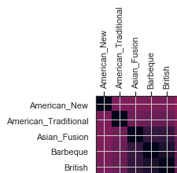
Distance matrix based on Bag-of-Words
Sparse matrix =>
everything looks related
Not very informative

Slide 6
Step 3: Can we do better? Topics
Model: assume we have topics, which are probability distributions over sets of words
Assume each document is generated by drawing words from a number of topics
Latent Dirichlet Allocation (LDA): compute the topics and for each (document, topic) the probability that the document was generated by drawing from the topic
Topic0:ami,mon_ami,lobster_bisque,frites,porterhouse,french_onion
Topic1:frites,keller,joel_robuchon,picasso,escargot,french_onion
Topic2:spicy_tuna,miso_soup,hamachi,california_roll,shrimp_tempura,bento

Slide 7
Latent Dirichlet Allocation (LDA)
The LDA model produces a number of topics (i.e. probability distributions of a set of words), each of which contains a number of words, ordered by their descending frequencies. For each cuisine and topic, it computes the probability that the cuisine's reviews were generated by sampling the topic.
For instance, for each cuisine, we get the topic probabilities like so:
list[(topic_id, probability)], e.g. [(2, 0.6096), (6, 0.0867), (9, 0.303), …]
Now, we can represent any document (i.e. cuisine) in the topic space, which is lower-dimensional (dozens vs thousands)

Slide 8
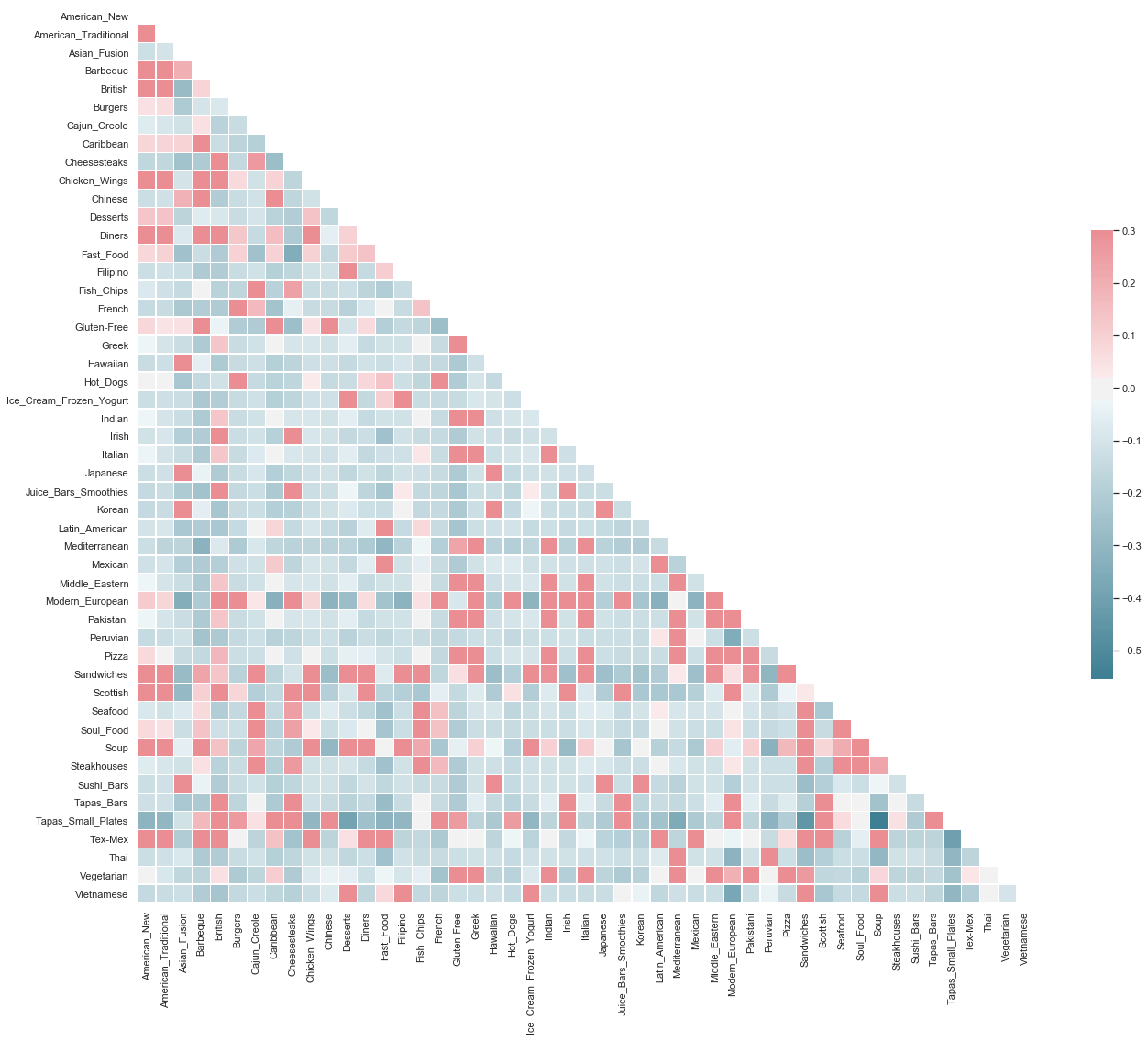
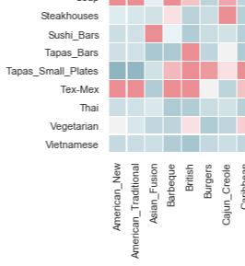
Visualizing Cuisines, In Topic Space
Easier to see correlations between cuisines, e.g. “Sushi Bars” – “Asian Fusion”

Slide 9
Step 4: Clustering
Clustering refers to the task of grouping a set of objects in such a way that objects in the same group (called a cluster) are more similar (in some sense) to each other than to those in other groups (clusters).
Multiple algorithms exist, and multiple distance functions can be used to define what it means to say that two objects are “similar” / “close to each other”
In our case, clusters can guide users who are curious about a cuisine they have not tried
A cluster of cuisines can tell users which known cuisines are similar to the unfamiliar one

Slide 10
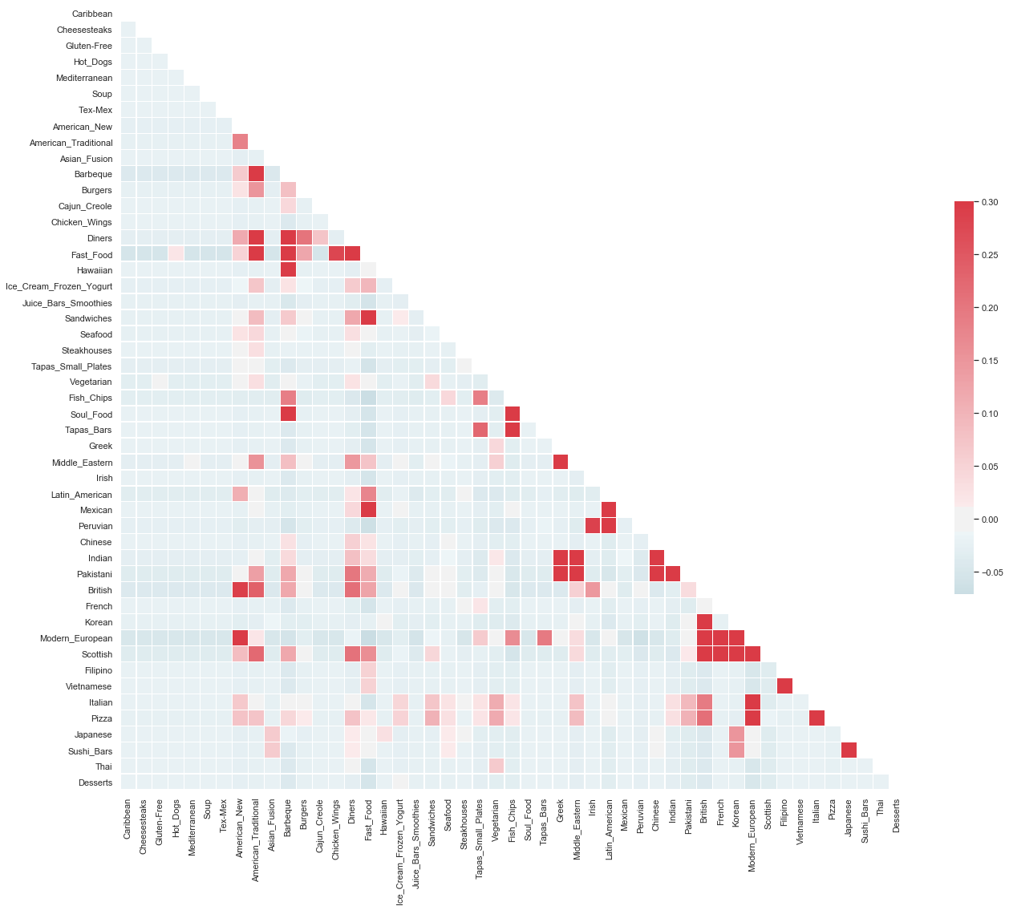
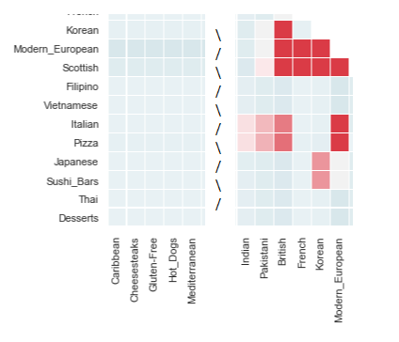
Visualizing clusters
Clusters help users understand similarities between groups of cuisines.
In the zoomed-in image: Korean, Modern European, Scottish, British, French

