Slide 1
Go Basic Rules
Two Players take turns placing a stone on the board
Stones that are completely surrounded are removed
The player, who surrounded more territory, wins the game

Slide 2
Why is Go a difficult Problem for AI
On average 200 different possible moves for a position
About 250 moves in a typical game
10^170 different legal positions
=> Classical Algorithms like Minimax can not explore the state tree deep enough in a reasonable amount of time

Slide 3
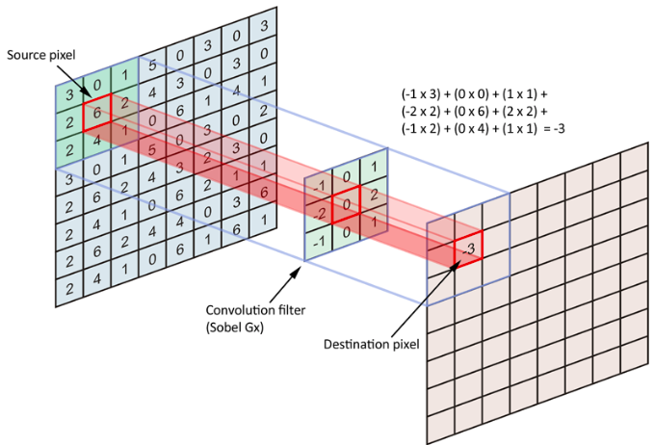
Convolutional Networks
Reduces the number of weights in the network
Allows the network to generalize features

Slide 4
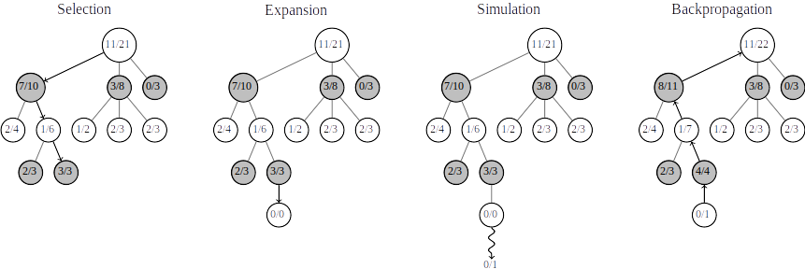
Monte-Carlo-Tree-Search

Slide 5
Some Optimizations
Exploiting Symmetries (Rotation, Mirroring, Swapping of Players) to increase the amount of training data by a factor of 16
Visit previously highly rated moves first

