Slide 1
Generic Programming Summer School 2018 Sebastian Gorobievschi
Realize innovation.
Unrestricted © Siemens AG 2018 All rights reserved.

Slide 2
What is Generic Programming
Generic programming is a style of computer programming in which algorithms are written in terms of types to-be-specified-later that are then instantiated when needed for specific types provided as parameters.

Slide 3
Types of templates
Function templates
Class templates

Slide 4

Function templates

Slide 5
Class templates

Slide 6
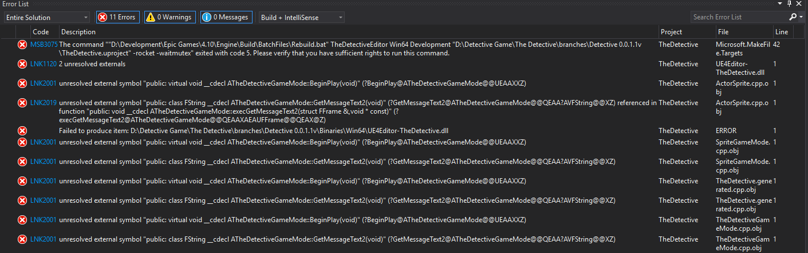
Linker errors

Slide 7

Questions?

Slide 8

Template guidelines

Slide 9
Class template instantiation
A class template by itself is not a type, or an object, or any other entity. No code is generated from a source file that contains only template definitions. In order for any code to appear, a template must be instantiated: the template arguments must be provided so that the compiler can generate an actual class (or function, from a function template).

Slide 10
Class template specialization
Specialization allows alternative implementations to be provided based on certain characteristics of the parameterized type that is being instantiated. Template specialization has two purposes: to allow certain forms of optimization, and to reduce code bloat.

Slide 11
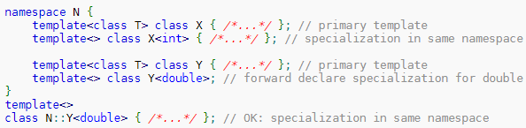
Class template specialization

Slide 12
Questions?

Slide 13
Curiously Recurring Template Pattern
Inherit from a template class
Use the derived class itself as a template parameter of the base class

Slide 14
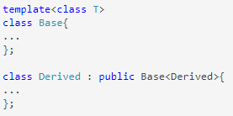
Curiously Recurring Template Pattern

Slide 15
Type traits
Think of a trait as a small object whose main purpose is to carry information used by another object or algorithm to determine “policy” or “implementation details” – Bjarne Stroustrup

Slide 16
Questions?

Slide 17
Let’s have some fun

