Slide 1








TEST FACTORY
Why Do We Need
a Test Factory?
Standardised, governed, and automated quality assurance across every delivery pipeline
The Problem
The Test Factory
Manual testing slows deployments
Inconsistent quality across teams
No safety guards for higher environments
Hotfixes take days instead of hours
A unified, governed platform that:
Automates test execution across CI, CD, and CT pipelines
Enforces safety guards: what runs where, who approves
The Risk
Accelerates hotfix delivery from days to hours
Unauthorized tests in PROD
Performance tests overwhelming UAT
No traceability from test to requirement
Tribal knowledge, no shared standards
Standardises test types, tags, and quality gates
Provides traceability from commit to production

Slide 2


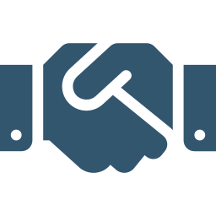

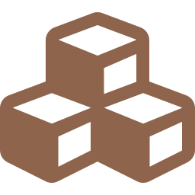

Test Pyramid & Test Types
From fast, cheap feedback at the base to slow, expensive validation at the top
Slower
More expensive
End-to-end
System
Static Code Analysis
SAST, linting, code quality. No execution needed.
Every commit, every PR
App Integration
Unit Tests
▲
Individual functions/methods in isolation. Fast, mocked.
Every commit, every PR
Component
Contract Tests
API contracts between consumer and provider (Pact).
CI (PR), provider verification in TEST
Contract
Component Tests
Single service with real dependencies mocked at boundary.
CI (PR), CD (post-deploy)
Unit
App Integration
▼
Multiple components of one application tested together.
Faster
Cheaper
Isolated
CT (post-CD in TEST/UAT)
Static Analysis
System Tests
End-to-end across multiple applications forming a product.
CT (TEST/UAT only)

Slide 3

Execution Pipelines
Three pipeline strategies, each with distinct triggers, ownership, and safety boundaries
CI
CD
CT
Continuous Integration
Continuous Deployment
Continuous Testing
Azure DevOps
Tekton
Azure DevOps + Tekton
GitHub Actions / ADO Pipelines
ServiceNow → Tekton Pipelines
ADO orchestrates, Tekton executes (OpenShift, Kafka, Vault)
TRIGGER
TRIGGER
TRIGGER
Code commit, Pull Request
ServiceNow Change Request (post-deployment)
Post-CD success, manual, scheduled
TESTS EXECUTED
TESTS EXECUTED
TESTS EXECUTED
Static Code Analysis (SAST, lint)
Unit Tests
Contract Tests (consumer)
Code coverage gating
Health / Smoke Tests (read-only)
Version + config verification
Critical API happy-path (GET only)
Application Integration Tests
System Tests (end-to-end)
Regression Suites
Performance Tests (TEST only)
GOAL: Fast feedback before merge. Every PR validated.
GOAL: Go/No-Go for deployment. Failure = automatic rollback.
GOAL: Broader quality confidence. Not blocking deployment.

Slide 4
End-to-End: Deliver Patch to Production
From hotfix commit to production deployment — stages, test types, pipelines, and triggers
Commit
hotfix/*
Merge
release/x.y
Publish
Artifactory
Deploy
DEV
Deploy
TEST
Deploy
UAT
Deploy
PROD
▶
▶
▶
▶
▶
▶
Test Type
/ Pipeline
CI
(Commit/PR)
DEV
(Post-Deploy)
TEST
(Post-Deploy)
UAT
(Post-Deploy)
PROD
(Post-Deploy)
Static Analysis
CI
✓ Commit + PR
—
—
—
—
Unit Tests
CI
✓ Commit + PR
—
—
—
—
Contract Tests
CI + CT
✓ PR
(consumer)
—
✓ Provider
verification
can-i-deploy
check
can-i-deploy
check
Component Tests
CI + CD
✓ PR
✓ CD
ServiceNow
✓ CD
ServiceNow
✓ CD
ServiceNow
✓ CD
Smoke only
App Integration
CT
—
✓ CT
Manual/Auto
✓ CT
Post-CD
✓ CT
Approved
✗ BLOCKED
System Tests
CT
—
—
✓ CT
Post-CD
✓ CT
Approved
✗ BLOCKED
Performance
CT
—
✓ CT
Manual
✓ CT
Scheduled
✗ BLOCKED
✗ BLOCKED
CI = Azure DevOps
CD = Tekton (ServiceNow)
CT = ADO + Tekton
✗ = Safety Guard Blocked

