Slide 1
Web Recommender Systems
Project presentation
Taraburca Radu - whx862

Slide 2
Recommender models
User-based recommender model
SVD recommender model
TopPop model
Content-based recommender model
Weighted strategy - Hybrid recommender model
Switching strategy - Hybrid recommender model
Meta-level strategy - Hybrid recommender model

Slide 3
Week 1 - Familiarization with the Datasets
Data Cleaning and Preprocessing
Clean both splits from missing ratings and duplicates, and keep only the most recent rating for each duplicate entry.
Double check that all users from the test split also appear in the training set, and remove those that do not appear in training.
Mapping:
Use the id map.csv mapping table to get the corresponding overview column in the movies metadata.csv file for each movie in MovieLens 100K.
Statistics:
Compute user and item statistics (such as distribution of ratings per user/item, the top 5 most popular items) for the training set and write a discussion on the dataset properties.
Frequency of movies :
Compute the frequency of movies that were rated highly (rating >=3) by each user.

Slide 4
Week 2 - CF Recommender System
TopPop recommender system:
A simple recommender system that recommends the most popular items to all users.
Implemented by sorting the items by the frequency of high ratings they receive, and recommending the top-k items.
Neighborhood-based model:
This model uses the observed user-item ratings in the training set to predict the unobserved ratings by considering similarities between users to make predictions.
Specifically, the K-Nearest Neighbor (KNN) algorithm with user-based similarity was used for this.
I used the “KNNWithMeans” model from Surprise package for this.
Hyperparameters were tuned using 5-fold cross-validation on the training set.
Latent factor model:
This model uses observed user-item ratings to predict the unobserved ones, but it decomposes the user-item rating matrix into two matrices of latent factors: user factors and item factors, and the predictions are obtained by multiplying these two matrices.
The Singular Value Decomposition (SVD) algorithm from the Surprise was used to implement this model.
Hyperparameters were tuned using 5-fold cross-validation on the training set
Hyperparameters tuning:
Used 5-fold cross-validation on the training set to tune the hyperparameters of the chosen models
GridSearchCV was used for both models to evaluate the best combination of hyperparameters
Metrics used to evaluate the models were RMSE and MAE

Slide 5
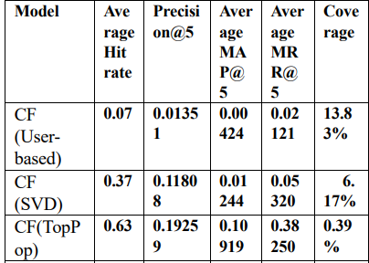
Week 3 - Evaluation of Recommender Systems
Measures of evaluation:
RMSE, Hit rate, Precision@k, Mean Average Precision (MAP@k), Mean Reciprocal Rank (MRR@k), Coverage
Limitations of metrics:
RMSE cannot be computed for TopPop
Hit rate only considers the presence of recommended items, not the rank order or quality of recommendations
Precision@k is affected by the definition of relevance and the size of k
MAP@k may not accurately reflect user satisfaction with the entire recommendation list
MRR@k only considers the rank of the first relevant recommendation
Coverage does not consider the quality or relevance of recommended items
Comparison of systems:
Error analysis:
Retrieving the 10 nearest neighbors of the first and last users from the test set and analyzing their rate history and predictions for neighborhood-based CF

Slide 6
Week 4 - Text Representation
Preprocessing:
Clean the overview column from the metadata file by tokenizing, transforming to lowercase, removing stopwords, and stemming.
The nltk library is used for the preprocessing.
The size of the vocabulary before preprocessing is 172304, and after preprocessing, it is reduced to 70731.
The vocabulary size was reduced from 15754 words to 9559 words for the merged dataframe.
Text representation:
TF-IDF vector space: Represent each movie in the TF-IDF vector space using scikit-learn
word embeddings
Similarity between movies:
Calculate the cosine similarity for each representation.
Pearson correlation coefficient is used to compare the two matrices obtained
The Pearson correlation coefficient obtained after comparing the cosine similarity matrices obtained from TF-IDF and word embeddings is 0.1906.
This value indicates that the two cosine similarity matrices are not strongly correlated.

Slide 7
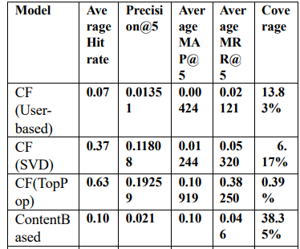
Week 5 - Content-Based Recommender System
Transformed movie overviews into a numerical representation and selected other features ( genres and production companies) to use as item features
Represented each user in the same vector space as the items by using an average of the items the user rates
Calculated user-item rating for a movie by using cosine distance between the user and the movie
Reported evaluation metrics, such as Precision@5, MAP@5, MRR@5, hit rate, and coverage

Slide 8
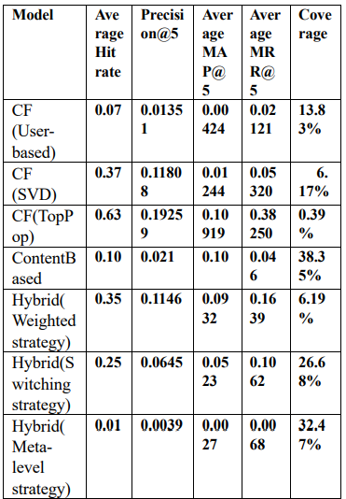
Week 6- Hybrid Recommender System
Weighted strategy:
Combines recommendations from CF(SVD) and content-based systems.
The final list of recommendations is obtained by weighting the two systems' rankings using two weights, alpha and beta,where alpha = 0.6 and beta = 0.4.
Switching strategy:
Combines recommendations from CF(SVD) and content-based systems.
The Borda count method was used to combine recommendations from the two models.
To solve the tie problem, I used a randomizer to select one solution and to add more randomness, I run the algorithm a few random times
Meta-level strategy:
The content-based recommendations are used as input to the CF(SVD) model.
Evaluation of models:

Slide 9
Q&A

