Slide 1


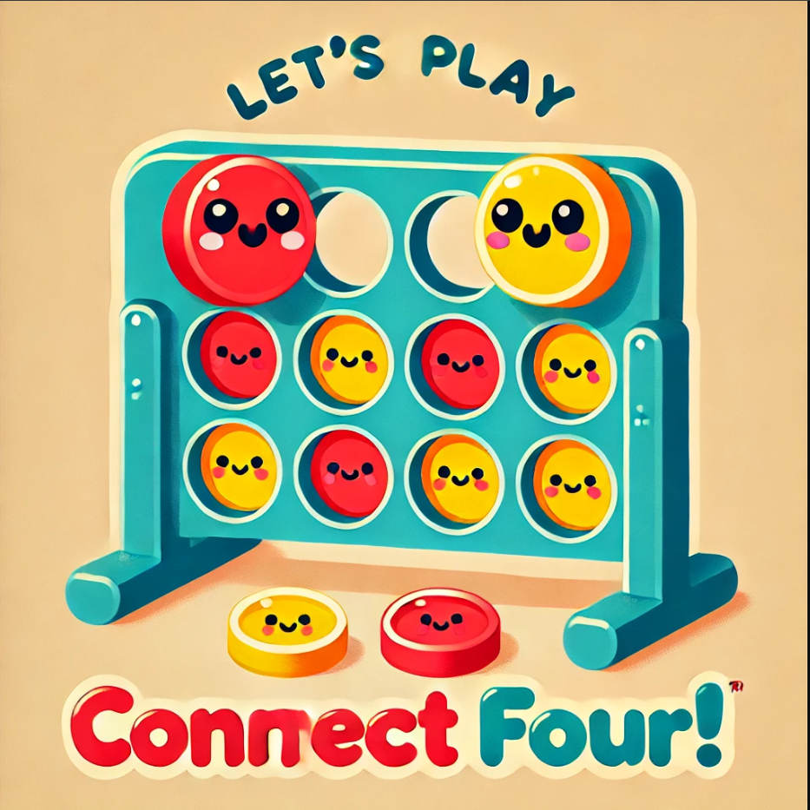
Helwan University - Faculty of Computers & Artificial Intelligence – Computer Science Department
Course: AI310 Artificial Intelligence – Fall 2024
Documentation for :
An Intelligent Connect 4 Player Using :
the MinimaxAlgorithm
Alpha-Beta Pruning
and Heuristic Functions
Instructor: Dr. Amr S. Ghoneim

Slide 2
Team Members :
 | IDs | Full Name | Department
1 | 20220162 | Radwa Mohamed Mohamed Mohamed | CS-L3
2 | 20220148 | Doaa Karem Mohamed AbdAlmksoud | CS-L3
3 | 20220164 | Rana Ayaman Rezq Allah Hussien | CS-L3
4 | 20220158 | Rahma Mohamed Taha Ismail | CS-L3
5 | 20220099 | Aya Younis AboAlfouh ELalfy | CS-L3
6 | 20220332 | Fatma Amr AbdAlrahman Abduallah | CS-L3
Source Code : https://github.com/radwa018/4Agents

Slide 3
Project Overview:
Connect Four is a two-player strategy game where players take turns dropping colored discs into a vertical grid. The goal is to connect four consecutive discs of the same color horizontally, vertically, or diagonally before the opponent does.
Game Features
Game Board: A grid of 6 rows and 7 columns where players drop their discs.
Player Turns: Two players (Player 1 and Player 2) alternate turns.
Win Condition: The game ends when one player connects 4 discs in a row (horizontally, vertically, or diagonally).
Draw Condition: If the grid is completely filled and no player wins, the game ends in a draw.
User Interface: A visual representation of the grid where players can see the discs being dropped.
Restart Option: Allows the players to start a new game after a win, draw, or by choice.
Input Handling: Players choose the column where they want to drop their disc.

Slide 4
Components:
Board Representation:
A 2D list (6x7) to store the state of the board.
Empty slots are initialized with 0, Player 1 discs are represented as 1, and Player 2(AI) discs as 2.
Game Logic:
Check Win: A function to verify if there is a winning combination.
Valid Moves: Ensure discs can only be dropped into non-full columns.
Draw Condition: Check if the board is full and no player has won.
Graphics (Pygame):
Use Pygame to visually display the board.
Create circular slots for discs and animate dropping discs.
Highlight the winning discs when a player wins.
Player Interaction:
Handle mouse clicks to choose a column.
Switch turns between players.
Game Flow:
Start the game.
Alternate turns between Player 1 and Player 2(AI).
Check for a win or draw after each move.
End the game when a win/draw occurs, with an option to restart.

Slide 5
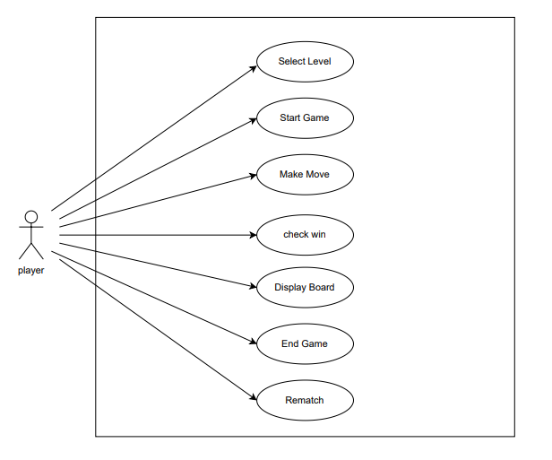
Use case diagram of the game :

Slide 6
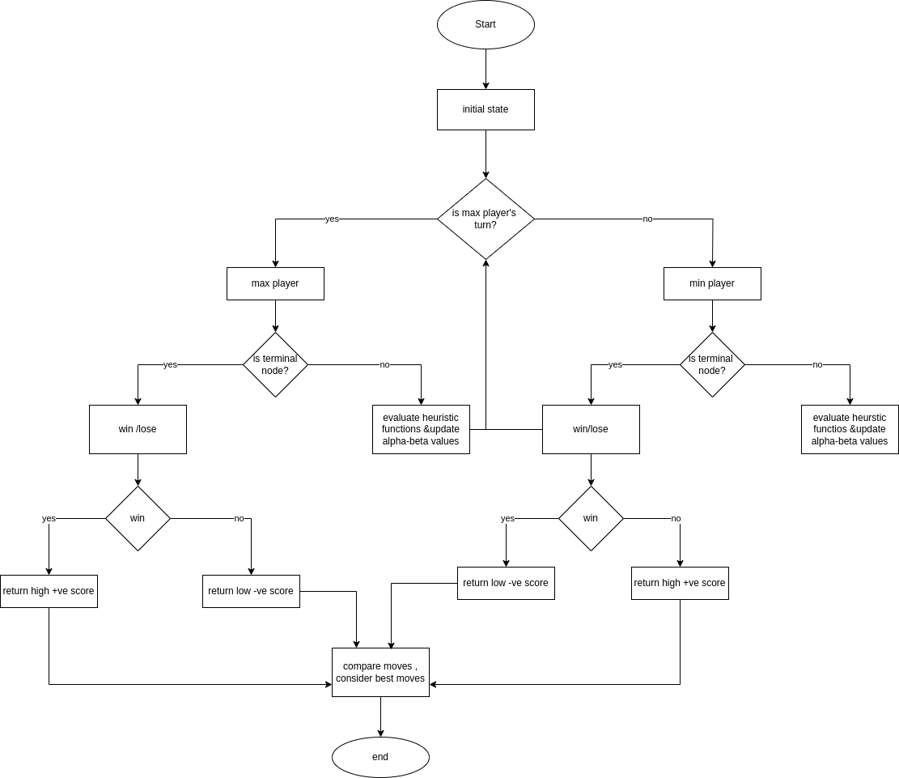
Flow Chart diagram :

Slide 7
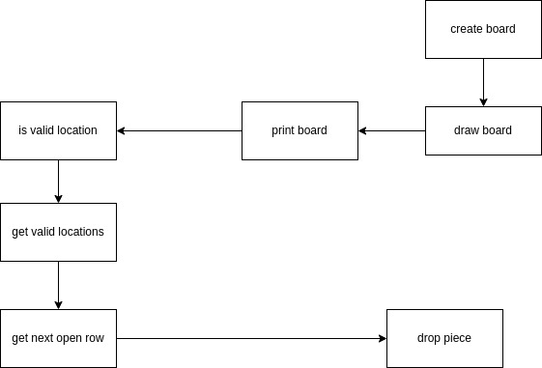
System Block diagram :

Slide 8
Applied Algorithms :
Minimax :
It’s a decision-making algorithm used in two-player games (like Connect Four or Chess) to determine the optimal move.
->Maximizer: Tries to maximize the score (best possible move).
->Minimizer: Tries to minimize the score (opponent’s best move).
The Minimax algorithm simulates all possible moves and counter-moves to select the move that leads to the best guaranteed outcome for the player.
In our case Minimax has limitations because of its time and space complexity ,as it explores all possible moves
leading to an exponential growth in computation time :
For a game with b possible moves per turn and a depth d --> Time complexity is O(b^{d})
also it requires a lot of memory to store the game tree for deeper levels --> Space Complexity
Minimax works for Dereministic games , struggles in games with Randomness (dice rolls) where probabilities must be considered(Stochastic games)

Slide 9
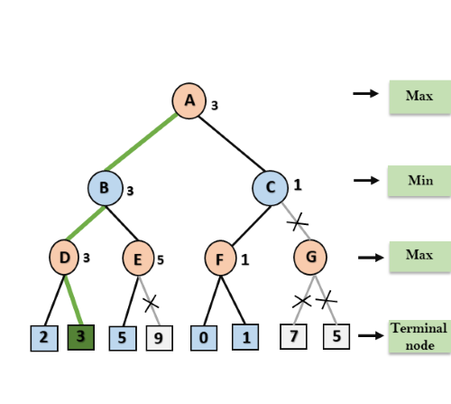
Applied Algorithms :
Alpha-Beta Pruning:
it is an optimization technique for the Minimax algorithm. It reduces the number of nodes evaluated in the game tree by pruning branches that cannot influence the final decision.
->Alpha (α): The best value the Maximizer can guarantee so far.
->Beta (β): The best value the Minimizer can guarantee so far.
If it finds a branch where the outcome is worse than the current α or β, that branch is pruned (ignored).
this leads to reduce computation time significantly while still finding the optimal move.

Slide 10

what if we need to find the solution without relying on complex Algorithms ?
In such cases, we can turn to heuristic functions, which offer a simpler and more efficient approach by providing approximate solutions based on problem-specific insights.
AS we menthined before that algorithms aim for the perfect solution but take a long time , heuristics gives you a good enough solution quickly which is crucial in real time situations.
->heuristics are lightweight and save both time and resources.
->heuristics are easier to design and implement because they use simple logic.
In our connect 4 A heuristic might say :
“Add 5 points if I form a pair of discs; add 3 points if I block the opponent.”
it doesn't check all possible future moves but gives the AI a direction to play smartly right now.
In contrast, a complex algorithm would try to calculate every possible move to ensure the absolute best outcome, which is often overkill for practical purposes.

Slide 11
Heuristic functions used in our project :
->find_best_move_heur1():
Simulates all possible valid moves, evaluates each move using a heuristic function (evaluate_board_score), and returns the best column for the AI to play.
->evaluate_board_score():
Assigns a score to the board based on favorable horizontal positions for the AI and defensive positions (blocking opponents).
->def valid_moves(board):
The heuristic works by evaluating all valid moves the AI can make, simulating each move, scoring the resulting board positions, and selecting the column that maximizes the score. This method helps the AI choose the move that will likely lead to the best position, based on the scoring system implemented in the score_position() function.
find_best_move_heur1 uses evaluate_board_score, while valid_moves uses score_position. The two functions have different heuristic evaluation strategies, which could lead to different behavior and outcomes in selecting the best move.

Slide 12
Algorithms Comparsion :
Minimax Only :
Likely slower with large depths due to exhaustive search.
Explores the most nodes.
High memory usage.
Minimax with Alpha-Beta :
Significant reduction in nodes explored and faster execution time.
Similar move quality to Minimax Only.
Minimax with Heuristic 1/2 :
Faster than both raw Minimax and Alpha-Beta due to reduced depth.
Move quality depends on the heuristic's design and effectiveness.

Slide 13
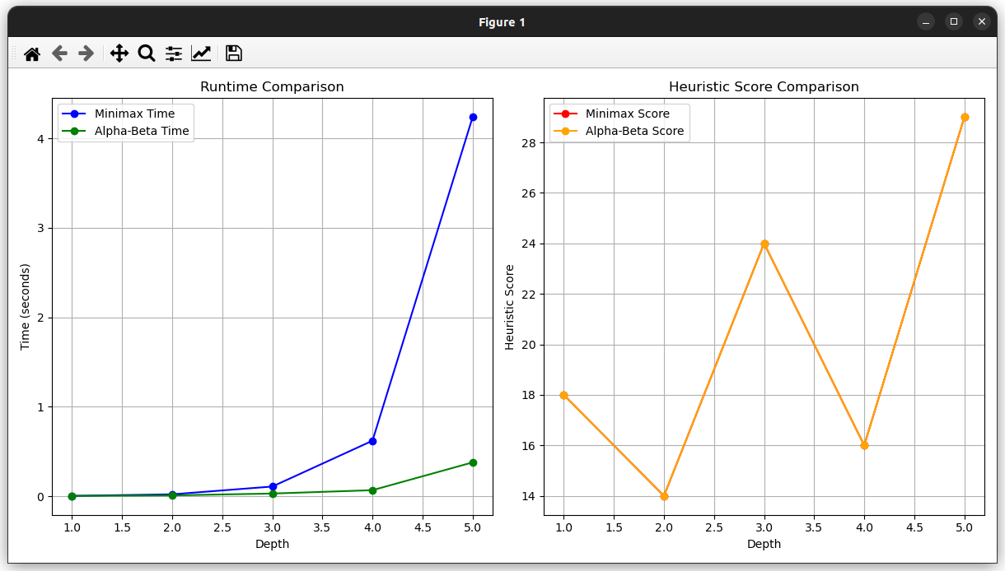
Algorithms Comparsion :

Slide 14
Algorithms Comparsion :
1. Runtime Comparison Plot
Compares the time taken by the Minimax and Alpha-Beta Pruning algorithms to compute the best move at various search depths.
As depth increases, the time taken by both algorithms increases, but Alpha-Beta Pruning takes significantly less time.
2. Heuristic Score Comparison Plot
Compares the heuristic scores of the board state as evaluated by Minimax and Alpha-Beta Pruning at various depths.
Both Minimax and Alpha-Beta Pruning should produce the same scores at each depth because Alpha-Beta Pruning is an optimization of Minimax, not a heuristic change.

Slide 15
another ways to improve AI :
--> we can use machine learning :
Reinforcement Learning(RL) --> we can teach the AI how to play connect4 based on rewards. the agent would learn over time by simulating many games and receiving positive rewards for winning and negative rewards for losing.
Supervised Learning --> Another approach would be to train the AI using a dataset of expert-level games (games played by strong human or AI players) to classify moves that lead to successful outcomes.
--> Monte Carlo Tree Search (MCTS):
MCTS is an alternative search algorithm that can be used to make decisions in complex games like Connect Four. It works by running many simulations of the game and selecting the move that results in the best outcome.
Unlike Minimax, which searches the entire game tree to a fixed depth, MCTS dynamically explores the tree based on the most promising paths. This would allow the AI to make better decisions without the need to exhaustively search all possibilities

Slide 16
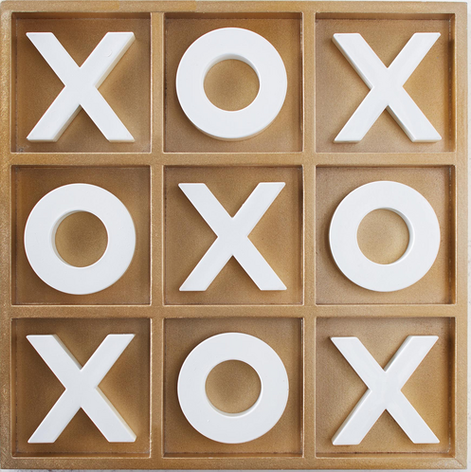
Applications similar to connect four :
1) Tic Tac Toe:
Platform:
Mobile (iOS/Android), Web
Functionality/Features:
Single Player Mode: Play against an AI with different levels of difficulty.
Multiplayer Mode: Play with friends or other users.
Board Reset/Undo: Reset the game board to play again.
Simple User Interface: Clean design for ease of use.
How it Works:
Players take turns marking spaces on a 3x3 grid with X's and O's.
The game ends when a player gets three symbols in a row or when the grid is full (a tie).

Slide 17
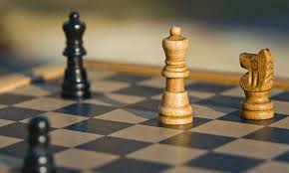
Applications similar to connect four :
2) Chess :
Platform: Mobile (iOS/Android), Web, Desktop
Functionality/Features:
Multiplayer Mode: Online and local multiplayer.
AI Mode: Play against different difficulty levels of AI.
Game Timer: Set time limits for each move or the entire game.
Game Analysis: Offers suggestions or insights on possible moves.
How it Works:
Players move chess pieces on an 8x8 grid following the standard rules of chess.
The game checks for check, checkmate, and stalemate conditions.
Multiplayer features allow players to join games with others online.

Slide 18
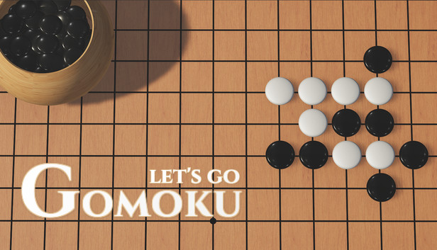
Applications similar to connect four :
3) Gomoku (Five in a Row):
Platform: Web, Mobile
Functionality/Features:
Multiplayer: Online matches against friends or strangers.
Single Player: Play against the computer with different levels of difficulty.
Timer: Add time limits for moves or the entire game.
Statistics: Track game history and win rates.
How it Works:
Players place black or white pieces on a grid, aiming to form an uninterrupted line of five pieces.
The game checks after each move for a winning line.

Slide 19
References and Literature Reviews :
- Minimax with alpha-beta pruning:
https://www.academia.edu/41561708/Minimax_with_alpha_beta_pruning_connect_4_game_
- Evaluation of the Use of Minimax Search in Connect-4:
https://www.scirp.org/pdf/am_2023061214362735.pdf
- AI: Connect Four Agent:
https://dl.acm.org/doi/pdf/10.1145/3554916
- Using Game-Theory and Demonstrations to Learn the Win Conditions of a Connect Four Game:
https://cpb-us-e1.wpmucdn.com/sites.psu.edu/dist/2/117852/files/2020/05/Ayub-ICSR2018-v4.pdf
- MCTS heuristic search algorithm:
https://en.wikipedia.org/wiki/Monte_Carlo_tree_search

Slide 20


