Slide 1
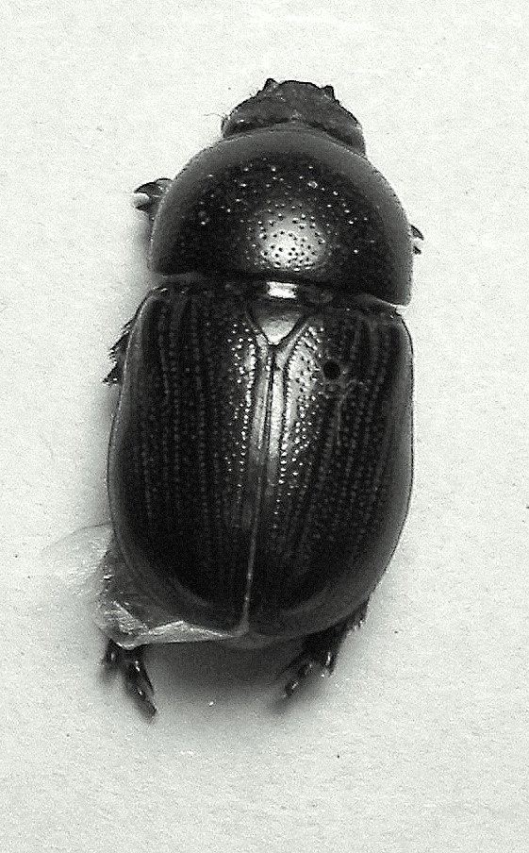

Beetle-FX
w Zabierzowie chrząszcz brzmi w trzcinie
(in bierzów cane beetle sounds)

Slide 2
What is Beetle-FX?
For a company that needs to maximise their income whilst ensuring the best price for their products and services to their customers.
Beetle-FX is a tool that allows business to identify where their income originates allowing them to offer localised pricing whilst being offered the best rate of exchange into their own currency

Slide 3
Who it is for?
Internet based companies who have a overseas sales
Larger companies who operate cross borders
Small shops who reply on tourist trade
Who accept credit / debit card payments
Who have many foreign tourist customers
who wish to price and transact multi currency pricing in store (akin to Ferry companies) without the hassle of rapidly changing exchange rates.

Slide 4
What does it do?
Shows break down by area of the source of customer transactions
Provides total income based on currency.
Allows HSBC to offer propositions based upon total income by currency
Allows the customer to benefit from higher currency exchange amounts rather than individual transactions

Slide 5
What can we Propose?
Check to see if current receipts are optimised
Offer the scheme to optimise their foreign transactions
Offer options to open account in the foreign currency (Euro) and take payments in Euros
Offer access to HSBC trading services, loans and credit
Actually open the account in the foreign currency ready for trading

Slide 6
How does it do it?
Used the transaction history to identify the location of transactions
Totals up overall income by region & currency
Uses FX API to work out currency exchange to offer ‘best’ value for money for exchange back to Customers currency
Utilises the Account Opening API to open foreign currency account
And of course the Google Maps API

Slide 7
Thank You
Pierre DE LEUSSE
Piotr MASLANKA
Przemyslaw J CZAJKOWSKI
Radoslaw M KAPLONIAK
Richard J COLLEY

