Slide 1
Oh Ship!
Team members:
Zachary Cox
Rae Vroman
Gilad Berman

Slide 2
Problem Statement
The goal of the game is for the player to make their way to the deck of the ship, collecting items, defeating pirates, and solving puzzles along the way.

Slide 3
Problem Statement
Specific customer goals:
Pickup/drop/use/examine items they’ve found
Solve, ignore, get hints on puzzles
Look at the map, navigate room to room
Fight or attempt to escape from monsters
Save their progress
Load their progress

Slide 4
Analysis Outcome
The original requirements stated that this would be a web game, we agreed to make it just a standalone desktop application with GUI.
Scrapped crew member party system requirement.
Scrapped ability to defend against enemy attacks, leaving only the ability to attack or escape.
When a player dies they will automatically respawn at the previous staircase.

Slide 5
System Design
Most of the classes were modeled around the room and character classes.
We decided to only use text files to save and load user data since we didn’t feel comfortable working with databases currently.

Slide 6
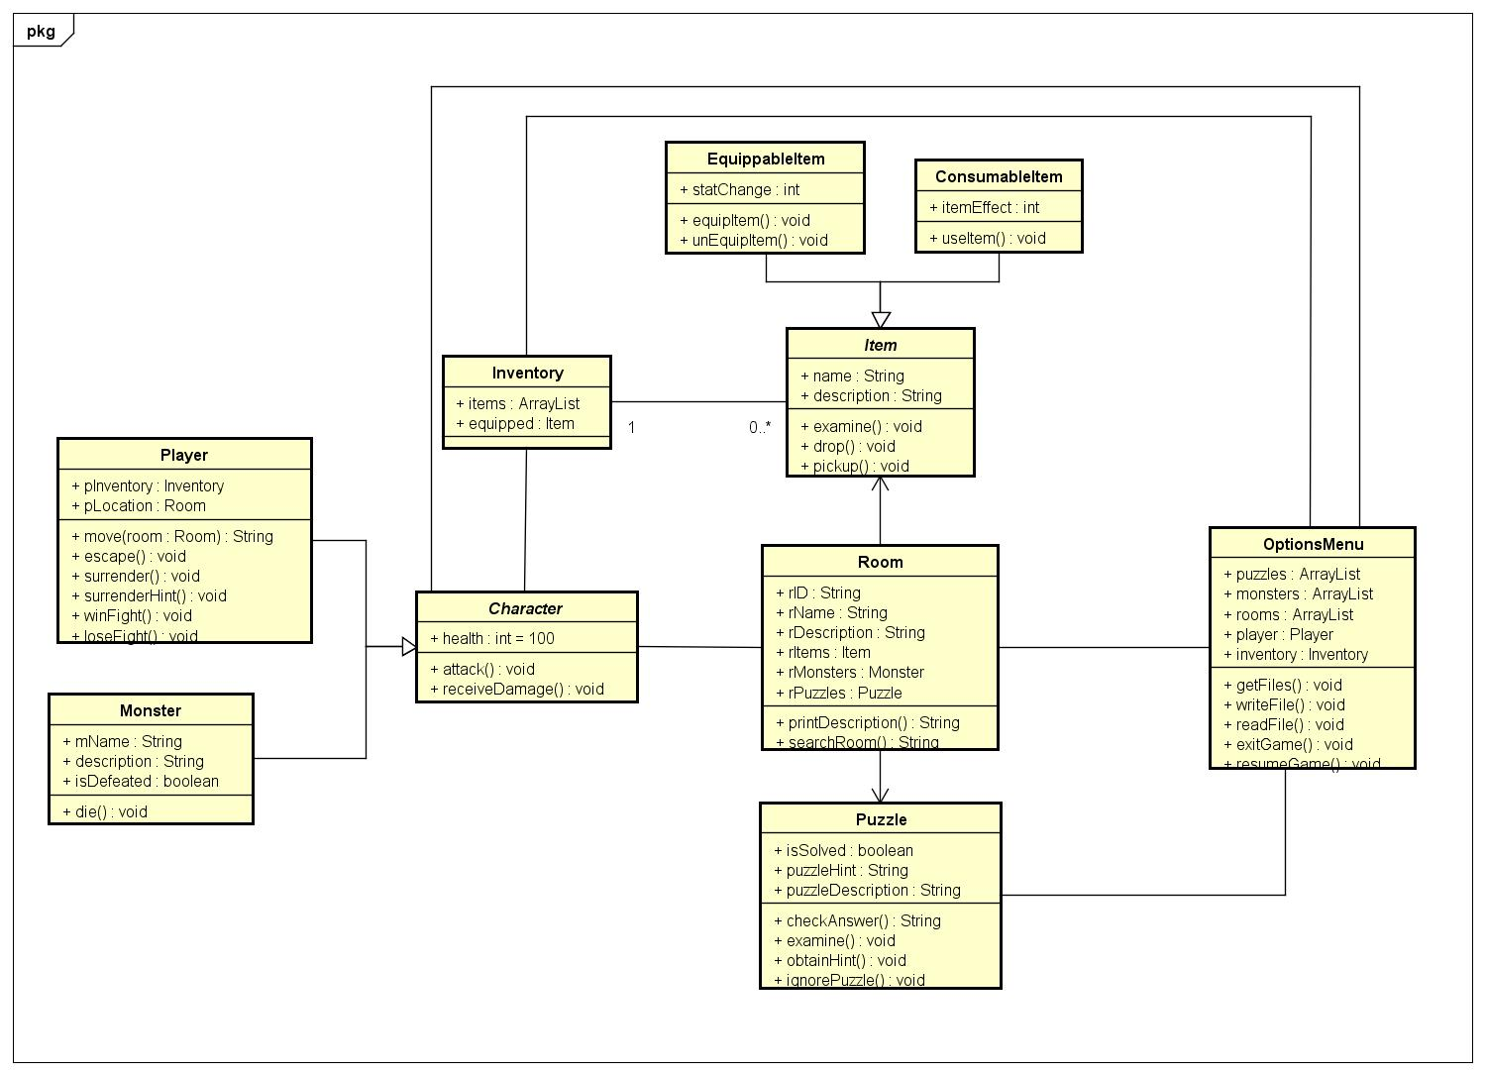
System Design (Continued)

Slide 7
Implementation
Major pitfalls
  Strayed from original system design
  Minimal communication
  Hung up on roadblocks for too long
  Problems with Github early on
  Time management
Successes
  lol

Slide 8
Lessons Learned.
Get as much done as possible early on in the implementation stage.
  Can’t count on everyone being available last minute
Try to stick to the original design plan
  The code will be difficult to maintain if the documentation differs from the actual structure.
Focus on important features first
  Prioritize the features that matter, the smaller features will be easier to add on at the end.

Slide 9
Demonstration of Game

Slide 10
Any
Questions?

