Slide 1
The Holy Quran word association
Rami Nahas

Slide 2
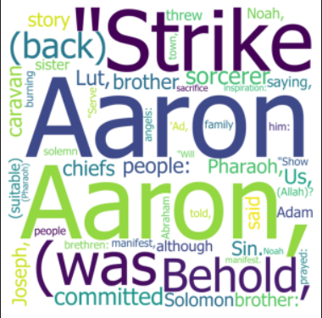
This model will take the Holy Quran text in Arabic and English and transform it into a clean text using different tools. After that, a machine learning model will be used to train a model that when taking an input word, it will print the associated word with it.

Slide 3
Word Embedding is the process of taking a words or a phrases from the vocabulary which are mapped to vectors of real numbers.
So, we will use this concept on the Holy Quran dataset. the idea is to capture as much information as possible

Slide 4
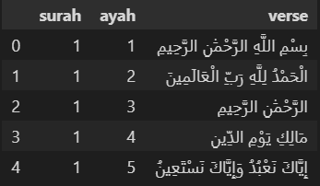
This is the dataset.
It has 6236 verse of the whole Quran

Slide 5
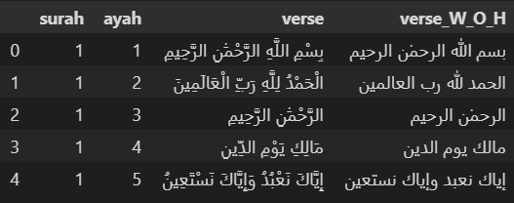
First, we will remove the harakat (tashkeel) from the Arabic text.

Slide 6
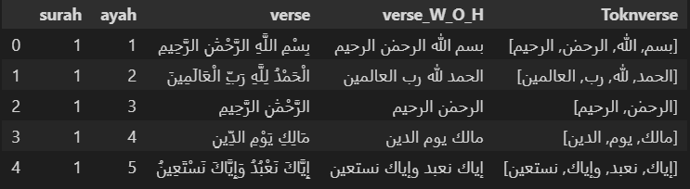
Second, tokenize where each verse is divided into words.

Slide 7
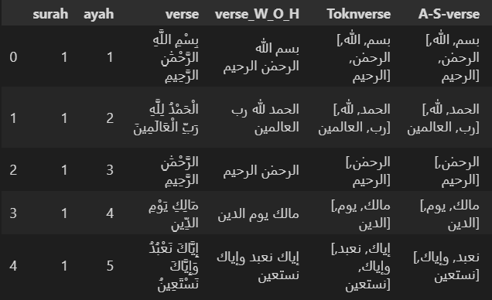
Third, will remove the Arabic stop words from the text.

Slide 8
We will use word2vec model which will train our model. word2vec is a model that uses neural networks to learn word association. each word is represented as a vector.
word2vec has 2 training algorithms:
continuous bag-of-words (CBOW) or continuous skip-gram.
In the CBOW architecture, the model predicts the current word from a window of surrounding context words. The order of context words does not influence prediction (bag-of-words assumption).
In the continuous skip-gram architecture, the model uses the current word to predict the surrounding window of context words. The skip-gram architecture weighs nearby context words more heavily than more distant context words.

Slide 9
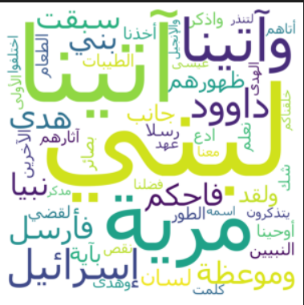
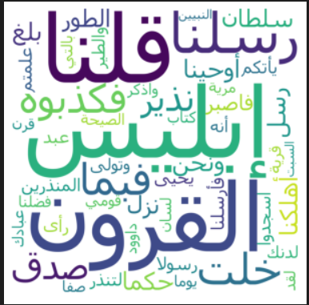
Results Arabic (keyword = “موسى” )
Skip gram
CBOW

Slide 10
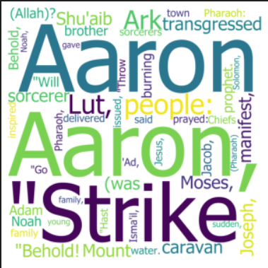
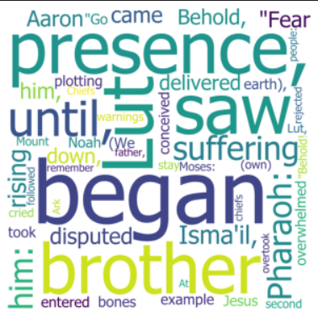
Result English (keyword = “Moses”)
Skip gram
CBOW

Slide 11
Future works
Using the developed model for summarization of Arabic or English text.

