Slide 1
Multilabel Text Classification of Research Articles
Rachel Chiang
August 2023
Notes:
Hello, I’m Rachel, and this is my second independent capstone project, which is a multilabel text classification of research articles.
Before we begin, I wanted to mention a fictional book that I read a couple months ago. In this world, there’s an extraterrestrial civilization that, despite being technologically advanced compared to humans at the time of first contact, they feared humans because of our supposed ability to accelerate scientific progress. That was in reference to the frequency of the stages of our major technological achievements squishing over time, beginning with thousands of years of gaps between the hunter-gatherer, agricultural, and industrial ages, and then to our few hundred years and few decades to go to the Atomic and Information ages.
That sounds very optimistic and like a very cool species trait… But is this true? I’m not sure, but at the very least, we have a growing number of scientific publications.

Slide 2
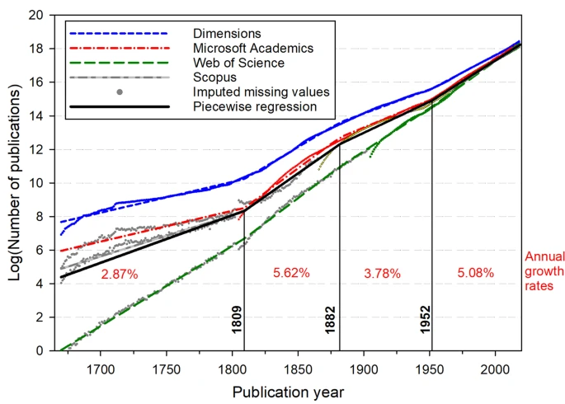
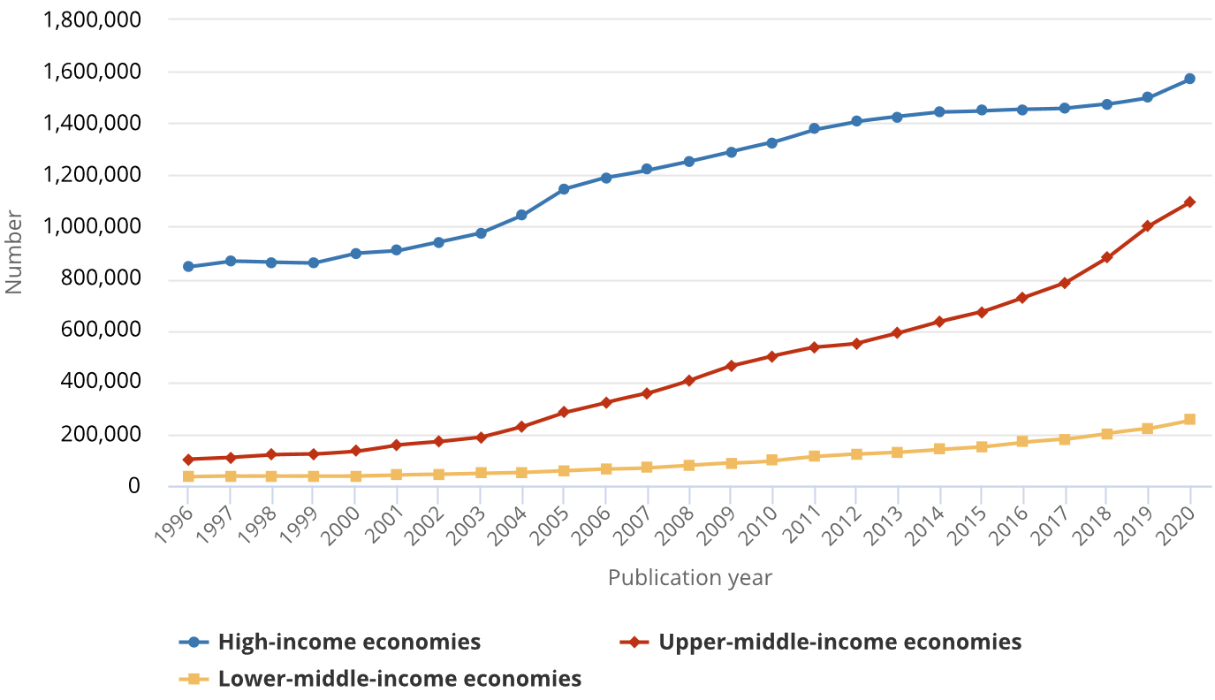
Scholarly Publishing Overview
Voice of the researchers
Desire for accessibility and transparency [3]
Trends: Open Access, crowdsourcing, and open sources [4, 5]
Internet and technology
Changes in publishing models [5]
Availability, affordability, and speed
Number of research articles increases
Growth rate of 3-4% [1]
Knowledge doubles every 15-17 years [1, 2]
Scientific article growth (log publications vs year)
Science and engineering articles published (count vs year)
Plot for segmented unrestricted growth of scientific articles from four bibliographic databases [1]
Science and engineering articles published per year by income group in 1996-2020 [6]
Notes:
Historically and in modern studies, people have observed that we have a growth rate of 3-4% in the number of article publications per year, with the total doubling every 15-17 years. It doesn’t appear to be slowing down, though interestingly, major economic crises and war can pause or slow our growth for a time, as seen in the chart on the left, but we tend to bounce back, and on the other hand, we can speed up with groundbreaking technological advancements, like in the 1809 to 1882 section, which is when the Industrial Revolution took place.
Digitization and the Internet also have an undeniable impact on increasing our ability to produce and share more articles, and surveys have shown that researchers value accessibility and many are enthusiastic about giving back, as models and concepts like Open Access, crowdsourcing, and expedited versions of the publishing systems grow in popularity. In theory, all of these should open the door for people without a lot of resources for subscriptions to access new information faster, and they in turn can contribute their work as well.

Slide 3
Project Objective
Problems
Sheer volume and increased digitization of articles
Solution
(Or at least one part of a solution)
Automated categorization with at least 70-80% accuracy using titles and abstracts
Researchers desire availability and transparent, sophisticated search engines [3]
Notes:
This brings us to a problem: we have a lot of articles, and it may not be very realistic or reliable for people to manually tag or verify every article, and not all of them are categorized in the first place. Plus, new subjects develop as we learn and discover more, so some articles may benefit from being categorized over and again. This project aims to automatically categorize articles with at least 70-80% accuracy based off of an article’s title and abstract. This alone would not be sufficient for a search engine because researchers would want more granularity in their subject matter, but it may help in the organization and hierarchies of the articles.

Slide 4
Who may be interested?
Who can use the tool?
Digital journals, archives, libraries, search engines
Who does this benefit?
Researchers, students, and librarians
Notes:
Digital journals, archives, libraries, and search engines may find use for this tool, and in general, researchers, students, and librarians may benefit from it.

Slide 5
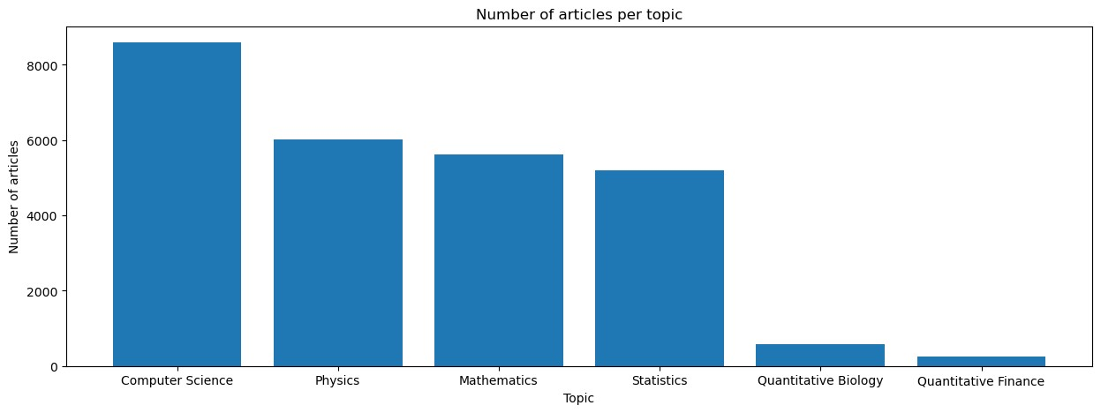
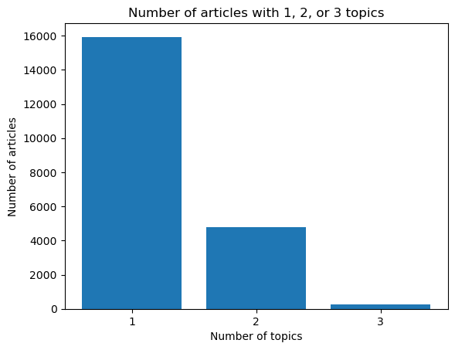
The Data
20,972 articles labeled with one to three of the categories:
Computer Science
Physics
Mathematics
Statistics
Quantitative Biology
Quantitative Finance
Notes:
The dataset used contained the titles and abstracts of 20,972 articles labeled with one to three of the six categories: Computer Science, Physics, Mathematics, Statistics, Quantitative Biology, and Quantitative Finance.
Looking at the graphs to the right… Clearly there is an imbalance in both the target classification categories and in the number of articles marked as interdisciplinary. The two quantitative subjects are extremely underrepresented, and so is Statistics to some degree, whereas Computer Science is overrepresented.
There are also not nearly as many multilabeled articles as there are single labeled articles.

Slide 6
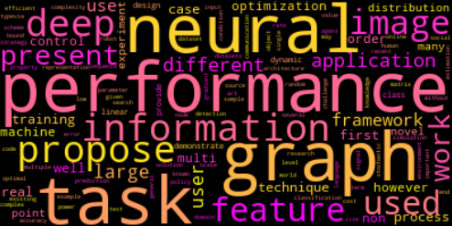
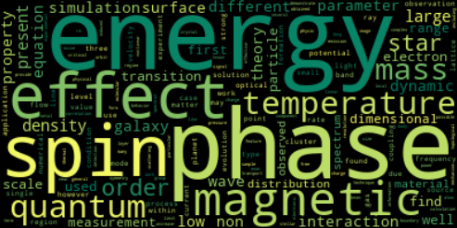
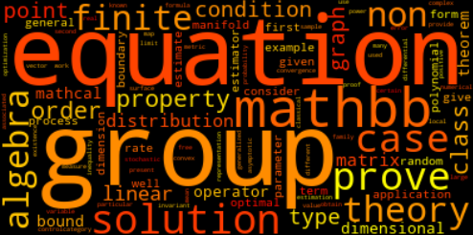
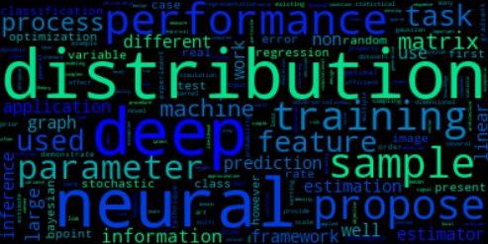
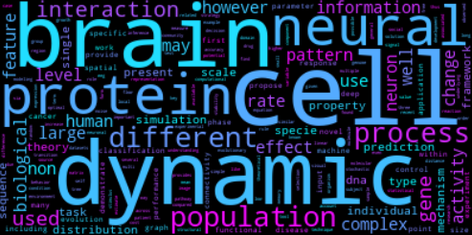
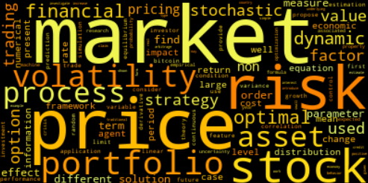
Filtered Word Clouds
Computer Science
Physics
Mathematics
Statistics
Quantitative Biology
Quantitative Finance
Notes:
A preliminary glance at the word clouds per category revealed that there were a handful of terms shared across all categories, such as “model” and “method”, so the thirty most common global words were filtered out for these word clouds. At this point, we can see that there is some expression of the subject matter for each of the categories, with the latter two especially clearly expressing words that belong to their topic. Meanwhile, Computer Science and Statistics seem to share certain words that may relate also to Data Science concepts, such as deep learning and neural networks.

Slide 7
Complement Naïve Bayes Classifier
Problem:
Single label, four categories
TF-IDF Vectorizer:
Strip accents
Convert to lowercase
Remove stop words
Max document frequency of 0.2
Min document frequency of 5
Unigrams and bigrams allowed
Select K Best Features:
f_classif (ANOVA F-value)
k of 20000
Other Considerations:
 | Precision | Recall | F1-Score
Computer Science | 0.80 | 0.91 | 0.85
Physics | 0.95 | 0.94 | 0.94
Mathematics | 0.88 | 0.93 | 0.90
Statistics | 0.84 | 0.39 | 0.53
Accuracy |  |  | 0.87
Macro Avg | 0.87 | 0.79 | 0.81
Weighted Avg | 0.87 | 0.87 | 0.86
[Problem] All six categories
[Classifier] MultinomialNB
[Feature Selection] No K Best
[TF-IDF] Different max and min values for document frequency
[Normalization] L1 and L2
[Tokens] Unigram only

Slide 8
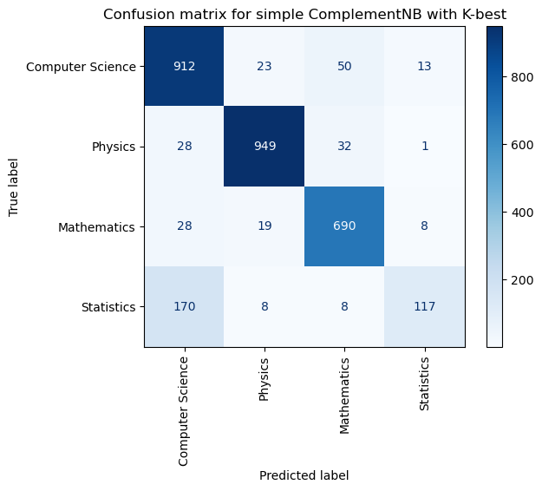
Confusion Matrix for ComplementNB on Four Categories

Slide 9
Final Model: Unigram Bag-of-Words Model
Problem:
Multilabel, four categories
spaCY English pipeline with regex:
Convert to lowercase
Tokenize and lemmatize
Remove stop words, numbers, punctuation, special characters, and empty tokens
spaCY Multilabel Text Categorizer:
Unigrams only
Scorer threshold of 0.45 (to 0.50)
Always returns one category
 | Precision | Recall | F1-Score
Computer Science | 0.85 | 0.90 | 0.87
Physics | 0.91 | 0.85 | 0.88
Mathematics | 0.84 | 0.84 | 0.84
Statistics | 0.74 | 0.83 | 0.78
Micro Avg | 0.84 | 0.86 | 0.85
Macro Avg | 0.84 | 0.85 | 0.84
Weighted Avg | 0.84 | 0.86 | 0.85
Samples Avg | 0.88 | 0.89 | 0.86
Notes:
A few classifiers were tested, for two broad problem spaces: a single label classification for six or four categories using TF-IDF and Naïve Bayes classifiers, and a multilabel classification on four categories using spaCY pipelines with bag-of-word and CNN models. In the end, the unigram bag-of-words model using spaCY’s multilabel text categorizer was found to be the most successful. This model used spaCY’s small English pipeline and a bit of regular expressions to preprocess the texts, and the text categorizer examined unigrams only.
When the model predicts, it returns scores for each category. To be considered as part of a category, its corresponding score has to exceed a specific threshold value. A threshold of 0.45 to 0.50 would attain a decent range of 0.74 to 0.93 precision and recall across every subject. The classification report that is displayed here is using a threshold of 0.45, but in reality, this value would depend on the application. For example, if this was to be used eventually in an exploratory system—say, a “Read more articles” section—a high recall might be preferable. However, if the application is a search engine, then precision might be favored because people are typically seeking specific results.
One issue found was that occasionally, none of the scores returned by the model would meet a realistic threshold value, such as if the scores were all under 0.30, but every article needs at least one tag. Thus, the scorer forces the article to be tagged with the highest-scored category.

Slide 10
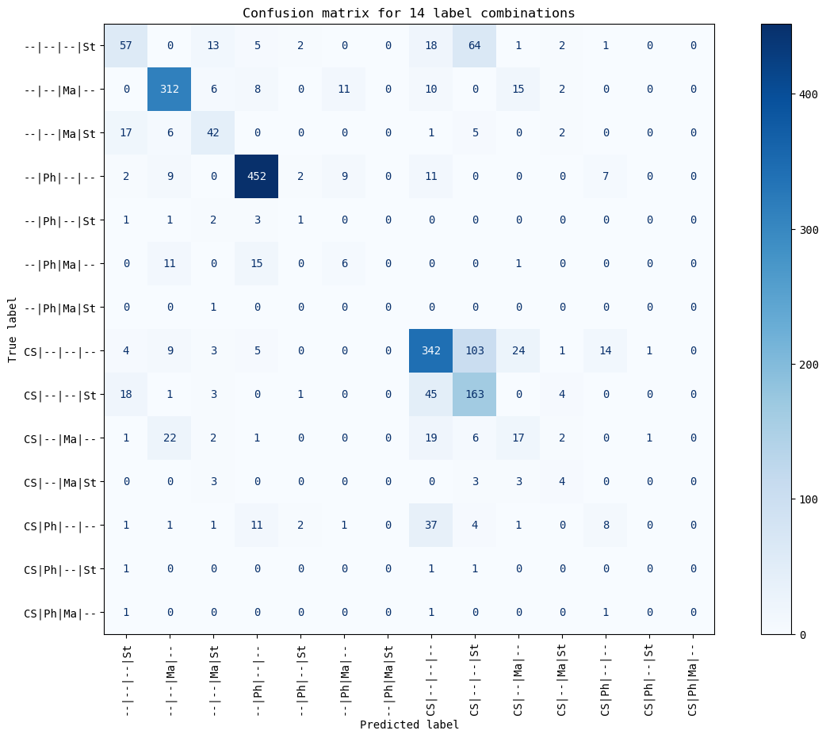
Confusion Matrix for 14 Label Combinations
Notes:
The confusion matrix for the unigram bag-of-word model with a threshold of 0.45 and a minimum of one category returned as true is displayed here.
It tended to be the most successful with articles that should have only one label, and it performed the worst with categorizing Statistics articles overall. This was expected because the dataset was imbalanced, but even so, the model predicted them decently. Similarly, but on the flip side, the overrepresented category, Computer Science, tended to show up when it shouldn’t have, which can be seen in the darker squares along the predicted Computer Science columns not lying along the diagonal.
Statistics and, perhaps counterintuitively, Physics have some fuzziness with Computer Science.
After looking through a handful of the problem cases, it seemed like software and technology terms tended to show up in some of these titles and abstracts, which may be writers mentioning their methods and tools.
As for the fuzziness with Statistics and Computer Science, this is expected. As mentioned, these are the minority and majority classes. Furthermore, we saw in the word cloud that they had a fair bit of overlapping terms.

Slide 11
Other Considerations
Architectures: bigram bag-of-words and convolutional neural network
Comparable results
Slower training times
Learning Parameters
No improvements except when lowering learning rate
Thus, has tradeoff of a slow training time
Scorer
Threshold of 0.4, 0.45, or 0.5
Precision and recall tradeoff
No minimum one category returned
Weak predictions return nothing

Slide 12
Top 10 Tokens from 100 Samples by Mean SHAP Values
Computer Science
Physics
Mathematics
Statistics
Reachability
Bit
Inability
Improvement
Communication
Robot
Attempt
Segmentation
Principled
Validate
Mechanic
Calculation
Sky
Symmetry
Detector
Molecular
Galaxy
Hydrodynamic
Spacecraft
Removal
Prove
Operator
Sharp
Article
Homotopy
Theorem
Perturb
Mathematical
Category
Conic
Bayesian
Sequential
Statistical
Recommender
Clustering
Approximate
Trial
Parametric
Learning
Explanation
-2.47 and +[0.05, 0.06]
-3.52 and +[0.04, 0.07]
-9.97 and +[0.05, 0.06]
-10.24 and +[0.05, 0.1]
Notes:
Using 100 of the samples from the test set, we can examine some of the tokens that the model found important on average per category. The number of features is high, and the subjects of the articles were probably very broad, so it can’t represent every article, but it’s still interesting to see how the model seemed to value certain tokens and the strengths that it attributed to each.
The top words seem relevant to each category, but each category seems a bit different from the rest broadly speaking. In the top ten, Computer Science has goal-oriented tokens, physics has subject domain tokens, mathematics has a lot of tool-related tokens, and statistics has technique-related tokens.

Slide 13
How the model can be used
Automatically tag new articles with the four categories
Overall good precision/recall for the major categories, especially when articles have one label
May tag too many articles with Computer Science and too few articles with Statistics
General multilabel fuzziness
Notes:
This project sought to create a model that classifies articles into categories, and it can be used to automatically tag new articles with the four categories, to fairly good precision and recall, especially for the three major categories, and especially when the articles have only one label.
However, it should not be ignored that this model may categorize too many articles with Computer Science and too few articles with Statistics, and there will probably be some fuzziness with interdisciplinary articles.

Slide 14
Future Work: Addressing the two problems
Problem: Category imbalance
Resample datasets: downsample Computer Science, upsample Statistics
Use different categories, thus becoming both an unsupervised and supervised problem
Problem: Scoring
Adjust prediction interpretation to be more sophisticated, such as using present score distribution
Convert to a recommendation system problem
Notes:
There were two major problems with the model: category imbalance and the scorer.
The category imbalance was known from the beginning, and two extremely underrepresented classes were even dropped, but overall, this can be mitigated with resampling the datasets. We can try downsampling Computer Science and upsampling Statistics. I chose not to do that for this project because the model did not predict Statistics too poorly. Alternatively, we can try using different categories, and we can convert this problem into both an unsupervised and supervised problem.
The scorer itself wasn’t exactly a problem, but it has its weaknesses. It was a pretty basic scorer, and having a single threshold value was ultimately failing to solve the problem because every article should have been given at least one topic. The workaround in the project was to force it to return the category that had the highest score, but this method means that the uncertain articles would only belong to exactly one category. Perhaps we could adjust the prediction interpretation to determine the correct categories given the present distribution of the prediction scores, so that if there’s low variance in some of the scores or if no value meets the threshold, it is able to return more than one label. Alternatively, the default scorer could be replaced with one that judges it more like a recommendation system problem, so it might consider the ranks of the categories by relevance.

Slide 15
Thank you.
Notes:
With our increasing knowledge base, digitization, and openness to share, text categorization can help to facilitate organization and information retrieval, so people can focus on learning and discovery. This project addressed one aspect of the larger applications of recommendation or search engines that would likely want to continue deeper into more specific topics.
Thank you for your time and attention.

Slide 16
References
[1] Bornmann, L., Haunschild, R., & Mutz, R., “Growth rates of modern science: a latent piecewise growth curve approach to model publication numbers from established and new literature databases”. Humanit Soc Sci Commun 8, 224 (2021). https://doi.org/10.1057/s41599-021-00903-w .
[2] Amnet, “Scholarly Publishing: Challenges, Opportunities, and Trends”. Amnet (2022). https://amnet-systems.com/scholarly-publishing-challenges-opportunities-and-trends/ .
[3] Sandusky, R., Tenopir, C., & Casado, M., “Figure and table retrieval from scholarly journal articles: User needs for teaching and research”. Asis&t 44: 1-33 (2008). https://doi.org/10.1002/meet.1450440390 .
[4] ScienceEditor, “The Future of Academic Publishing: Emerging Trends You Should Know”. ServiceScape (2021). https://www.servicescape.com/blog/the-future-of-academic-publishing-emerging-trends-you-should-know .
[5] Singh, S., “2022 in review: Key developments shaping scholarly publishing”. Editage insights (2023). https://www.editage.com/insights/2022-in-review-key-developments-shaping-scholarly-publishing .
[6] White, K., “Publication Output by Country, Region, or Economy and Scientific Field”. Science and Engineering Indicators, National Science Board, National Science Foundation (2021). https://ncses.nsf.gov/pubs/nsb20214/publication-output-by-country-region-or-economy-and-scientific-field .

