Slide 1
ESPRIT SCHOOL OF BUSINESS · INTEGRATED PROJECT 2026
VIGIE
Customer churn analysis and prediction
See churn coming. Act before the account closes.
Group BI 5 — Raed Meddeb · Ibrahim Grira · Salsabil Ben Elhadj · Salah Chebbi · Ines Ayed
Supervisors: Aymen Ben Brik and Hela Hammami
Notes:
[Raed] Good morning. We are Group BI 5 and our project is called VIGIE — French for 'lookout'. In 20 minutes we will show how we went from a raw banking file to a deployed tool that measures and anticipates churn. Each of us will present the part they led.

Slide 2
INTRODUCTION
The question: understand, measure and anticipate churn
▪ Anonymised banking snapshot: 483,536 rows · 363,024 customers · 410,309 accounts
▪ Churn = account closed; a customer churns when all accounts are closed
▪ Five phases: data → warehouse → reporting → prediction → application
▪ One rule: every figure is verified — checks, reference values, reproducible models
▪ Privacy by design: no data in the repository, aggregates only in the app
36.1%
36.8%
churn rate per account
churn rate per customer
51%
0.751
of closures in 5 mass weeks
ROC-AUC of the churn model
19 / 19
26
warehouse checks passed
automated tests
VIGIE · Group BI 5 · Raed Meddeb
2
Notes:
[Raed Meddeb] The bank gave us an anonymised snapshot of 363 thousand customers. Our goal was to answer three questions: how much churn, where and why, and what comes next. We followed the five phases of the project, with one rule: verify every number before using it.

Slide 3
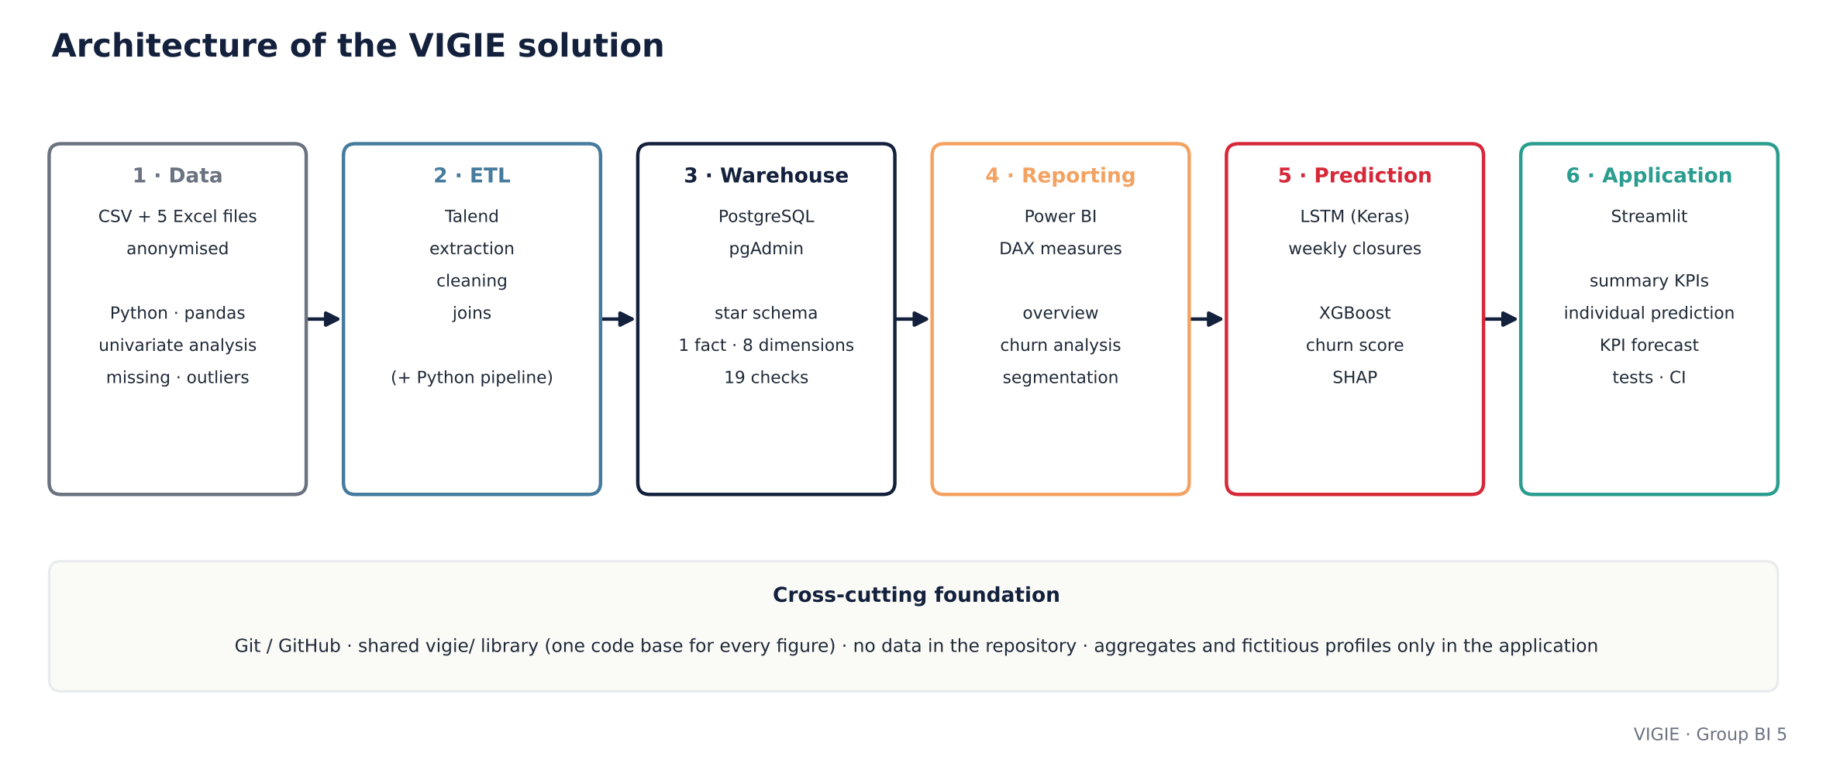
INTRODUCTION
Architecture: one chain, one code base
VIGIE · Group BI 5 · Raed Meddeb
3
Notes:
[Raed Meddeb] Six stages. The key design choice is the shared library: the warehouse, the notebooks and the application compute every number with the same code, so a figure cannot differ from one deliverable to another.

Slide 4
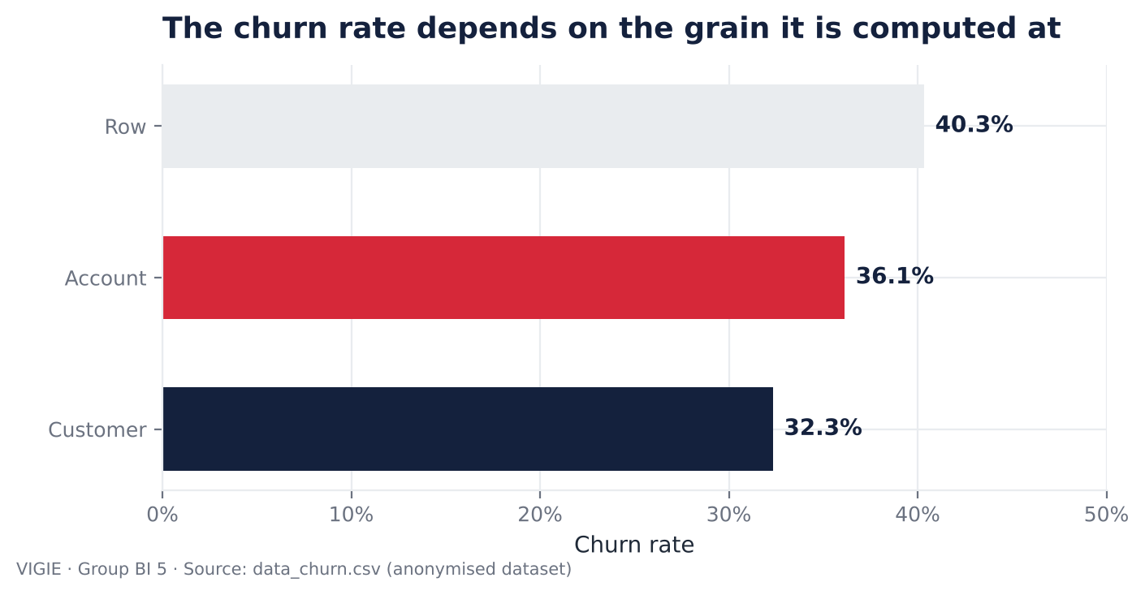
UNDERSTANDING THE DATA
Phase 1 · A rate is meaningless without its grain
▪ Volumes match the supervisors' document: to the unit
▪ One row = customer × account × product: 9% of rows have no account
▪ No customer is both active and closed: customer churn is unambiguous
▪ Moderate imbalance (36.8%): no rebalancing needed
▪ Anomaly: 20,166 accounts closed before they were opened — flagged
VIGIE · Group BI 5 · Ines Ayed
4
Notes:
[Ines Ayed] First finding: the file mixes three grains. The same data gives 40, 36 or 32 percent of churn depending on what you count. We fixed two grains: the account for the warehouse, the customer for the model. And no customer is both active and closed — which makes customer churn unambiguous.

Slide 5
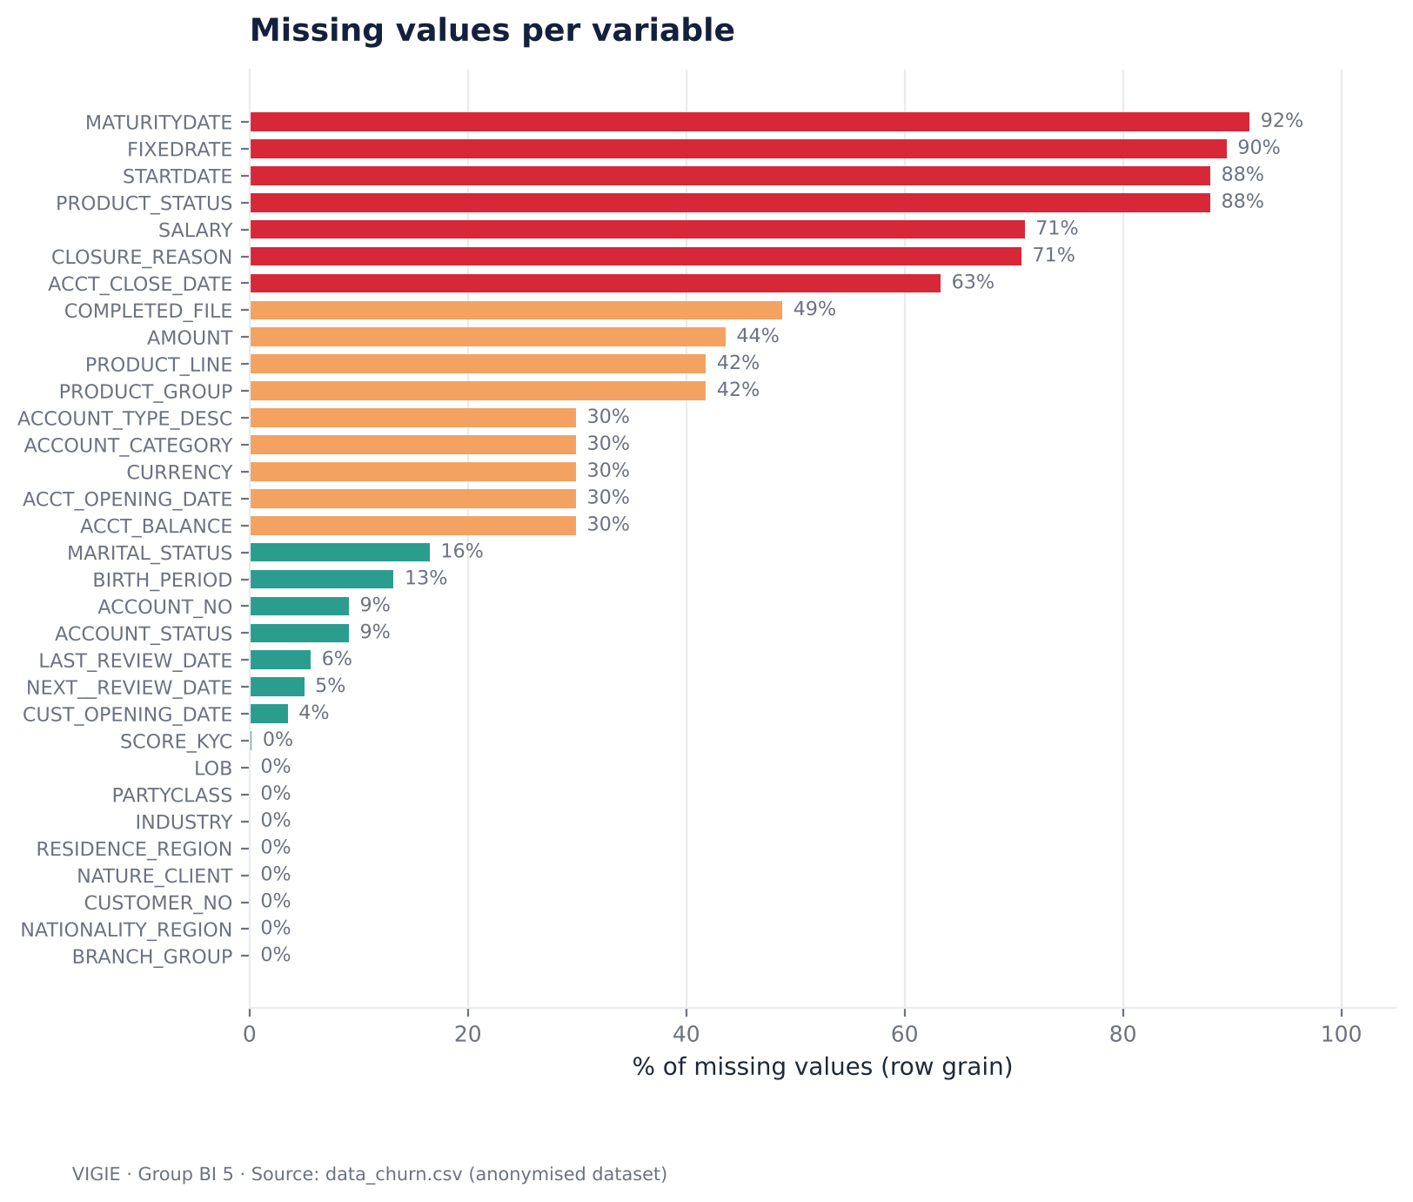
UNDERSTANDING THE DATA
Phase 1 · Some blanks give the answer away
▪ Structural, business, declarative blanks: typed one by one
▪ Tied to the closure: blank for 67.8% of closed accounts, 0% of active ones → target leak
▪ Outliers (IQR): 32% of balances — loan accounts in debit, not errors
▪ No row deleted: flags and medians instead
▪ Bivariate (bonus): incomplete file → 49.6% churn vs 22.5%
VIGIE · Group BI 5 · Ines Ayed
5
Notes:
[Ines Ayed] Missing values are not all the same. The important ones: balance, account family, currency and opening date are blank for 68 percent of closed accounts and never for active ones. They record the departure — so they cannot be used to predict it. Outliers: a third of balances are 'outliers', but they are loans in debit, not errors.

Slide 6
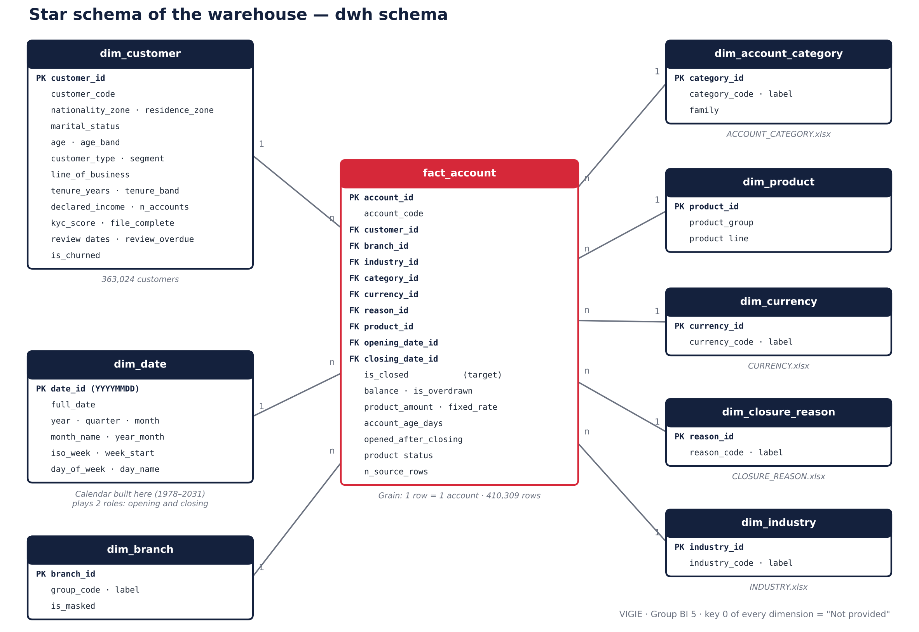
DATA WAREHOUSE AND ETL
Phase 2 · Star schema at account grain
▪ fact_account: 410,309 accounts
▪ 8 dimensions: customer keeps the 43,984 customers with no account
▪ Key 0 = Not provided: no null foreign key
▪ Calendar in SQL: two roles
▪ Bonus: SCD type 2 on the customer
VIGIE · Group BI 5 · Salsabil Ben Elhadj
6
Notes:
[Salsabil Ben Elhadj] One fact table, one row per account, eight dimensions. Two choices matter: a 'Not provided' member with key zero, so no join ever loses rows, and a calendar built in SQL that plays two roles — opening and closing.

Slide 7
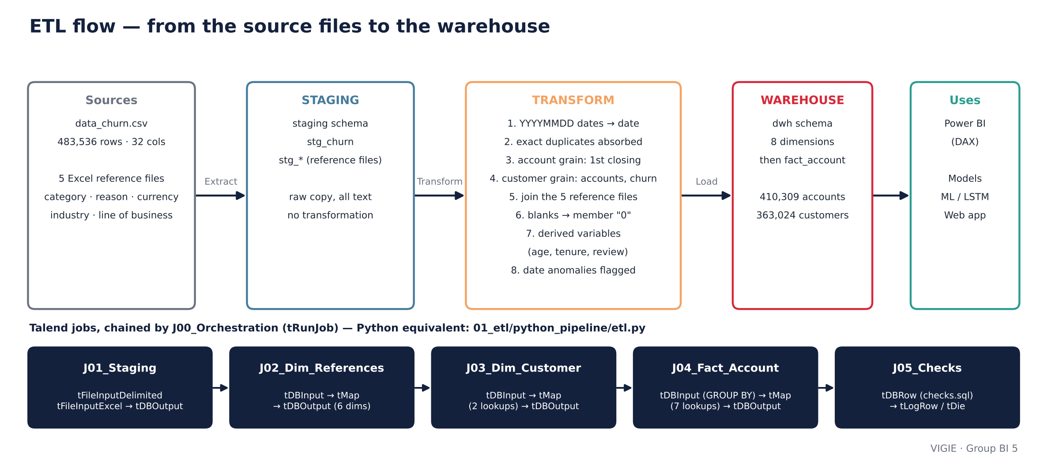
DATA WAREHOUSE AND ETL
Phase 2 · ETL and 19 checks, 19 OK
▪ Volumes: 483,536 rows · 410,309 accounts · 363,024 customers — identical on both sides
▪ Indicators: 148,215 closures · churn 36.12% · first closing date kept · balances reconciled
▪ Integrity: no duplicate, no orphan, every date in the calendar, anomalies flagged
VIGIE · Group BI 5 · Salsabil Ben Elhadj
7
Notes:
[Salsabil Ben Elhadj] The flow: staging, transformation, load. The Talend jobs are specified component by component, and a Python pipeline gives the reference load. Then 19 checks compare source and warehouse: volumes, KPIs, integrity. All pass.

Slide 8
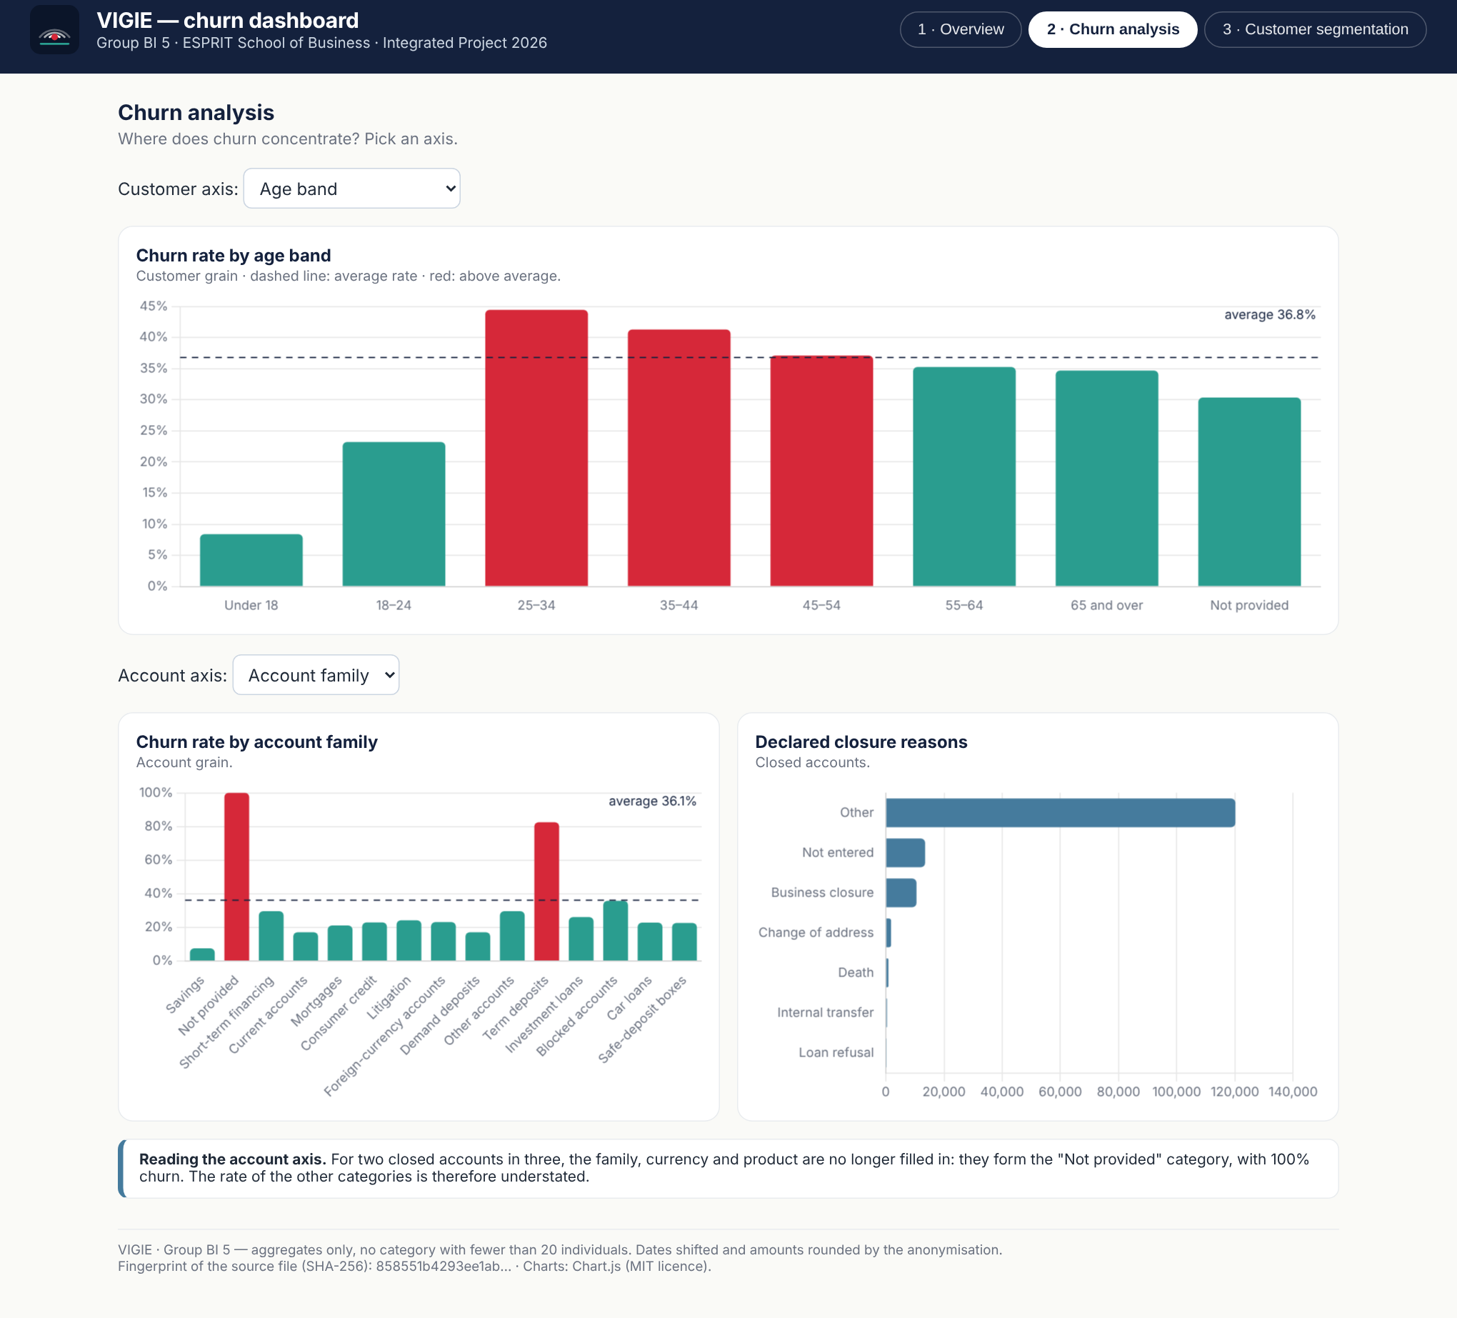
REPORTING
Phase 3 · Reporting: 3 pages, 30 documented DAX measures
▪ Pages: overview · churn analysis · segmentation
▪ Account Churn Rate = 36.12%: Customer Churn Rate = 36.78%
▪ Two inactive date relationships: USERELATIONSHIP per measure
▪ "Not provided" stays visible: 68% of closed accounts
▪ Bonus: Chart.js dashboard, offline, phone-friendly
VIGIE · Group BI 5 · Ines Ayed
8
Notes:
[Ines Ayed] Thirty DAX measures, each with the value it must show — so the report can be checked number by number. Two rules: a rate at its grain, and inactive date relationships so that a date filter never distorts the global KPIs. The JavaScript dashboard is our bonus and our mockup.

Slide 9
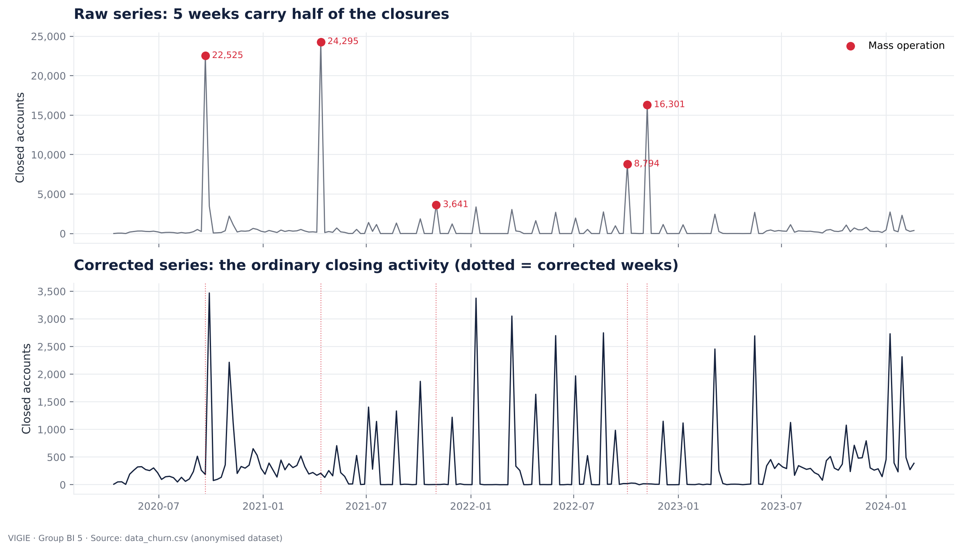
PREDICTIVE MODELS
Phase 4 · The KPI: weekly closures — and 5 mass weeks
▪ 202 weeks: 11 zero weeks added
▪ 5 weeks = 51% of closures: batch operations
▪ Corrected series: local median
▪ Three regimes: no calendar seasonality
▪ 8-week window: MAE / RMSE (no MAPE)
VIGIE · Group BI 5 · Salah Chebbi
9
Notes:
[Salah Chebbi] Our KPI is the number of accounts closed per week. Five weeks carry half of all closures: they are batch operations, with 'Other' as reason in 99.5 percent of cases. They cannot be forecast, so we corrected the series and forecast the ordinary activity.

Slide 10
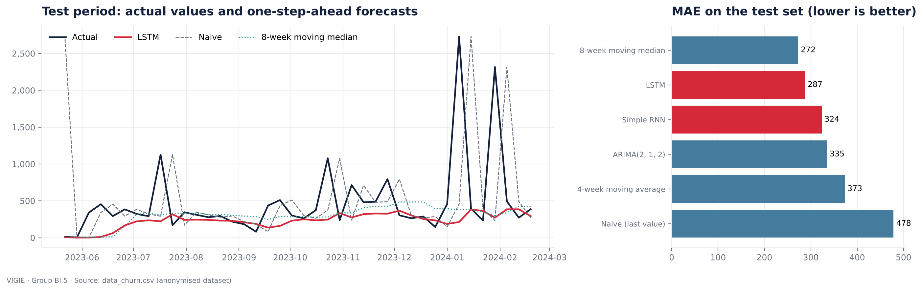
PREDICTIVE MODELS
Phase 4 · LSTM: −40% vs naive, but a median does as well
▪ LSTM MAE 287 · moving median 272 · RNN 324 · ARIMA 335 · naive 478 (last 40 weeks)
▪ Second KPI (bonus): customers lost per week — the LSTM has the best MAE (125 vs 133)
VIGIE · Group BI 5 · Salah Chebbi
10
Notes:
[Salah Chebbi] The LSTM cuts the error of the naive forecast by 40 percent and beats the simple RNN and ARIMA. But an 8-week moving median does slightly better. With 202 weeks, a regime change and random spikes, that is expected, and we show it instead of hiding it. On the second KPI, customers lost, the LSTM is the best.

Slide 11
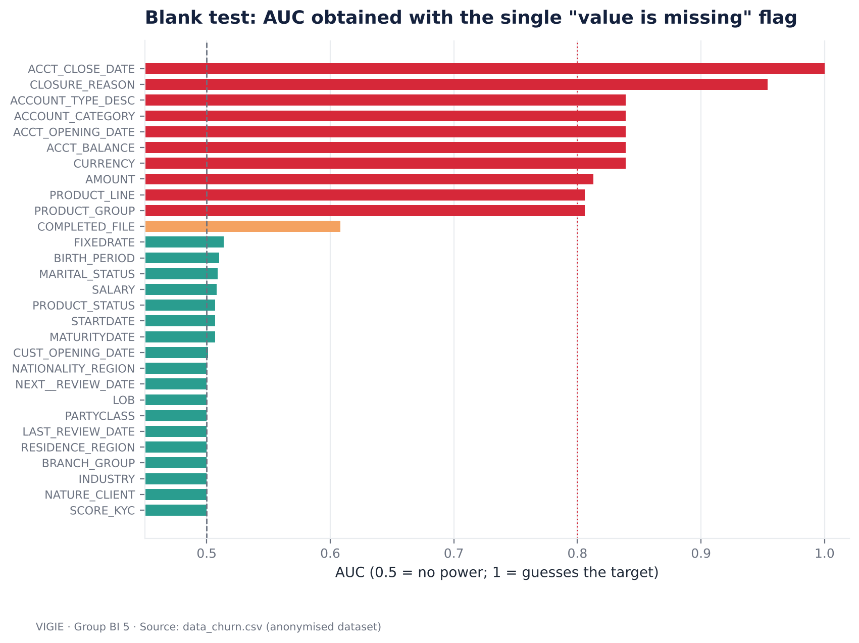
PREDICTIVE MODELS
Phase 4 · Leakage check: a 0.95 AUC would be a lie
0.951
ROC-AUC with 3 leaking flags
0.751
ROC-AUC without them — the model kept
10 columns excluded: closing date and reason, balance, opening date, family, currency, amount, product. PRODUCT_STATUS excluded for its values.
VIGIE · Group BI 5 · Raed Meddeb
11
Notes:
[Raed Meddeb] Before modelling churn, we tested every column: can its blanks alone guess the target? Ten columns can. If we keep only three blank flags, the AUC jumps to 0.95. That is not a good model, it is a model reading the answer. Without them we get 0.75 — the honest level.

Slide 12
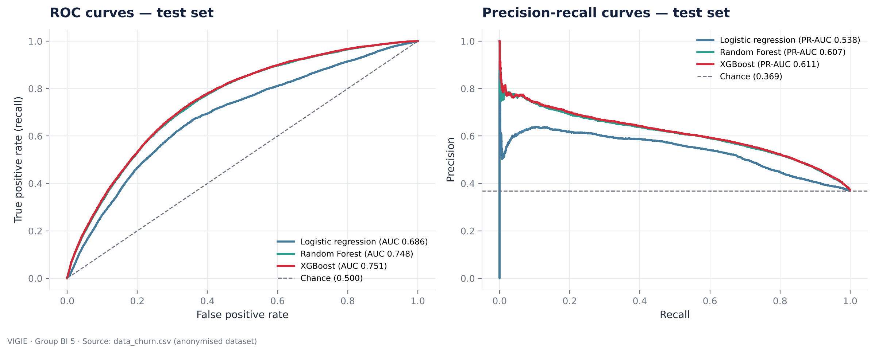
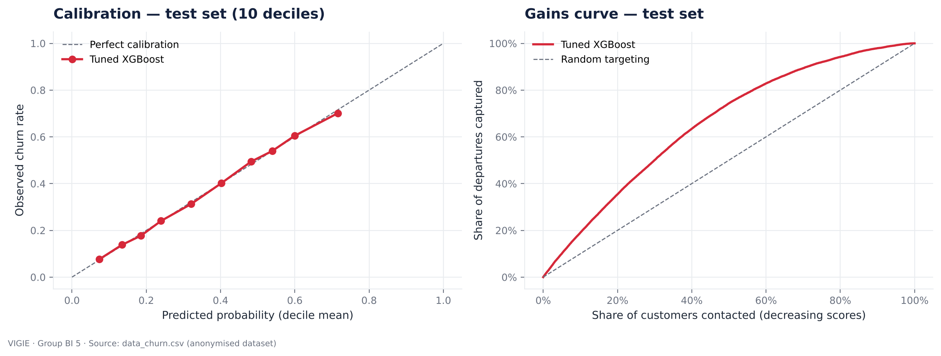
PREDICTIVE MODELS
Phase 4 · Churn model: XGBoost, AUC 0.751, recall 79%
▪ Logistic regression: 0.686
▪ Random Forest: 0.748
▪ Tuned XGBoost: 0.751 · PR-AUC 0.611
▪ Calibrated: within 1.5 pt per decile
▪ Gains: top 30% of scores → 50% of departures
▪ Risk levels: 15% · 38% · 61% observed departures
VIGIE · Group BI 5 · Raed Meddeb
12
Notes:
[Raed Meddeb] Customer grain, twelve profile features, a split per customer so nobody is in both training and test. Three models; XGBoost wins and is well calibrated. At our threshold it catches 79 percent of the leavers. Targeting the top 30 percent of scores reaches half of the departures.

Slide 13
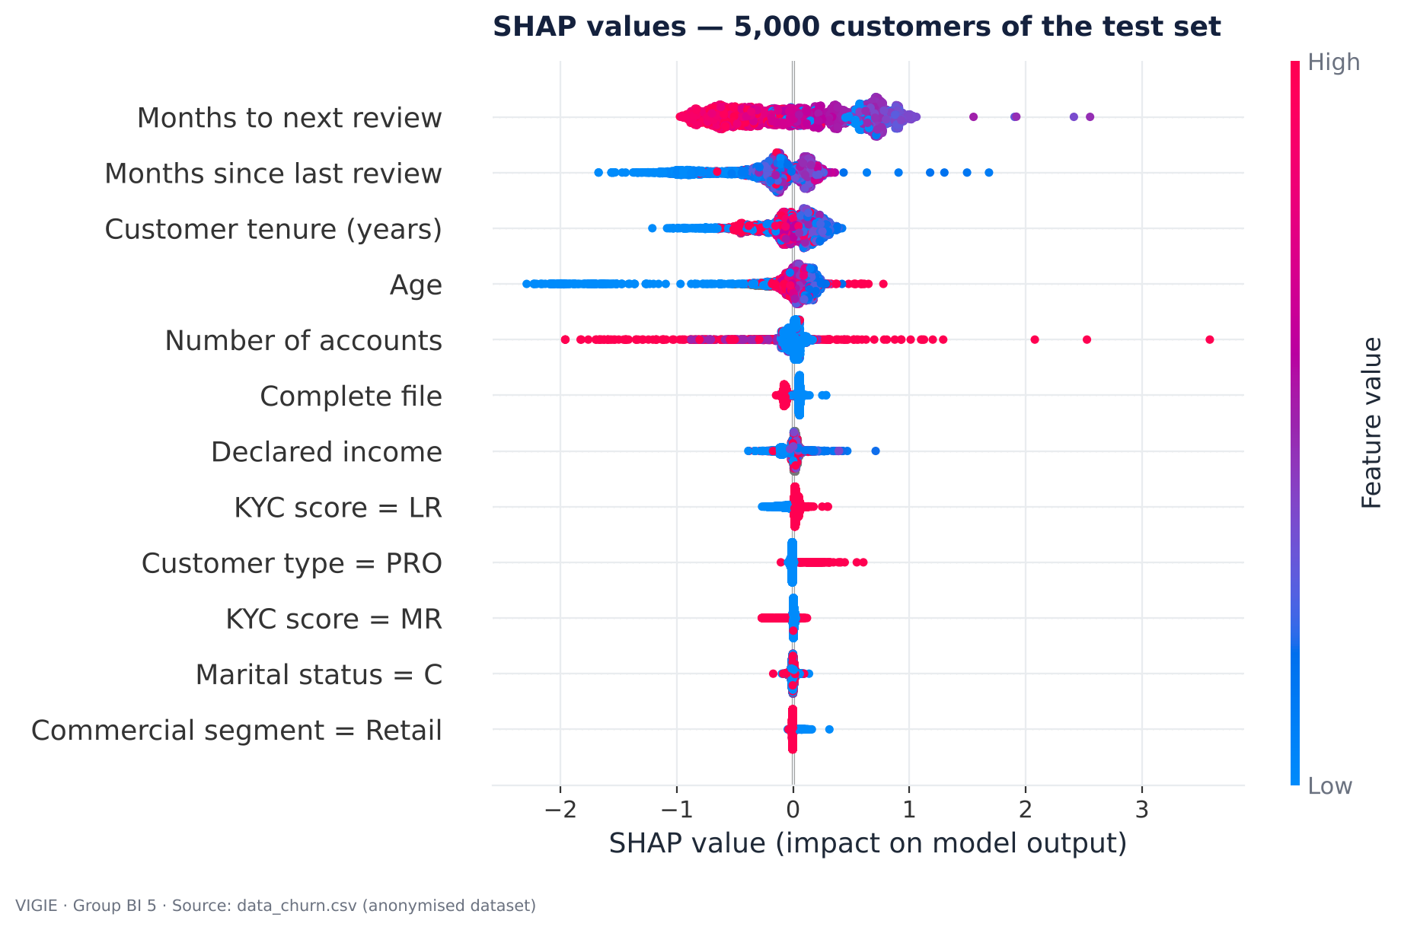
PREDICTIVE MODELS
Phase 4 · Why customers leave
▪ Overdue review: +0.53 — the first warning sign
▪ Recent review: −0.53 — protects
▪ 25–44 years, 5–10 years of tenure: the fragile zone
▪ Two accounts or more: −0.20
▪ Compliance = 62% of importance: segment < 2%
▪ Honest bound: AUC 0.751 with, 0.660 without compliance
VIGIE · Group BI 5 · Raed Meddeb
13
Notes:
[Raed Meddeb] SHAP tells us why. The strongest signal is an overdue file review. Churn peaks at 25 to 44 years and after 5 to 10 years of relationship, and holding several accounts protects. The segment barely matters. Caveat: a neglected file can also be a consequence of leaving — so we report the model with and without these features.

Slide 14
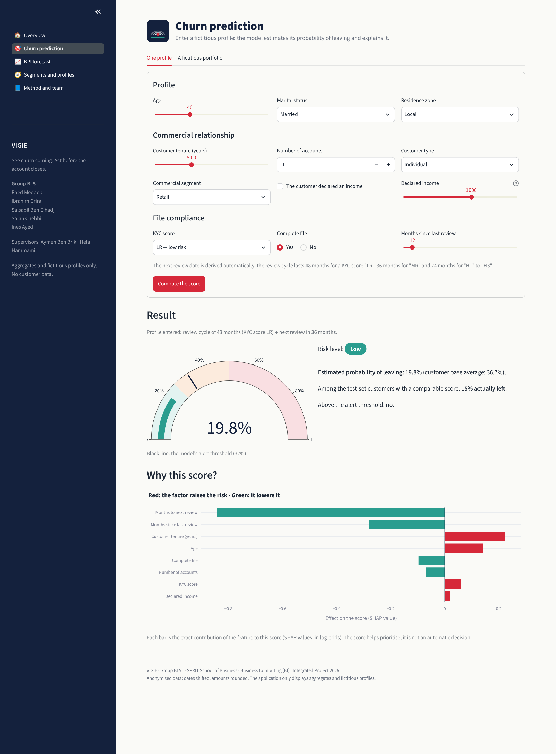
APPLICATION
Phase 5 · The VIGIE application
▪ Overview: 8 KPIs, churn by axis, closures and forecast
▪ Prediction: fictitious profile → score, risk level, SHAP drivers, action
▪ Forecast: LSTM 8 weeks + comparison with references
▪ Segments · Method and team
▪ No data: aggregates (≥ 20) and JSON trees only
▪ Same encoder as training: no gap between model and app
VIGIE · Group BI 5 · Ibrahim Grira
14
Notes:
[Ibrahim Grira] The application has five pages around the three required features: summary KPIs, an explained prediction on a fictitious profile, and the LSTM forecast. It only reads aggregates and the model's trees in JSON — no customer data. Live demo next.

Slide 15
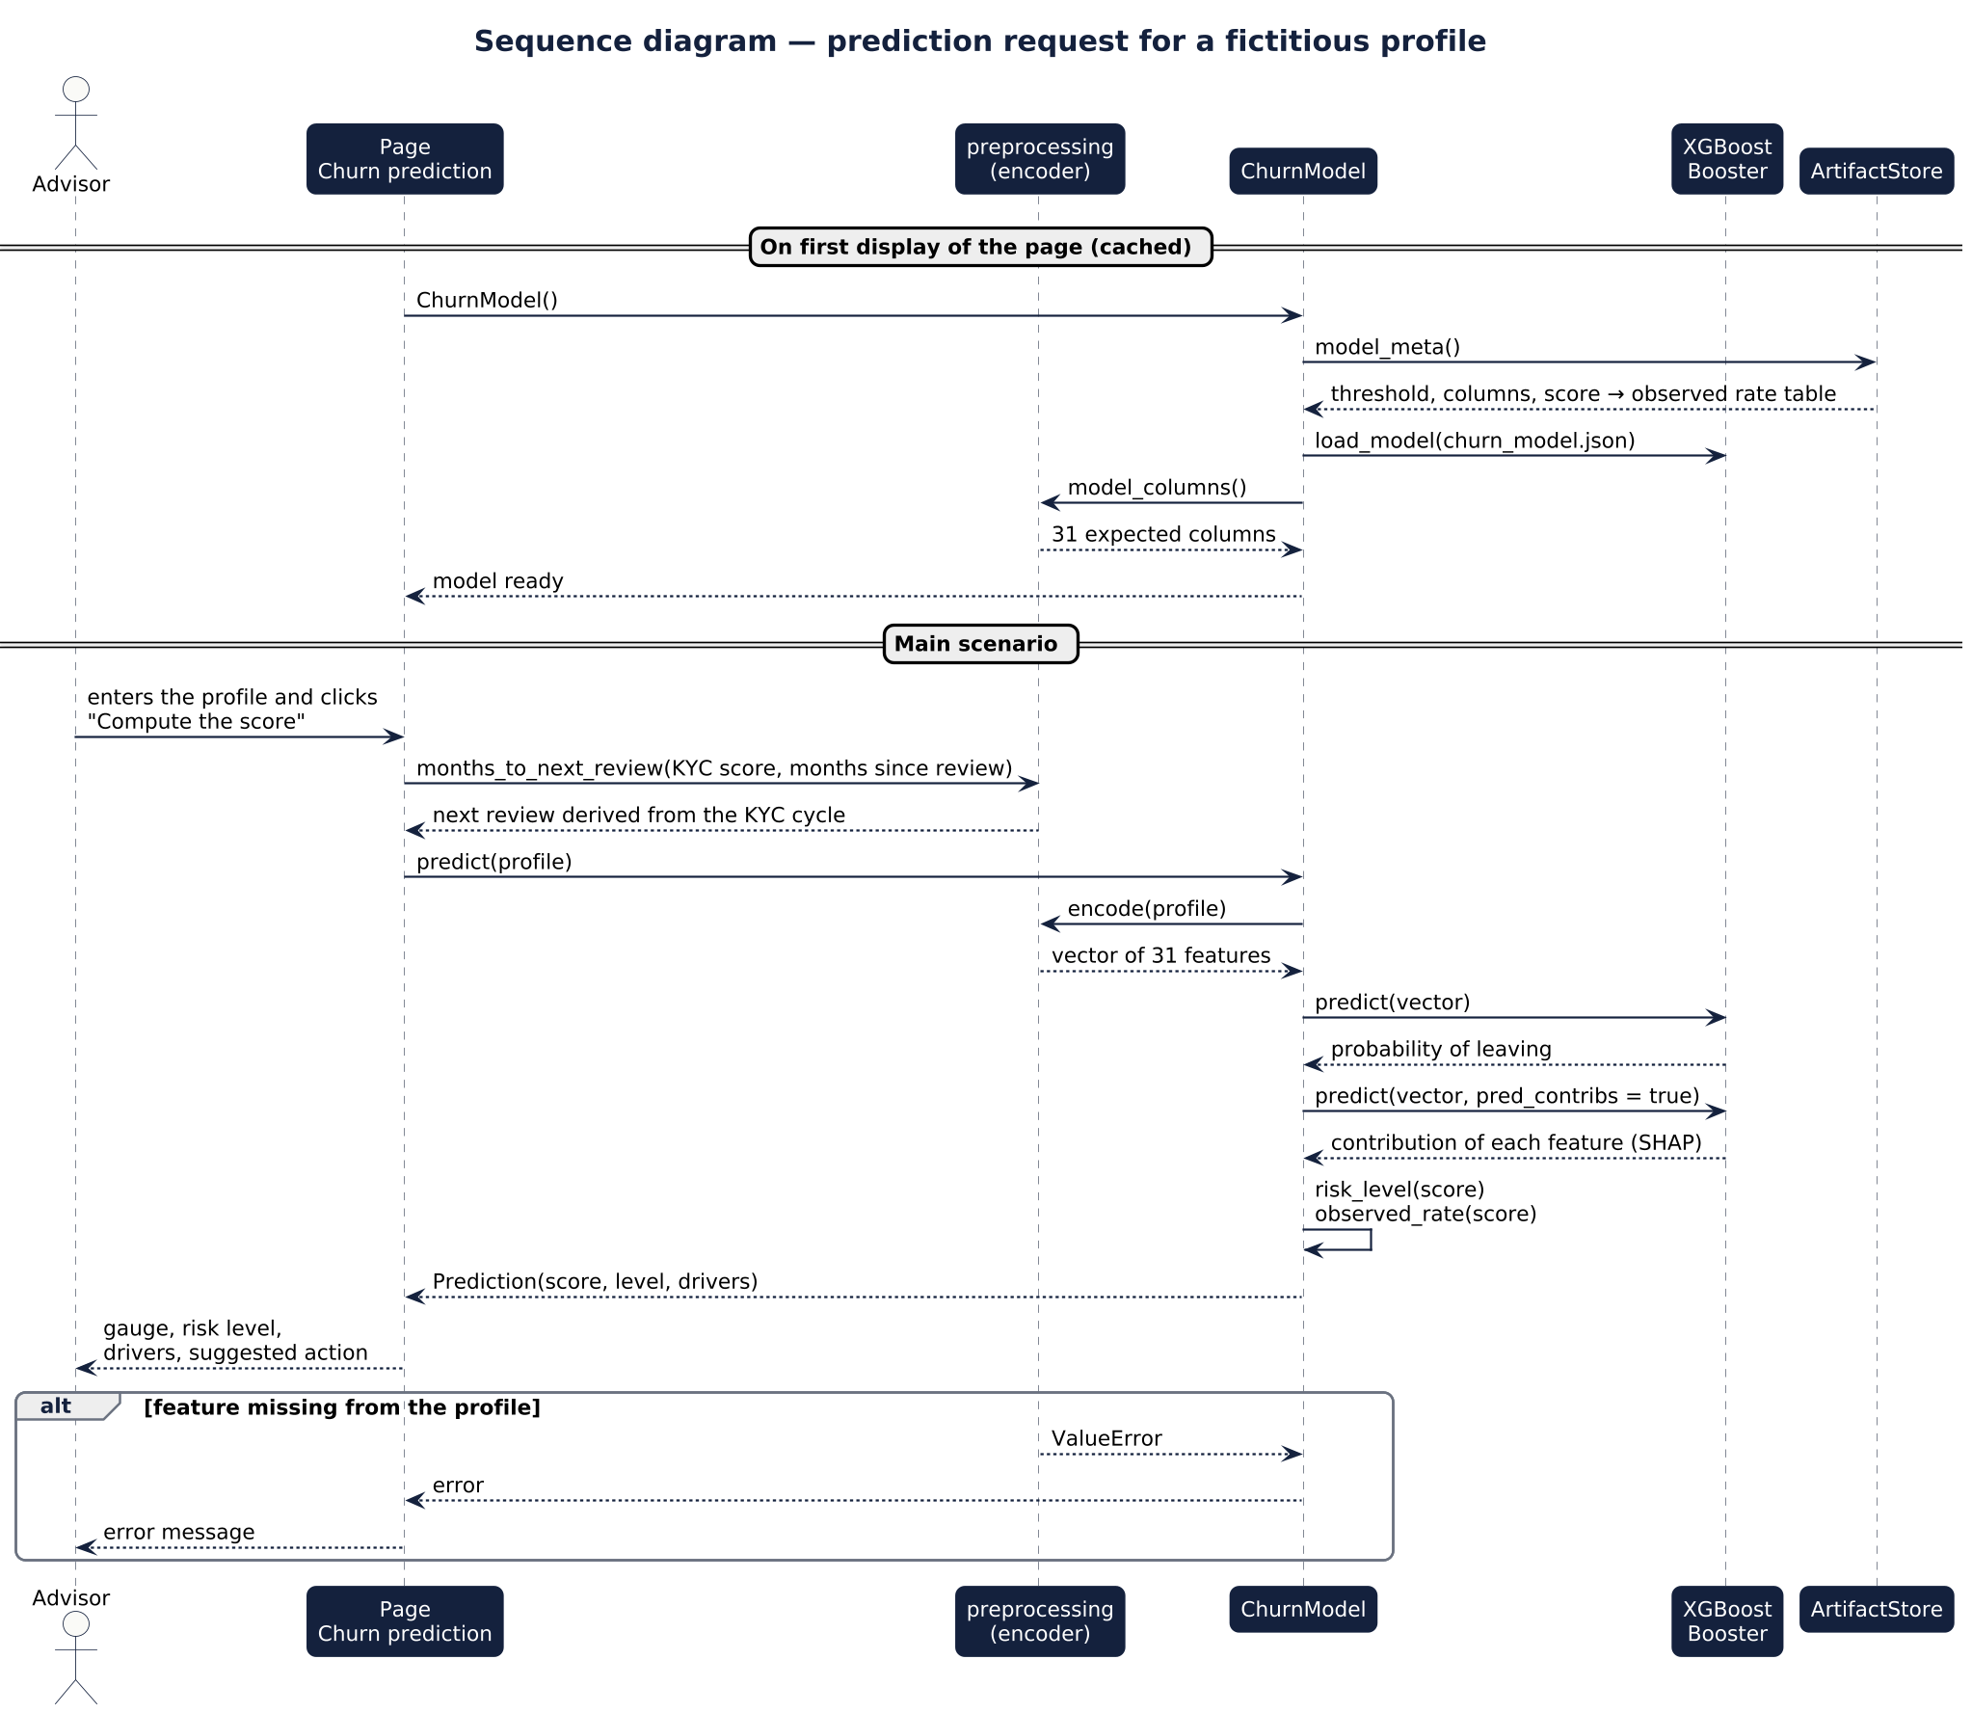
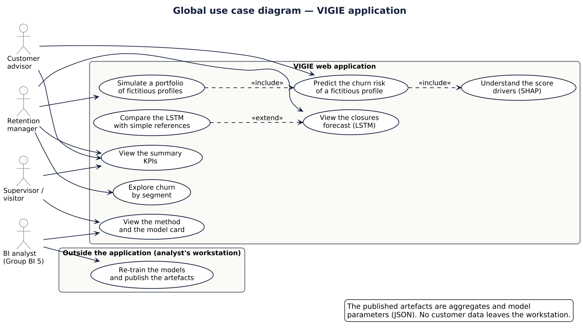
APPLICATION
Phase 5 · UML: use cases, sequence, classes
VIGIE · Group BI 5 · Ibrahim Grira
15
Notes:
[Ibrahim Grira] Three diagrams: the global use cases with four actors, the sequence of a prediction request, and the classes of the application — the model, the prediction, the artefact store and the fictitious generator.

Slide 16
APPLICATION
Phase 5 · Tests, CI and data protection
26
5 / 5
0
100%
automated tests (pytest)
pages tested end to end
data files in the repository
metrics reproduced by train.py
▪ Encoding: fixed columns, missing values, unknown categories, KYC review cycle
▪ Model: probabilities, exact SHAP explanation, direction of effects, fictitious portfolio
▪ Application: every page runs; the form reacts in the right direction
▪ Confidentiality: no data file, no identifier, no aggregate below 20, consistent volumes
▪ Deployment: Streamlit Community Cloud — no TensorFlow, no .pkl needed
VIGIE · Group BI 5 · Ibrahim Grira
16
Notes:
[Ibrahim Grira] Twenty-six automated tests run on every push with GitHub Actions. They check the encoding, the model, every page of the app — and the confidentiality rules: if anyone commits a data file or a customer identifier, the build fails.

Slide 17
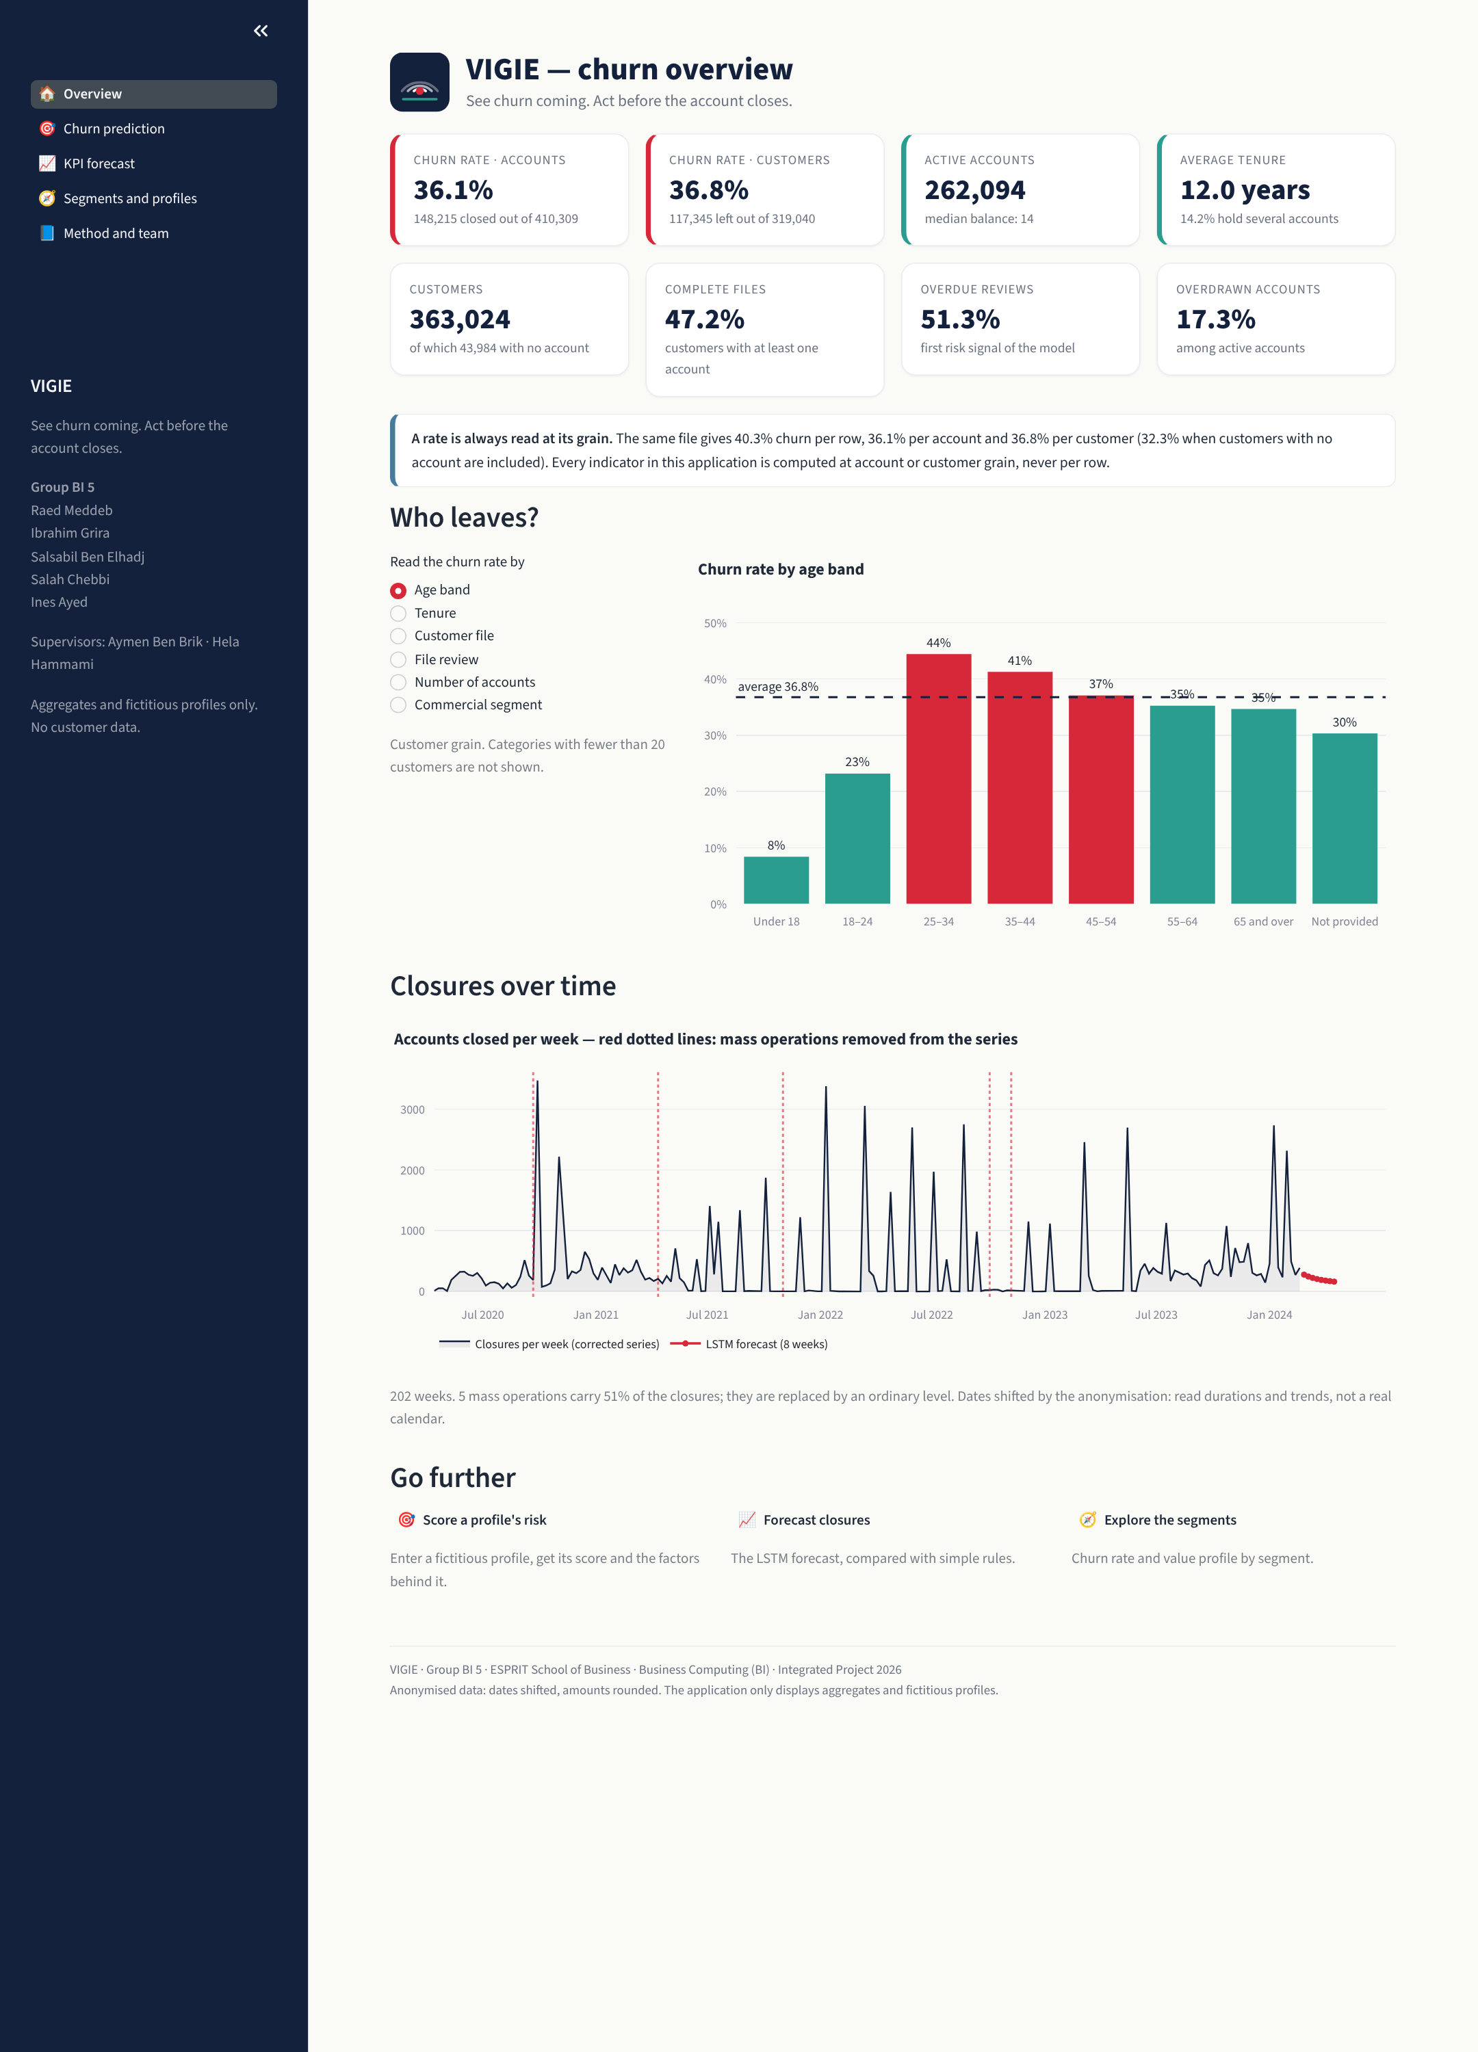
APPLICATION
Live demo
▪ 1 · Overview: KPIs and "a rate at its grain"
▪ 2 · Prediction: default profile → overdue review → score rises
▪ 3 · Fictitious portfolio: who to call first
▪ 4 · Forecast: next 8 weeks, honest comparison
▪ Backup: recorded video
VIGIE · Group BI 5 · Ibrahim Grira
17
Notes:
[Ibrahim Grira] Demo plan (5 minutes): overview and the grain note; prediction with the default profile, then move 'months since last review' to 100 and show the score and the drivers change; fictitious portfolio; forecast page. Backup: the video in 07_presentation if the network fails.

Slide 18
CONCLUSION
Limitations and next steps
▪ A snapshot, not a film: some features may follow the departure
▪ No behavioural data: AUC capped at 0.75
▪ Batch closures: half of the "churn"
▪ 202 weeks, 3 regimes: hard to forecast
▪ Separate batch closures from real departures
▪ Monthly behavioural snapshots (balances, complaints)
▪ Re-train regularly: LSTM next to the median
▪ Measure value: campaign vs control group
VIGIE · Group BI 5 · Salah Chebbi
18
Notes:
[Salah Chebbi] Our limits: a single snapshot, no behavioural data, batch closures mixed with real departures, and a short series. Next steps: separate batch closures at the source, add monthly behavioural snapshots, re-train regularly, and measure the value of a retention campaign against a control group.

Slide 19
CONCLUSION
Conclusion: watch the files nobody reviews
▪ Complete chain: data → warehouse → Power BI → LSTM and XGBoost → web application
▪ Verified at every step: 19 checks · reference values for every DAX measure · reproducible models · 26 tests
▪ Lessons: a rate needs its grain; blanks can fake a perfect model; a deep network does not always beat a median
▪ Business message: an overdue file review is the strongest warning sign — act on it
Thank you — questions?
VIGIE · Group BI 5 · Raed Meddeb
19
Notes:
[Raed Meddeb] To conclude: we delivered the full chain, and every stage is verified. The main lesson: question the numbers before trusting them. And the business message: an overdue file review is the strongest warning sign — the bank can act on it today. Thank you; we are happy to take your questions.

