Slide 1

SAS MIDDLE EAST · AGENTIC AI IN ACTION
The NCGR AI Copilot
«مُعين» — your platform, your data, your choice of AI model.
National Center for Government Resources Systems (NCGR)
SAS Middle East · July 2026
Company Confidential — For Internal Use Only
Copyright © SAS Institute Inc. All rights reserved.
sas.com · 1

Slide 2
THE VISION
Your Copilot, On Your Terms
1
2
3
Your AI model
Your SAS platform
Your language
Cloud today. Fully on-premises tomorrow. Swap it anytime.
Real data, real models, real dashboards — not chatbot guesses.
English ⇄ Arabic. One click.
Company Confidential — For Internal Use Only
Copyright © SAS Institute Inc. All rights reserved.
sas.com · 2

Slide 3
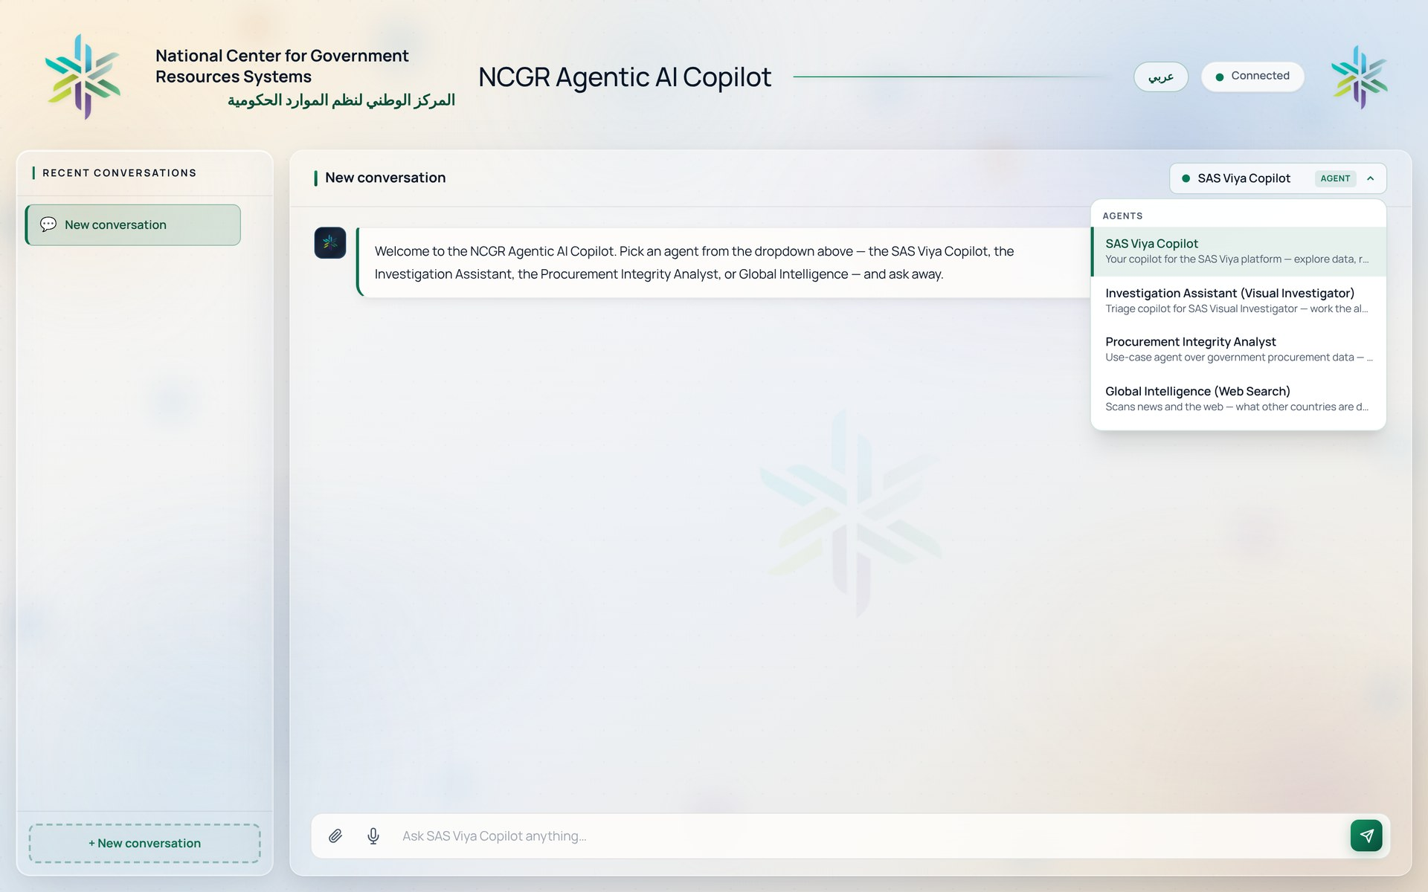
ONE CHAT · FOUR AGENTS
Meet Your AI Team
ncgr-copilot.up.railway.app
SAS Viya Copilot
Data, models & dashboards on request
Investigation Assistant
Alert triage for Visual Investigator
Procurement Integrity Analyst
A watchdog over every tender
Global Intelligence
The world's playbook — with sources
One window. Pick an agent. Ask.
Company Confidential — For Internal Use Only
Copyright © SAS Institute Inc. All rights reserved.
sas.com · 3

Slide 4
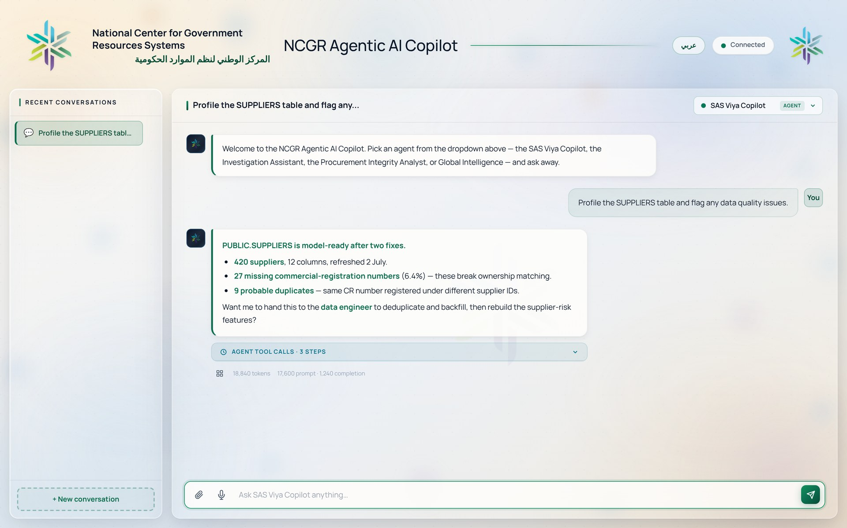
AGENT 01 · SAS VIYA COPILOT
Ask. It Finds, Builds, Explains.
▪ Finds and profiles your data
▪ Builds models with SAS AutoML
▪ Scores new cases in real time
▪ Answers from official SAS docs
ncgr-copilot.up.railway.app
Behind the scenes: a team of six specialist agents — visible in the trace.
Company Confidential — For Internal Use Only
Copyright © SAS Institute Inc. All rights reserved.
sas.com · 4

Slide 5
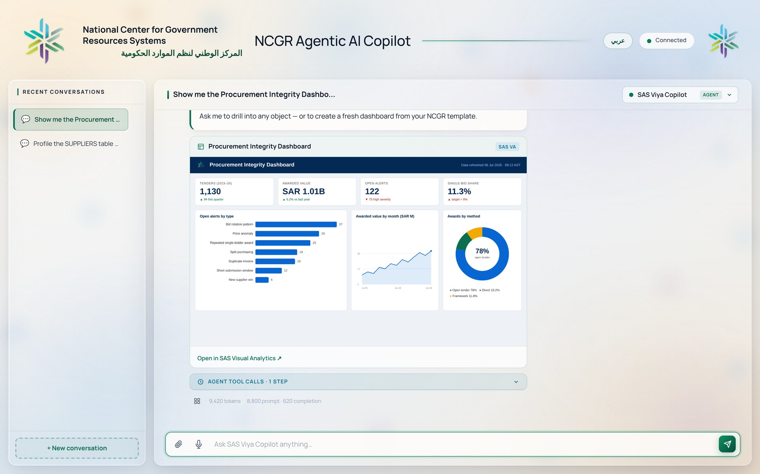
AGENT 01 · VISUAL ANALYTICS
Dashboards on Demand
ncgr-copilot.up.railway.app
Show it.
Analyze it.
Create it.
It advises like a BI consultant:
“Add a KPI for single-bid awards, so you can track competition at a glance.”
Company Confidential — For Internal Use Only
Copyright © SAS Institute Inc. All rights reserved.
sas.com · 5

Slide 6
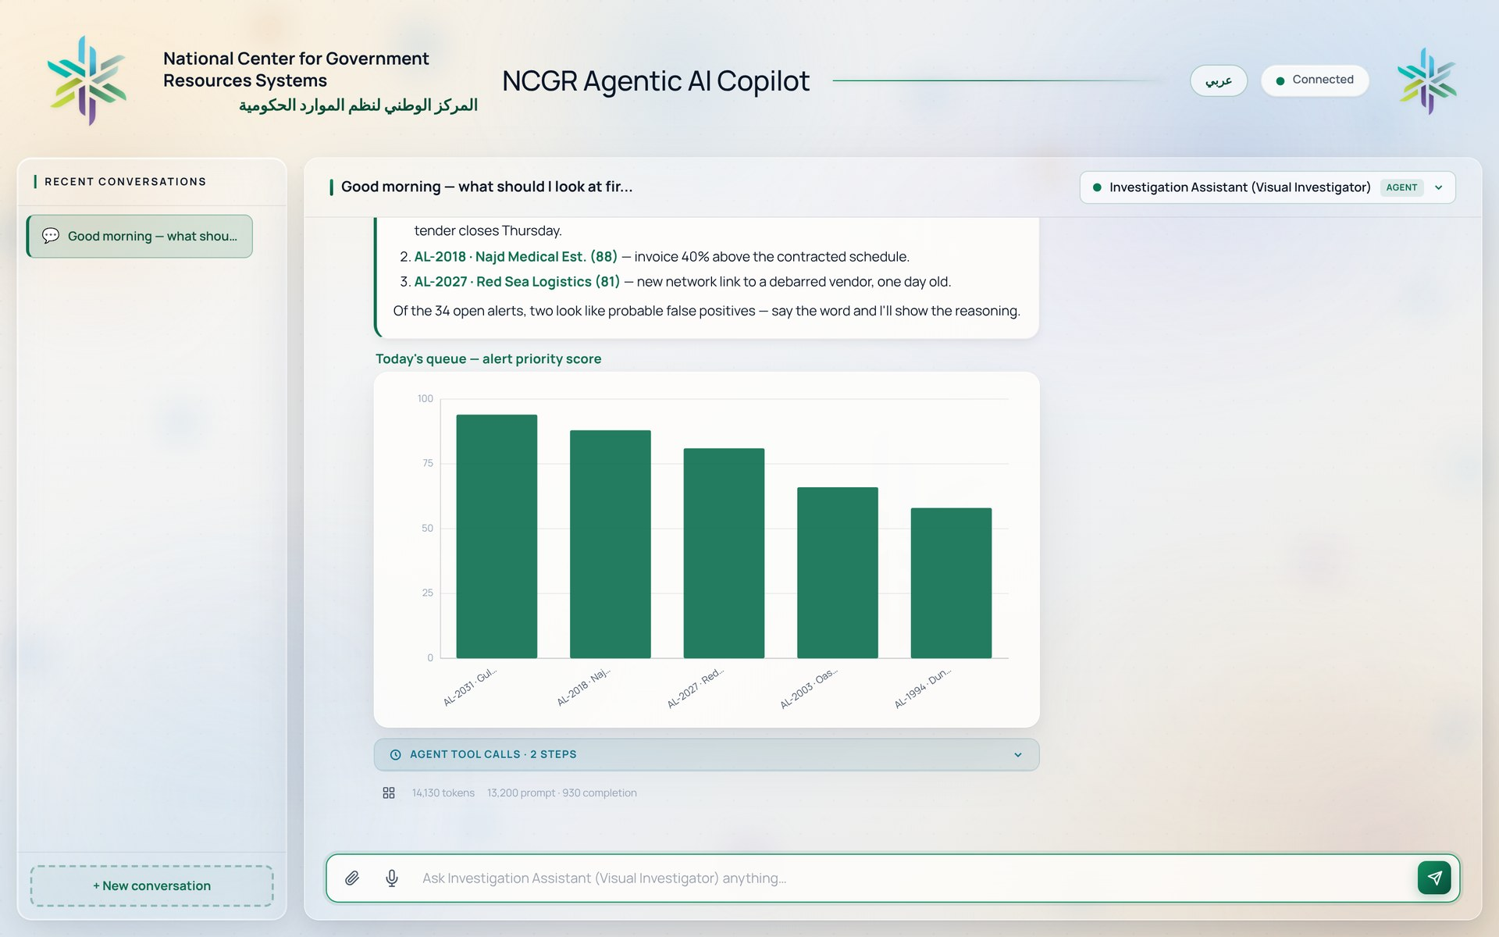
AGENT 02 · SAS VISUAL INVESTIGATOR
Your Morning Briefing.
▪ Prioritizes the alert queue
▪ Explains why each alert fired
▪ Maps hidden networks
▪ Flags likely false positives
ncgr-copilot.up.railway.app
Investigators investigate — the sorting is already done.
Company Confidential — For Internal Use Only
Copyright © SAS Institute Inc. All rights reserved.
sas.com · 6

Slide 7
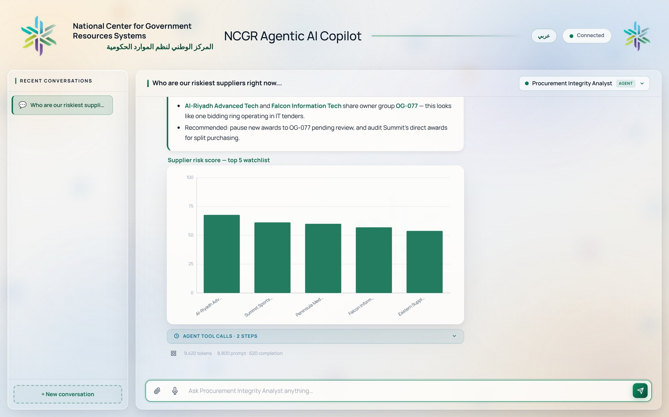
AGENT 03 · PROCUREMENT INTEGRITY
Red Flags Before Award.
▪ Supplier risk scores
▪ Bid-rigging screen
▪ Price-anomaly detection
▪ Split purchases & duplicate invoices
ncgr-copilot.up.railway.app
Catch it before contract award — when it's cheapest to fix.
Company Confidential — For Internal Use Only
Copyright © SAS Institute Inc. All rights reserved.
sas.com · 7

Slide 8
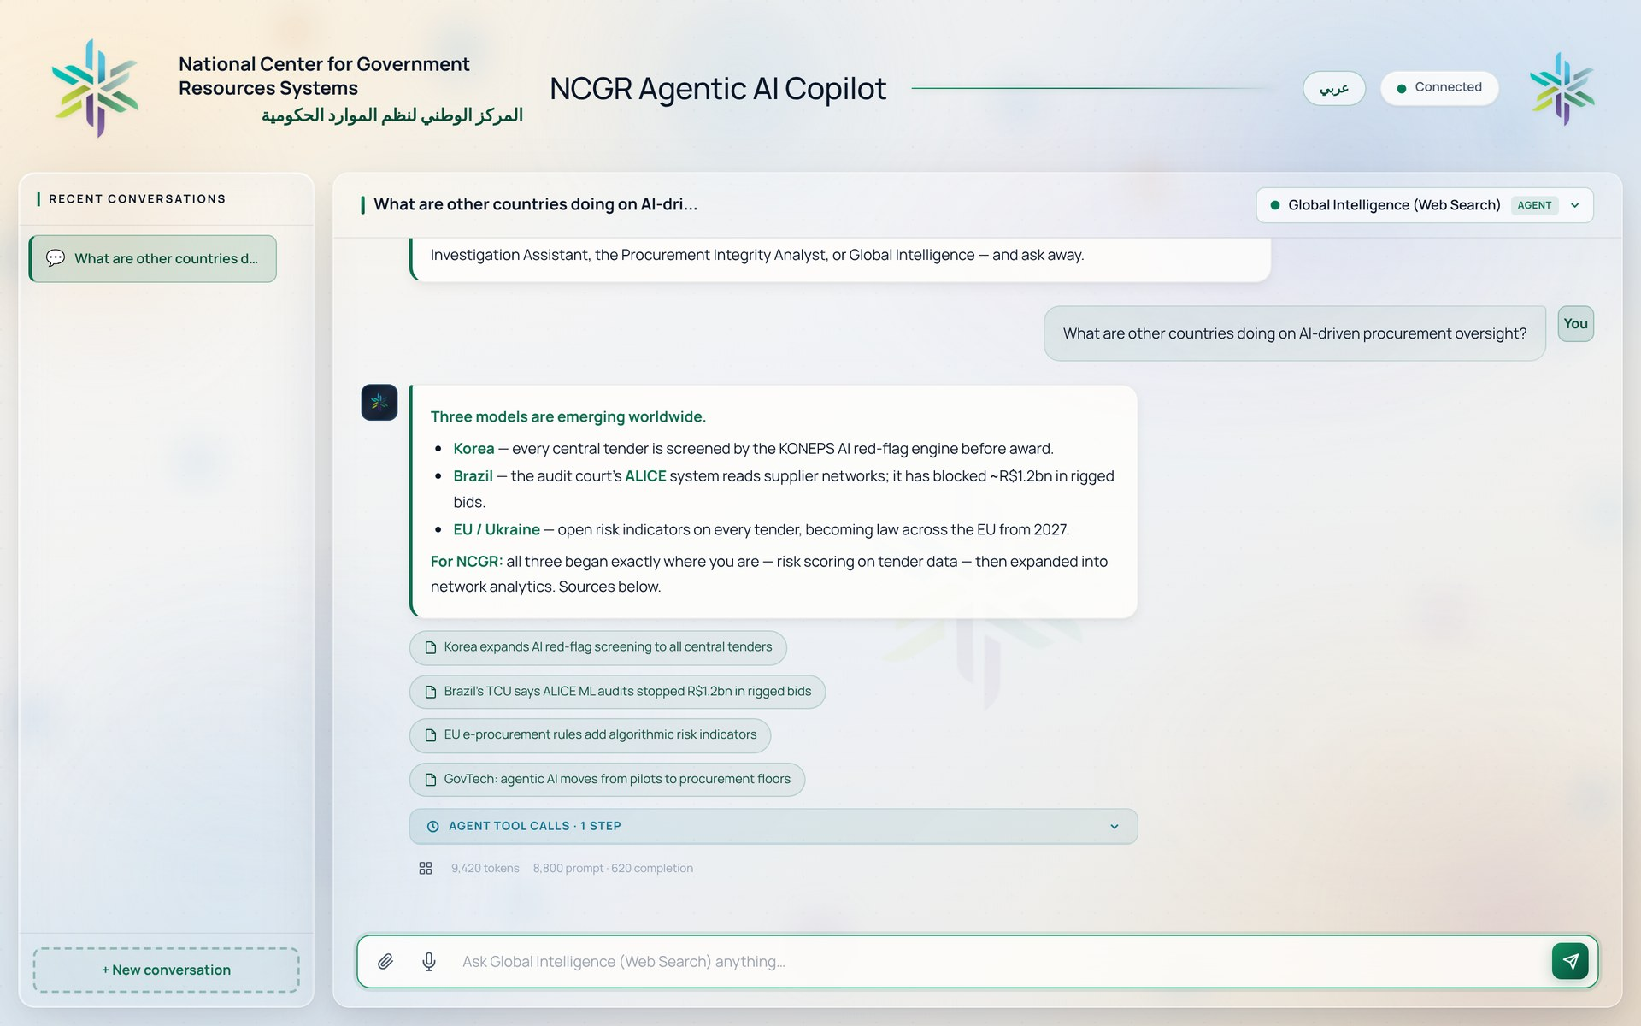
AGENT 04 · GLOBAL INTELLIGENCE
The World, Cited.
▪ What other countries are doing
▪ Emerging tech, summarized
▪ Monitored topics, on schedule
▪ Every answer carries its sources
ncgr-copilot.up.railway.app
Benchmark decisions — without standing up a research team.
Company Confidential — For Internal Use Only
Copyright © SAS Institute Inc. All rights reserved.
sas.com · 8

Slide 9
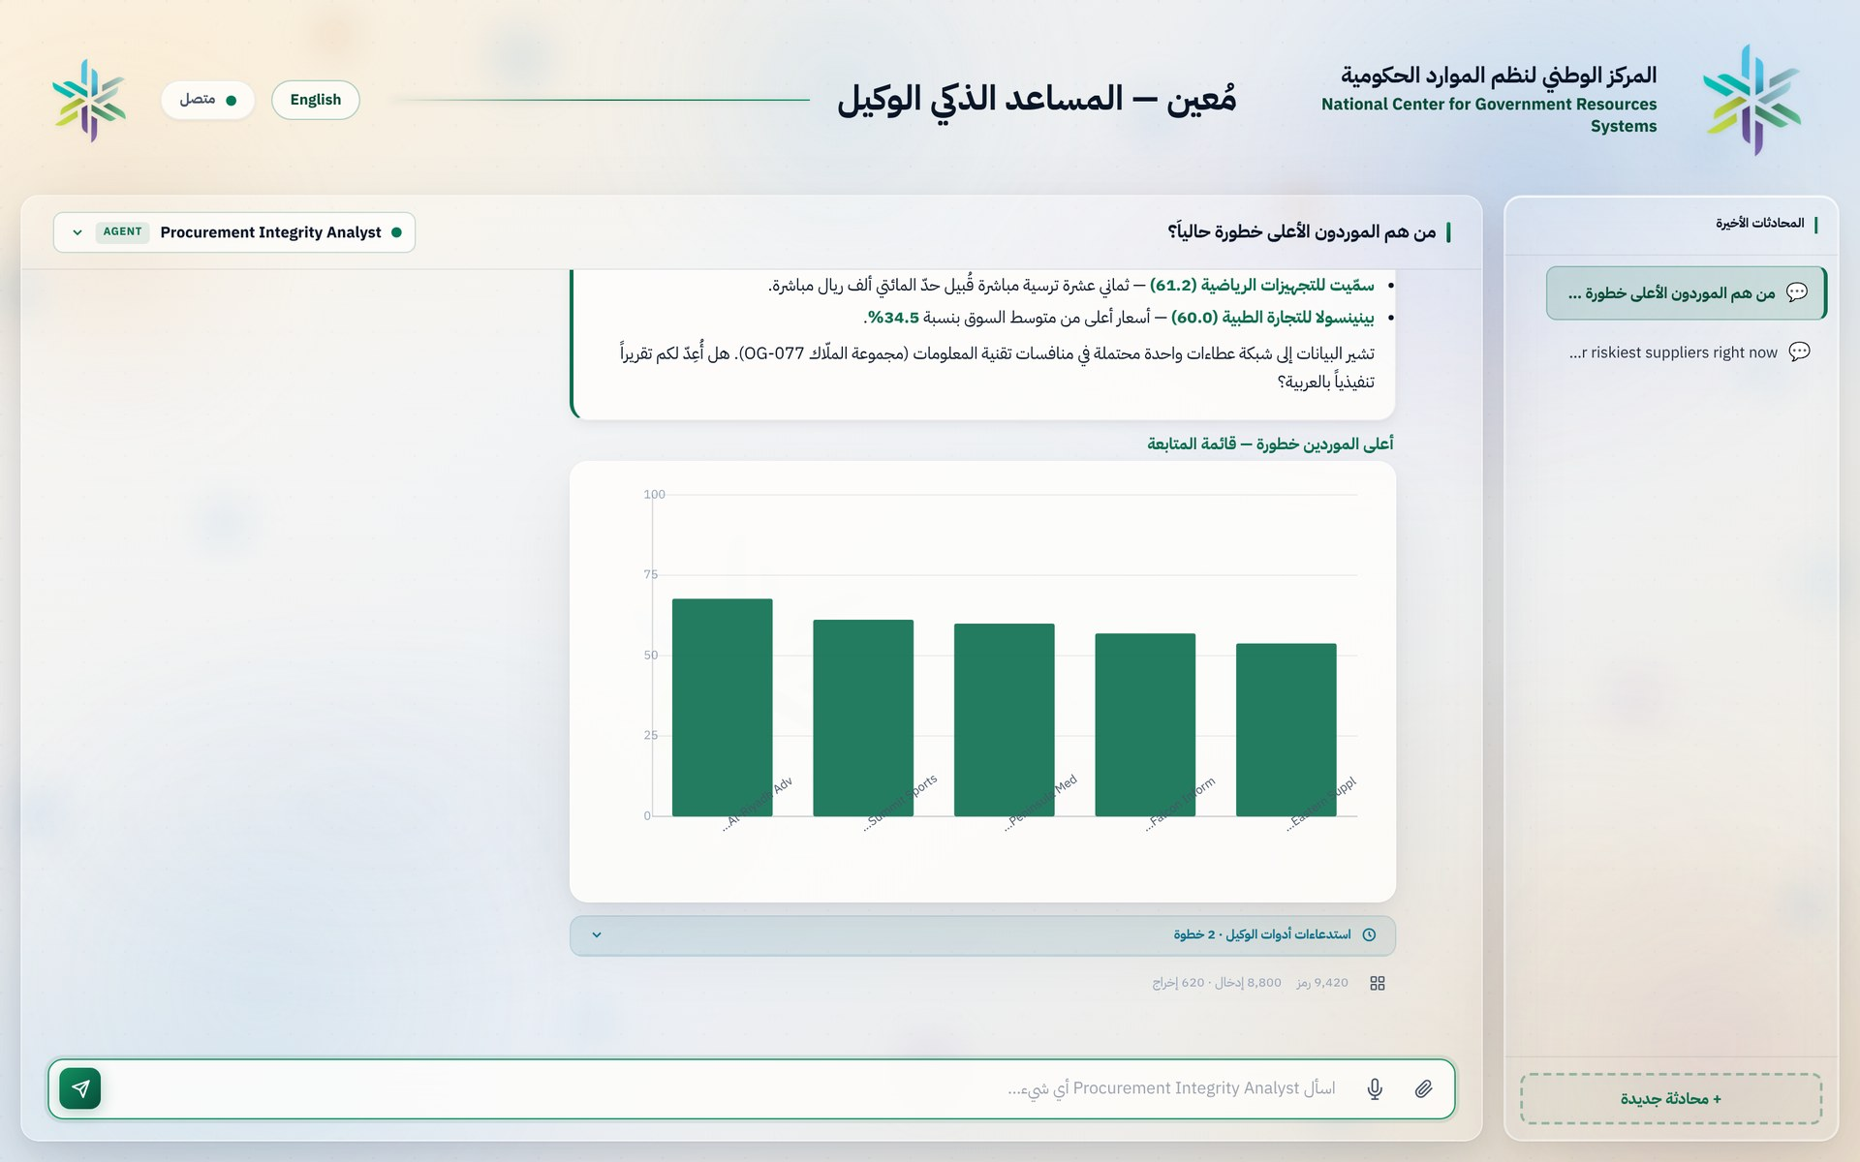
SOVEREIGNTY & TRUST
Built for the Kingdom.
ncgr-copilot.up.railway.app
عربي — one click
The whole experience flips: interface, answers, voice.
Data stays home
Runs with an on-premises AI model. Nothing leaves.
Every answer shows its work
Steps, tools, and data — audit-ready.
Company Confidential — For Internal Use Only
Copyright © SAS Institute Inc. All rights reserved.
sas.com · 9

Slide 10
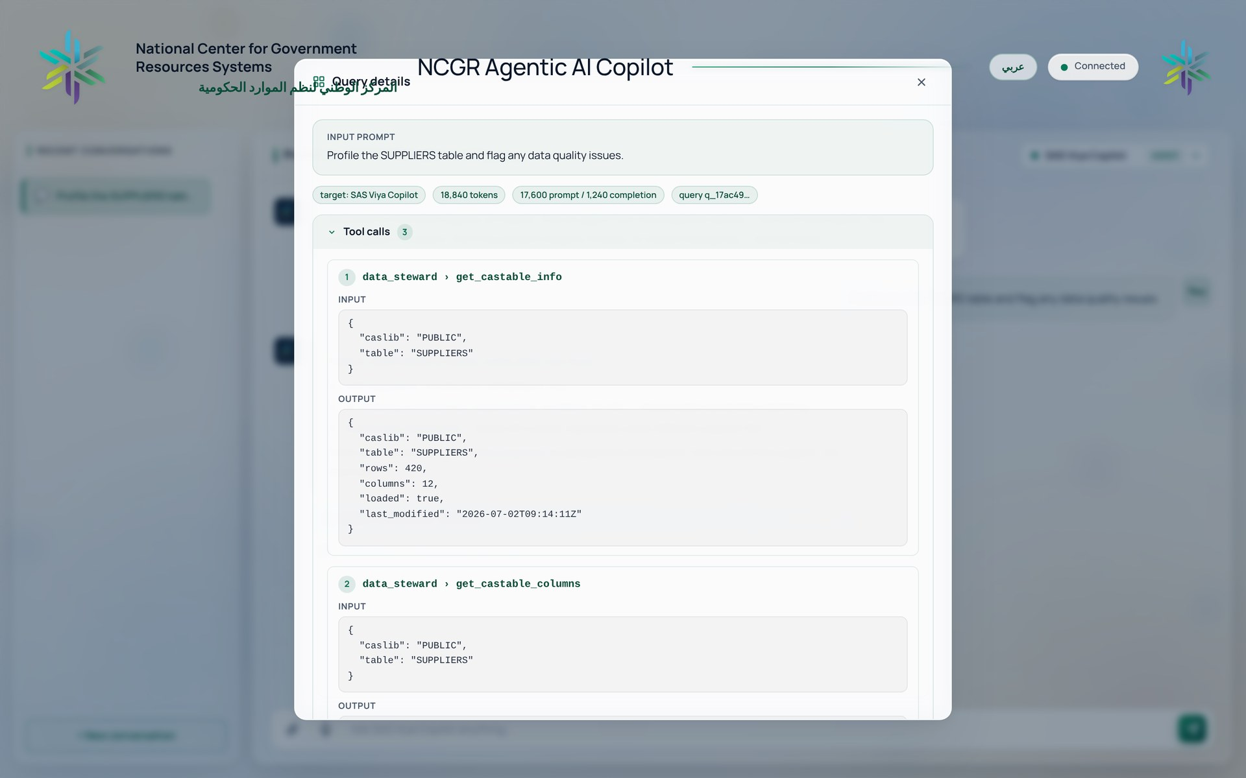
LIVE DEMO
What You'll See Today
1
A model built from one sentence
ncgr-copilot.up.railway.app
2
A dashboard, shown and analyzed in chat
3
Today's alerts, triaged
4
A bid-rotation ring, uncovered
5
The world scanned — with sources
Every step the agents take — visible.
Company Confidential — For Internal Use Only
Copyright © SAS Institute Inc. All rights reserved.
sas.com · 10

Slide 11
NEXT STEPS
From Demo to Production
1
2
3
Pick the use cases
Connect your platform
Pilot & scale
Procurement integrity is ready today.
Your SAS, your data, your AI model.
Measure. Expand agent by agent.
شكراً — Thank You
Raed Aldweik · SAS Middle East
Company Confidential — For Internal Use Only
Copyright © SAS Institute Inc. All rights reserved.
sas.com · 11

