Slide 1
Raeed Mohammed M Alghribi
Predicting the price value of FIFA players
Tuwaiq-bootcamp-project

Slide 2
Work Flow
Loading data file
Data filtering and cleaning
Handling categorical features

Slide 3
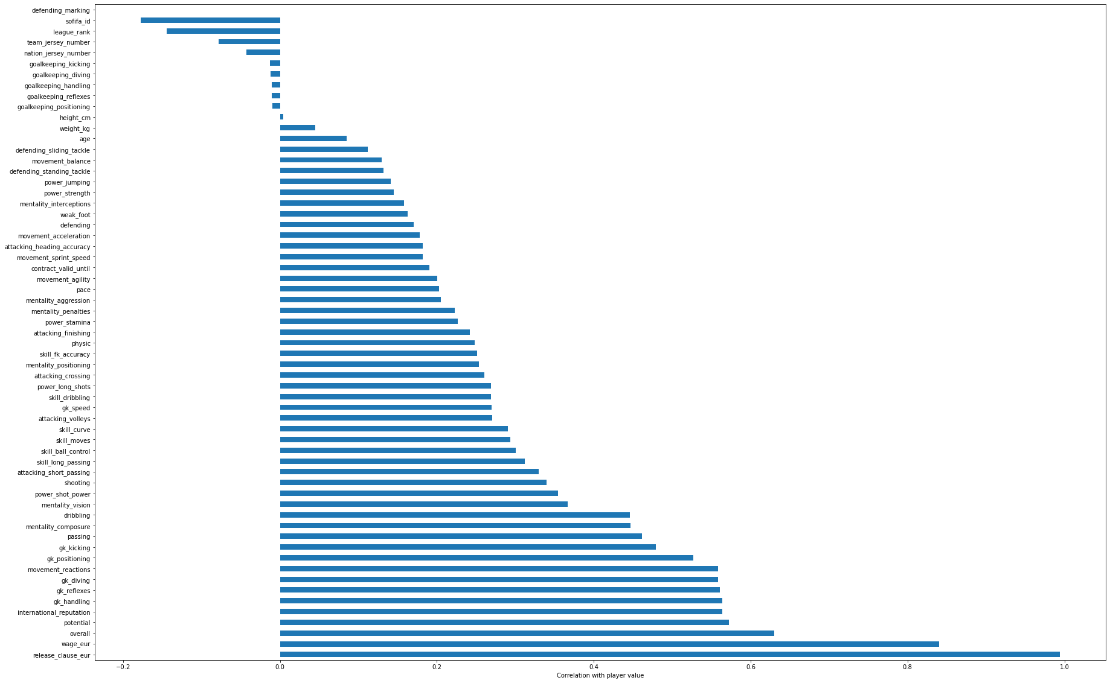
correlation between target and all other features

Slide 4
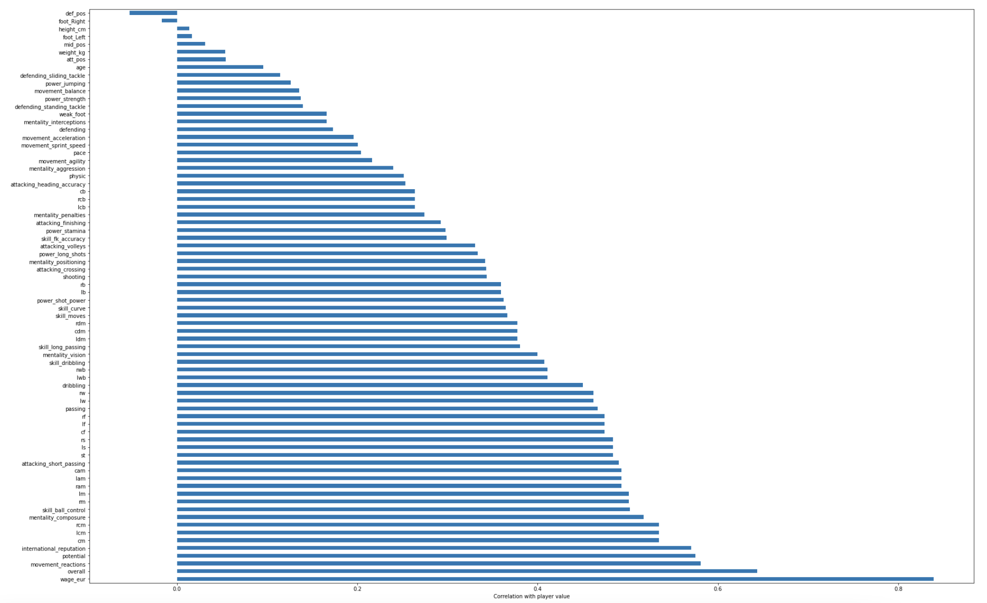
correlation between target and final features

Slide 5
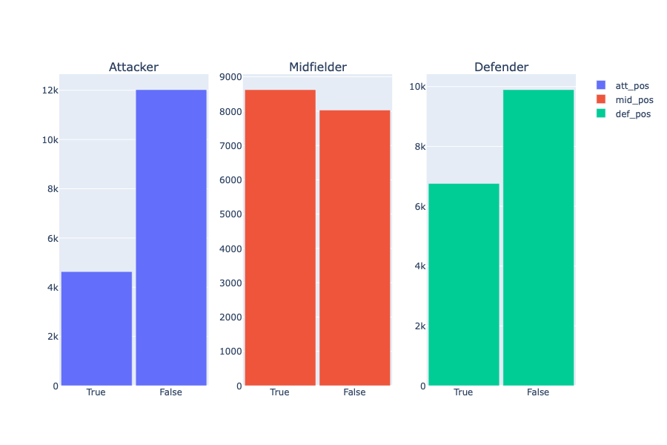
Sum Up player postions

Slide 6
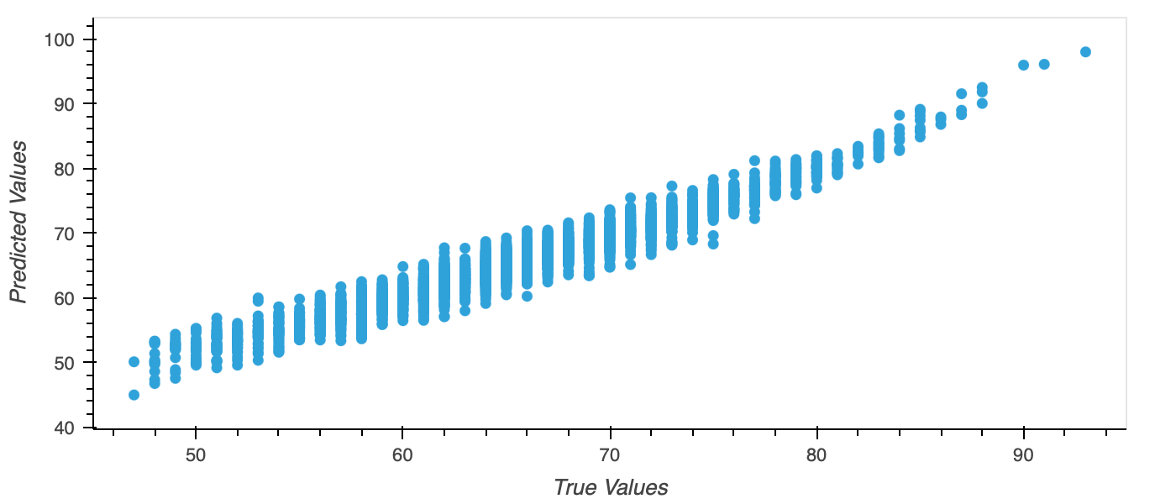
Predicting player overall
r2 score: 0.9423670034257592
RMSE : 1.6858125893701004

Slide 7
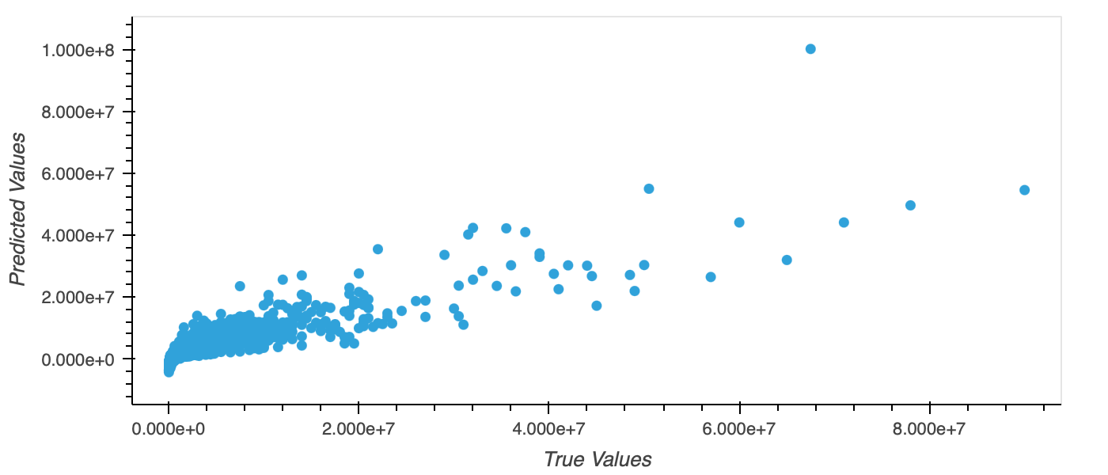
Predicting player price
r2 score: 0.7851041044554063
RMSE : 2619163.5620737183

Slide 8
Raeed Mohammed M Alghribi
The End
Tuwaiq-bootcamp-project

