Slide 1
RAPIDS Reconciling Availability, Accuracy, and Performance in Managing Geo-Distributed Scientific Data
Lipeng Wan, Jieyang Chen, Xin Liang, Ana Gainaru, and others
Muhammad Raees
mr2714@rit.edu
1

Slide 2
Objective
Increase the performance of geo-distributed data (scientific) storage systems by
Reducing storage and network overhead
Improving data access/latency
While maintaining the same level of data
Availability
Accuracy

Slide 3
Data Size Grows
Large scientific datasets
XGC gyrokinetic particle-in-cell code
Square Kilometer Array (SKA)
High-Performance Storage Needs
Managing failures is critical
Availability, accuracy, and performance
Notes:
Big Data Growth in Modern Science
Simulation of the edge region of magnetically confined thermonuclear fusion plasma

Slide 4
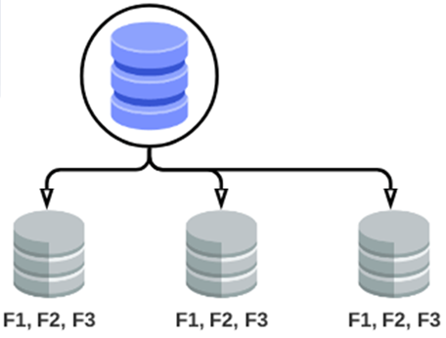
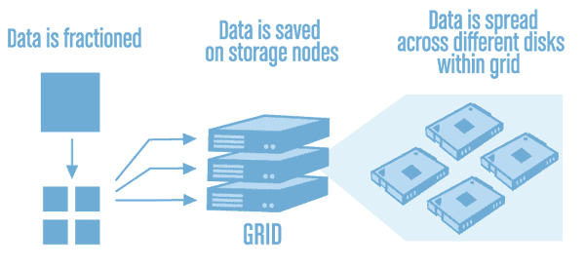
Improving Resilience
Data Duplication
Erasure Coding
Availability Improvement
Storage and Network Overhead
Splitting data into data and parity fragments
Data restoration from a subset of fragments
Still, it is expensive to create, transfer, and store many (large) parity and data fragments to achieve high availability for large scientific datasets.

Slide 5
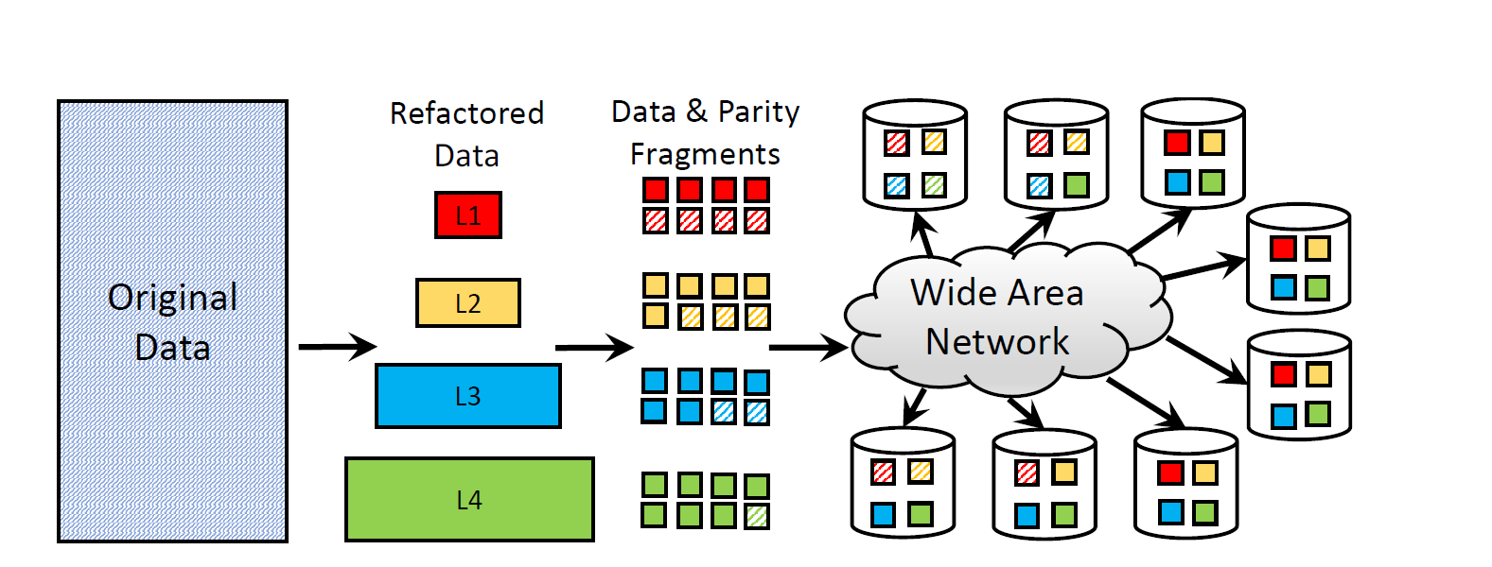
RAPIDS – Store Data

Slide 6
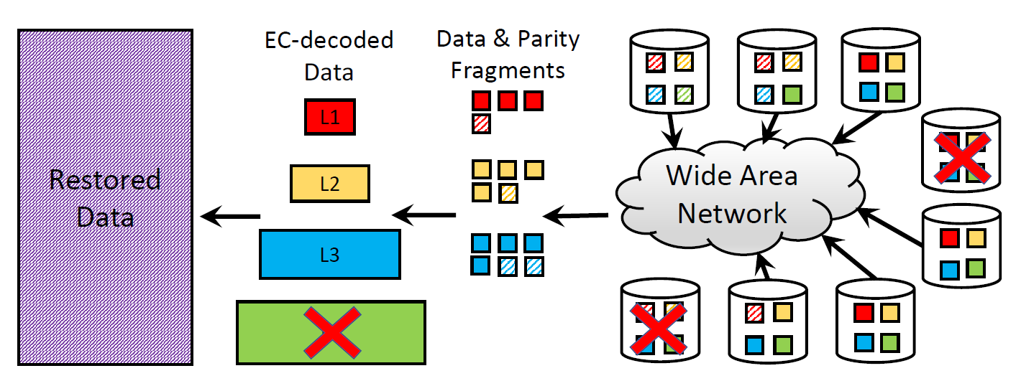
RAPIDS – Get Data
Notes:
The original data can be reconstructed using only the top-level(s) and error decreases with lower levels added

Slide 7
Refactor & Compress
MGRAD

Slide 8
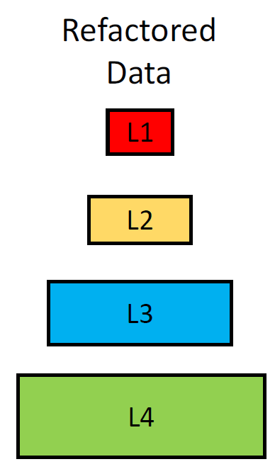
Refactor & Compress
Error-bounded lossy compression
Refactor the original data into a hierarchical representation
E.g., 4 levels
Size: s1 < s2 < s3 < s4
Data reduction is applied
Error in the reduced representation
Size: S > s1 + s2 + s3 + s4
https://github.com/CODARcode/MGARD
Notes:
MGRAD ensures: multi-level compression and refactoring using linear quantization, Huffman encoding, and bitplane encoding

Slide 9
Erasure Coding
MGRAD
EC

Slide 10
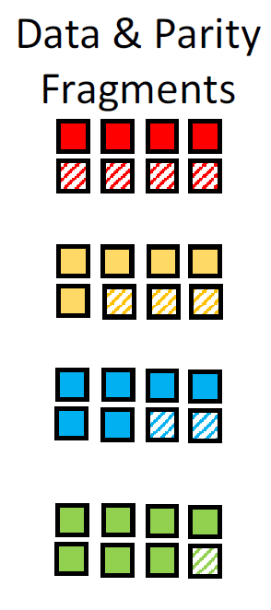
Erasure Coding
Erasure coding (each level) with fault tolerance
Encoded into 𝑛−𝑚𝑗 data and 𝑚𝑗 parity
Parity 𝑚1 > 𝑚2 > 𝑚3 > 𝑚4
Reduces storage and network overhead compared to whole data compression
Data s1 < s2 < s3 < s4
Smaller duplication overhead.
https://github.com/openstack/liberasurecode
Notes:
Erasure coding with different fault tolerance configurations is then applied to each level so that the number of parity fragments created for each level decreases from the top to the bottom. If the size of the refactored data at the 𝑗th level is 𝑠𝑗 , the size of each parity fragment of level 𝑗 is 𝑠𝑗/(𝑛−𝑚𝑗)

Slide 11
Distributed Storage
MGRAD
EC
Distribute
https://github.com/globus/globus-cli

Slide 12
RAPIDS – Get Data
Reconstruct
Gather

Slide 13
RAPIDS – Get Data
Data gathering optimization
Which fragment fetched from which source
Network overhead / latency
Reconstruction – Fault tolerance configuration is critical for availability and accuracy
Minimize the expected relative error

Slide 14
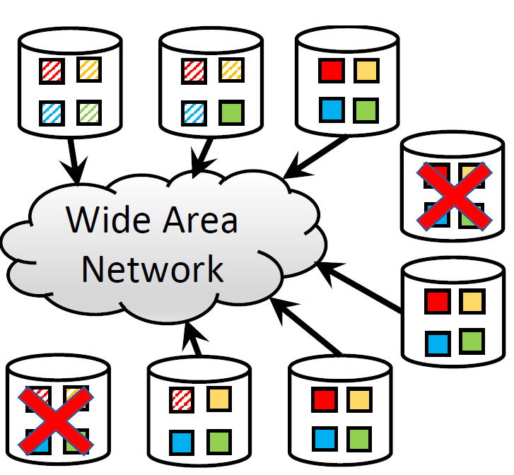
Data Gathering
Find a set with values of enough fragments (fragments, systems) to minimize data transfer time
Find time for each transfer request (including multiple request sources)
Reduce average time for all requests
Fetch a subset of fragments
Prioritize high-bandwidth
Reduce concurrency
http://www.midaco-solver.com
Notes:
Mixed Integer Distributed Ant Colony Optimization (MIDACO)
mixed integer Nonlinear Programming (MINLP)

Slide 15
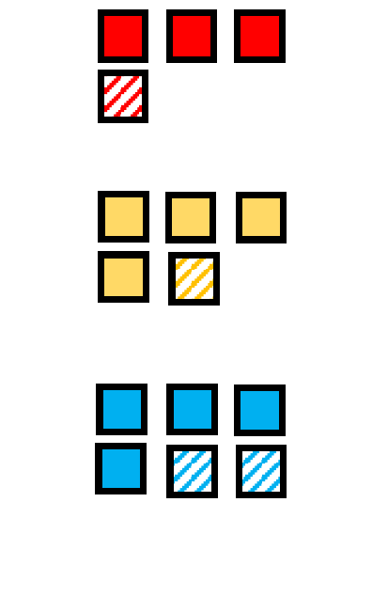
Fault Tolerance
Erasure coding defines data restructuring
how many failures each level can sustain
If failure (N) > m1,
Data will be unavailable for reconstruction
Max error (1), data is useless
If m_{j+1} < 𝑁 <= m_{j},
Data will be available for reconstruction
Error 𝑒𝑗

Slide 16
Fault Tolerance
Minimize faults (each level) to reduce error under constraints (optimization)
Storage overhead should not exceed the threshold (defined)
Number of failures at each level can tolerate should follow 𝑚1 > 𝑚2 > . . . > 𝑚𝑙 ≥ 1 as (𝑠1 < 𝑠2 < . . . < 𝑠𝑙 )
Small solution space – Brute-force search
𝑂(Storage systems – refactor levels)⁴
Large solution space – Heuristic search
Notes:
If the 𝑗^{th} level is encoded into 𝑛−𝑚𝑗 data and 𝑚𝑗 parity EC-fragments (𝑛 EC-fragments in total which are distributed to 𝑛 storage systems, one per each system), it means level 𝑗 can tolerate 𝑚𝑗 concurrent failures.

Slide 17
Fault Tolerance Heuristic
Set initial fault tolerance configuration w.r.t. overall storage overhead – reducing search space
Increment parity on the level (bottom start)
If storage overhead is violated
Reduce/use the last stable configuration
Move to the level above in the hierarchy and go to step 2
Assumptions
𝑠1 ≪ 𝑠2 ≪ 𝑠3 ≪ 𝑠4
𝑒1 ≫ 𝑒2 ≫ 𝑒3 ≫ 𝑒4

Slide 18
Recap
Original data from the disk
Refactor data to generate hierarchical representation
Erasure coding at each level
Data Distribution
Meta Data Management
Data Gathering
Erasure Decoding
Reconstruction
Restored Data
MGARD
liberasurecode
(CLI) of Globus
MINLP Solver
MIDACO
Notes:
Mixed Integer Distributed Ant Colony Optimization (MIDACO)
mixed integer Nonlinear Programming (MINLP)

Slide 19
Meta Data Management
Track all the data and parity fragments
key-value database (fragment: system)
Restoring lost fragments – EC (fragment: system)
Reconstruction information
Central – Prone to failure

Slide 20
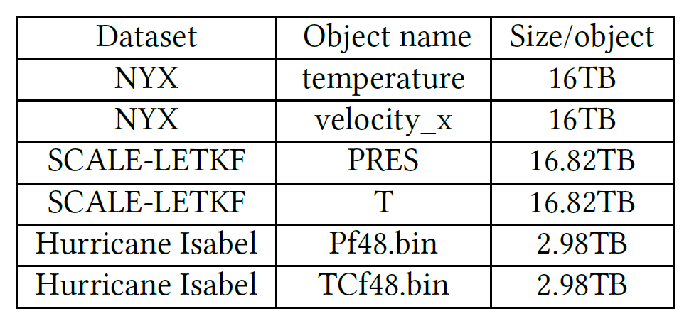
Evaluation – Data Sets
NYX cosmology simulation
SCALE-LETKF weather simulation
Hurricane Isabel climate simulation
Oak Ridge Leadership Computing Facility (OLCF)
704-compute node cluster; where each node has
2 16-core Processors (32 cores)
256GB of memory
9 GPU nodes; where each node has
2 NVIDIA K80 GPUs, 2 Intel Xeon 14-core processors
1TB memory

Slide 21
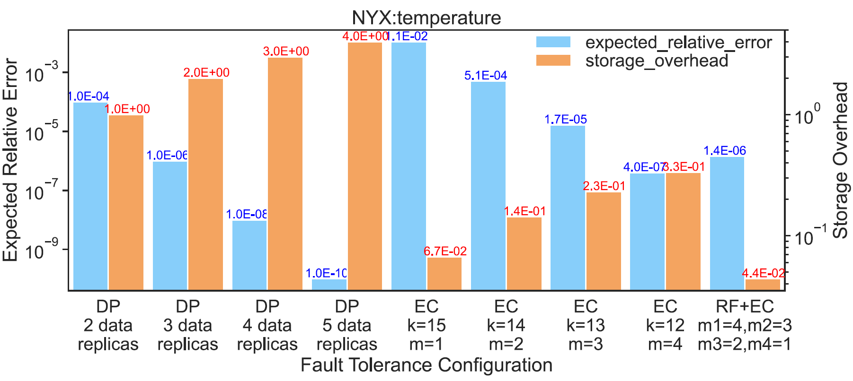
Evaluation – Error and Storage

Slide 22
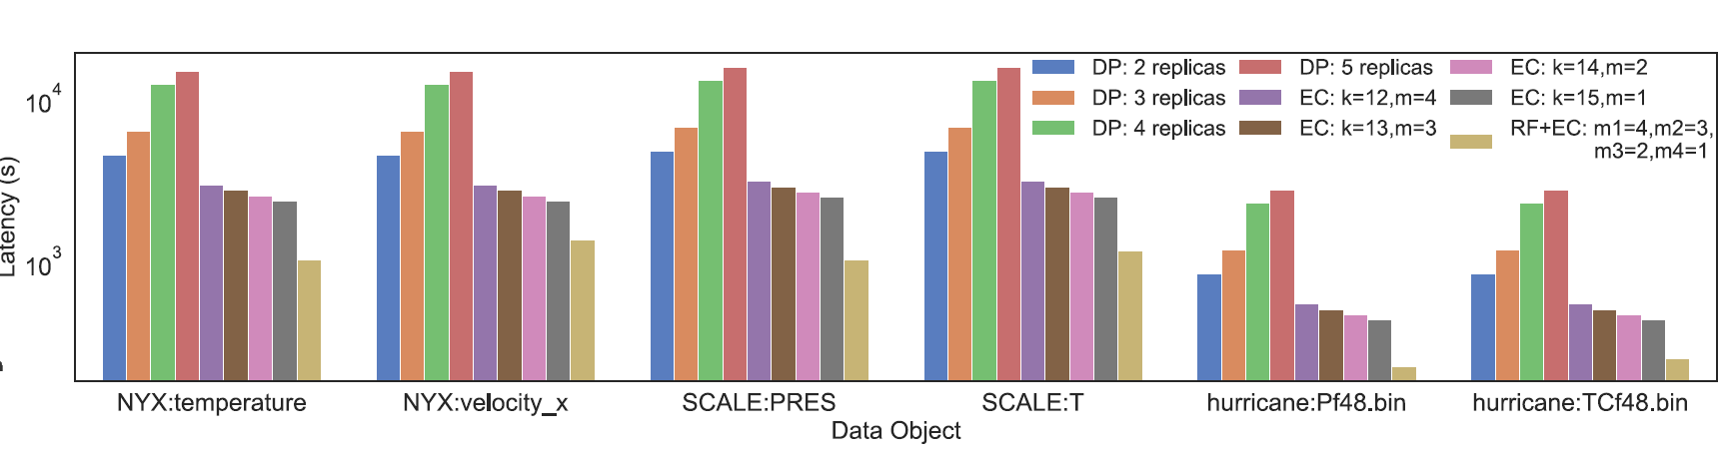
Evaluation – Latency

Slide 23
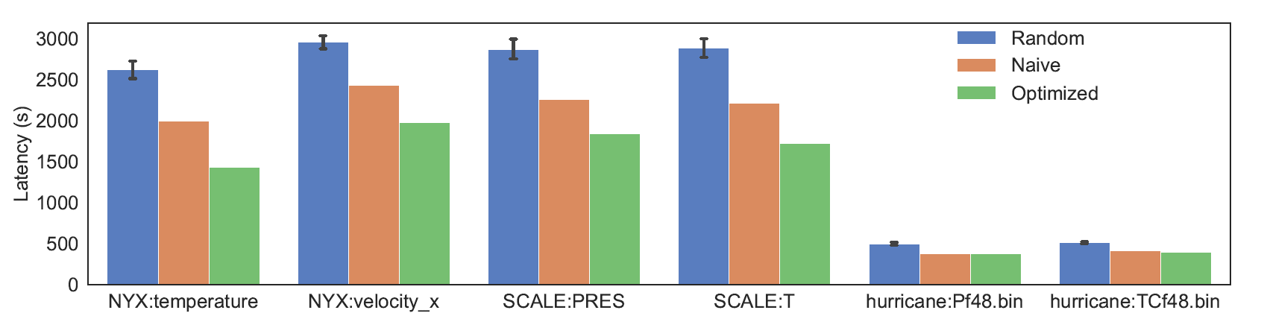
Evaluation – Data Gathering
Average over 50 iterations
Random: varying the seed
Naïve: Sort by bandwidth and select from top-bottom
Optimized: Naïve + MIDACO

Slide 24
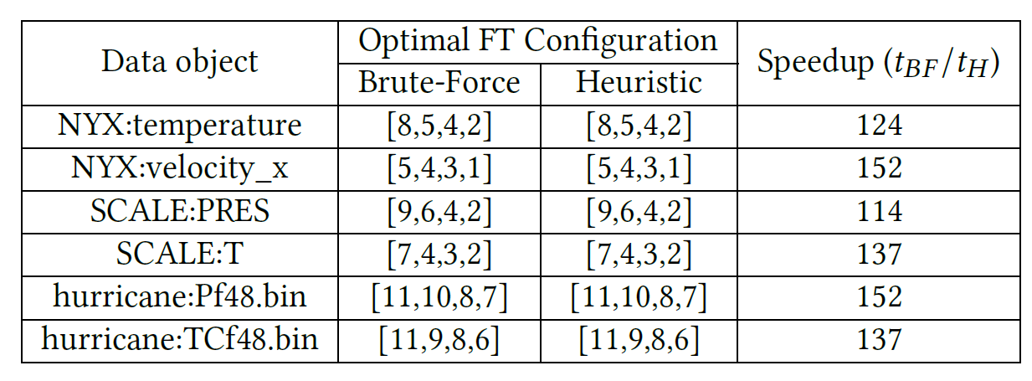
Evaluation – FT Heuristic

Slide 25
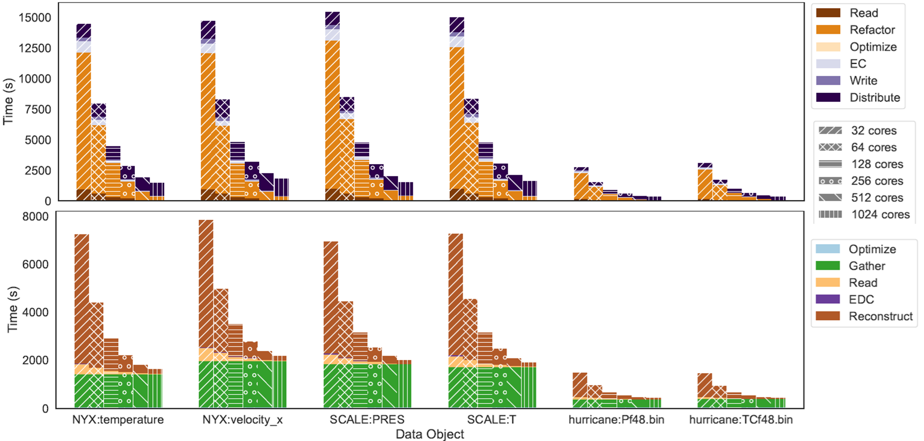
Evaluation – Performance
Notes:
MP/GPU can accelerate refactoring, compression/decompression, and erasure coding/decoding are expensive operations.

Slide 26
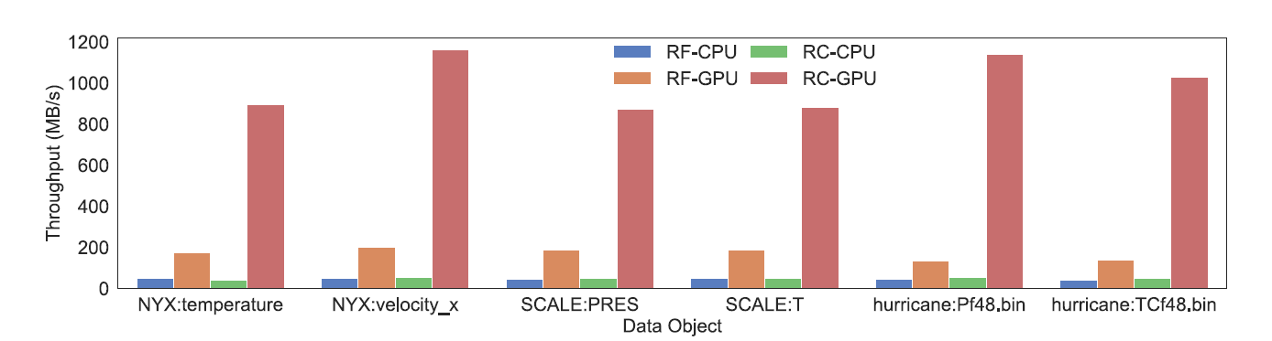
Evaluation – Performance

Slide 27
RAPIDS
Two optimization models.
A mixed integer nonlinear programming (MINLP) solver for gathering data – MIDACO
A heuristic algorithm compared to the brute-force search for optimizing fault tolerance
Evaluation results show
Minimum expected relative error
Reduced storage overhead
Higer data latency
Notes:
storage overhead 7.5x
Network overhead 3x

Slide 28
Thank You

Slide 29
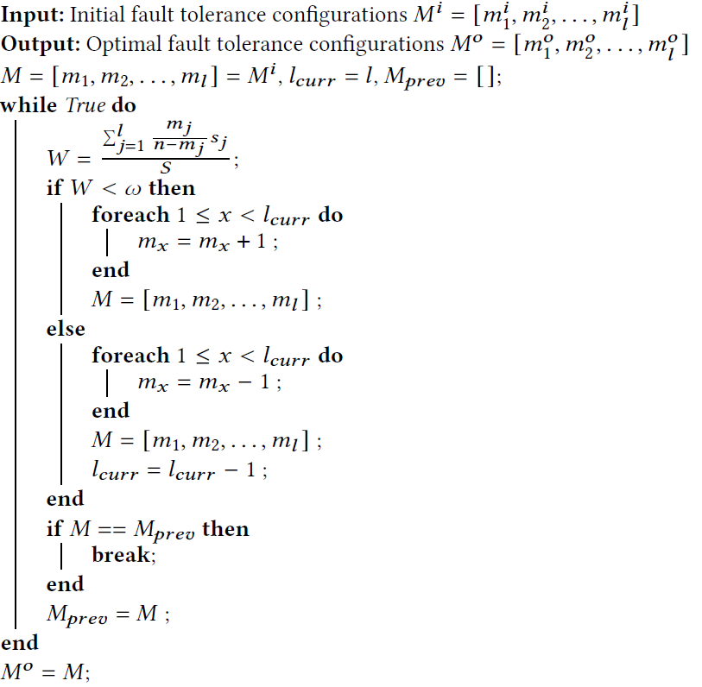
Optimal Fault Tolerance Configurations

Slide 30
PMGRAD
PMGARD, multilevel decomposition approach, with an error-controlled data refactoring and reconstruction framework for scientific data.
Decomposing original data into multiple components
Multilevel coefficients, at relative importance to the precision of the reconstructed data, are used to reconstruct the approximation of the original data

