Slide 1
INNOVATHON (30 HOURS CONTINOUS)
TEAM NAME: COFFEE AND CODE
TEAM ID: IN31 TEAM LEAD: SHUBHANKAR SAKET
PROJECT NAME: ATTENDEASE

Slide 2

GO paperless
Problem Statement
High dependency on paper for administrative and academic tasks.
Manual processes for attendance, exams, and student records are time-consuming and error-prone.
Lack of accessibility to study materials and resources.
The Impact:
Increased environmental impact due to excessive paper use.
Inefficiencies in managing education processes.
Limited support for students to resolve academic and administrative issues promptly.

Slide 3
Go Paperless with Smart Digital Systems
The Solution:
An online face recognition system for secure student authentication.
A dynamic question paper generator customizable by topic and mark distribution.
A chatbot to address student queries about university/college matters (e.g., syllabus, exams, attendance).
Unique Selling Proposition (USP):
Eliminates the need for paper in administrative and academic workflows.
Enhances efficiency and accuracy in managing education processes.
Key Features:
Online Face Recognition: Ensures secure and seamless authentication.
Question Paper Generator: Customizable for various topics and marks (5, 10, 15).
Student Chatbot: Provides instant assistance with syllabus, exam dates, & more.

Slide 4
Building a Robust Paperless Education System
Technology Stack:
Face Recognition: OpenCV
Question Paper Generator: Python, Natural Language Processing (NLP).
Auth Page: Clerk
Chatbot: GPT-based AI model
Database: MongoDB Atlas/SQL for storage of student records and generated data.
Implementation Details:
Face Recognition: Integrates camera input with AI algorithms for real-time verification.
Dynamic Question Paper Generator: NLP processes keywords and generates structured questions.
Chatbot: AI-powered assistant preloaded with FAQs and resource links.
Attendance Records & More: Cloud-based storage for scalability and accessibility.

Slide 5
Expanding the Horizons of Paperless Education
Planned Enhancements:
Expand chatbot functionality with multilingual support.
Integrate AI for personalized learning paths.
Develop mobile apps for seamless access to all features.
Long-Term Goals:
Collaborate with educational institutions for large-scale implementation.
Incorporate gamification for student engagement.
Develop predictive analytics for academic performance monitoring.
For the ease of students we are working on WhatsApp based Chatbot.

Slide 6
Assessing Feasibility and Addressing Challenges
Feasibility:
Leverages existing technologies (AI, cloud storage, NLP) to ensure compatibility.
Scalable architecture to handle increasing student data.
Cost-effective with long-term savings on paper and administrative overhead.
Challenges:
Technical: Ensuring accuracy of face recognition and question generation algorithms.
Adoption: Resistance from institutions and staff accustomed to traditional methods.
Infrastructure: Dependence on stable internet connectivity and hardware availability.

Slide 7
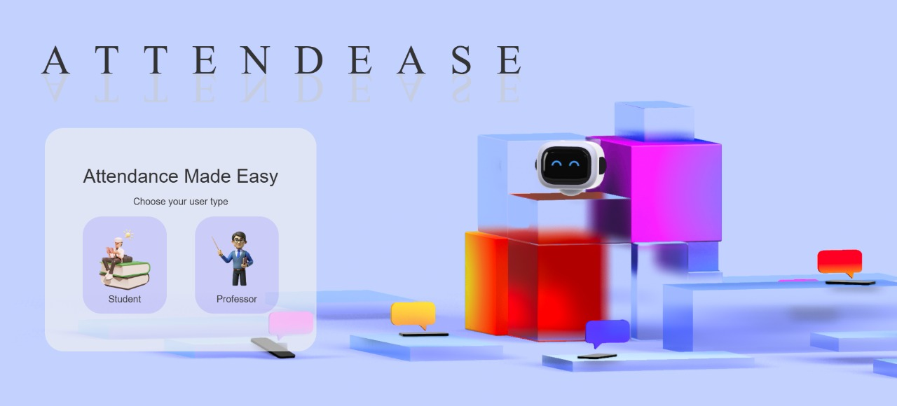

Slide 8
Team Details
Shubhankar Saket – BTech in CSE (Artificial Intelligence)
Ankit Kumar Singh – BTech in CSE (Data Science)
Md Rayees Ansari – BTech in CSE

