Slide 1

Tower Hopscotch Group 5
Raphael Emberger
Stefan Bösch
Philipp Meier
Nicolas Eckhart

Slide 2
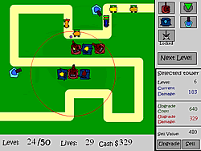

Tower Defense?
Subgenre of real-time or turn-based strategy video games
Goal: Defend your territories or possessions from various enemies
Achieved by building defensive structures to block, impede or destroy enemies
Origins
Precursors to TD such as Space Invaders in the 1980
Boom with the emergence of smart phones in the late 2000s

Slide 3
And How?
Main Process
Multi-layered
Custom maps

Slide 4
Thank you for listening
Raphael Emberger
Stefan Bösch
Philipp Meier
Nicolas Eckhart

