Slide 1
Designing a business platform using Microservices
Rajendra Kharbuja, Master Thesis - Initial Presentation

Slide 2


Prof. Dr. Florian Matthes [Supervisor]
Manoj Mahabaleshwar [Advisor]
Andrea Stubbe
[Advisor]

Slide 3
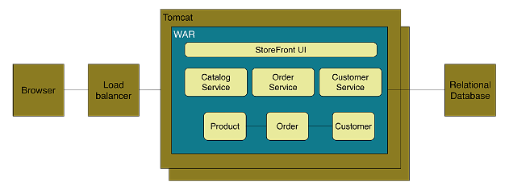
Context
Monolith Architecture Style
Definition
application deployed as a single artifact irrespective of internal structure [1][2]
One of three cases:[3]
All code share the same codebase and need to be compiled together
All deployment share same versioned code
The whole application is run under single server process
Figure: Online Store Example of Monolith Architecture [1]

Slide 4
Context
Monolith Architecture Style
Advantages
Easy to develop and test
Deployment is easy
Scaling is clear and simple
Prompt reuse of components and functionalities
Disadvantages
Limited Agility due to difficult continuous delivery
Single codebase, deployment of small change needs whole application to be deployed
Affects continuous delivery, especially when multiple deployment per day
May lack of clear modular boundary and changes get relayed
Decrease in Productivity due to understandability
Understanding of application is difficult due to overwhelming volume of codebase, esp for new developer
Difficult Team Structure
Common ways by technology and geography
Communication and ownership not straight forward
Long-term Commitment to Technology Stack
Technology chosen during analysis phase
Limited Scalability due to unavailable option for scaling of individual units
Only one option ie, Horizontal Scaling
Independent scaling of components not possible

Slide 5
Context
Microservice Architecture style
Definition
“decompose an application functionally into a set of collaborating services, each with a set of narrow, related functions, developed and deployed independently, with its own database.”
“a style of software architecture that involves delivering systems as a set of very small, granular, independent collaborating services.”
[C. Richdson. 2014]
[B. Wootton, 2014]
Catalog Service
“Loosely coupled service oriented architecture with bounded contexts.”
Checkout Service
Customer Service
Order Management
Order Service
[A. Cockcroft, 2015 ]
Figure: Functional Decomompostion into microservices

Slide 6
Context
Microservice Architecture style
Definition
“is an approach to developing a single application as a suite of small services, each running in its own process and communicating with lightweight mechanisms, often an HTTP resource API. These services are built around business capabilities and independently deployable by fully automated deployment machinery. There is a bare minimum of centralized management of these services, which may be written in different programming languages and use different data storage technologies.”
[M. Fowler and J. Lewis, 2014]

Slide 7
Research Questions
What are the parameters that defines the size of a microservice?
What are the technical challenges in the microservices architecture?
How to handle dependencies between microservices?
What are the good practices for defining a microservice architecture?
What are the quality attributes of a microservice?
What is the process of creating a microservice architecture?
How to implement a microservice?
How to deploy a microservice?
How to maintain a microservice?

Slide 8
Research Process
Phase 1
Data Collection Phase
1. Search Term Selection Strategy
keywords from research questions
synonyms of keywords
accepted terms from academics and industry
reference discovered from papers selected
“microservices are fine grained SOA” [2-4]
2. Resources Used
google scholar (scholar.google.de)
IEEExplore
ACM Digital Library
Researchgate
Books
Technical Articles
M papres
3. Study Filteration Criteria
Is the study relevant to answer the research question?
Does the study have good base in terms of source as well as references of the past studies?
Are there any case studies provided to verify the research result derived in the study?
NPaprers
1. Select Search Terms
3. Filter the papers
2. Search and Gather Studies
Figure: Data Collection Phase [1]
References
Guidelines for performing Systematic Literature Reviews in Software Engineering.Tech. rep. Keele University, 2007
M. Fowler and J. Lewis. Microservices. Mar. 2014. url: http://martinfowler.com/articles/microservices.html
G. Radchenko, O. Taipale, and D. Savchenko. Microservices validation: Mjolnirrplatformcase study. Tech. rep. Lappeenranta University of Technology,2015
A. Cockcroft. State of the Art in Mircroservices. Feb. 2015. url: http://www.slideshare.net/adriancockcroft/microxchg-microservices.

Slide 9
Research Process
Phase 2
Data Synthesis Phase
2. Data Synthesis Strategy
Qualitative approach applied
Comparision of the data achieved from papers
Similaritiies and differences studied
1. Extract data from selected papers individually
3. Create Draft
2. Synthesize Data
Figure: Data Synthesis Phase [1]
References
Guidelines for performing Systematic Literature Reviews in Software Engineering.Tech. rep. Keele University, 2007

Slide 10
What does granularity mean?
Definition
Definition
Figure: Coarse- Grained Service
Functionality
Reach
Data
Range
Business Value
Realm
Figure:
Fine- Grained Service
Functionality
Reach
Data
Range
Business Value
Realm
References: Total Articles found ()

Slide 11
Research Question 1: Boundaries and Size of a microservice?
Principles of correct granularity
The correct granularity of a service depends on supporting technologies.
A service should be autonomous reusable component and support various
cohesion.
An optimum service should not support huge number of operations.
A service should provide transaction integrity and compensation.
The notion of right granularity is more important than fine or coarse.
The level of abstraction of service should reflect real world business activities.
A service should bound all data with similar semantic meaning.
Keep the volume as low as possible.
The granularity of a service have different effects on other aspects of services
such as reusability, scalability, stability etc.
References: Total Articles found ()

Slide 12
Research Question 2: Best practices for defining Microservices?
Quality Attributes for Services
# | References/Attributes | [1] | [2] | [3] | [4] | [5] | [6]
1 | Coupling | ✔ | ✔ | ✔ | ✔ | ✔ | ✔
2 | Cohesion | ✔ | ✗ | ✔ | ✔ | ✔ | ✔
3 | Autonomy | ✔ | ✗ | ✗ | ✗ | ✗ | ✗
4 | Granularity | ✔ | ✔ | ✔ | ✔ | ✔ | ✔
5 | Reusability | ✔ | ✗ | ✗ | ✔ | ✗ | ✔
6 | Abstraction | ✔ | ✗ | ✗ | ✗ | ✗ | ✗
7 | Complexity | ✗ | ✗ | ✗ | ✔ | ✗ | ✗
References: Total Articles found ()

Slide 13
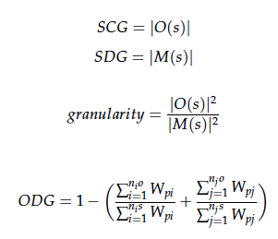
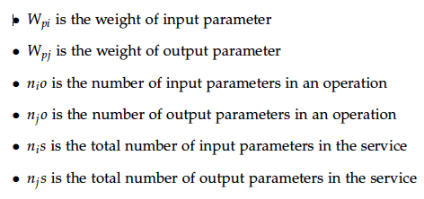
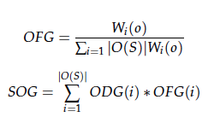
Research Question 2: Best practices for defining Microservices?
Cohesion Quality Metrics for Services
References: Total Articles found ()

Slide 14
Research Question 2: Best practices for defining Microservices?
Cohesion Quality Metrics for Services
# | Cohesion Metrics Definition
1 | defines SFCI which measures the fraction of operations using similar messages out of total number of operations in the service operations of the service
2 | SIDC : defines cohesiveness as the fraction of operations based on commonality of the messages they operate on. SIUC : defines the degree of consumption pattern of the service operations which is based on the similarity of consumers of the operations SIUC : defines the cohesion based on the sequential consumption behavior of more than one operations of a service by other services
3 | cohesion is given by the inverse of average number of consumed messages by a service
4 | cohesion is defined as the consensus among the operations of the service regarding the functionality and data granularity which represents the type of parameters and the operations importance

Slide 15
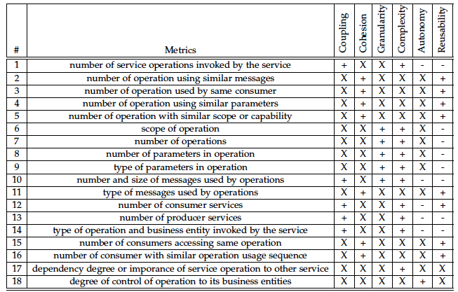
Research Question 2: Best practices for defining Microservices?
Basic Quality Metrics for Services

Slide 16
Research Question 2: Best practices for defining Microservices?
Principles based on quality attributes
Large number of operations means large number of consumers, which increases maintainability whereas fine grained services increases network coupling
Low coupling improves understandability, reusability and scalability where as high coupling increases maintainability.
A good strategy is to group operations which are used together, which limits the number of consumers and improves maintainability.
A high cohesive attribute defines a good service which is easy to understand, test, change and is more stable.
Services must be selected in a way so that they focus on single business functionality. It follows the idea of low coupling.
The complexity of a service is determined by granularity and coupling.
The selection of an appropriate service is multi-objective optimization problem. The quality attributes are not independent and trade offs have to be made for mutually exclusive attributes.
Business entity convergence is an important criteria for selection of service candidate.
The reusability increases as the scope of functionality provided by the service decreases.
References: Total Articles found ()

Slide 17
Current Status and Summary of Achievement
Research Question | Achievement Summary | Status
How are boundaries and size of microservices are defined? | factors determining size Microservices are not completely “micro-services” Principles defining a correct size of service listed | Done Report Available
What makes any service a good candidate for a microservice? | attributes to determine a good service Metrics to calculate the attributes Interpretation of all metrics from papers into a set of basic metrics Principles defining a good service based on quality attributes | Done Report Available
What are the techniques defined in scientific literature? | Use case modeling Domain Driven Design | In Progress Draft Available
Link to Report

Slide 18
What next?
2
4
Techniques used in industries
to define microservices
Guidelines to define microservices architecture
1
3
Techniques discussed in scientific literature to define microservices
Challenges for defining microservices architecture
Mar.15.2016
Nov.16.2015
Dec.15.2015
Jan.15.2016
Feb.15.2016
Draft and Report Writing

Slide 19

Thank you for your attention!
Any questions?

Slide 20
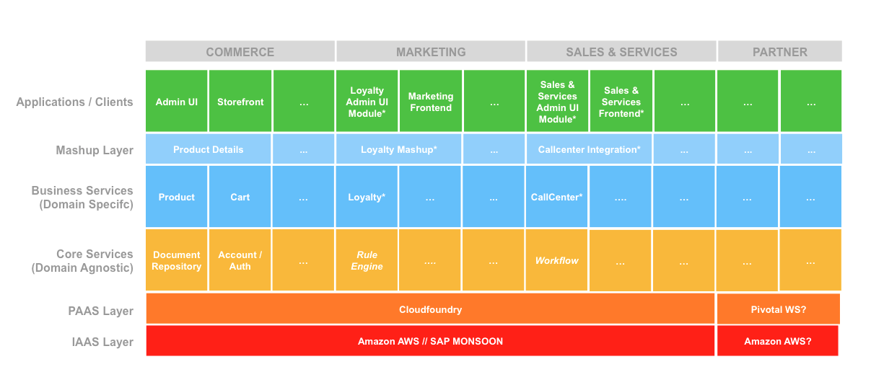
Backup

Slide 21
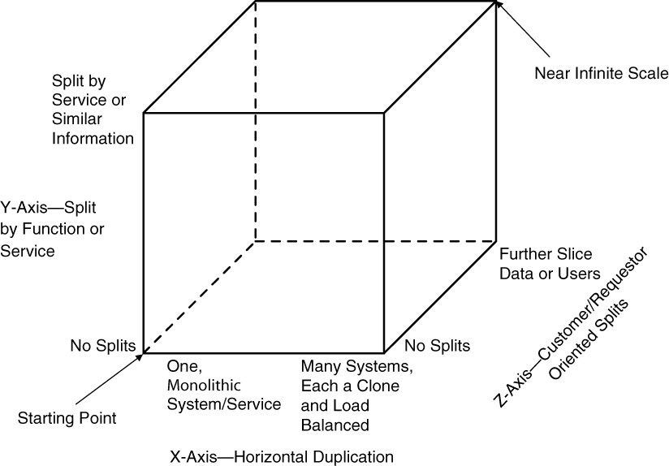
Context
Scale Cube
Dimensions
X-axis | Horizontal Cloning
Z-axis | Split by Criteria
Y-axis | Split by Function / Data
Figure: Scale Cube [1]
References
M. T. Fisher and M. L. Abbott. The Art of Scalability: Scalable Web Architecture,Processes, and Organizations for the Modern Enterprise, Second Edition.Addison-Wesley Professional, 2015

