Slide 1
Designing a business platform using Microservices
Rajendra Kharbuja, Master Thesis - Initial Presentation

Slide 2


Prof. Dr. Florian Matthes [Supervisor]
Manoj Mahabaleshwar [Advisor]
Andrea Stubbe
[Advisor]

Slide 3
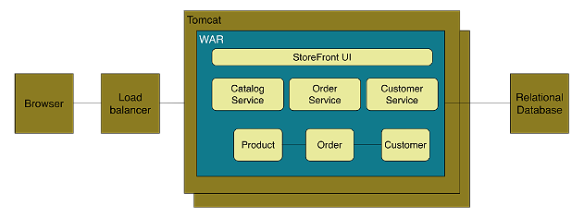
Context
Monolith Architecture Style
Definition
application deployed as a single artifact irrespective of internal structure [1][2]
One of three cases:[3]
All code share the same codebase and need to be compiled together
All deployment share same versioned code
The whole application is run under single server process
Figure: Online Store Example of Monolith Architecture [1]

Slide 4
Context
Monolith Architecture Style
Advantages
Easy to develop and test
Deployment is easy
Scaling is clear and simple
Prompt reuse of components and functionalities
Disadvantages
Limited Agility due to difficult continuous delivery
Single codebase, deployment of small change needs whole application to be deployed
Affects continuous delivery, especially when multiple deployment per day
May lack of clear modular boundary and changes get relayed
Decrease in Productivity due to understandability
Understanding of application is difficult due to overwhelming volume of codebase, esp for new developer
Difficult Team Structure
Common ways by technology and geography
Communication and ownership not straight forward
Long-term Commitment to Technology Stack
Technology chosen during analysis phase
Limited Scalability due to unavailable option for scaling of individual units
Only one option ie, Horizontal Scaling
Independent scaling of components not possible

Slide 5
Context
Microservice Architecture style
Definition
“decompose an application functionally into a set of collaborating services, each with a set of narrow, related functions, developed and deployed independently, with its own database.”
“a style of software architecture that involves delivering systems as a set of very small, granular, independent collaborating services.”
[C. Richdson. 2014]
[B. Wootton, 2014]
Catalog Service
“Loosely coupled service oriented architecture with bounded contexts.”
Checkout Service
Customer Service
Order Management
Order Service
[A. Cockcroft, 2015 ]
Figure: Functional Decomompostion into microservices

Slide 6
Context
Microservice Architecture style
Definition
“Microservices are SOA done right”
M. Fowler and J. Lewis, 2014
A. Cockcroft, 2015
G. Radchenko, O. Taipale, and D. Savchenko, 2015
“is an approach to developing a single application as a suite of
small services, each running in its own process and communicating with lightweight mechanisms, often an HTTP resource API. These services are built around business capabilities and independently deployable by fully automated deployment machinery. There is a bare minimum of centralized management of these services, which may be written in different programming languages and use different data storage technologies.”
[M. Fowler and J. Lewis, 2014]

Slide 7
Research Questions
1. What are the parameters that defines the size of a microservice?
2. What are the good practices for defining a microservice architecture?
What is the process of creating a microservice architecture?
What are the quality attributes of a microservice?
How to implement a microservice?
How to deploy a microservice?
How to maintain a microservice?

Slide 8
Research Process
Phase 1
Data Collection Phase
1. Search Term Selection Strategy
keywords from research questions
synonyms of keywords
accepted terms from academics and industry
reference discovered from papers selected
2. Resources Used
google scholar (scholar.google.de)
IEEExplore
ACM Digital Library
Researchgate
Books
Technical Articles
M papres
3. Study Filteration Criteria
Is the study relevant to answer the research question?
Does the study have good base in terms of source as well as references of the past studies?
Are there any case studies provided to verify the research result derived in the study?
NPaprers
1. Select Search Terms
3. Filter the papers
2. Search and Gather Studies
Figure: Data Collection Phase

Slide 9
Research Process
Phase 2
Data Synthesis Phase
2. Data Synthesis Strategy
Qualitative approach applied
Comparision of the data achieved from papers
Similaritiies and differences studied
1. Extract data from selected papers individually
3. Create Draft
2. Synthesize Data
Figure: Data Synthesis Phase

Slide 10



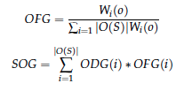
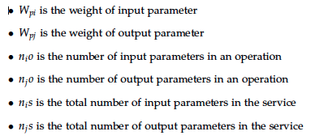

size of microservice
Articles Found: 9
Selected: 3
ODG: Operation Data Granularity
OFG: Operation Functionality Granularity
SOG: Service Granularity
Granularity of a service is determined by the number of operations, number of messages required by the operations and type of the messages.

Slide 11
Good Microservice
Single Responsibility Principle
Microservices should be small and focused on doing one thing well [S.Newman and M. Stine]
“Gather together those things that change for the same reason, and separate those things that change for different reasons.” [16]
Single Responsibility Principle closely related to Coupling and Cohesion. [18, 19]
Autonomy [8, 20, 21, 22]
“The logic governed by a service resides within an explicit boundary” [24]
“ The service has control within this boundary and does not
depend on other services to execute its governance.
It also frees the service from ties that could inhibit its deployment and evolution” [23]
Techlology
The right value of granularity for an organization is highly influenced by its IT infrastructure. The organization should be capable of handling the complexities such as communication, runtime, infrastructure etc if they choose low granularity. [25, 26]

Slide 12
Quality Attributes for Services
# | References/Attributes | [13] | [27] | [15] | [14] | [28] | [29]
1 | Coupling | ✔ | ✔ | ✔ | ✔ | ✔ | ✔
2 | Cohesion | ✔ | ✗ | ✔ | ✔ | ✔ | ✔
3 | Autonomy | ✔ | ✗ | ✗ | ✗ | ✗ | ✗
4 | Granularity | ✔ | ✔ | ✔ | ✔ | ✔ | ✔
5 | Reusability | ✔ | ✗ | ✗ | ✔ | ✗ | ✔
6 | Abstraction | ✔ | ✗ | ✗ | ✗ | ✗ | ✗
7 | Complexity | ✗ | ✗ | ✗ | ✔ | ✗ | ✗

Slide 13


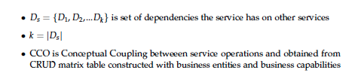
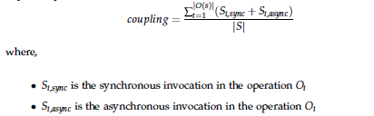
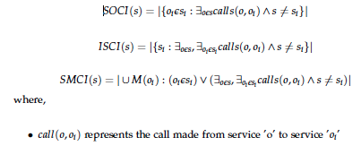
Quality attribute ofr a microservice
Coupling
n_{c} total number of consumers
n_{p} total number of producers
n_{s} total number of services
Coupling in a service increases with the number of service invocations, number of dependent services and number of messages used.

Slide 14

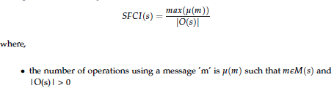
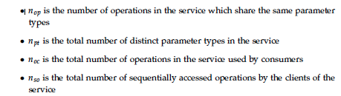

Quality Metrics for Services
Cohesion
Cohesion is given by the number of operations sharing similar messages and parameters.

Slide 15
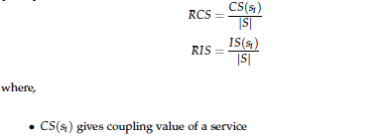
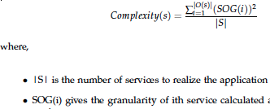

Quality Metrics for Services
Complexity of the service increases with granularity and coupling.

Slide 16
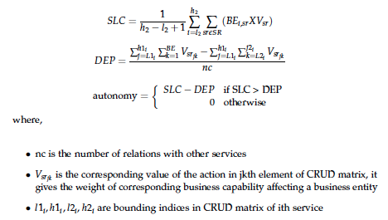
Quality Metrics for Services
Autonomy
Autonomy of a service gives the degree of control of a service upon its business entities.

Slide 17
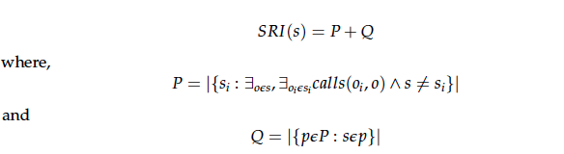

Quality Metrics for Services
Reusability
Reusability is increases with cohesion and consumers but decreases with granularity and coupling.

Slide 18
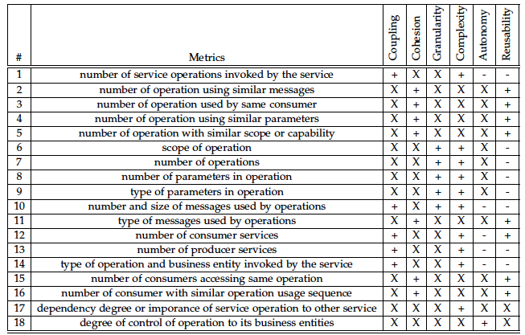
Basic Quality Metrics for Services

Slide 19
Research Question 2: Best practices for defining Microservices?
Principles based on quality attributes
References: Total Articles found ()

Slide 20
Current Status and Summary of Achievement
Research Question | Summary
How are boundaries and size of microservices are defined? | factors determining size Principles defining a correct size of service listed
What makes any service a good candidate for a microservice? | attributes to determine a good service Metrics to calculate the attributes Interpretation of all metrics from papers into a set of basic metrics Principles defining a good service based on quality attributes
What are the techniques defined in scientific literature? | Use case modeling Domain Driven Design
Link to Report

Slide 21
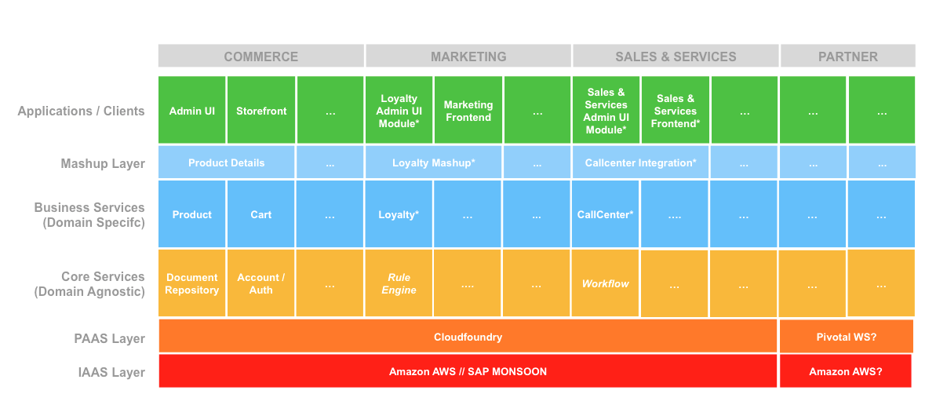
Backup

Slide 22
What next?
2
4
Techniques used in industries
to define microservices
Guidelines to define microservices architecture
1
3
Techniques discussed in scientific literature to define microservices
Challenges for defining microservices architecture
Mar.15.2016
Nov.16.2015
Dec.15.2015
Jan.15.2016
Feb.15.2016
Draft and Report Writing

Slide 23

Thank you for your attention!
Any questions?

Slide 24
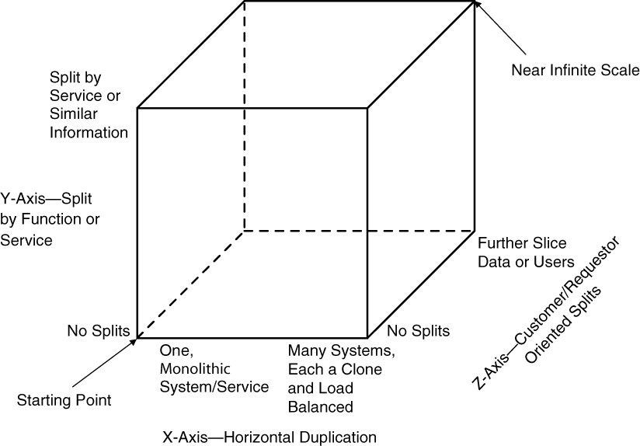
Context
Scale Cube
Dimensions
X-axis | Horizontal Cloning
Z-axis | Split by Criteria
Y-axis | Split by Function / Data
Figure: Scale Cube [1]
References
M. T. Fisher and M. L. Abbott. The Art of Scalability: Scalable Web Architecture,Processes, and Organizations for the Modern Enterprise, Second Edition.Addison-Wesley Professional, 2015

