Slide 1
Designing a business platform using Microservices
Rajendra Kharbuja, Master Thesis - Initial Presentation

Slide 2


Prof. Dr. Florian Matthes [Supervisor]
Manoj Mahabaleshwar [Advisor]
Andrea Stubbe
[Advisor]

Slide 3
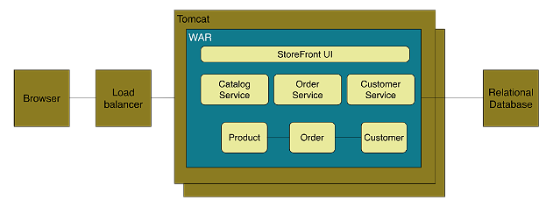
Context
Monolith Architecture Style
Definition
application deployed as a single artifact irrespective of internal structure
One of three cases:
All code share the same codebase and need to be compiled together
All deployment share same versioned code
The whole application is run under single server process
Figure: Online Store Example of Monolith Architecture

Slide 4
Context
Monolith Architecture Style
Advantages
Easy to develop and test
Deployment is easy
Scaling is clear and simple
Prompt reuse of components and functionalities
Disadvantages
Limited Agility due to difficult continuous delivery
Single codebase, deployment of small change needs whole application to be deployed
Affects continuous delivery, especially when multiple deployment per day
May lack of clear modular boundary and changes get relayed
Decrease in Productivity due to understandability
Understanding of application is difficult due to overwhelming volume of codebase, esp for new developer
Difficult Team Structure
Common ways by technology and geography
Communication and ownership not straight forward
Long-term Commitment to Technology Stack
Technology chosen during analysis phase
Limited Scalability due to unavailable option for scaling of individual units
Only one option ie, Horizontal Scaling
Independent scaling of components not possible

Slide 5
Context
Microservice Architecture style
Definition
“decompose an application functionally into a set of collaborating services, each with a set of narrow, related functions, developed and deployed independently, with its own database.”
“a style of software architecture that involves delivering systems as a set of very small, granular, independent collaborating services.”
[C. Richdson. 2014]
[B. Wootton, 2014]
Catalog Service
“Loosely coupled service oriented architecture with bounded contexts.”
Checkout Service
Customer Service
Order Management
Order Service
[A. Cockcroft, 2015 ]
Figure: Functional Decomompostion into microservices

Slide 6
Context
Microservice Architecture style
Definition
“Microservices are SOA done right”
M. Fowler and J. Lewis, 2014
A. Cockcroft, 2015
G. Radchenko, O. Taipale, and D. Savchenko, 2015
“is an approach to developing a single application as a suite of
small services, each running in its own process and communicating with lightweight mechanisms, often an HTTP resource API. These services are built around business capabilities and independently deployable by fully automated deployment machinery. There is a bare minimum of centralized management of these services, which may be written in different programming languages and use different data storage technologies.”
[M. Fowler and J. Lewis, 2014]

Slide 7
Research Questions
1. What are the parameters that defines the size of a microservice?
2. What are the good practices for defining a microservice architecture?
What is the process of creating a microservice architecture?
What are the quality attributes of a microservice?
How to implement a microservice?
How to deploy a microservice?
How to maintain a microservice?

Slide 8
Research Process
Phase 1
Data Collection Phase
1. Search Term Selection Strategy
keywords from research questions
synonyms of keywords
accepted terms from academics and industry
reference discovered from papers selected
2. Resources Used
google scholar (scholar.google.de)
IEEExplore
ACM Digital Library
Researchgate
Books
Technical Articles
Materials Found : 123
3. Study Filteration Criteria
Is the study relevant to answer the research question?
Does the study have good base in terms of source as well as references of the past studies?
Are there any case studies provided to verify the research result derived in the study?
Materials Selected: 64
1. Select Search Terms
3. Filter the papers
2. Search and Gather Studies
Figure: Data Collection Phase

Slide 9
Research Process
Phase 2
Data Synthesis Phase
2. Data Synthesis Strategy
Qualitative approach applied
Comparision of the data achieved from papers
Similaritiies and differences studied
1. Extract data from selected papers individually
Topic | Found | Selected
Granularity | 17 | 9
Service Attributes | 26 | 10
Service Identification | 22 | 16
Microservices | 32 | 19
Domain Modeling | 26 | 10
3. Create Draft
2. Synthesize Data
Figure: Data Synthesis Phase

Slide 10
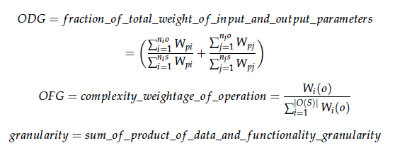




Size of a Microservice
Articles Found: 9
Selected: 3
Granularity of a service is determined by the number of operations, type of parameters of operations and size of messages.

Slide 11
Good Microservice
Single Responsibility Principle
Microservices should be small and focused on doing one thing well [S.Newman and M. Stine]
“Gather together those things that change for the same reason, and separate those things that change for different reasons.” [16]
Single Responsibility Principle closely related to Coupling and Cohesion. [18, 19]
Autonomy [8, 20, 21, 22]
“The logic governed by a service resides within an explicit boundary” [24]
“ The service has control within this boundary and does not
depend on other services to execute its governance.
It also frees the service from ties that could inhibit its deployment and evolution” [23]
Techlology
The right value of granularity for an organization is highly influenced by its IT infrastructure. The organization should be capable of handling the complexities such as communication, runtime, infrastructure etc if they choose low granularity. [25, 26]

Slide 12
Quality Attributes for Services
# | References/Attributes | [13] | [27] | [15] | [14] | [28] | [29]
1 | Coupling | ✔ | ✔ | ✔ | ✔ | ✔ | ✔
2 | Cohesion | ✔ | ✗ | ✔ | ✔ | ✔ | ✔
3 | Autonomy | ✔ | ✗ | ✗ | ✗ | ✗ | ✗
4 | Granularity | ✔ | ✔ | ✔ | ✔ | ✔ | ✔
5 | Reusability | ✔ | ✗ | ✗ | ✔ | ✗ | ✔
6 | Abstraction | ✔ | ✗ | ✗ | ✗ | ✗ | ✗
7 | Complexity | ✗ | ✗ | ✗ | ✔ | ✗ | ✗

Slide 13
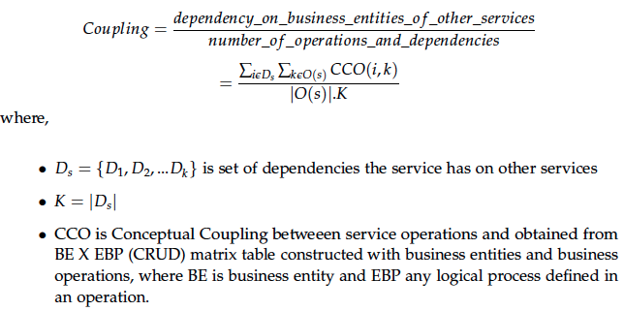

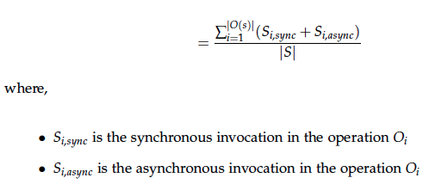
Quality attributes of a microservice
Coupling

Slide 14
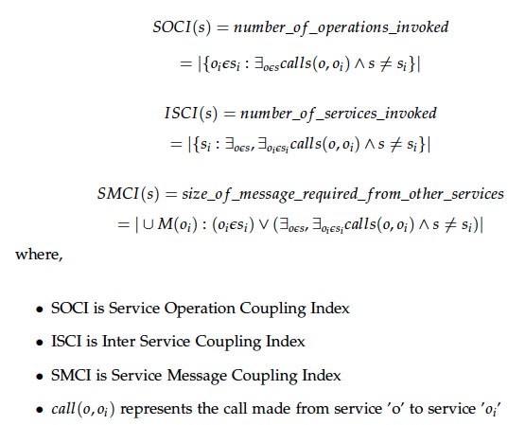
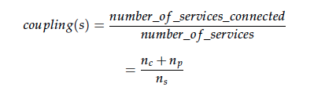
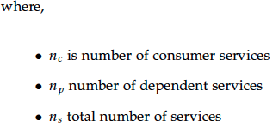
Quality attributes of a microservice
Coupling
Coupling in a service increases with the number of service invocations, number of dependent services and number of messages used.

Slide 15
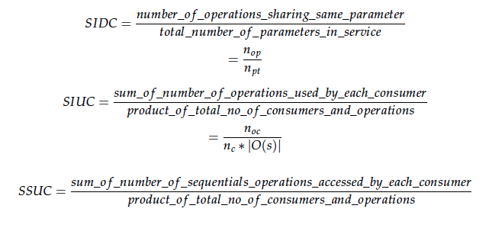
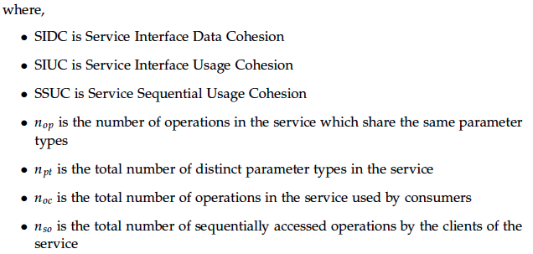
Quality attributes of a microservice
Cohesion

Slide 16
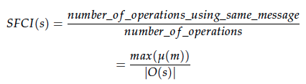
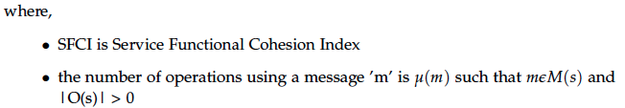
Quality attributes of a microservice
Cohesion
Cohesion is given by the number of operations sharing same messages, parameters and consumer.

Slide 17
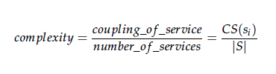
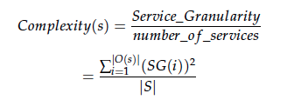


Quality attributes of a microservice
Complexity
Complexity of the service increases with granularity and coupling.

Slide 18
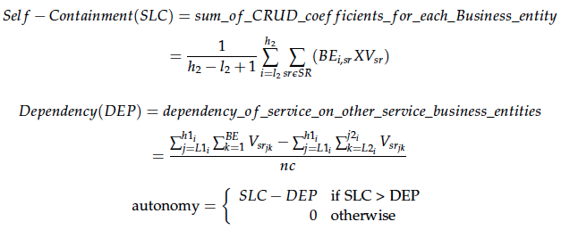
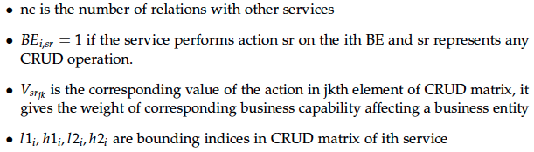
Quality attributes of a microservice
Autonomy
Autonomy of a service gives the degree of control of a service upon its business entities.

Slide 19


Quality attributes of a microservice
Reusability
Reusability is increases with cohesion and consumers but decreases with granularity and coupling.

Slide 20
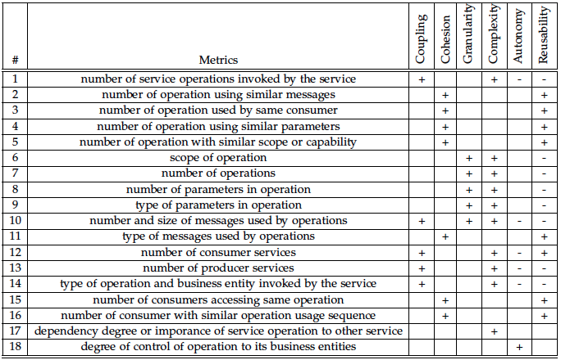
Basic Quality Metrics for Services

Slide 21
Current Status and Summary
Research Question | Summary
How can be size of a microservice be defined? | factors determining size Principles defining a correct size of service listed
What makes any service a good candidate for being a microservice? | Factors influencing the size defined attributes to determine a good service Metrics to calculate the attributes Interpretation of all metrics from papers into a set of basic metrics Principles defined for a good service based on quality attributes
What are the techniques defined to create microservice architecture? | Use case modeling Domain Driven Design
Link to Report

Slide 22
What next?
5
7
3
Techniques used in Hybris
to define microservices
Guidelines to define microservices architecture
Qualities of a good microservice
1
Background context
4
6
Techniques discussed in scientific literature to define microservices
Challenges for defining microservices architecture
2
Size of a microservice
Mar.15.2016
Sep.15.2015
Oct.16.2015
Nov.15.2015
Dec.15.2015
Jan.15.2016
Feb.15.2016
Draft and Report Writing

Slide 23
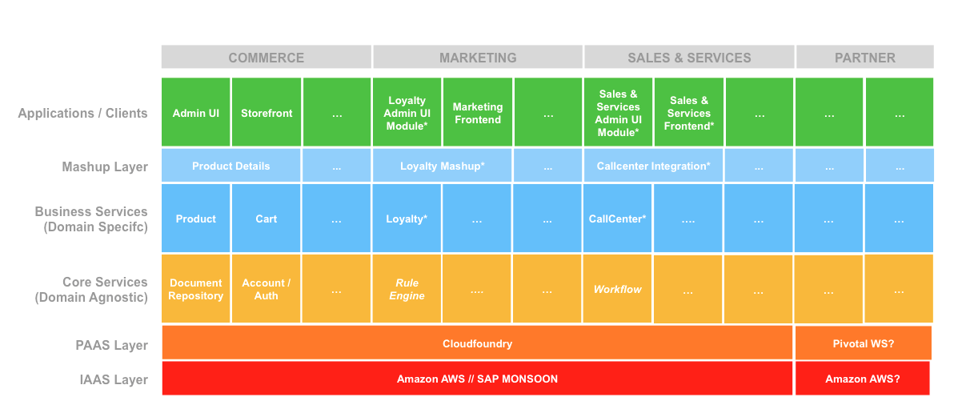
Hybris Microservices Architecture

Slide 24

Thank you for your attention!
Any questions?

Slide 25
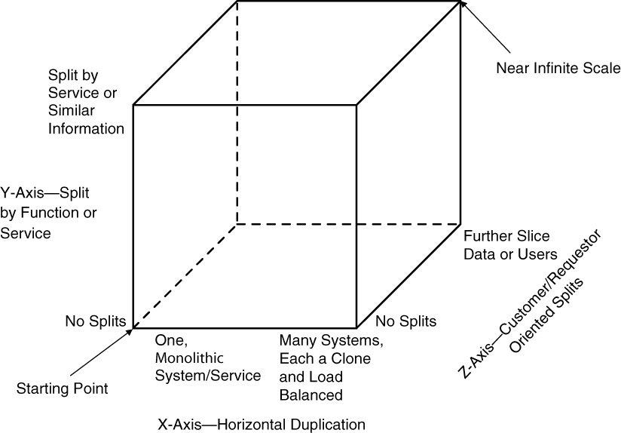
Scale Cube
Dimensions
X-axis | Horizontal Cloning
Z-axis | Split by Criteria
Y-axis | Split by Function / Data
Figure: Scale Cube [1]
References
M. T. Fisher and M. L. Abbott. The Art of Scalability: Scalable Web Architecture,Processes, and Organizations for the Modern Enterprise, Second Edition.Addison-Wesley Professional, 2015

Slide 26
Bibliography
C. Richardson. Microservices: Decomposing Applications for Deployability and Scalability. May 2014
C. Richardson. Pattern: Monolithic Architecture. 2014. url: http://microservices.io/patterns/monolithic.html
R. Annett. What is a Monolith? Nov. 2014
M. Fowler and J. Lewis. Microservices. Mar. 2014. url: http://martinfowler.com/articles/microservices.html
Gupta. Microservices, Monoliths, and NoOps. Mar. 2015
S. Abram. Microservices. Oct. 2014. url: http://www.javacodegeeks.com2014/10/microservices.html
D. Namiot and M. Sneps-Sneppe. On Micro-services Architecture. Tech. rep.Open Information Technologies Lab, Lomonosov Moscow State University,2014
S. Newman. Building Microservices. O’Reilly Media, 2015
C. Richardson. Pattern: Microservices Architecture. 2014.
B. Wootton. Microservices - Not A Free Lunch! Apr. 2014. url: http://highscalability.com/blog/2014/4/8/microservices- not- a- freelunch.html.
A. Cockcroft. State of the Art in Mircroservices. Feb. 2015. url: http://www.slideshare.net/adriancockcroft/microxchg-microservices.
G. Radchenko, O. Taipale, and D. Savchenko. Microservices validation: Mjolnirrplatformcase study. Tech. rep. Lappeenranta University of Technology,2015
R. Sindhgatta, B. Sengupta, and K. Ponnalagu. Measuring the Quality of Service Oriented Design. Tech. rep. IBM India Research Laboratory
B. Shim, S. Choue, S. Kim, and S. Park. A Design Quality Model for Service-Oriented Architecture. Tech. rep. Sogang University, 2008
S. Alahmari, E. Zaluska, and D. C. D. Roure. A Metrics Framework for Evaluating SOA Service Granularity. Tech. rep. School of Electronics and Computer Science University Southampton, 2011.
http://programmer.97things.oreilly.com/wiki/index.php/The_Single_Responsibility_Principle
M. Stine. Jun. 2014. url: http://www.mattstine.com/2014/06/30/microservices-are-solid
E. Cobham Brewer url: http://www.objectmentor.com/resources/articles/srp.pdf
http://deviq.com/single-responsibility-principle/
J. Cramon. Feb. 2014 url: https://www.tigerteam.dk/2014/micro-services-its-not-only-the-size-that-matters-its-also-how-you-use-them-part-1/

Slide 27
Bibliography
J. Stenberg. Feb. 2015 url: http://www.infoq.com/news/2015/02/characteristics-microservices-ap
A. Rostampour, A. Kazemi, F. Shams, P. Jamshidi, and A. Azizkandi. Measures of Structural Complexity and Service Autonomy. Tech. rep. Shahid Beheshti University GC, 2011.
Y. Ma, H.X. Li, and P. Sun, "A Lightweight Agent Fabric for Service Autonomy," Springer, 2007, pp. 63-77.
P. Reldin and P. Sundling. Explaining SOA Service Granularity– How IT strategy shapes services. Tech. rep. Linköping University, 2007.
P. Herzum and O. Sims. Business Components Factory: A Comprehensive Overview of Component-Based Development for the Enterprise. John Wiley Sons, 2000
W. Xiao-jun. Metrics for Evaluating Coupling and Service Granularity in Service Oriented Architecture. Tech. rep. Nanjing University of Posts and Telecommunications
Q. Ma, N. Zhou, Y. Zhu, and H. Wang1. Evaluating Service Identification with Design Metrics on Business Process Decomposition. Tech. rep. IBM China Research Laboratory and IBM T.J. Watson Research Center, 2009
G. Feuerlicht and J. Lozina. Understanding Service Reusability. Tech. rep. University of Technology, 2007
Guidelines for performing Systematic Literature Reviews in Software Engineering.Tech. rep. Keele University, 2007
D. Foody. Getting web service granularity right. 2005.
A. Goeb and K. Lochmann. A software quality model for SOA. Tech. rep. Technische Universität München and SAP Research, 2011.
A. Gupta. Microservices, Monoliths, and NoOps. Mar. 2015.
R. Haesen, M. Snoeck, W. Lemahieu, and S. Poelmans. On the Definition of Service Granularity and Its Architectural Impact. Tech. rep. Katholieke Universiteit Leuven.
J. K. Lee, S. J. Jung, S. D. Kim, W. H. Jang, and D. H. Ham. Component Identification Method with Coupling and Cohesion. Tech. rep. Soongsil University and Software Quality Evaluation Center, 2001.
Q. Ma, N. Zhou, Y. Zhu, and H. Wang1. Evaluating Service Identification with Design Metrics on Business Process Decomposition. Tech. rep. IBM China Research Laboratory and IBM T.J. Watson Research Center, 2009.
M. Mancioppi, M. Perepletchikov, C. Ryan, W.-J. van den Heuvel, and M. P. Papazoglou. Towards a Quality Model for Choreography. Tech. rep. European Research Institute in Services Science, Tilburg University.
Y.-F. Ma, H. X. Li, and P. Sun. A Lightweight Agent Fabric for Service Autonomy. Tech. rep. IBM China Research Lab and Bei Hang University, 2007.
V. D. Naveen Kulkarni. The Role of Service Granularity in A Successful SOA Realization – A Case Study. Tech. rep. SETLabs, Infosys Technologies Ltd, 2008.

Slide 28
Bibliography
M. Perepletchikov, C. Ryan, K. Frampton, and Z. Tari. Coupling Metrics for Predicting Maintainability in Service-Oriented Designs. Tech. rep. RMIT University, 2007.
M. Perepletchikov, C. Ryan, and K. Frampton. Cohesion Metrics for Predicting Maintainability of Service-Oriented Software. Tech. rep. RMIT University, 2007.
C. Richardson. Microservices: Decomposing Applications for Deployability and Scalability. May 2014.
B. Shim, S. Choue, S. Kim, and S. Park. A Design Quality Model for Service-Oriented Architecture. Tech. rep. Sogang University, 2008.

